Slide 1
CR04: Numerical Linear Algebra Julien Langou
Slides at https://langou.github.io/NLA/
M2 - Wave #2
Tuesdays 8:00am – 10:00am (A1)
Thursdays 8:00am – 10:00am (B)
Julien Langou, Professor, University of Colorado Denver

Slide 2
About me
PhD in 2003 from France, then moved to the US
2006-current: Professor at University of Colorado Denver
25 years of Research in Numerical Linear Algebra
Actively contributes to numerical software libraries such as LAPACK.

Slide 3
Problems to be solved
( fast + stable ) + ( interoperable ) + ( portable )
Linear system of equations
Eigenvalues
A
x
b
A
x
x
=
=
𝝺
Linear Least Squares
Singular Value Decomposition
b
A
x
A
U
V^{T}
min ||
-
||₂
=
𝞢
_{x}

Slide 4

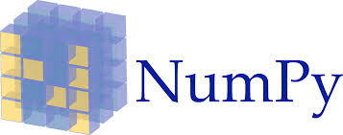

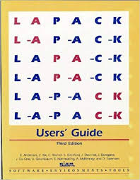




Ecosystem
users
hardware, optimized libraries

Slide 5
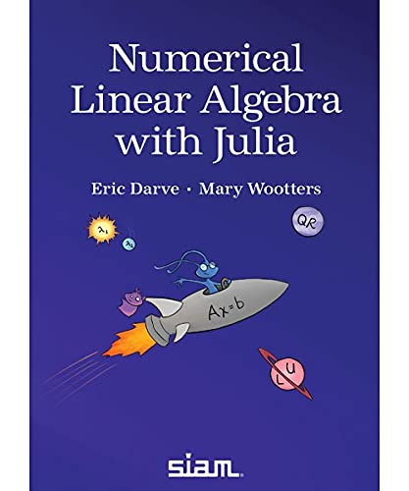
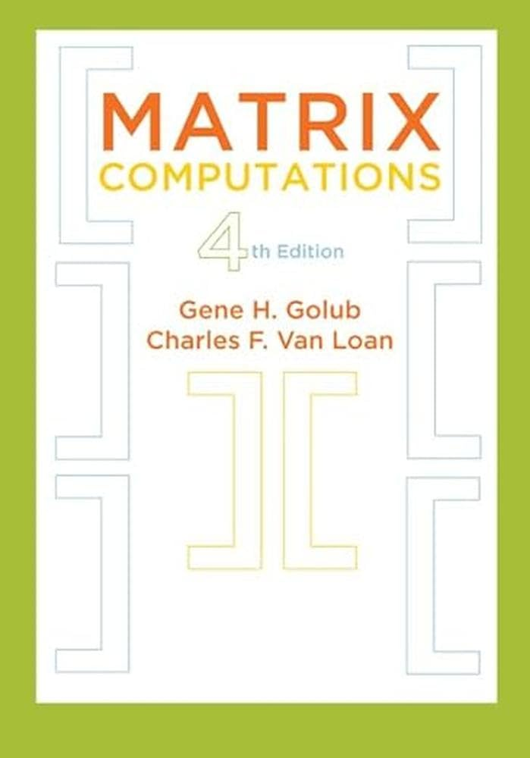
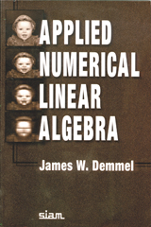
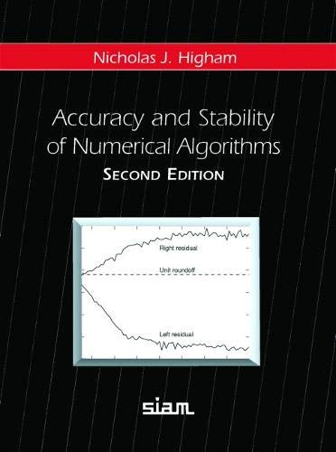
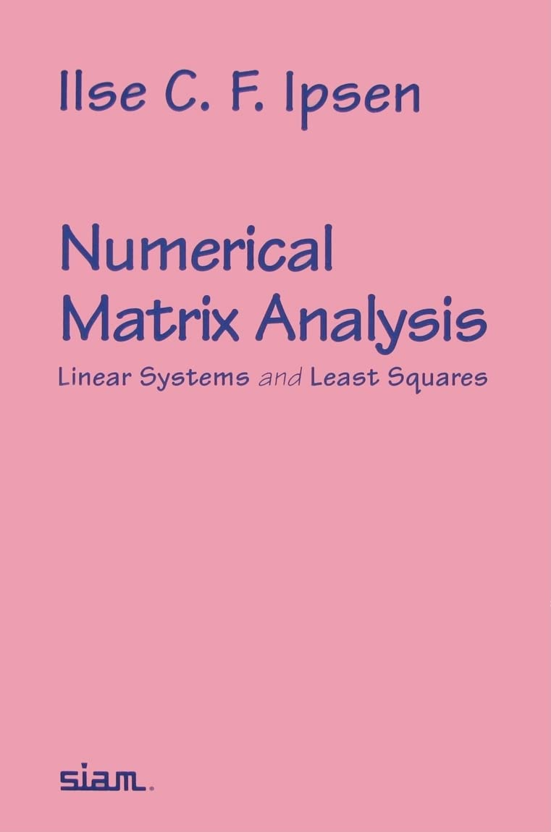
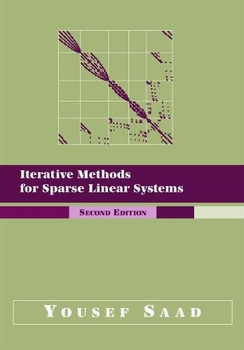
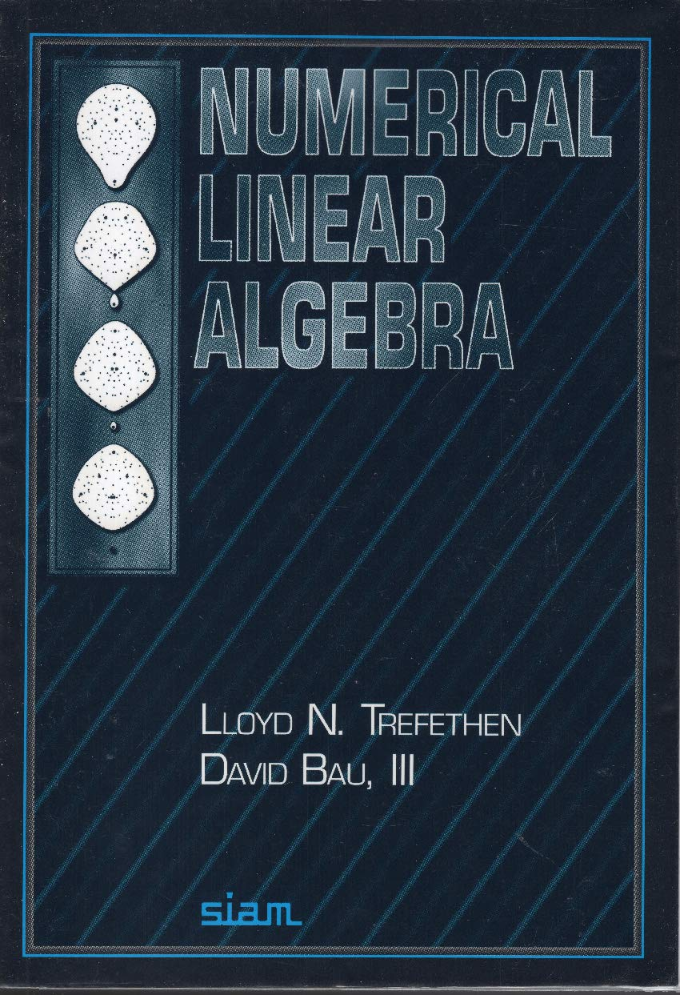
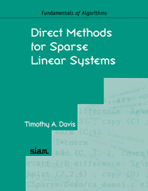
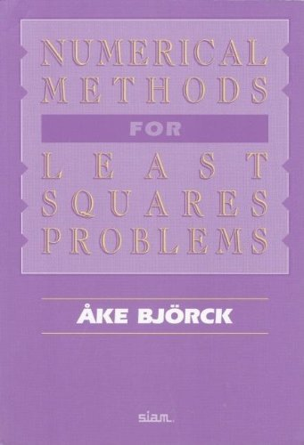
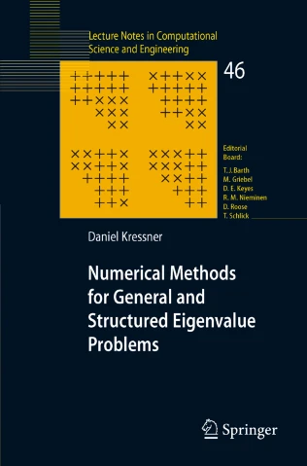

Slide 6
24-25 Winter School in Numerical Linear Algebra
Week 1: Tu. Nov 19 – Th. Nov 21 solving dense linear systems of equations
Week 2: Tu. Nov 26 – Th. Nov 28 solving dense linear least squares problems
Week 3: Tu. Dec 3 – Th. Dec 5 introduction to BLAS and parallel implementations (code tuning, I/O, etc.)
Week 4: Tu. Dec 10 – Th. Dec 12 methods for eigenvalue problems (part 1)
Week 5: Tu. Dec 17 – Th. Dec 19 methods for eigenvalue problems (part 2)
Week 6: Tu. Jan 7 – Th. Jan 9 iterative methods for sparse matrices
Week 7: Tu. Jan 14 – Th. Jan 16 solving sparse linear systems of equations
Week 8: Tu. Jan 21 – Th. Jan 23 project presentations
Week 9: Tu. Jan 28 – Th. Jan 30 ( slack )
For each topic, we will review:
the problem to be solved,
main algorithms to solve the problem
condition number, backward error, error analysis
efficient implementations, parallel implementation
some applications
some current research topics will be mentioned

Slide 7
Prerequisites
Some programing experience in Python, C, Julia, or etc.
Good understanding of linear algebra
Evaluation
50% “contrôle continu” avec DM (Devoir Maison)
50% "contrôle terminal” une soutenance de projet
Typical projects
Write a dense nonsymmetric eigenvalue solver
Write a dense symmetric eigenvalue solver
Write a dense singular value solver
Write a sparse direct solver

Slide 8
Benefits of the class
Numerical Linear Algebra is used in many applications. It is good to know what are the algorithms behind.
Some ideas that you can use in many other contexts
Code tuning
Parallelism
Backward stability, error analysis, condition number, etc.

