Slide 1
Smart Cinema
Killer Feature：New-release Movie Selection
Ruixiang Lang
Sunday, July 31, 2016

Slide 2
New-release Movie Selection
Predict the score of a new-release movie
A movie with higher score may bring more profit
Choose some new-release movies to invest

Slide 3

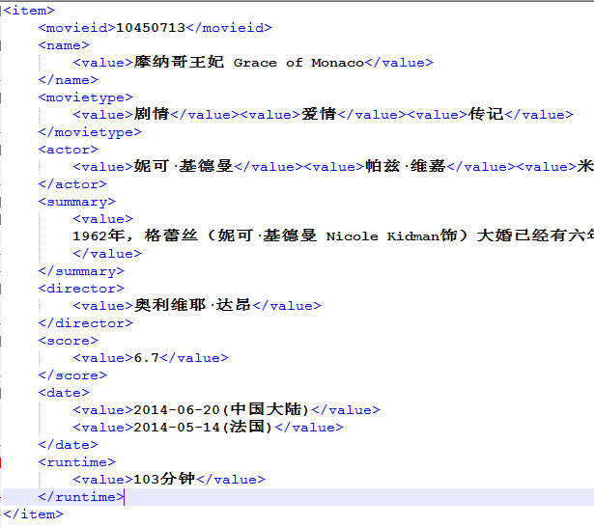
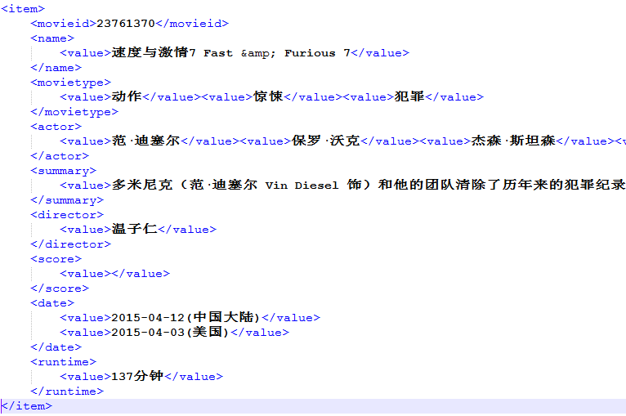
Data Source
Training Data : 460 movie information crawled from
Predict Data: 19 movie information without score

Slide 4
Basic Idea
Movie Actor Director Type Story
Score ActorScore DirectorScore TypeScore StoryScore

Slide 5
Actor/Director/Type Score
Actors:
[梁朝伟，刘德华，黄秋生， 曾志伟]
[梁朝伟，刘德华，黎明， 陈道明]
Similarity ：
[梁朝伟，刘德华] / [梁朝伟，刘德华， 黄秋生，曾志伟，黎明，陈道明]
Actor Score：
mean score of top20 highly similar movies

Slide 6
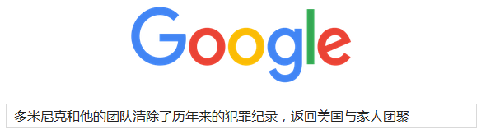
Story Score
Story:
[多米尼克和他的团队清除了历年来的犯罪纪录，返回美国与家人团聚……]
[1962年，格蕾丝大婚已经有六年，她的一颦一笑已经成为20世纪王妃的经典影像……]
Search Engine： （Inspired by ）
1. treat stories of 640 movies as documents to be searched
2. search the story to be predicted and get the first20 movies
Story Score：
mean score of first20 highly similar movies

Slide 7
Movie Score
Movie Actor Director Type Story
Score ActorScore DirectorScore TypeScore StoryScore
Score = a * ActorScore + b * DirectorScore +
c * TypeScore + d * StoryScore + d
Weighted Average for Easy Understanding !

Slide 8
Run My Program

Slide 9
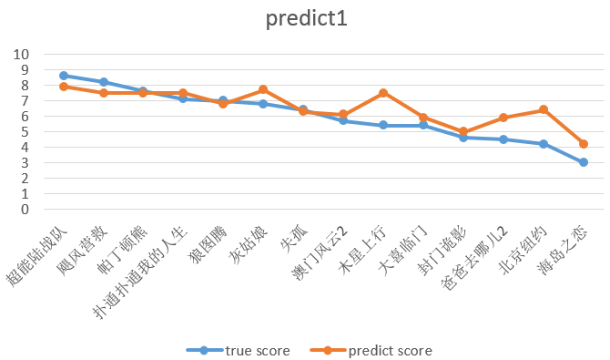
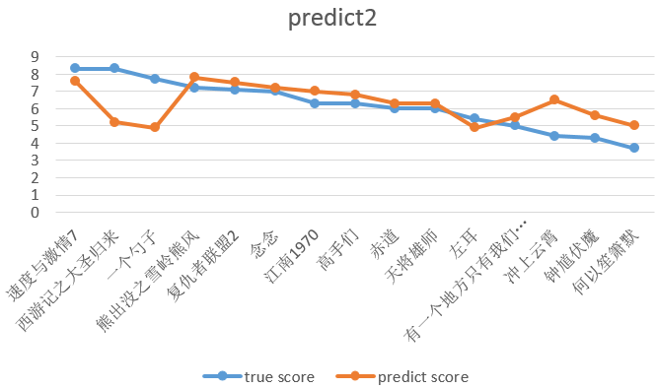
Result
Min Error : 0.07
Mean Error : 0.80
Max Error ： 2.19
Min Error : 0.17
Mean Error : 1.02
Max Error ： 3.06

Slide 10
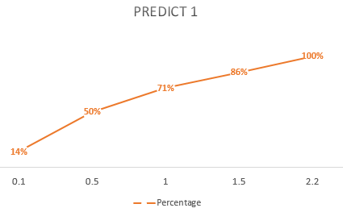
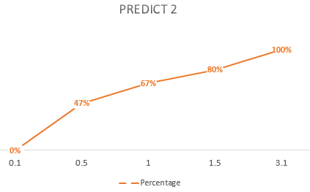
Result
<= 0.5 : 50%
<= 1 : 71%
<= 1.5 : 86%
<= 0.5 : 47%
<= 1 : 67%
<= 1.5 : 80%

Slide 11
Error Analysis
木星上行 2.1
北京纽约 2.2
西游记之大圣归来 3.1
一个勺子 2.8
冲上云霄 2.1
Directors or actors have little movie information in my training data
Improve it by crawling more data

Slide 12
I hope you like my killer feature!
Thank You!

