Slide 1

Mushroom Smart Farm
1. Lokman Yusoh 581431044
2. Sulaiman Makeng 58143107

Slide 2
INTRODUCTION
In the modern times, full-time jobs or salarymen are not the final answer for those who want to have financial stability or happiness in their work. Therefore, it is necessary to have a second job, and there are many more types of work to choose.
During the past, it can be seen that the cultivation of mushrooms is an interesting job for those who want to do extra job due to low cost it's a plant that uses little water easy to grow and good income.
This project propose for mushroom smart farm by controlling the temperature and humidity including camera real-time with Al by internet of thing.
Notes:
Overview about your project

Slide 3
PROBLEM STATEMENT
Nowadays, in the world have climate variability have an effect on agriculture productivity to grow up. That can’t to control the temperature, and can’t increase to humidity.
The most important of smart farm without automation control in the case of problems that the mushrooms to not grow because of the high temperature and lower humidity that will not have smog. (Sprinkler) to control the temperature in the greenhouses, and it will make mushrooms dried and not growth.
Notes:
It is a clear concise description of the issues, the problem should represent a solvable problem
Mostly, it’s present one of major problem and another problem will be miner.
This might be some motivation..

Slide 4
OBJECTIVE
To develop IOT system in control temperature and automatic machine.
To show the value of temperature and humidity with automatic include AI control system.
Save time, reduce risk, increase quantity and quality.
Notes:
Objective should be match with Problem statements
If you have 2 of problem so, in objective should support 2 problems..

Slide 5
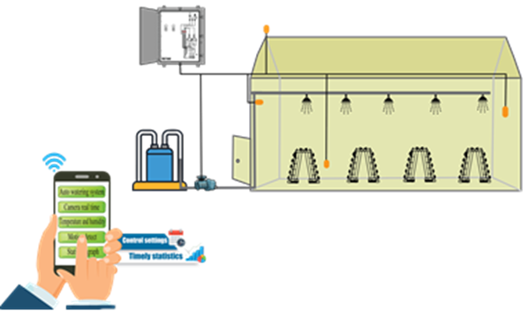
PROJECT SCOPE
In this research using an IOT system used to measure temperature and humidity, and using AI to monitoring the growth of mushrooms in mushroom house and control the water pump to opening and closing via automatic sprinkler by sending data through to the internet.
Can displaying humidity status and time for recording humidity data and for displaying the working conditions of automatic water pump via mobile as in figure

Slide 6
PROJECT SCOPE (cont..)
The factors that affect the growth of the mushroom, consisting.
1) temperature. The optimum temperature for mushroom growth is about 25 degrees Celsius. If the temperature is below 15 degrees Celsius or higher than 35 degrees Celsius, mushrooms will not bloom
2.) Humidity in mushroom that need high humidity, and suitable house conditions. The humidity content should not be less than 80-85 percent.
3. Nutrient content in mushroom cubes considered to be important to increase quantity of mushroom. Found that if supplementing with ammonium nitrate supplements will result in mushrooms increased by approximately 25 percent.

Slide 7
SIGNIFICANT OF STUDY
To developer:
To study the design and development of temperature and humidity control systems, and image processing system with IA.
To study the device to create the temperature control, and image processing.
Increase ability of developer to use software and hardware to be high quality.
To user:
To comfortable using the system of control in technology to agriculture.
To know the value of temperature and humidity with automatic control system on monitoring in mushroom farm.
Notes:
Who gets benefit?, and what are the benefit for whom?
It’s talking both benefit for developer and for user.
Significant can write from general to specific contribution
Or refer to the statement of the problem

Slide 8
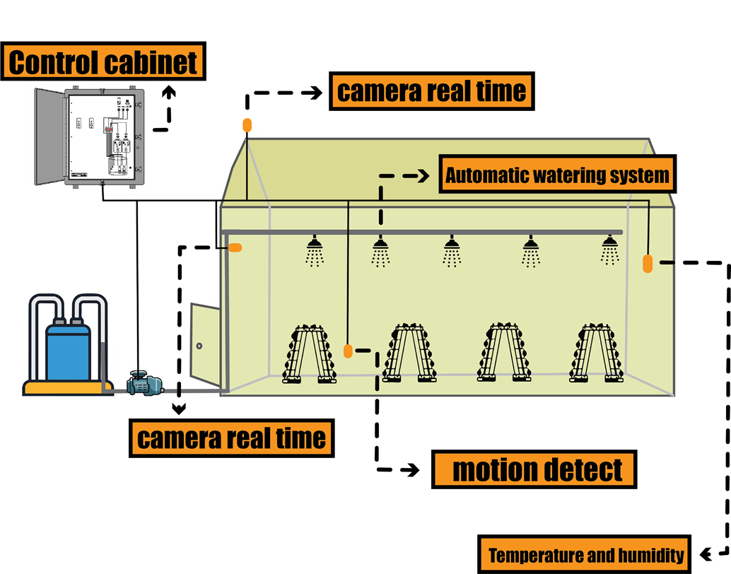
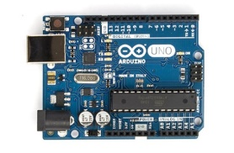
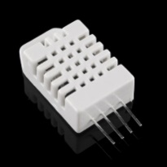
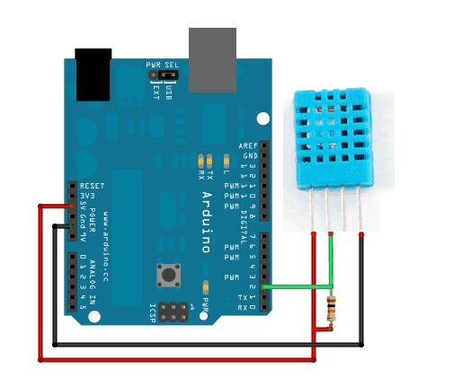
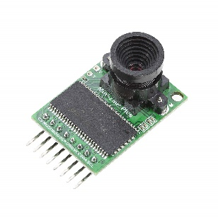
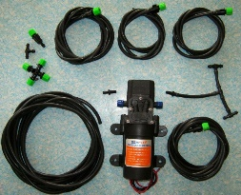
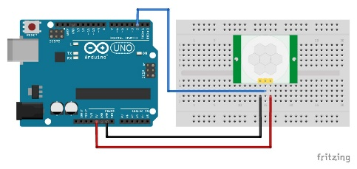
TOOLS USED
Microcontroller Arduino R3
Digital Temperature and Humidity Sensor
Relay 3-5 V
Motor
Sprinkle
Motion detect
Arducam-2MP-Plus

Slide 9

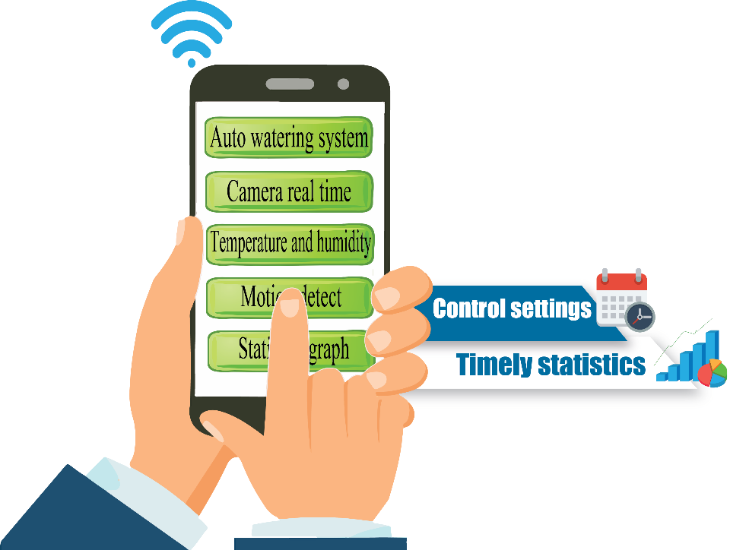
CHAPTER 2 LITERATURE REVIEW
Notes:
Make a conclusion what u have done in all slide

Slide 10





CHAPTER 3 METHODOLOGY
Use case
Notes:
Make a conclusion what u have done in all slide

Slide 11
SUMMARY
Environmental condition is a important factor that needs to be controlled in mushroom production. The device is able to develop an environmental control system that will increase the production of mushroom. The control system inside the device is automatically if the environmental conditions are not in optimum condition sprinkler will spray water to control temperature, and has camera real time to analyze the mushroom inside the cultivation farm.
However this system need to connecting the internet. Other than that, this system has successfully implemented the concept of IoT and automatic control in the precision agriculture.
Notes:
Make a conclusion what u have done in all slide

