Slide 2
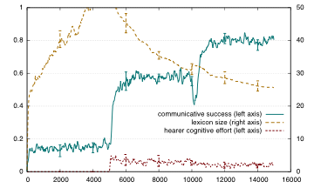
Stage III
Stage II
Stage I

