Slide 1
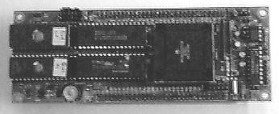
2x 64k EPROM
MC68332 micro-controller
2x 512 k RAM

