Slide 1

FACIAL RECOGNITION USING THE FACENET MODEL
COLLEGE OF INFORMATION AND COMMUNICATION TECHNOLOGY
DEPARTMENT OF INFORMATION TECHNOLOGY
GRADUATION THESIS
BACHELOR OF ENGINEERING IN
INFORMATION TECHNOLOGY
(HIGH-QUALITY PROGRAM)
Advisor:
Associate Prof. Dr. Thai-Nghe Nguyen
Student:
LANG TRUONG AN
Student ID: B1910609
CLASS: Cohort K45

Slide 2
CONTENT
1. The Problem of the Study
2. Content and Research Methodology
3. Results Achieved
4. Conclusion and Future Directions
5. Demo

Slide 3
1. The Problem Of The Study
The Urgency of the Topic
- There is a growing need to apply facial recognition technology to life.
- Developing an accurate facial recognition model will have a profound impact on sectors such as security, technology services, healthcare and education.

Slide 4
1. The Problem Of The Study
Reasoning Behind Topic Selection
- Originating from the critical need to research and develop a reliable facial recognition model that surpasses current limitations to meet the extensive societal demands.
The Purpose of the Study
- The goal of this study is to implement a Facenet model to provide an objective assessment of performance, accuracy, and processing speed.

Slide 5
2. Content and Research Methodology
1. Research and train the Facenet model
2. Deploying the Facenet recognition model using real-time cameras.
3. Comparison between Facenet and Resnet models.

Slide 6
2. Content and Research Methodology
Research and train the Facenet model
  The FaceNet Model
  FaceNet is a neural network-based system that uses deep learning algorithms to recognize faces.
  Developed by Google researchers in 2015.
  The system uses a convolutional neural network (CNN) to map facial features into a Euclidean space where distances directly correspond to a measure of face similarity.
  This space is then used to compare faces and recognize whether they belong to the same person or not.

Slide 7
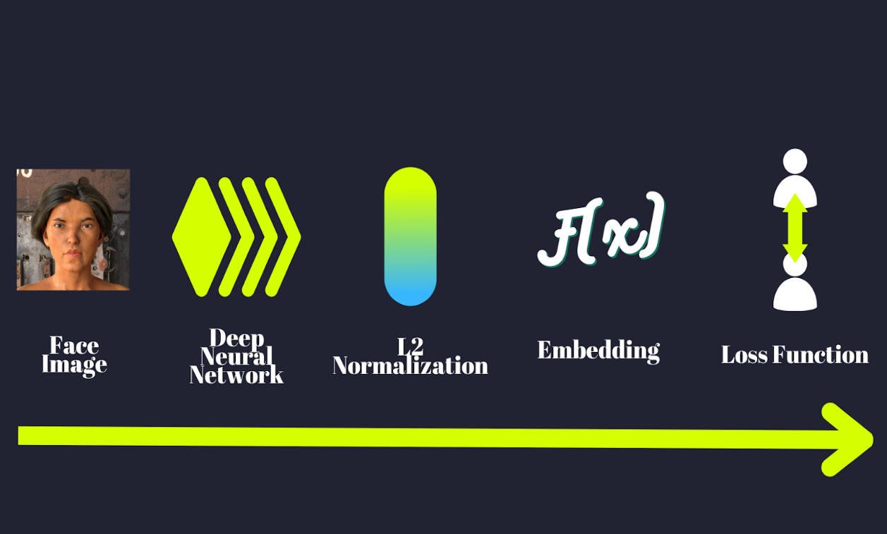
2. Content and Research Methodology
Research and train the Facenet model
  2. FaceNet Architecture

Slide 8
2. Content and Research Methodology
Research and train the Facenet model
  2. FaceNet Architecture
  FaceNet uses a deep network that learns and extracts various facial features.
  These features are then mapped to a 128-dimensional space, where images belonging to the same person are close to each other and far from images belonging to different subjects.

Slide 9
2. Content and Research Methodology
Research and train the Facenet model
  2. FaceNet Architecture
    Deep neural network
    FaceNet used Inception Network as its backbone architecture.
    The core concept of Inception is the use of 1X1 filters for dimensionality reduction (for example converting a 256x256x3 RGB image to a 256x256x1 image).
    Other filters (e.g., 3x3) can be used for the same input, combining the different outputs (this technique is called “inception module”).

Slide 10
2. Content and Research Methodology
Research and train the Facenet model
  2. FaceNet Architecture
    3. L2 Normalization
    The outputs are normalized using L2 Norm, also known as the Euclidean norm.
    It’s the distance of the output from the origin in the n-dimensional space and it is computed by the square root of the sum of the squared vector values.

Slide 11
2. Content and Research Methodology
Research and train the Facenet model
  2. FaceNet Architecture
    4. Embeddings
    The embeddings are calculated and mapped in the relevant feature space.
    The embeddings can be seen as a “summary” of an identity.
    Using such a smaller representation (compared to the full image) is crucial for tackling the face recognition task effectively.

Slide 12
2. Content and Research Methodology
Research and train the Facenet model
  2. FaceNet Architecture
    5. Loss Function
    This is one of the differentiating features of FaceNet, especially when compared to standard Siamese architectures.
    Hold your breath, the next paragraph is dedicated solely to FaceNet’s loss function: i.e. triplet loss.

Slide 13
2. Content and Research Methodology
Research and train the Facenet model
  2. FaceNet Architecture
    6. Triplet Loss
    The triplet loss function is the key to training the FaceNet model.
    The loss function compares the distance between an anchor image and a positive image of the same person with the distance between the anchor image and a negative image of a different person.
    Minimize distance for same-person images, maximize for different-person images.

Slide 14
2. Content and Research Methodology
Research and train the Facenet model
  3. Training the FaceNet model
    Deployment environment and technology
    Deployment Environment:
    Google Colab: Use the Colab environment to execute code, store data to Google Drive.
    Technology:
    MTCNN (Multi-Task Cascaded Convolutional Networks): Employed for face detection within images.
    SVM (Support Vector Machine) for face classification.
    FaceNet is utilized for the extraction of facial features.

Slide 15
2. Content and Research Methodology
Research and train the Facenet model
  3. Training the FaceNet model
    2. Data Collection
    Data collection requirements:
    The image must clearly show the face
    The image must have only one person
    Must have supplier's consent
    Diverse expressions and poses.
    Diverse lighting conditions

Slide 16
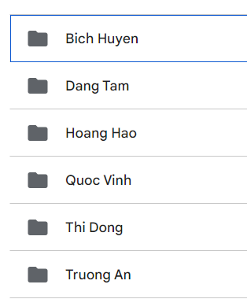
2. Content and Research Methodology
Research and train the Facenet model
  3. Training the FaceNet model
    2. Data Collection
    Bich Huyen with 40 images.
    Dang Tam with 40 images.
    Hoang Hao with 40 images.
    Quoc Vinh with 40 images.
    Thi Dong with 40 images.
    Truong An with 200 images.
Image 1. Dataset

Slide 17
2. Content and Research Methodology
Research and train the Facenet model
  3. Training the FaceNet model
    3. Preprocessing data
    Result:
    The image count for each person will be divided into two parts following a 3:1 ratio.
    The Dataset set contains 300 images.
    The Test set contains 100 images.

Slide 18
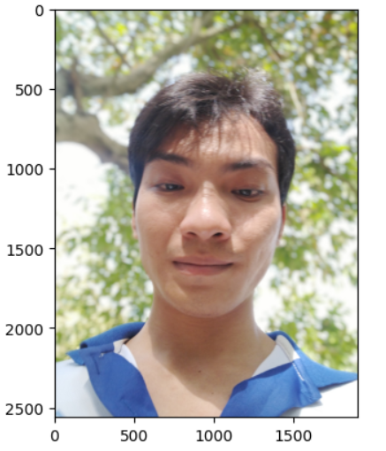
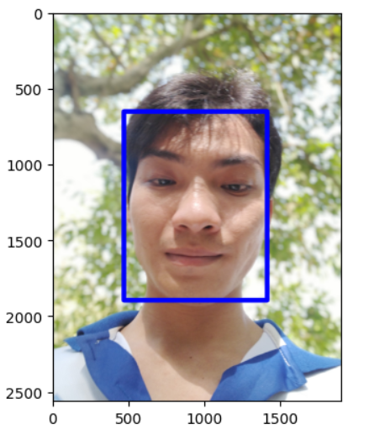
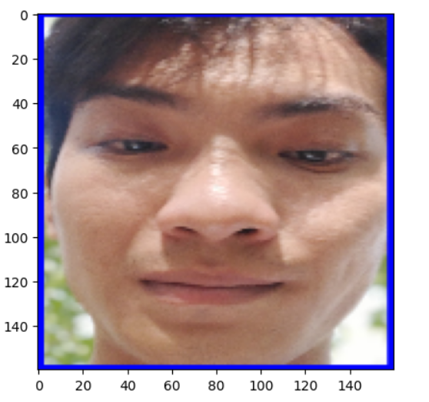
2. Content and Research Methodology
Research and train the Facenet model
  3. Training the FaceNet model
    4. Face Detection
Image 2. OpenCV (read files)
Image 3. MTCNN
(face detection)
Image 4. Resize (160x160)

Slide 19
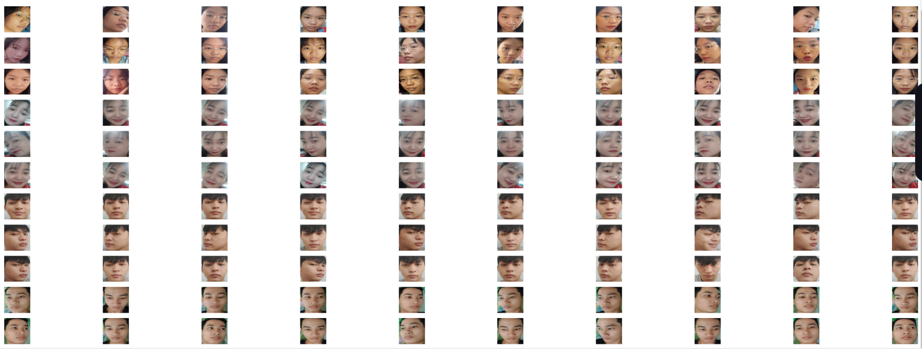
2. Content and Research Methodology
Research and train the Facenet model
  3. Training the FaceNet model
    4. Automate the preprocessing
    Write a function that automates the preprocessing for the dataset.
Image 5. Face detection of the dataset

Slide 20
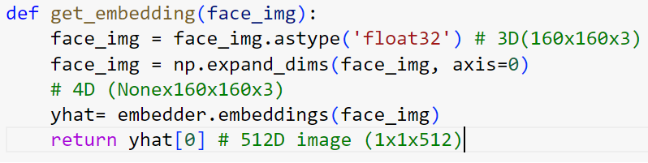
2. Content and Research Methodology
Research and train the Facenet model
  3. Training the FaceNet model
    4. Embeddings
3D (160x160x3)
4D (Nonex160x160x3)
512D (1x1x512)
Image 6. Embedded function

Slide 21
2. Content and Research Methodology
Research and train the Facenet model
  3. Training the FaceNet model
    4. Embeddings
    Extract the features of all faces in the dataset and save to the corresponding EMBEDDED_X list.
    Stores EMBEDDED_X feature vector data and Y class labels into a compressed file faces_embeddings_done_4classes.npz.
    Convert class labels from strings to integers

Slide 22
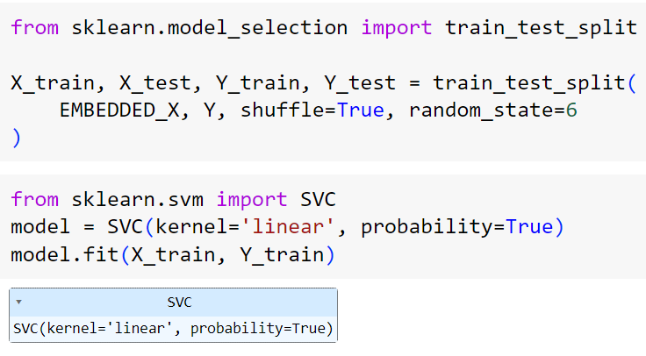
2. Content and Research Methodology
Research and train the Facenet model
  3. Training the FaceNet model
    4. Support Vector Machine (SVM) model for classification.
    Data Splitting
    SVM Model Training
Image 7. SVM model

Slide 23
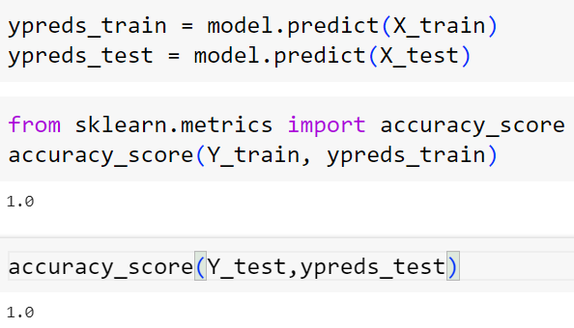
2. Content and Research Methodology
Research and train the Facenet model
  3. Training the FaceNet model
    4. Support Vector Machine (SVM) model for classification.
Prediction
Image 8. Prediction and Evaluation

Slide 24
2. Content and Research Methodology
Research and train the Facenet model
  3. Training the FaceNet model
    4. Support Vector Machine (SVM) model for classification.
    Performance Evaluation: An accuracy of 1.0 (or 100%) on both the training and testing sets for the FaceNet model suggests that the model has achieved perfect accuracy on the provided dataset. Sometimes indicate overfitting, where the model has essentially memorized the training data, leading to near-perfect performance when evaluated on the same data it was trained on.

Slide 25

2. Content and Research Methodology
Research and train the Facenet model
  3. Training the FaceNet model
    4. Support Vector Machine (SVM) model for classification.
    Performance Evaluation: on the Test set
Processing time per image:

Slide 26
2. Content and Research Methodology
Deploying the Facenet recognition model using real-time cameras.
  faces_embeddings_done_4classes.npz: Loading precomputed face embeddings for recognition/classification.
  haarcascade_frontalface_default.xml: Utilizing a pre-trained face detection model to identify faces in video frames.
  svm_model_160x160.pkl: Employing a saved SVM model for facial recognition based on the extracted embeddings and performing classification.

Slide 27
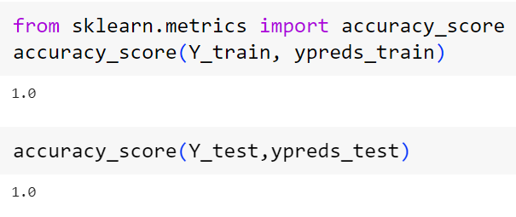
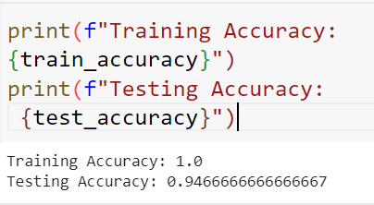


2. Content and Research Methodology
Comparison between Facenet and Resnet models.
1. The accuracy on the training set.
Facenet
Resnet

Slide 28
3. RESULTS ACHIEVED
1. Research and train the Facenet model
=> Successfully built the FaceNet model.
2. Deploying the Facenet recognition model using real-time cameras.
=> Successfully deployed real-time FaceNet model using cameras.
3. Comparison between Facenet and Resnet models.
=> Successfully compare the performance of two models FaceNet and ResNet.

Slide 29
4. CONCLUSION AND FUTURE DIRECTIONS
CONCLUSION
The FaceNet model has demonstrated impressive capabilities in facial recognition and feature extraction.
High Accuracy: FaceNet often achieves high accuracy in face recognition tasks, as evidenced by its ability to correctly identify faces and extract meaningful embeddings.
Robustness: The model tends to be robust in varying conditions such as different lighting, facial orientations, and backgrounds, making it reliable for real-world applications.

Slide 30
4. CONCLUSION AND FUTURE DIRECTIONS
CONCLUSION
Dimensionality Reduction: FaceNet's embeddings effectively represent facial features in a reduced dimensional space, enabling efficient and meaningful comparisons between faces.
Comparative Performance: Comparing its performance with other models, such as ResNet, can highlight its strengths and weaknesses in specific use cases.
Real-Time Application: Despite its computational demands, optimizations can be made to deploy FaceNet in real-time applications, allowing for efficient face recognition on camera streams.

Slide 31
4. CONCLUSION AND FUTURE DIRECTIONS
FUTURE DIRECTIONS
In the future, it is possible to develop a facial recognition model on mobile devices using the Mobile Facenet model.
Building a stranger identification system using the Facenet model.

Slide 32

5. DEMO

Slide 33

THANK YOU FOR YOUR ATTENTION

