Slide 1
An explorative approach to
unsupervised intent recognition
Steeve Laquitaine

Slide 2
Sophisticated models that compete in performance and in complexity on benchmark corpora of annotated queries.
Models are typically classification or sequence models trained on databases of annotated queries then used to predict intents on unseen utterances.
Despite the approach’s growing popularity, it relies on extensive human annotations and its opacity provides little to no insights into the structure of intent representation.
The unsupervised approach, far less explored, could be used to reduce labelling workload while enabling the elaboration of a clear and concise formal model of natural language intent.
Steeve Laquitaine

Slide 3
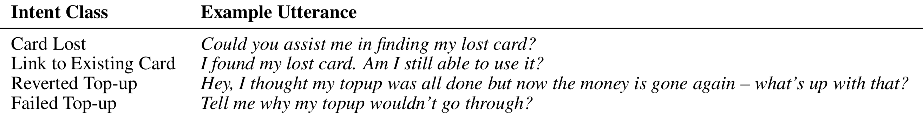
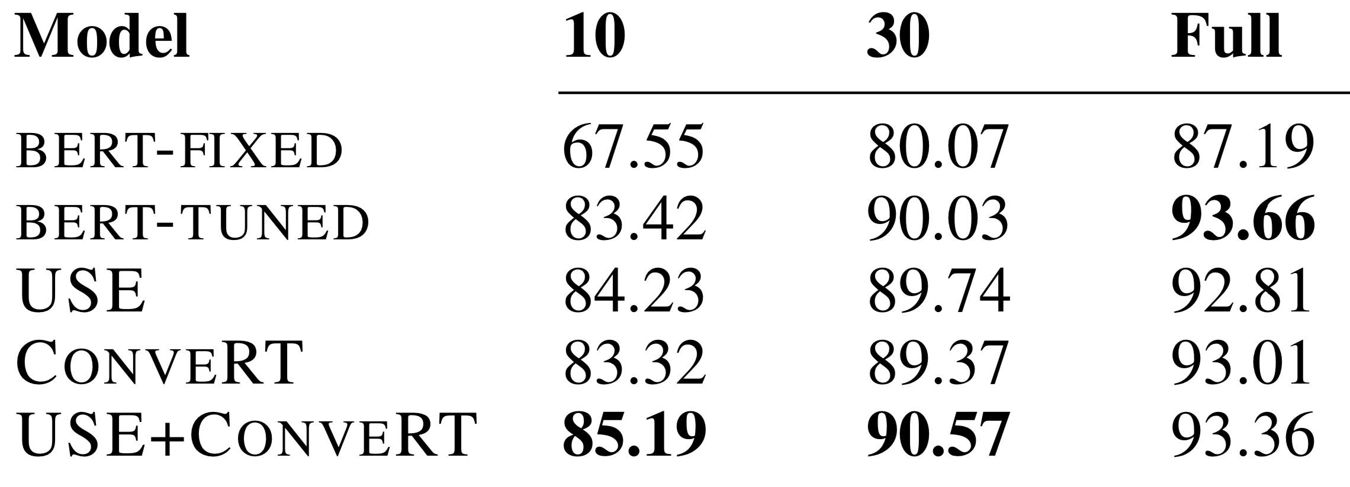
“Banking77” requires annotations
Instances per labels
Casanueva et al., arxiv ２０２０
Steeve Laquitaine

Slide 4
Intent Corpora
Banking77
* Sector: Finance
* Industry: Banking
* task: task-oriented dialog
* 13,083 {question, intents}
* 77 intents
* train input format: .csv
* url: [13]
* corpus url [30]
* license
* pros
* Ecological relevance:
* many intents, emulates commercial systems env. [13]
Steeve Laquitaine

Slide 5
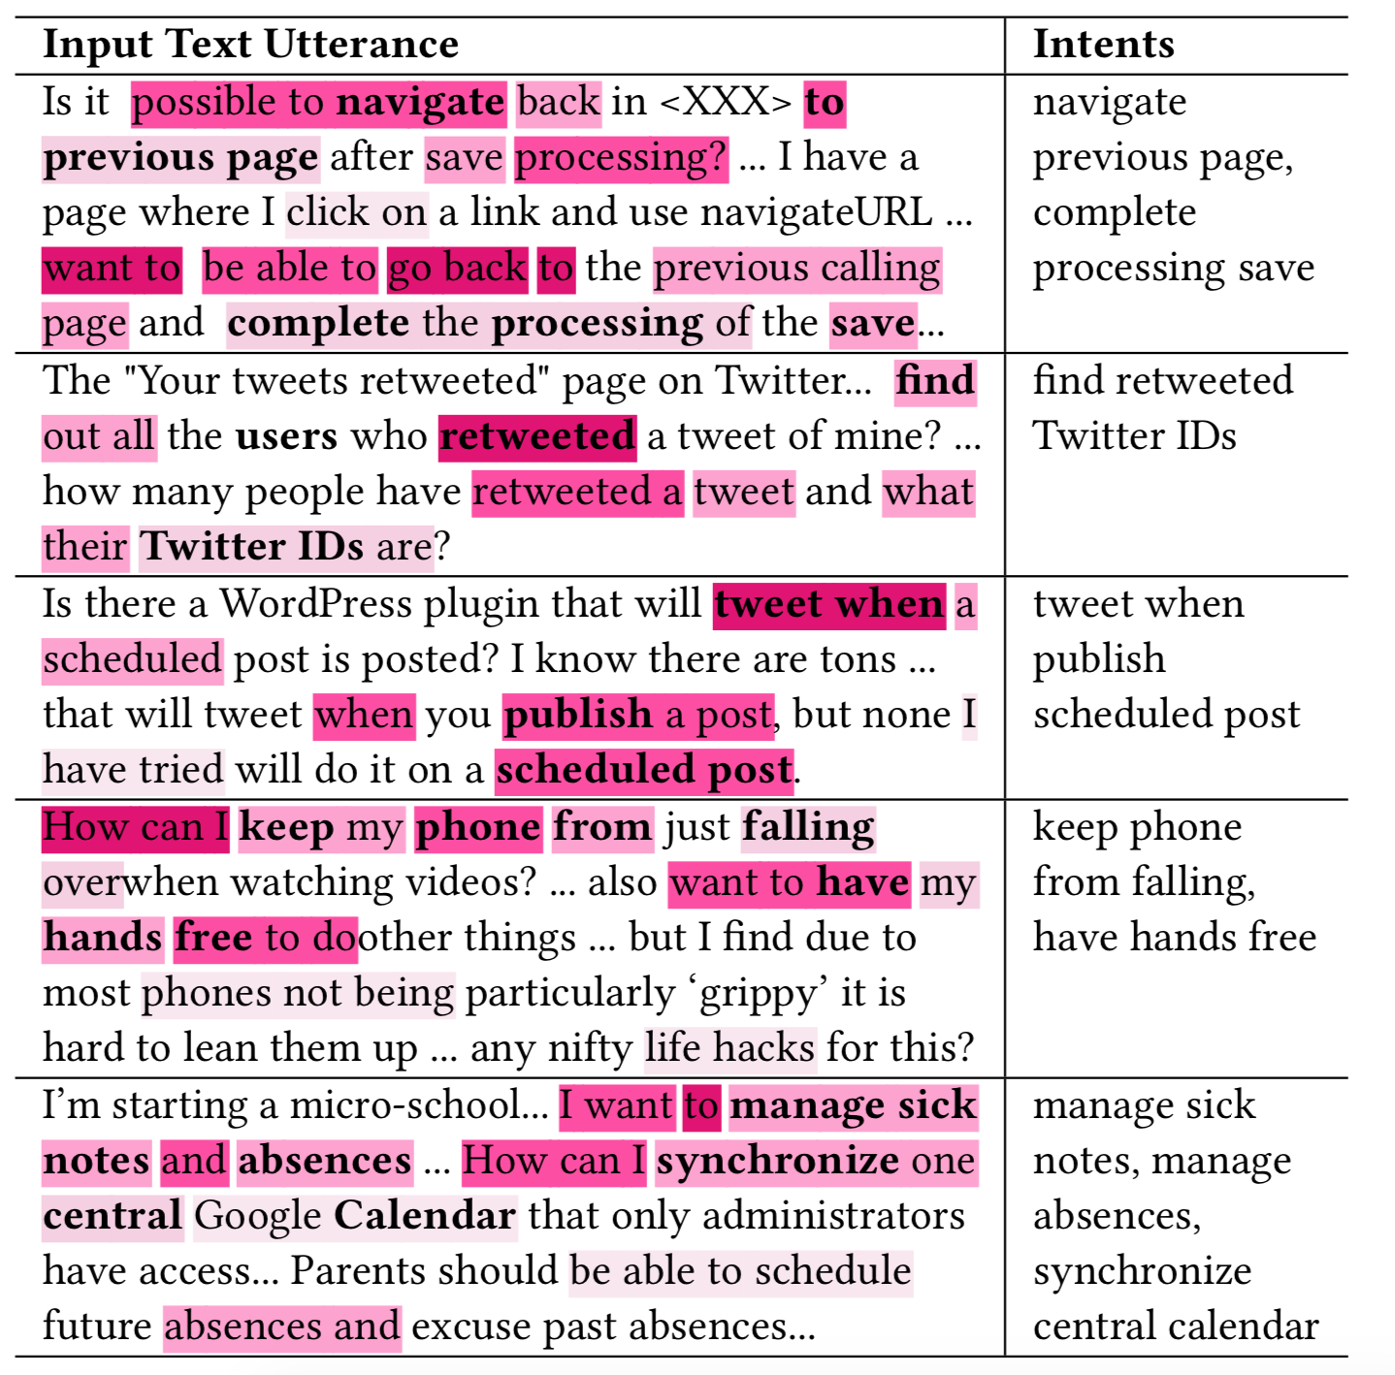
Formalizing intent
VB
NP
navigate to previous
VB
NP
find out all the users …
VB
PP
tweet when ..
VB
NP
keep my phone from …
VB
NP
manage sick notes
Steeve Laquitaine

Slide 6
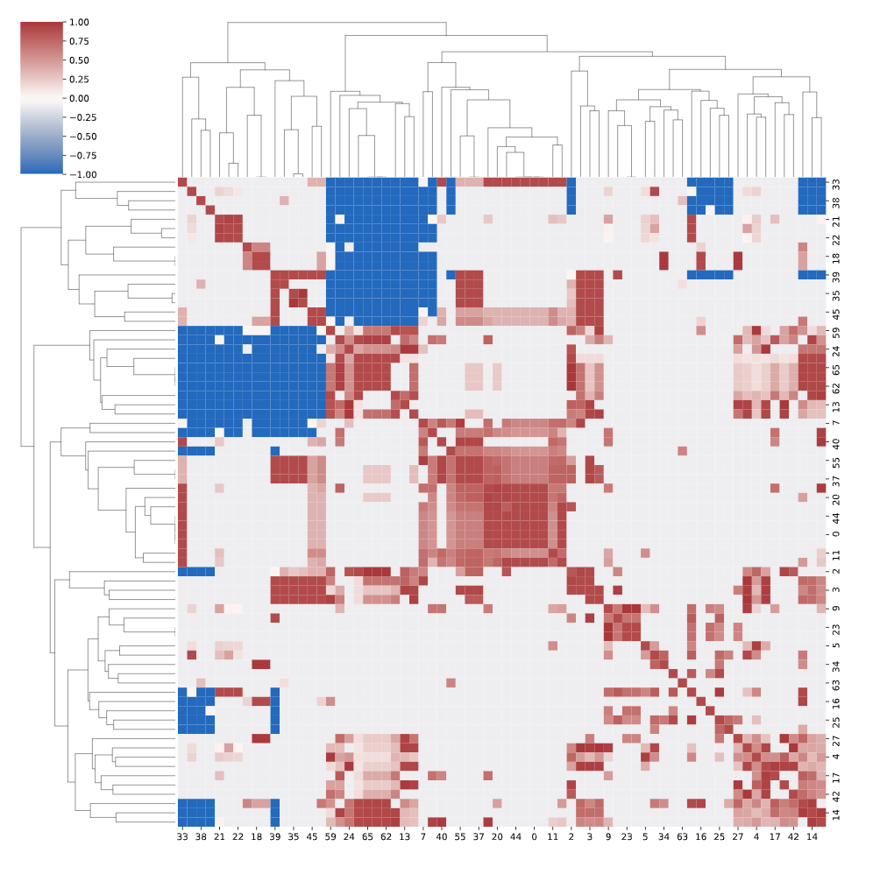
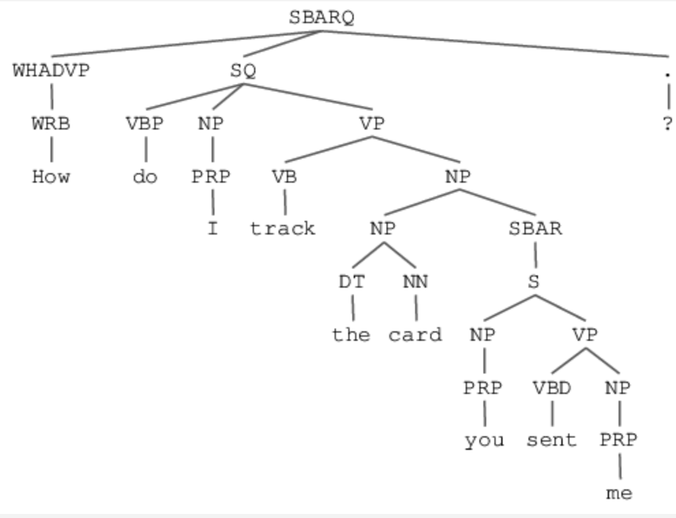
Semantic similarity analysis
Chunking
Steeve Laquitaine

Slide 7
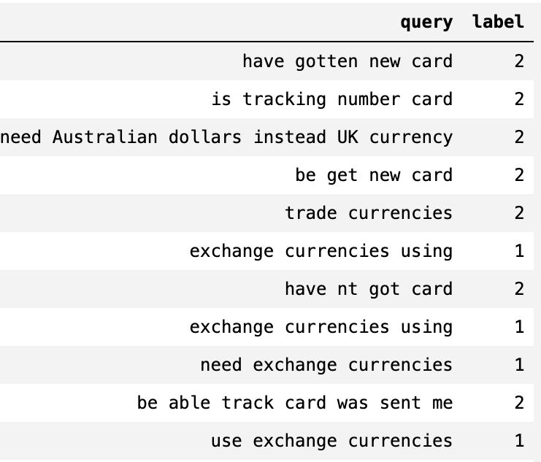
Some good labels but need real eval.
Steeve Laquitaine

Slide 8
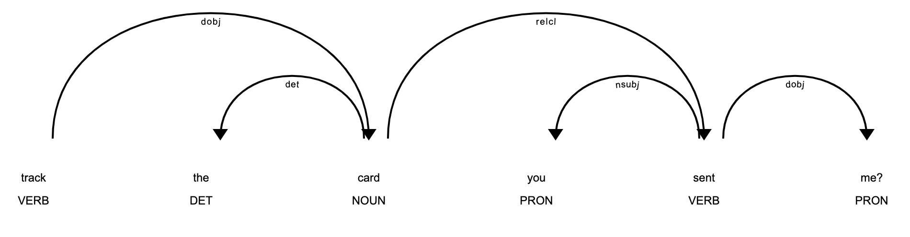
Chunking
Functional parsing
Parametrization
{
Intent: track
Intendeed: card
entities: [
{date: None,
?x: None
pp: you sent me
},
]
}
dobj
relcl
dobj
det
nsubj
root
Steeve Laquitaine

Slide 9
Approach 1
Approach 2
How do I track the card you sent me?
How do I track the card you sent me?
Chunking
Chunking
Semantic clustering
Parametrization
{
Intent: track
Intendeed: card
entities: [
{date: None,
?x: None
},
]
}
Intent
Class label
Expressive
intent
Steeve Laquitaine

Slide 10
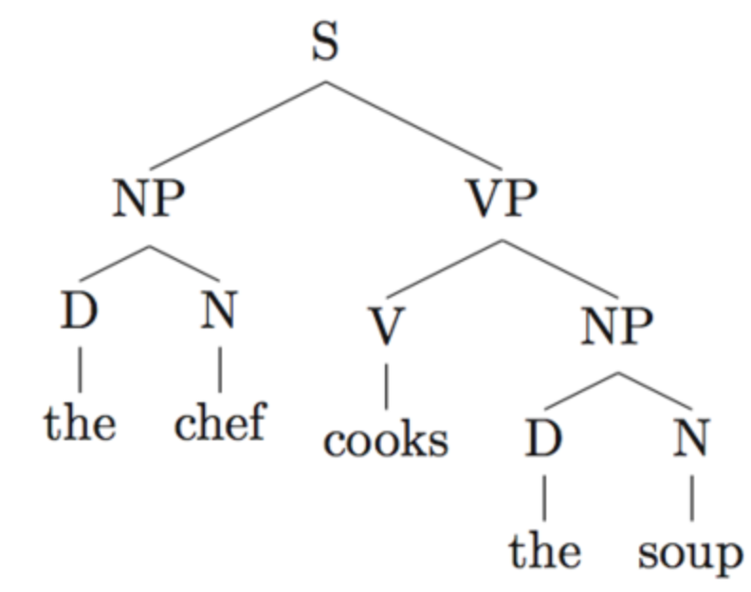
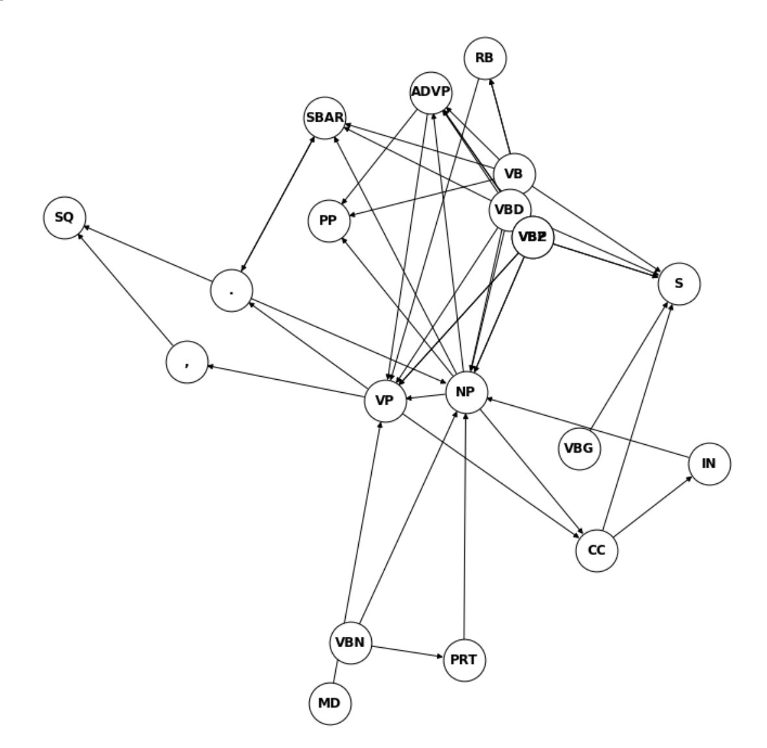
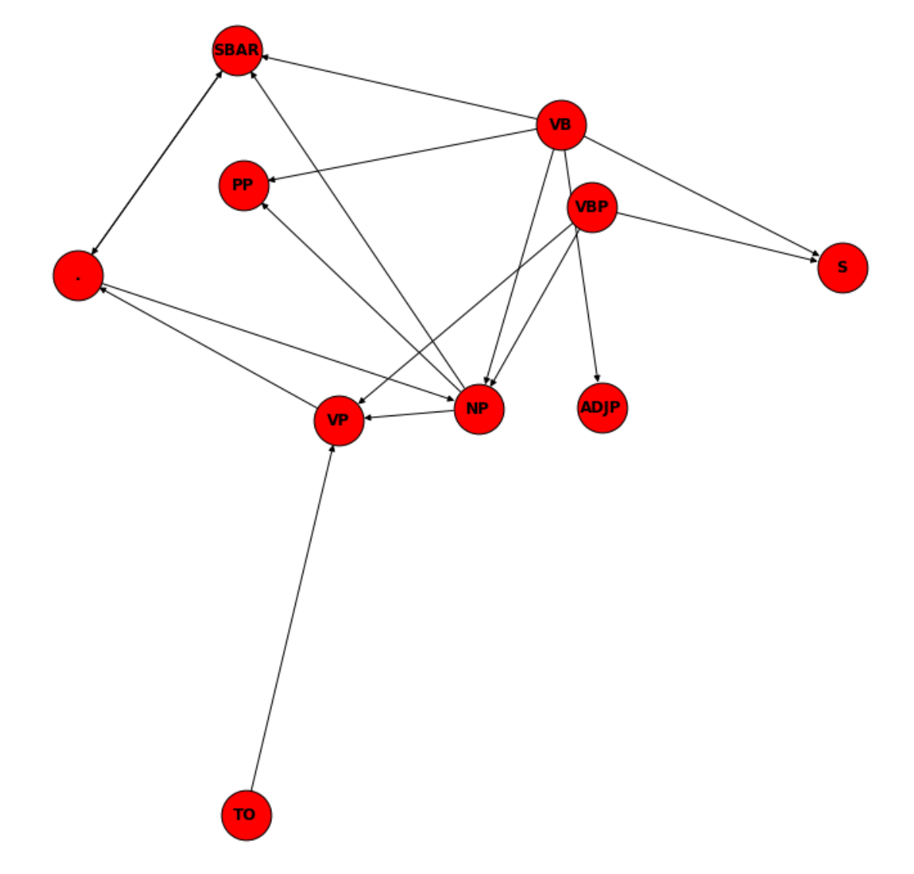
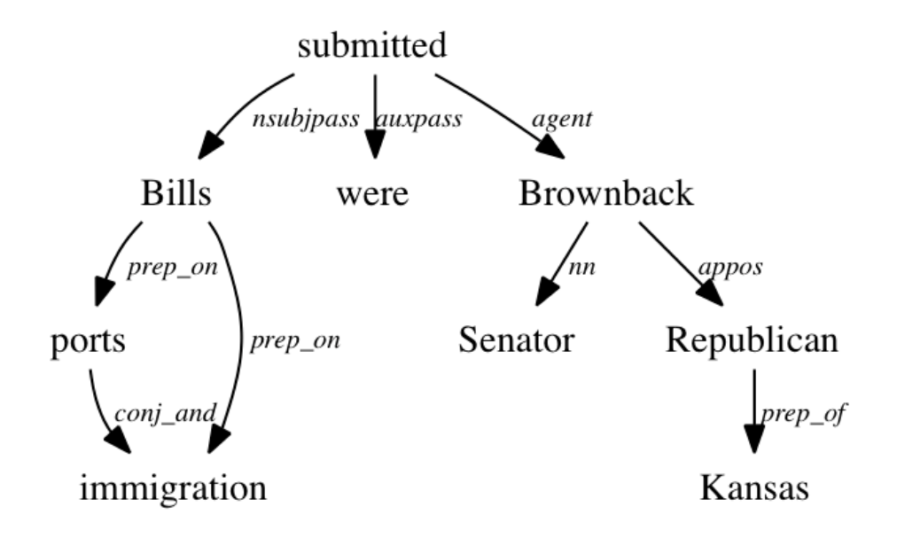
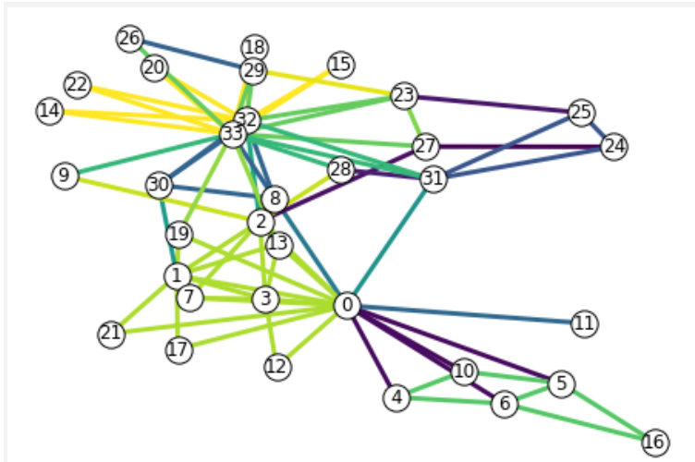
Perspectives
Improve data understanding
Understand how ambiguity affects parsing
Improve similarity analysis
Simplify and bridge the two approaches
etc …
Steeve Laquitaine

