Slide 1
An explorative approach to
unsupervised intent recognition
Steeve Laquitaine

Slide 2
Ideas
Error analysis
- to guide model improvement
Improvement:
Semantic graph pattern hypothesis: each intent has specific discriminable semantic
graph patterns
Find these patterns
A query can be represented
- as a 3D adjacency matrix
( intendee (synonym vector), intent (synonym vector), intended (synonym vector) )
Test with “seed” filtering vs “no seed” filtering

Slide 3
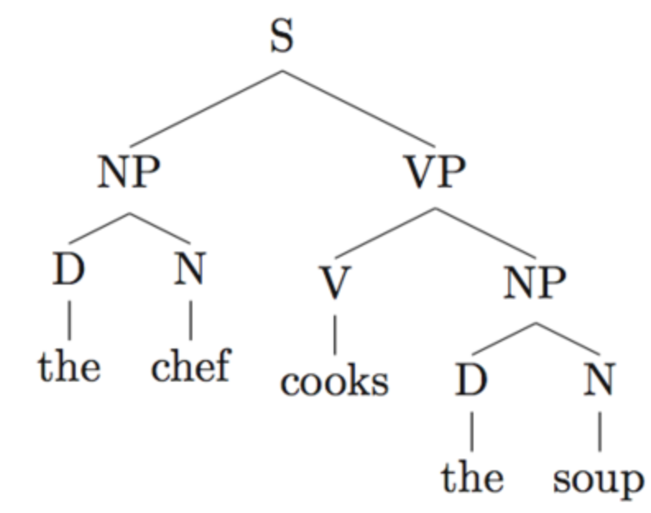
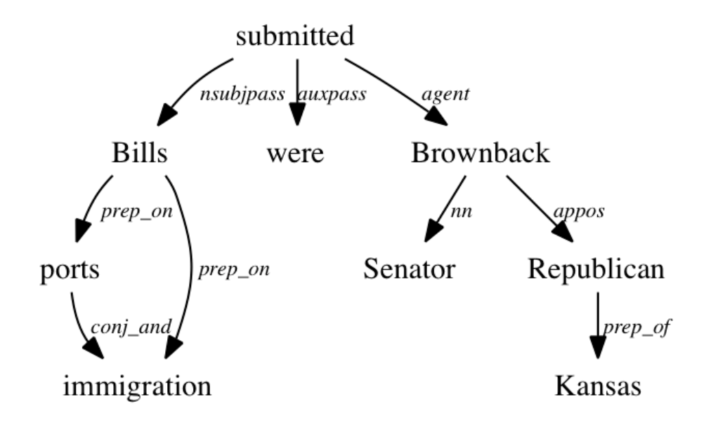
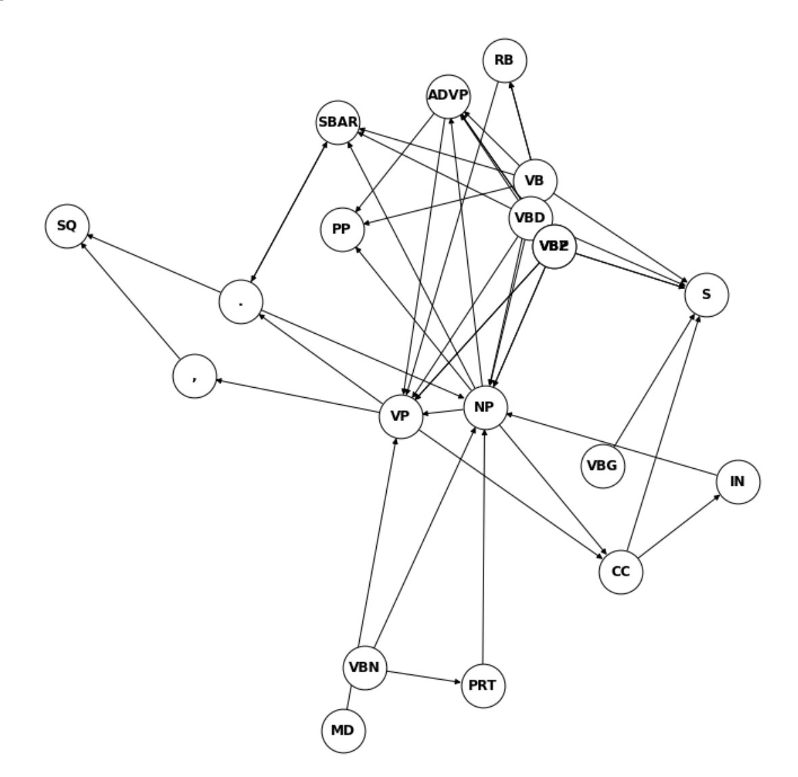
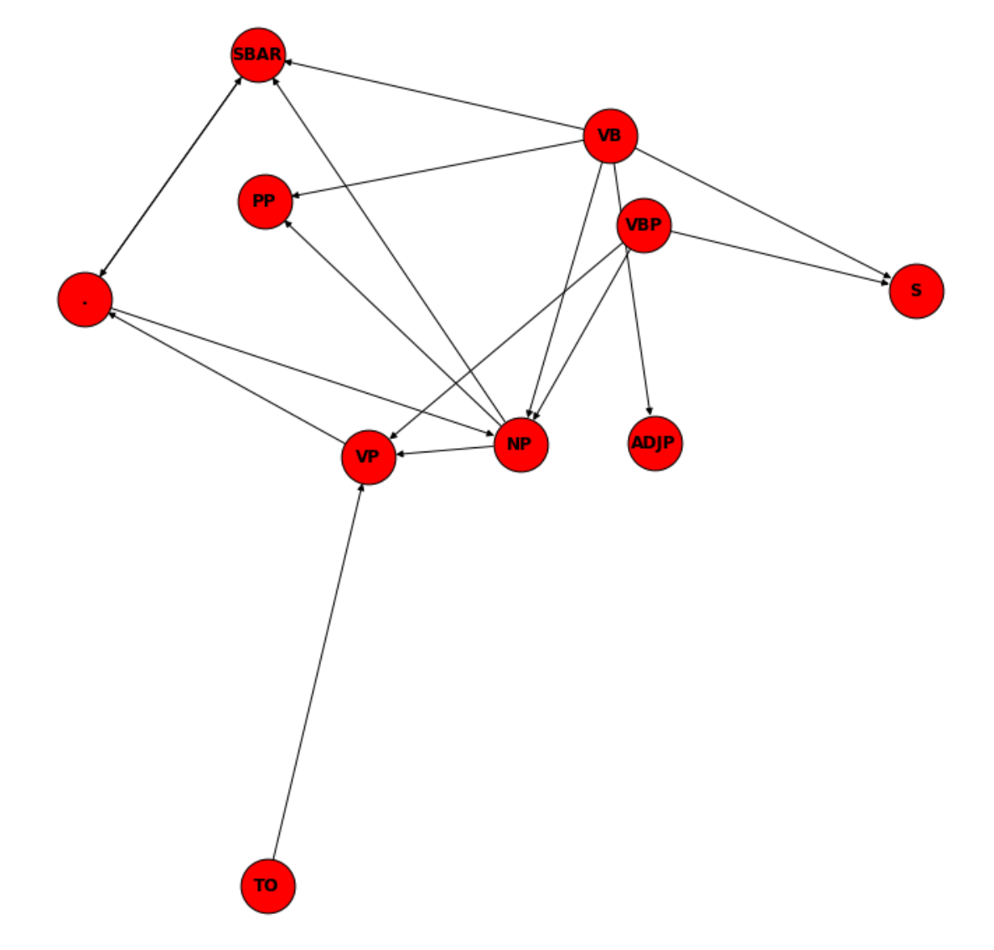
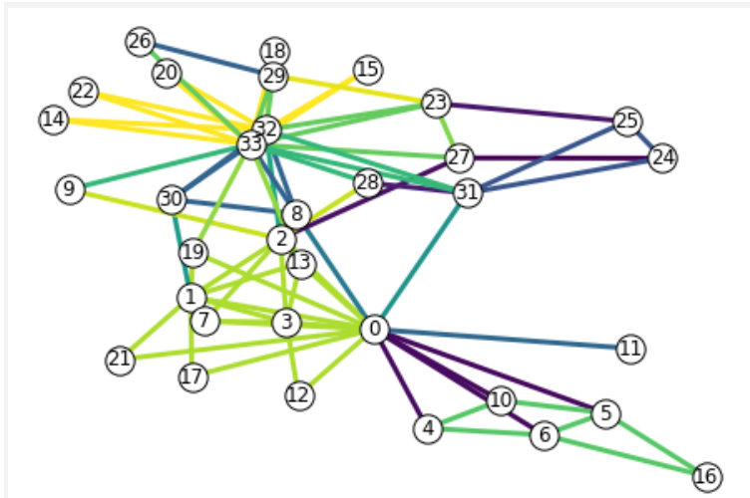
Perspectives
Improve data understanding
Understand how structural ambiguity affects parsing
Improve similarity analysis
Improve semantic disambiguation with Levin’s classes and verbnet
Bridge and simplify the factored and structured approaches
etc …
Constituency parsing
Verb phrase
Extraction
(tree search)
“I want to order
a credit card.”
Dependency parsing
Word graph
conversion
Similarity
ranking

