Slide 1
Overview
Pipeline
Queries ranking

Slide 2
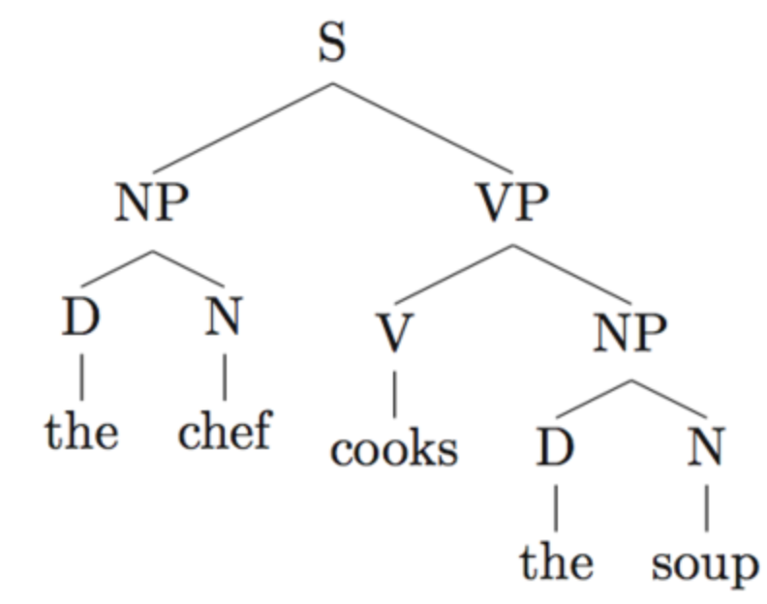
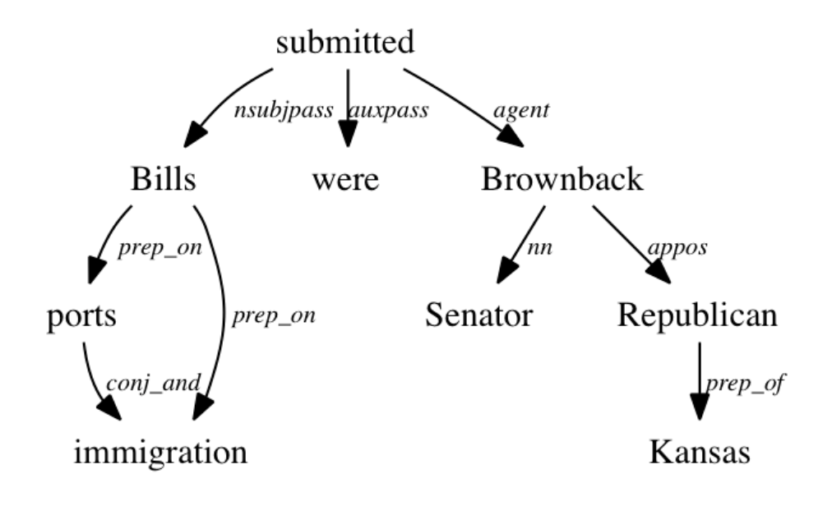
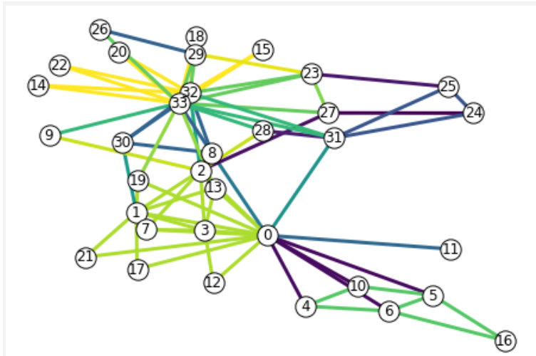
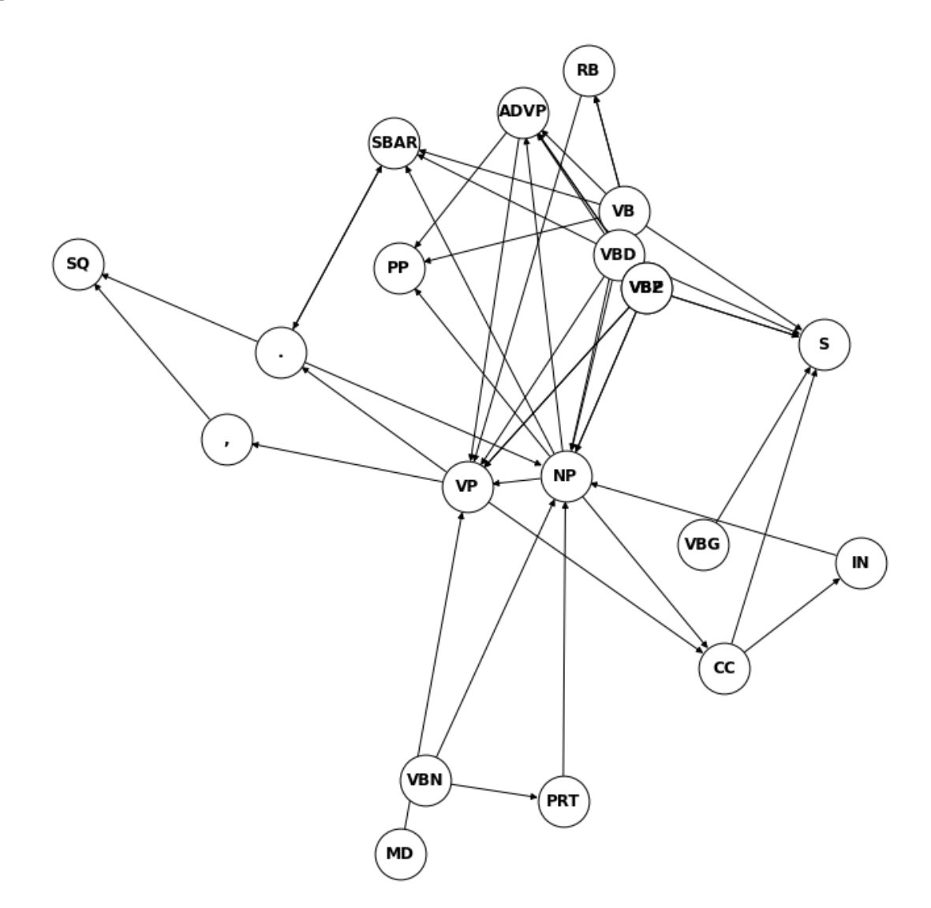
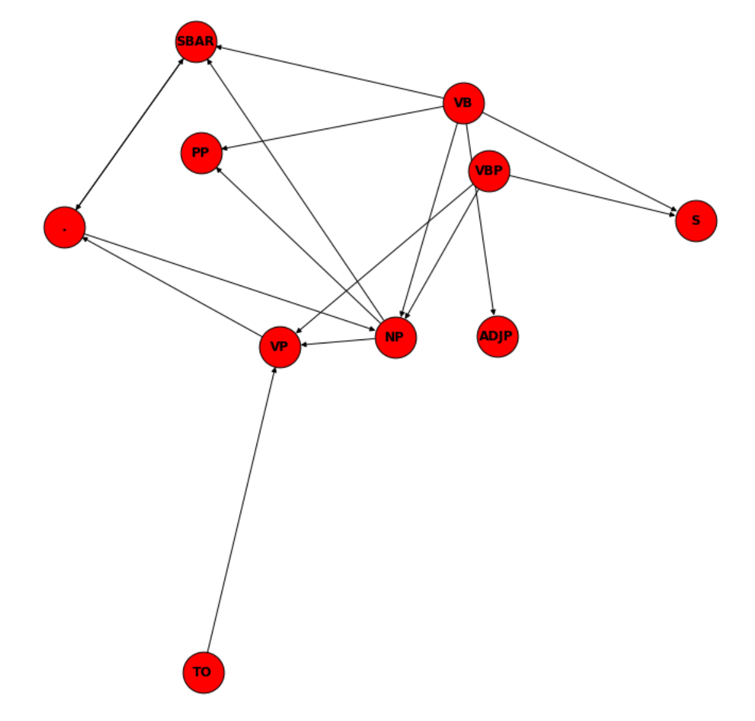
“I want to order
a credit card.”
Constituency parsing
Verb phrase
Extraction
(tree search)
Dependency parsing
Word graph
conversion
Well-formed intents
Ill-formed intents
Similarity
ranking
Notes:
Two grammar formalisms : phrase structure (context free grammar) and dependency structure
Hierarchical link community discovery
Signature features: tense, mood, verb modalities
Syntax representational space has lower dimensionality than the lexical one
Noise filtering: discard irrelevant constituents such as NP
Graph theoretical approach: More interpretable
Next step: Bayesian markov model
- Communities not easily separable
Attach probability to each path
Nice link with computational linguistic liter.

Slide 3
Query ranking
Well-formed intents
Notes:
Objective is extract well-formed intent: denoising
Then work on these seed queries. Then generalize to ill-formed queries.

Slide 4
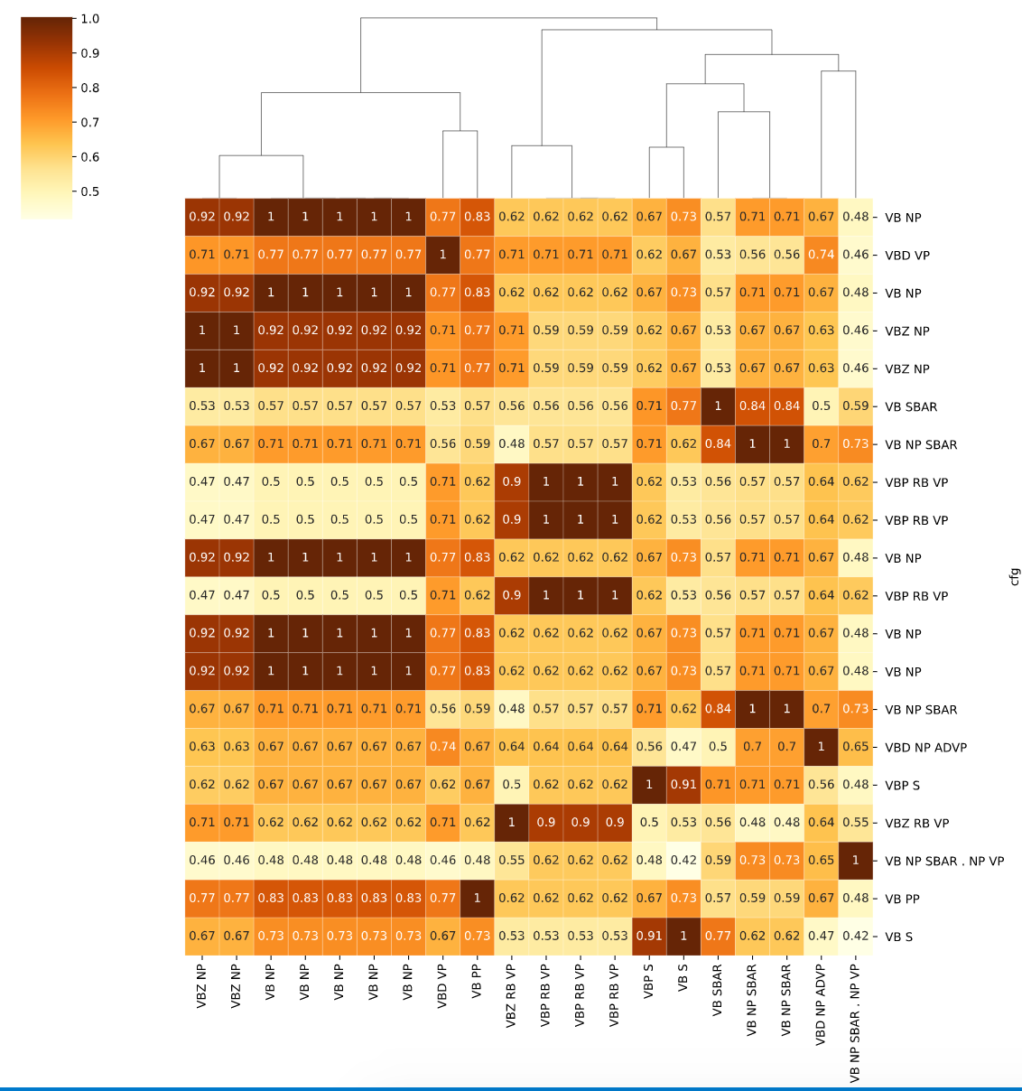
Query ranking
Longest common contiguous
subsequence
OK for now
Well-formed intents
Notes:
Suffixes tree
Why not longest common subsequence – theoretical parallel exists w/ Recurrent Neural Networks?

Slide 5
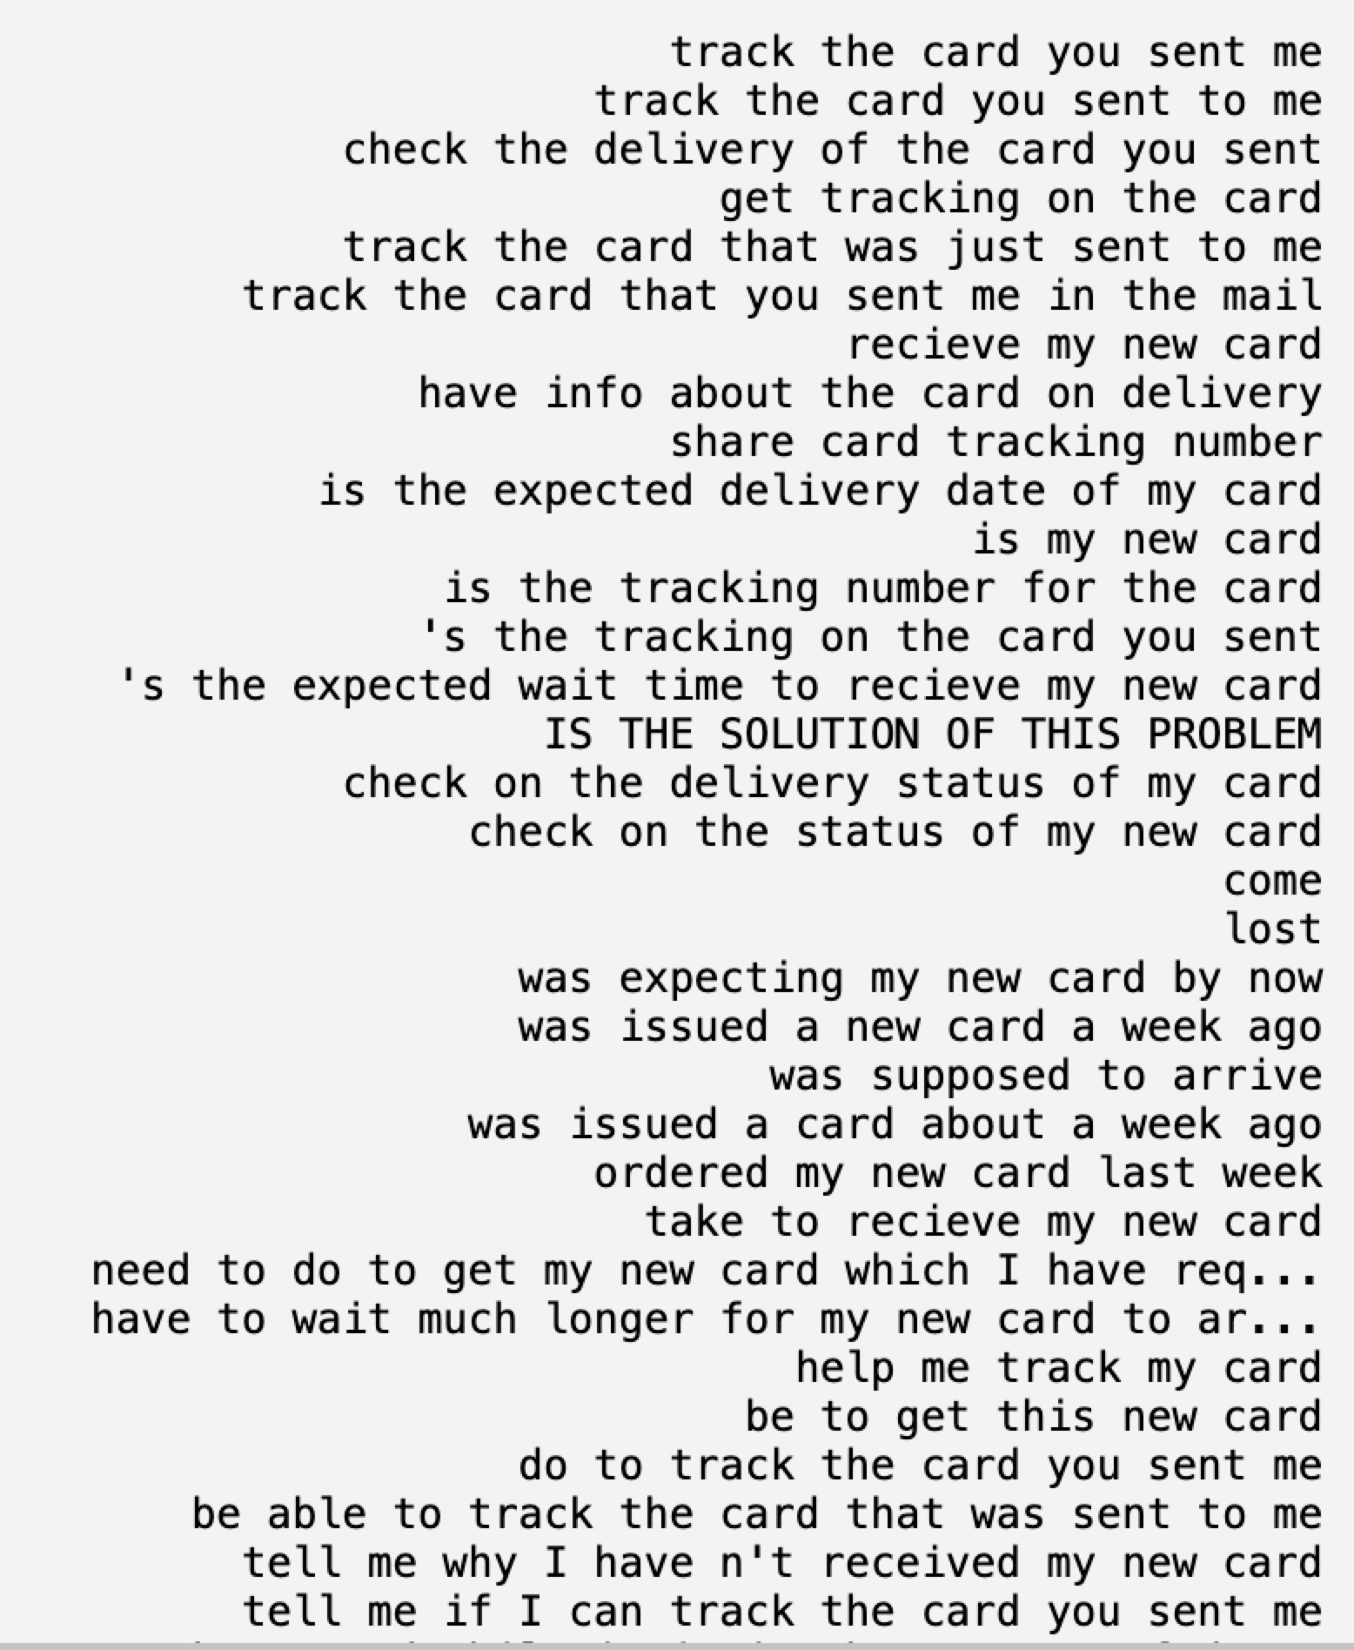
Seed filtering
VB NP
Well-formed intents
1
0.92
“to order a credit card.”
Notes:
Suffixes tree
Why not longest common subsequence – theoretical parallel exists w/ Recurrent Neural Networks?

Slide 6
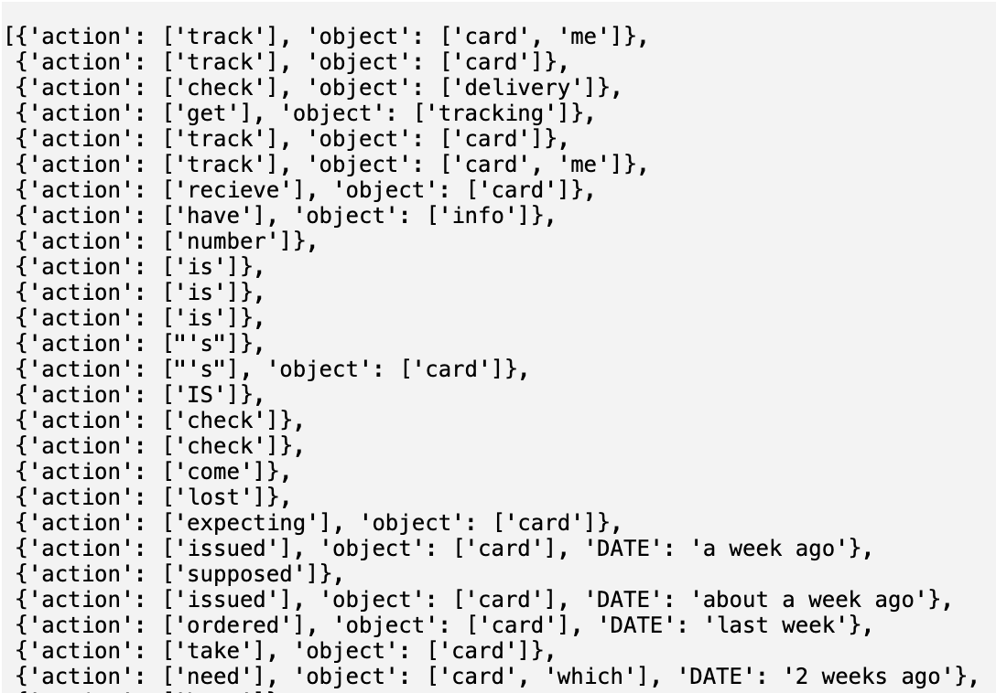
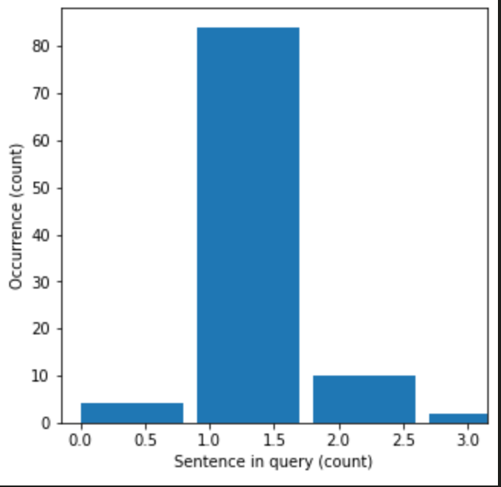
Intent & slot parsing
Show each intent as a graph?
Classiifaction
Has high performance
-> lexicon very
Intent discriminatif
Reclassify with verb and noun only
Latent intent inferrable
from entities ?
Intendee should contain core topic only, most important word, cannot be in a subordinate clause
Noun phrase Intendees might be more relevant
The topic “card” is missing
Topics modeled
out of word graphs
then detect that
topic in each query
Simple: LDA
Then word gaphs
Check topic alighnment with
Verb phrase
Dp VP always
Contain VPs?
Cannot be a verb form
Performance factors
Query complexity
multi-sentence
multi-clause
Mood
Structural ambiguity
PP attachment
lack of lexical conditioning: CFG rules don’t model syntactic facts about specific words, leading to problems with subcategorization ambiguities, preposition at- tachment, and coordinate structure ambiguities
Notes:
References
P414, Speech and language processing, Manning
P415, Speech and language processing, Manning
https://github.com/mlehman/nlp-intent-toolkit

Slide 7
IDEAS
Lexical clustering → VPs → w/n cluster verb modeling → within cluster dobj modeling
Knowledge that belongs to a lexical cluster
Should circumvent Noise from failed VP parsing
VPs → Topic modeling -> N topic intents -> select only VPs associated w/topic
from multi-clause queries
Assumption:
Most VP are well
parsed
Assumption:
Multi-clause queries are the most frequent causes of noise/ambiguity
VP topic modeling → C noun topics → find verb attached → Intent = V + Topic + NE
Do VP always contain the “topic”?
Predicate modeling?
Predicate – argument clustering?
Solutions:
- Use corpus contextual info to disambiguate “attachment ambiguities”
^{Differentiate} V + Preposition vs. V
marry on(person, date)”, “marry(person, person)”.

Slide 8
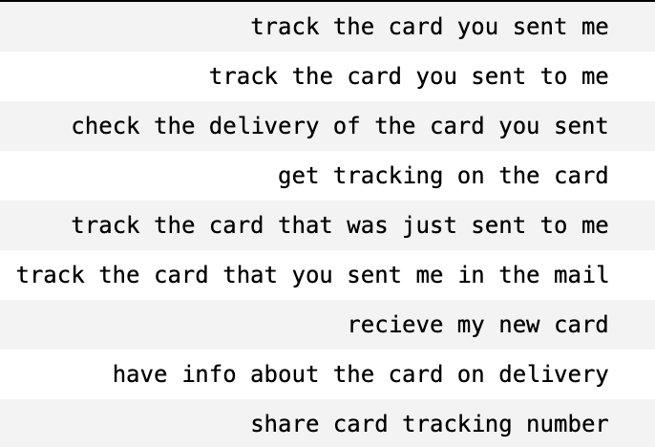
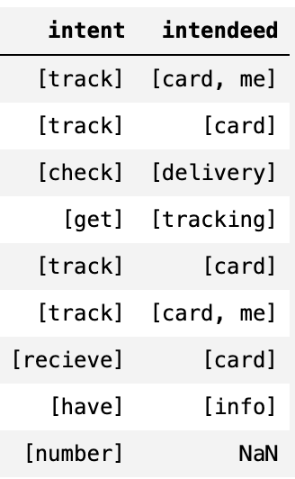
Intent & slot parsing
Query filtering
By complexity
By syntax similarity
By mood
Denoising produces 9% queries
Best result w/
SEED = " VB NP’
THRES_NUM_SENT = 1
NUM_SENT = 1
THRES_SIM_SCORE = 1
FILT_MOOD = ("ask",)
Notes:
References
P414, Speech and language processing, Manning
P415, Speech and language processing, Manning

Slide 9
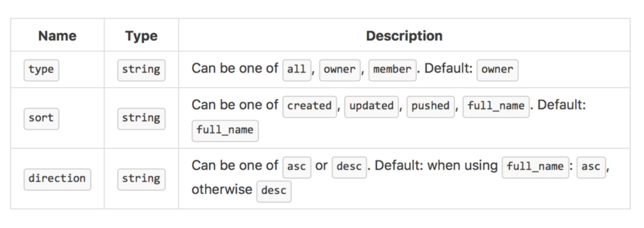
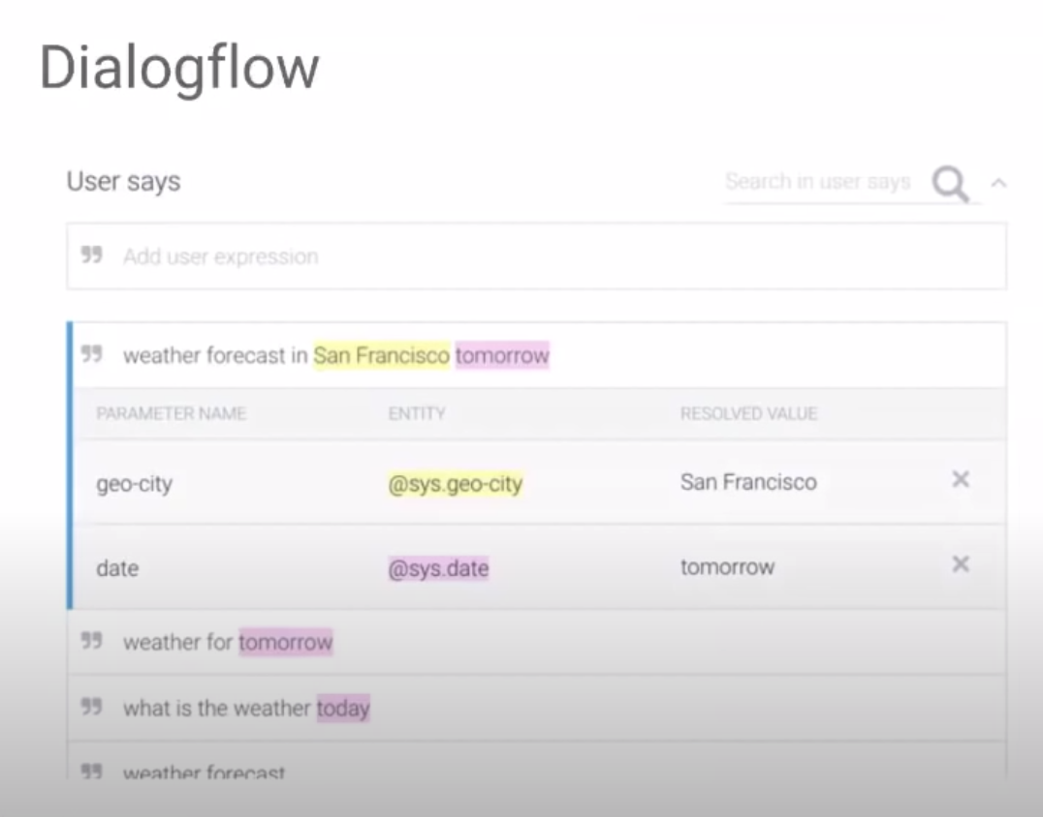
Expected output

Slide 10
Perspectives
Performances & generalization
Constituency parsing
Dependency parsing
Improve VP tree search
Test other similarity ranking approaches
Test different syntactical expressivity
Add intent detection stage (intent or not)
Time/space complexity of the pipeline

Slide 12
Supplementary

Slide 13
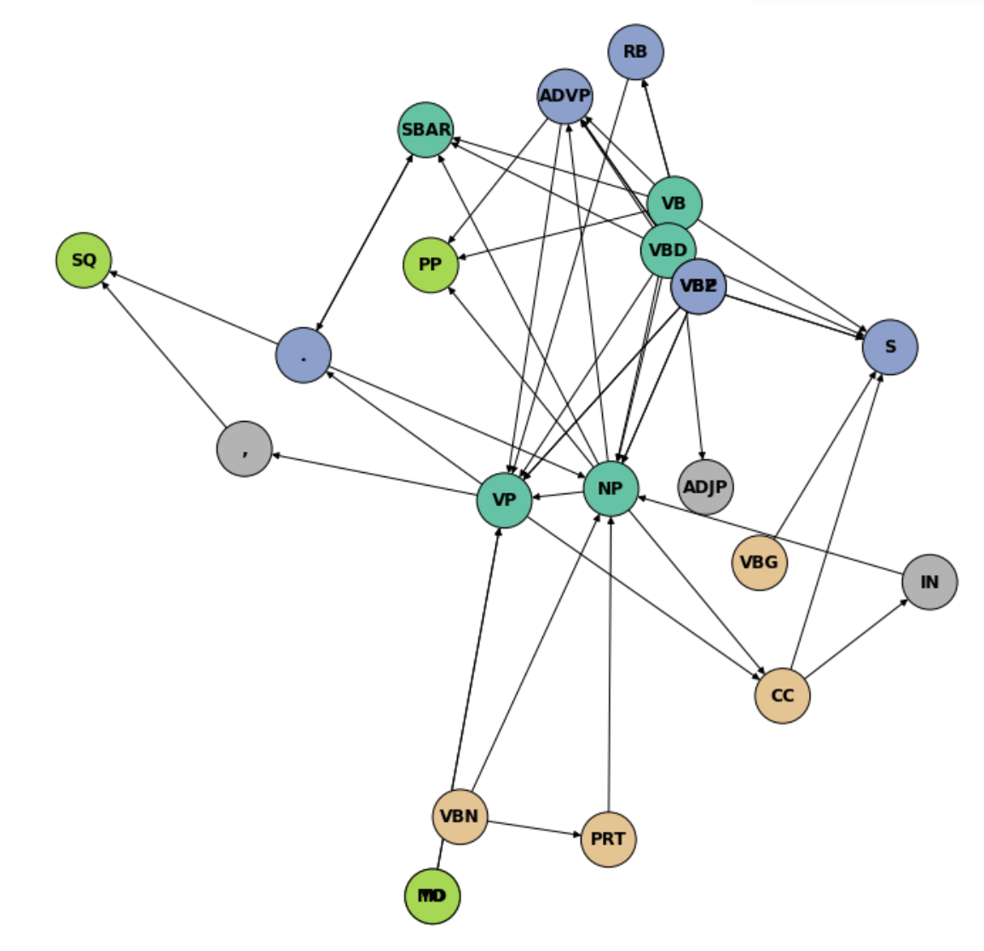
Node clustering
Louvain

Slide 14
Well-formed intent
Ill-formed intent
Signature of well → Subgraphs unique to “Well”?
Annotation

Slide 15
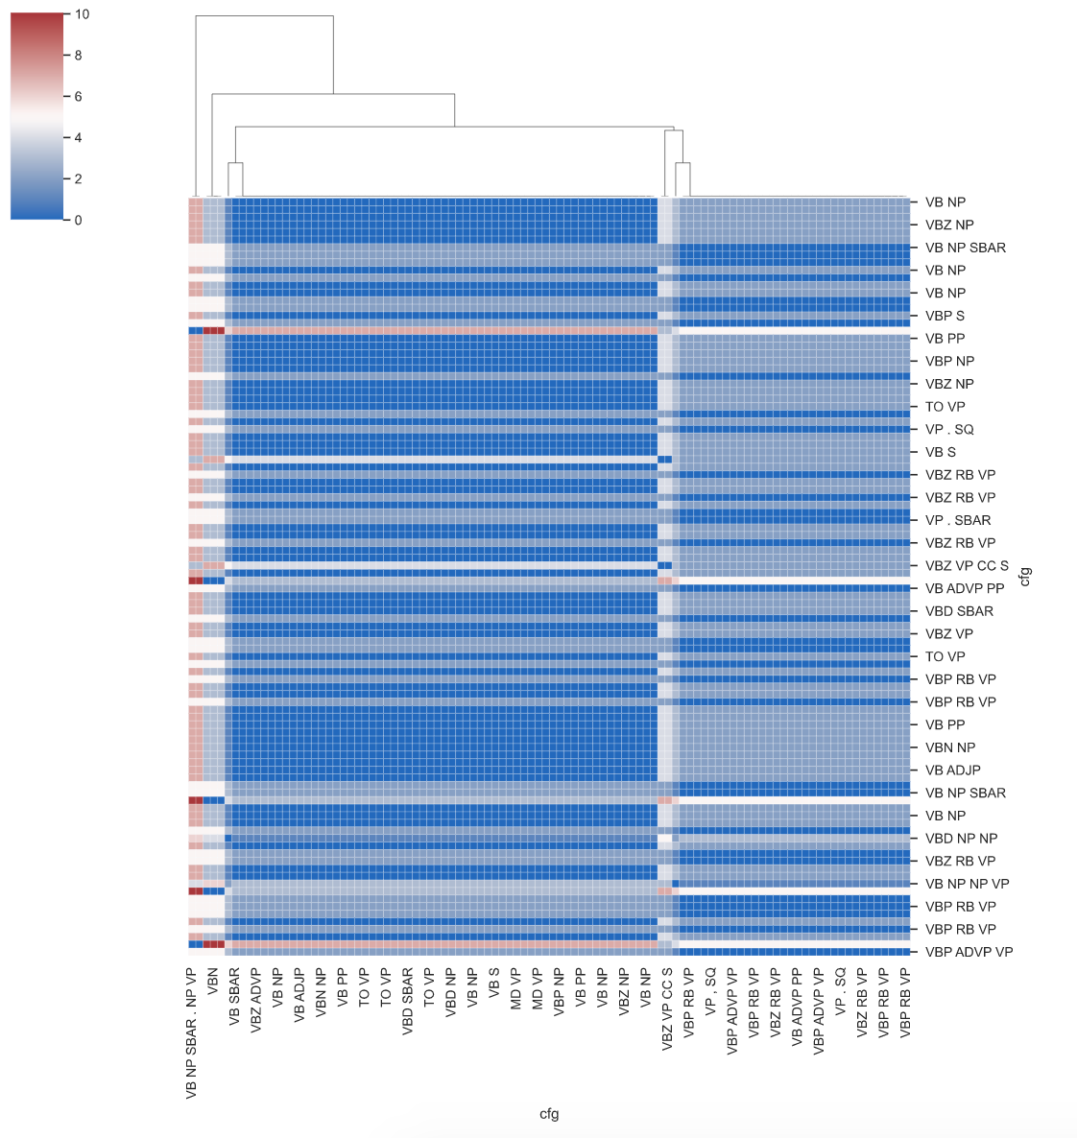
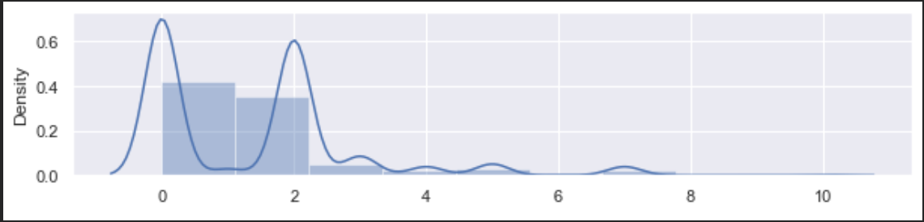
Graph edit distance
Uniform cost
Drop diagonal
distances

Slide 16
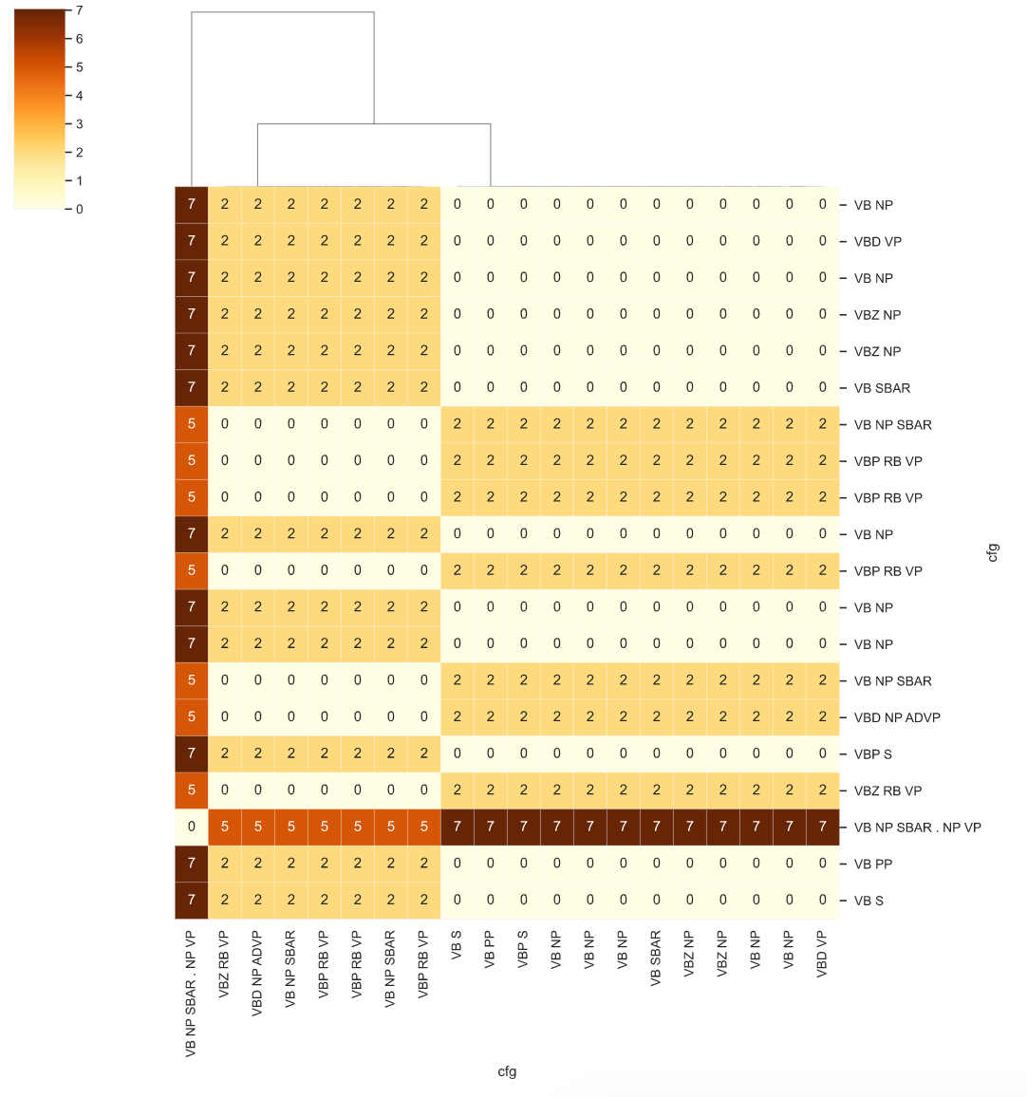
Graph edit distance
Uniform cost

Slide 17
Query ranking
Graph edit distance
(widely used)
Well-formed intents
Notes:
Graph edit distance: uniform edit cost

Slide 18
Not so great !
Why ? Test
isomorphism … not
what we look for
Query ranking
Graph edit distance
(widely used)
Well-formed intents
Notes:
Graph edit distance: uniform edit cost

Slide 19
Intent parsing
“Intent pattern”: VB -> direct Obj*
+ Entity slots
Dependency parsing
1. With dependency parser
2.Convert constituency tree to untyped dependency tree
w/o using a new dependency parser (faster, cheaper)(2)
Modifiers
When
Where
How
*dObj (1)

Slide 20
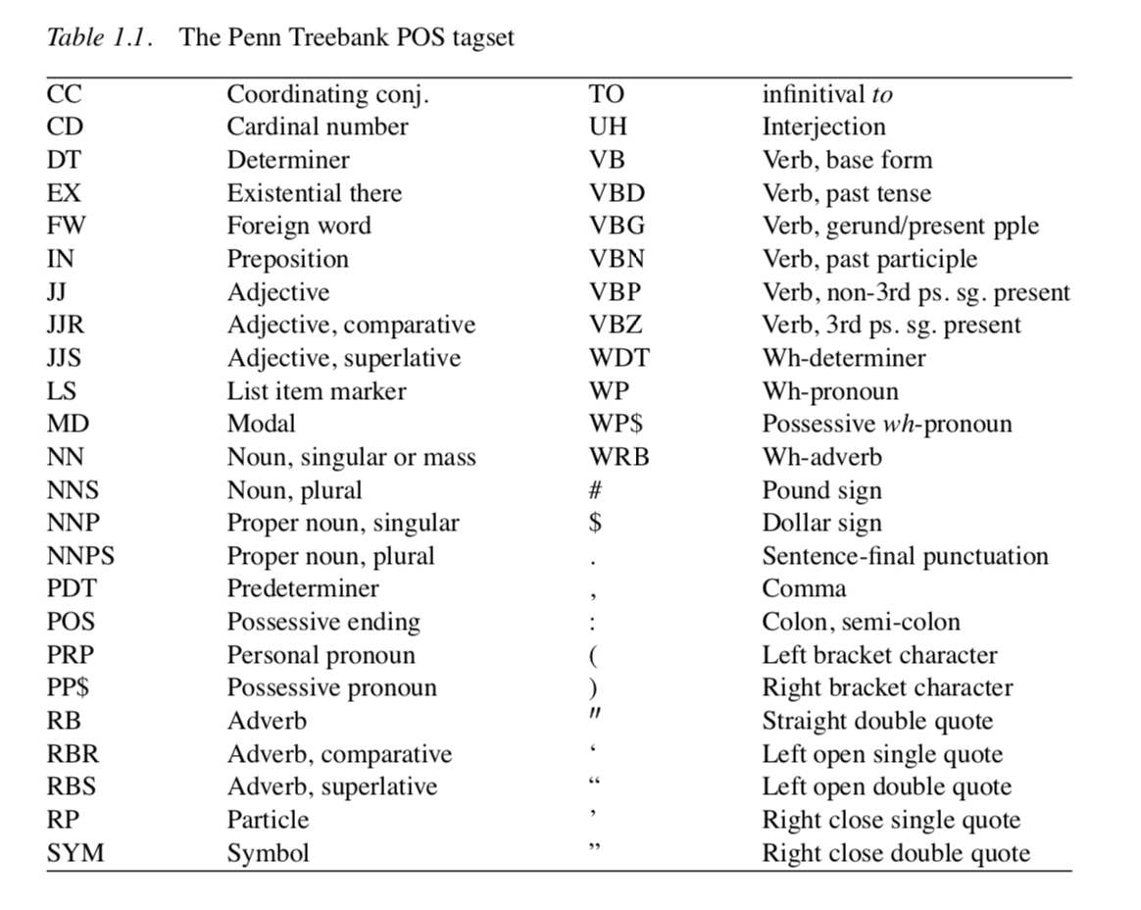
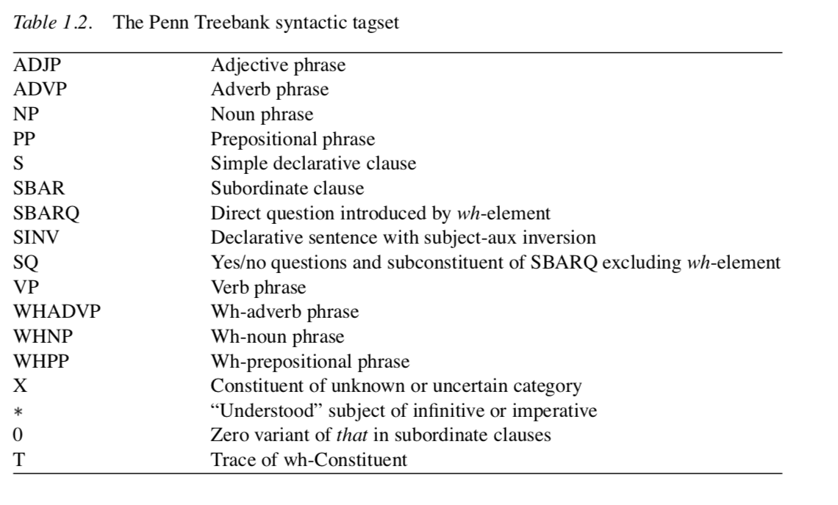
Constitutency grammar
Allennlp’s ELMo model representations are:
Contextual: The representation for each word depends on the entire context in which it is used.
Deep: The word representations combine all layers of a deep pre-trained neural network.
Character based: ELMo representations are purely character based, allowing the network to use morphological clues to form robust representations for out-of-vocabulary tokens unseen in training.
Peters, M. E., Neumann, M., Iyyer, M., Gardner, M., Clark, C., Lee, K., & Zettlemoyer, L. (2018). Deep contextualized word representations. arXiv preprint arXiv:1802.05365.
(1)
https://allennlp.org/elmo

Slide 21
References
(1) https://www.ling.upenn.edu/courses/Fall_2003/ling001/penn_treebank_pos.html

Slide 22
Tools
Joshi, V., Peters, M., & Hopkins, M. (2018). Extending a parser to distant domains using a few dozen partially annotated examples. arXiv preprint arXiv:1805.06556.
Constituency parser
tgrep
Spacy 2.2.4
dependency parser
NER
Similarity ranking
LCS similarity ranking
Graph edit distance

