Slide 1
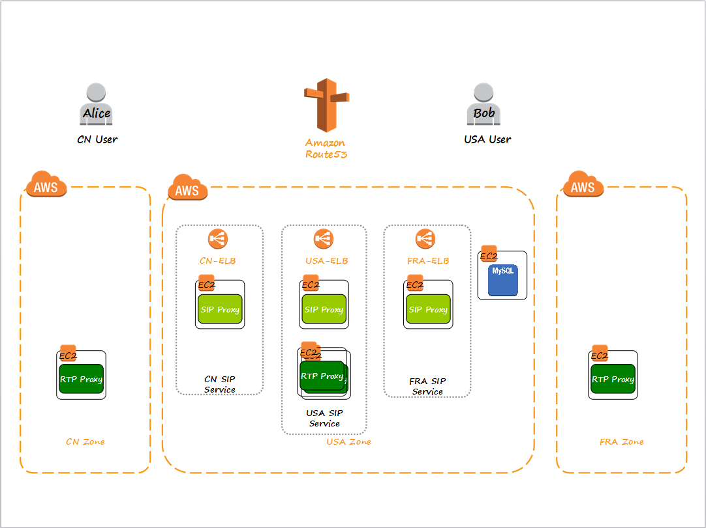


INVITE
Register to SIP Proxy
Register to SIP Proxy
DNS Query
Alice
ELB Addr Alice Used
Bob
Invite
Invite
Get Proxy Addr Bob registered
EC2
EC2
SIP Proxy
SIP Proxy
Modify SDP

Slide 2
200 OK
Alice
Bob
200 OK
200 OK
RTP
EC2
EC2
SIP Proxy
SIP Proxy
Modify SDP

