Slide 1
Modeling relaxation noise in transmon qubits
using the Lindblad master equation
Lan Hoang Mai
Department of Materials Science and Engineering
Department of Physics and Astronomy
University of Delaware

Slide 2

Closed quantum system

Slide 3

Open quantum system

Slide 4


Density matrix evolves with time

Slide 5

Simplifying the von-Neumann equation is essential
Environment in thermal equilibrium
Weakly coupled at t = 0
Born approximation
Markov approximation
Rotating wave approximation

Slide 6
Lindblad master equation is easier to solve

Slide 7

Transmon qubits decohere

Slide 8
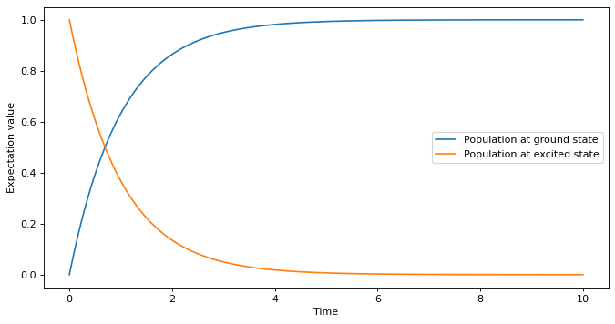
Transmon qubits decohere
Relaxation rate 0.1, free evolution

Slide 9
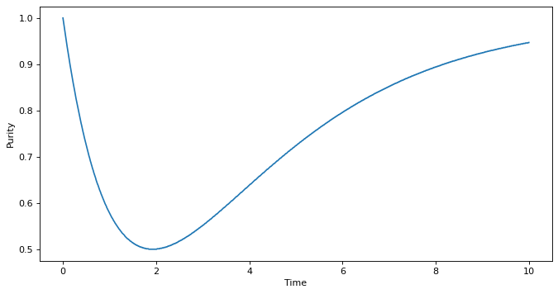
Transmon qubits decohere
Relaxation rate 0.1, free evolution

Slide 10
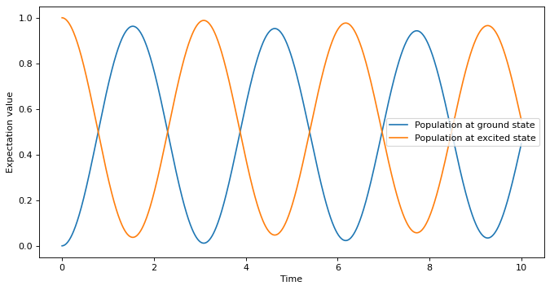
External driving mitigates decoherence
Relaxation rate 0.1, qubit frequency 0.05

Slide 11
External driving mitigates decoherence
Relaxation rate 0.1, qubit frequency 0.05, zero thermal photon

Slide 12
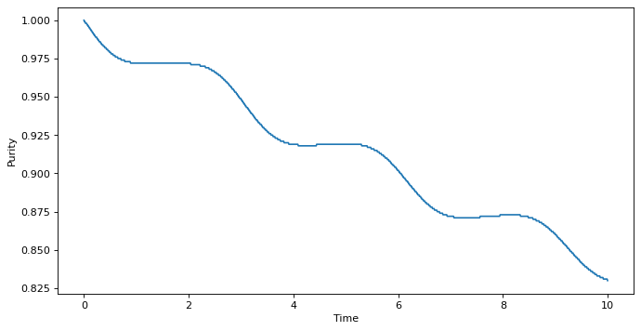
External driving mitigates decoherence
Relaxation rate 0.1, qubit frequency 0.05, zero thermal photon

Slide 13
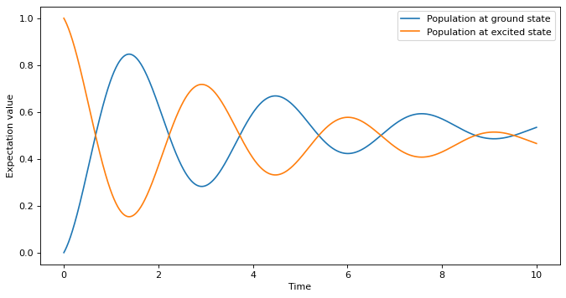
External driving mitigates decoherence
Relaxation rate 0.1, qubit frequency 0.05, five thermal photon

Slide 14
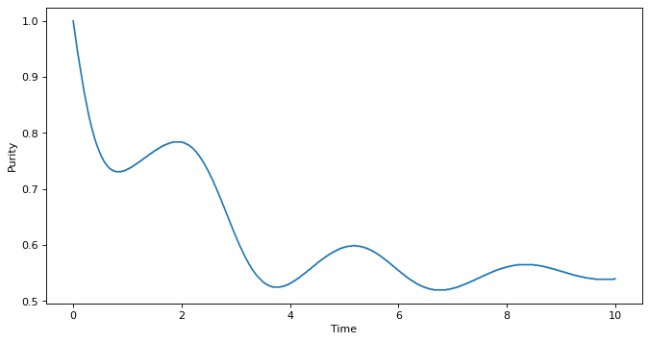
External driving mitigates decoherence
Relaxation rate 0.1, qubit frequency 0.05, five thermal photon

Slide 15
Reference
A. Blais et al., "Circuit quantum electrodynamics," Rev. Mod. Phys. 93, 025005, DOI: 10.1103/RevModPhys.93.025005
D. Manzano, "A short introduction to the Lindblad master equation," AIP Advances 10, 025106 (2020), DOI: 10.1063/1.5115323
S. Maniscalco, "Open quantum systems: Opportunities & challenges," Kavli Institute for Theoretical Physics, https://www.youtube.com/watch?v=BVuhHn3-PAM
T. Osborne, "Theory of quantum noise and decoherence, Lecture 7", University of Hannover, https://www.youtube.com/watch?v=LTj5UL89-ro&list=PLDfPUNusx1EotNvZr1mbu3-0QThQYilFD&index=7
J. R. Johansson, P. D. Nation, and F. Nori, "QuTiP 2: A Python framework for the dynamics of open quantum systems" Comp. Phys. Comm. 184, 1234 (2013), DOI: 10.1016/j.cpc.2012.11.019
J. R. Johansson, P. D. Nation, and F. Nori, "QuTiP: An open-source Python framework for the dynamics of open quantum systems," Comp. Phys. Comm. 183, 1760–1772 (2012), DOI: 10.1016/j.cpc.2012.02.021

