Slide 1
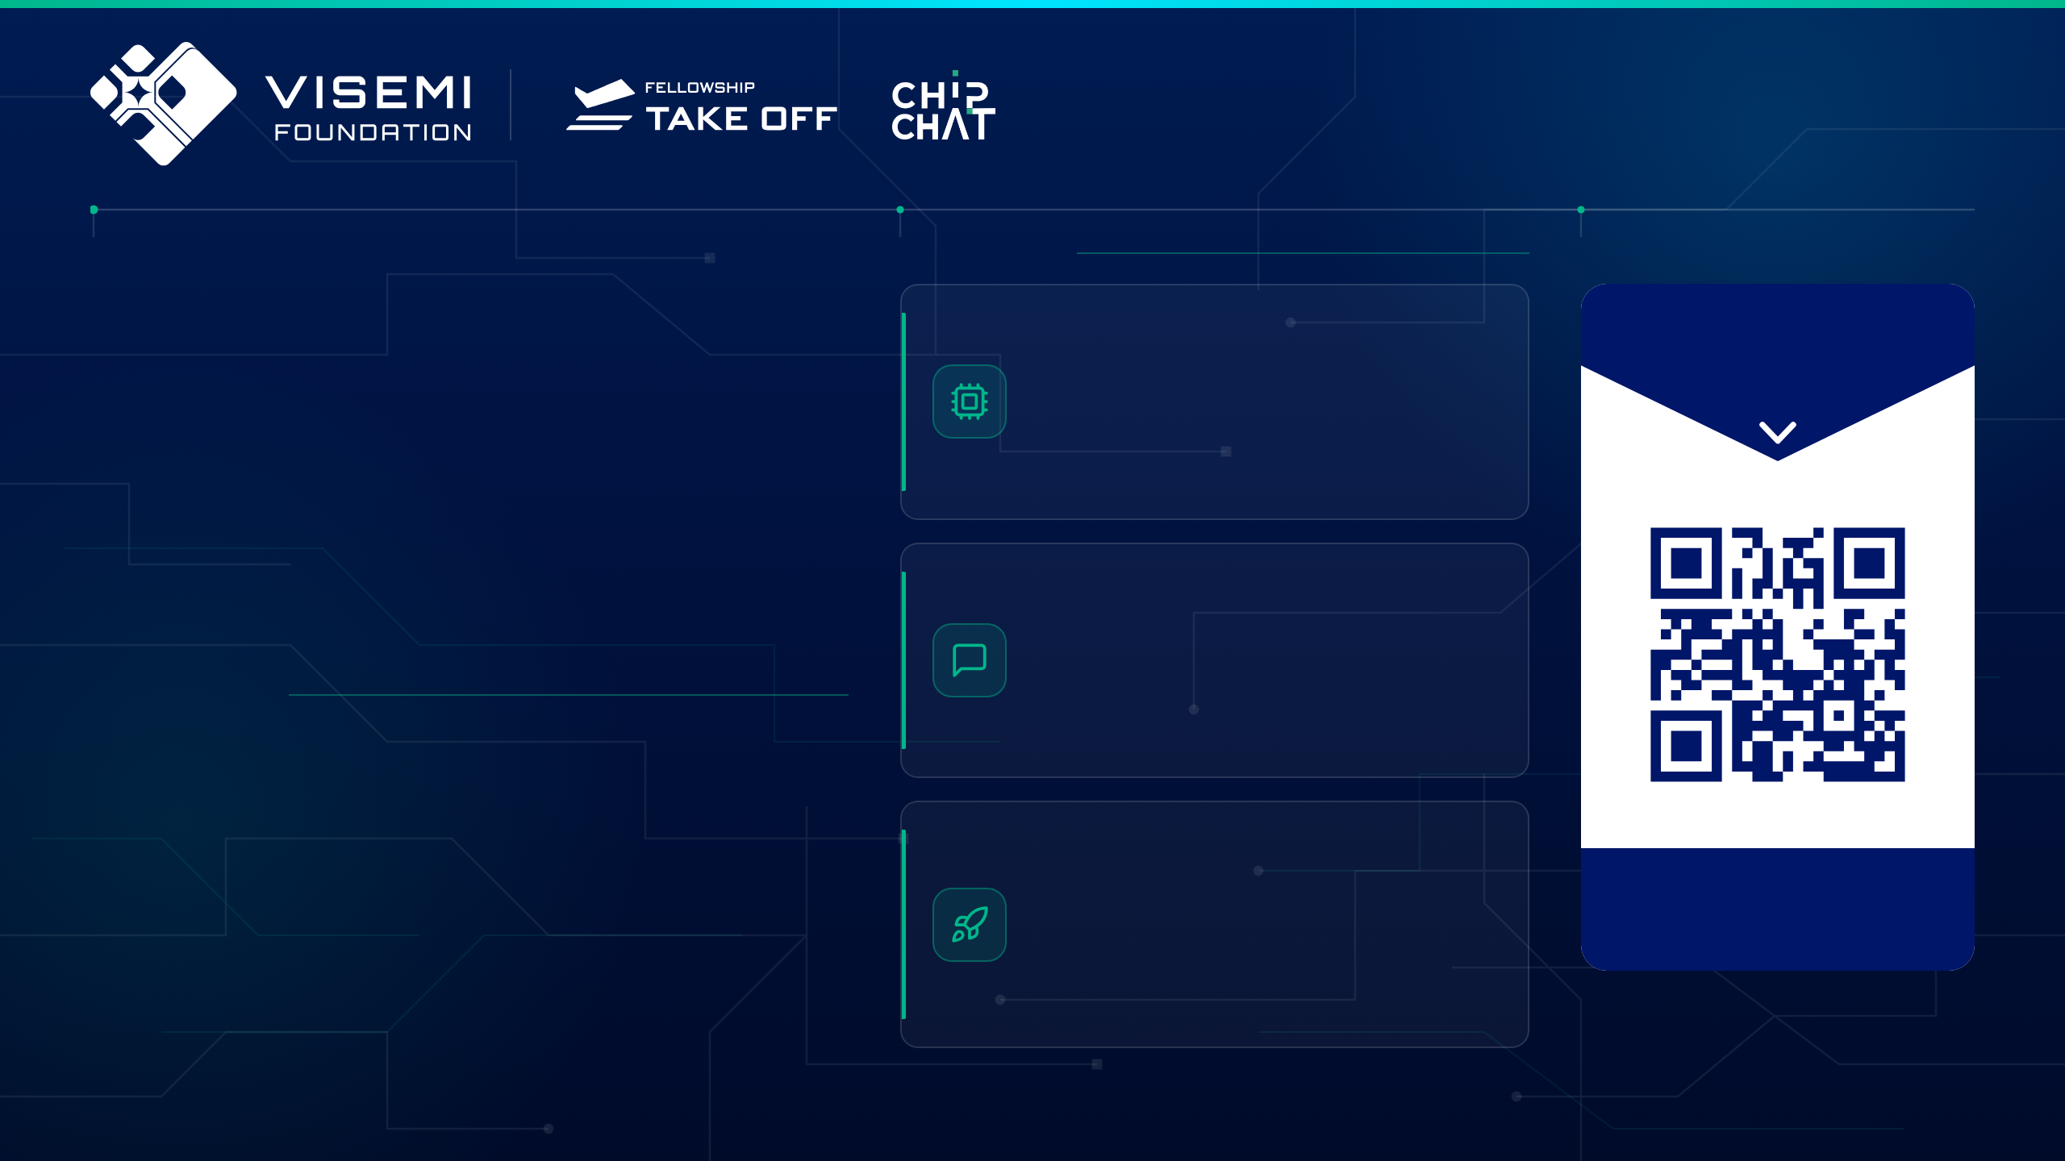
A U.S. 501(C)(3) NONPROFIT
SILICON VALLEY, CALIFORNIA
UNLOCK
WHAT WE DO
VIETNAM’S TALENTS
SCAN
Demystifying Semiconductors
TO LEARN MORE ABOUT US
IN SEMICONDUCTORS
The first in-depth semiconductor webinar series delivered entirely in Vietnamese
VISEMI Foundation connects Vietnamese talent with the semiconductor industry through education, mentorship, and global industry collaboration.
VISEMI Chip Chat
Video podcast carrying insider stories from global Vietnamese semiconductor experts
WHY WE EXIST
Chip demand is surging.
Skilled talent is not.
Cất Cánh (Takeoff) Fellowship
Industry needs and educational output have drifted apart. We close that distance with training built to industry requirements, so participants are ready to work in this critical sector.
Six-month accelerator and multi-tier scholarship launching Vietnamese STEM students into top global MS and PhD programs, plus Cất Cánh Pathway, its free bilingual public workshops on study destinations and application skills
visemi.org

