Slide 1


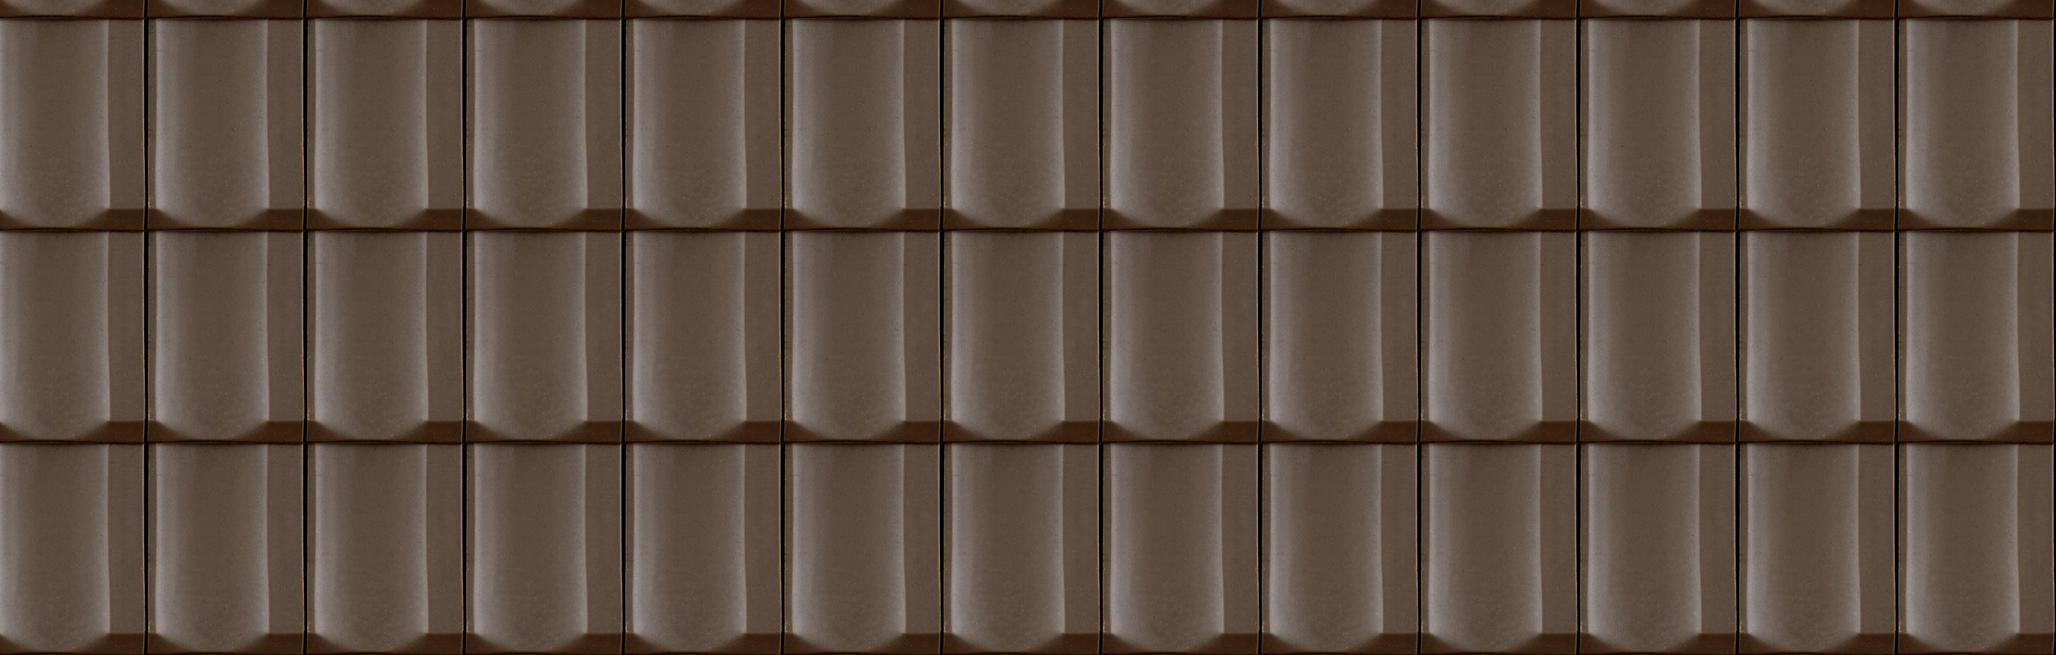

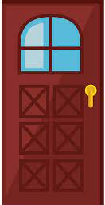

BUILD YOUR HOUSE
One stair
RED WALL
WHITE WALL
ROOF
CHANRY
DOOR
WINDOWS
OWNER BOARD
TREE

Slide 2
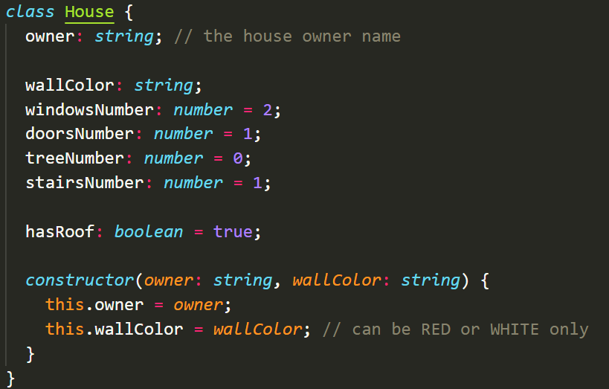
THE CLASS MODEL

Slide 3
THE OBJECT
let houseRonan = new House("ronan", "RED");
houseRonan.windowsNumber = 1;
THE RESULT
hasRoof is true
The owner is RONAN
Only 1 stair
1 DOOR by default
RONAN
1 window

Slide 4
THE OBJECT
let houseChanry = new House(“CHANRY", “WHITE");
houseChanry.stairNumber = 2;
houseChanry.windowsNumber = 5;
houseChanry. treeNumber = 2;
houseChanry.hasRoof = false;
THE RESULT
CHANRY

Slide 5
THE OBJECT
let houseKunthy = new House(“KUNTHY", “RED");
houseKunthy.stairsNumber = 2;
houseKunthy.windowsNumber = 3;
houseKunthy.doorsNumber = 2;
houseKunthy.treesNumber = 3;
houseKunthy.hasRoof = true;
THE RESULT
KUNTHY

Slide 6
THE OBJECT
<WRITE THE CODE TO BUILD THIS HOUSE>
let houseChanthea = new House(“CHANTEA", “WHITE");
houseChanthea.treesNumber = 5;
houseKunthy.doorsNumber = 2;
houseKunthy.windowsNumber = 0;
THE RESULT
CHANTHEA

