Slide 1

















Data & Advantages
Phoenix R., Yashi J., Jeilani D.

Slide 2
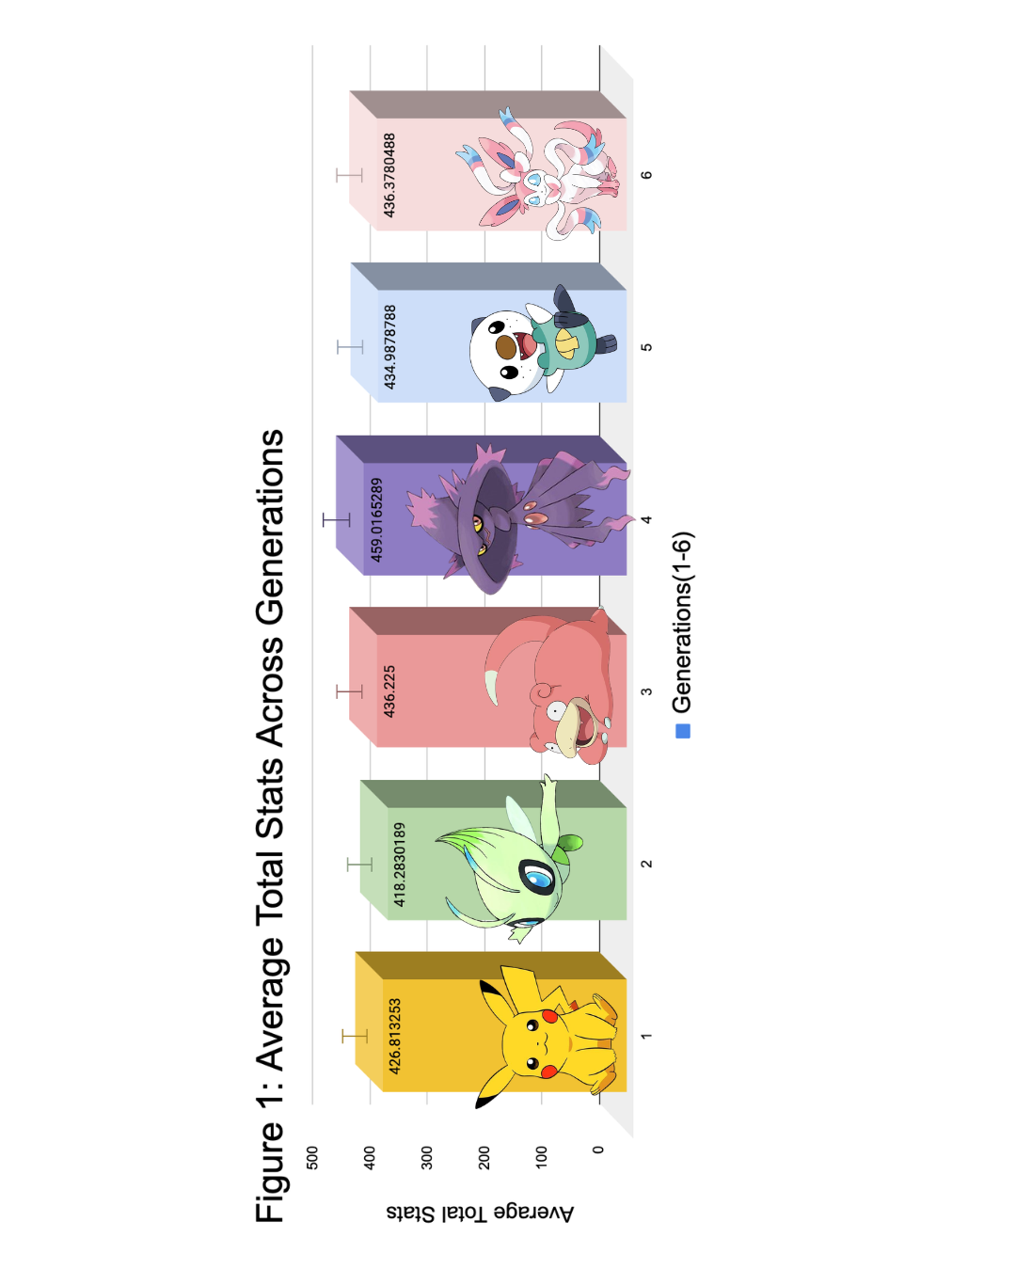

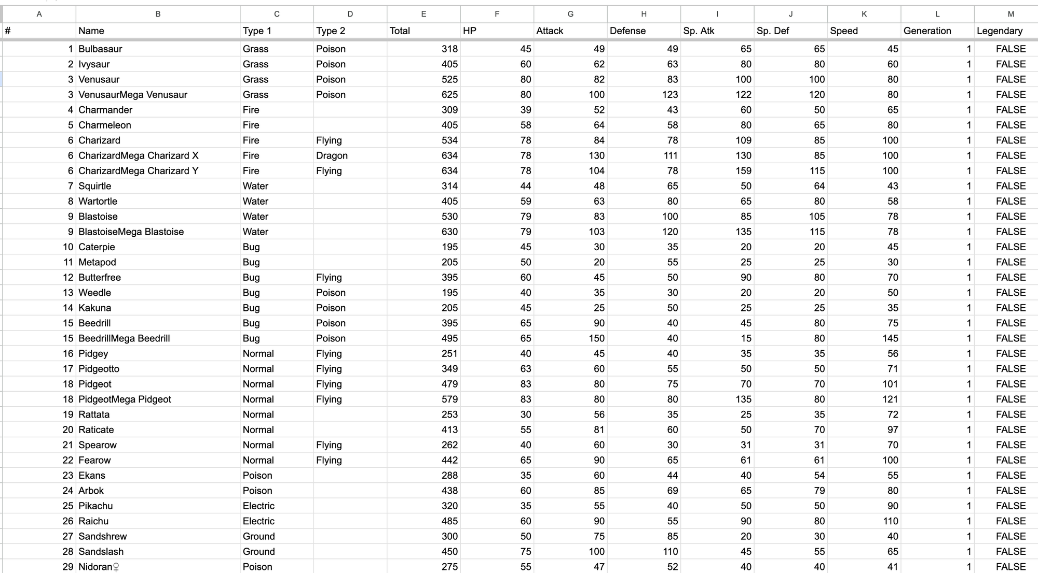

Question 1
What is the relationship between a Pokémon's generation and total stats? Are newer generations stronger than older ones, or has the game stayed balanced over time?
High levels of rainfall, warm temperatures,
and dense vegetation.
Canopy layer: towering trees, vines, epiphytes.
Understory layer: smaller trees, shrubs, ferns.
Forest floor: decomposing organic matter that provides fertile soil for new growth.
Data found on Kaggle.com!

Slide 3

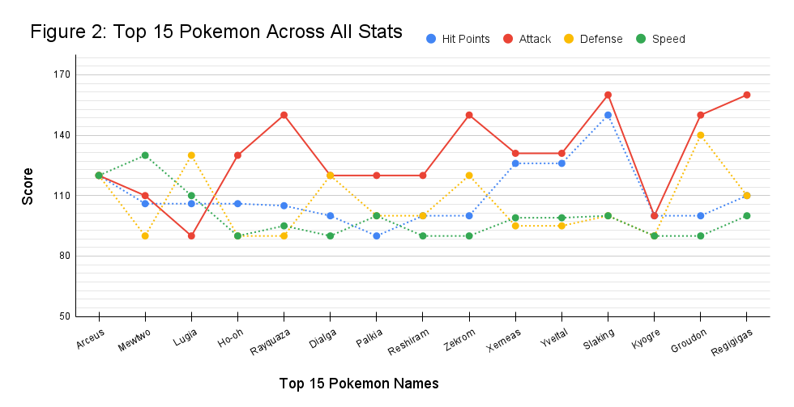
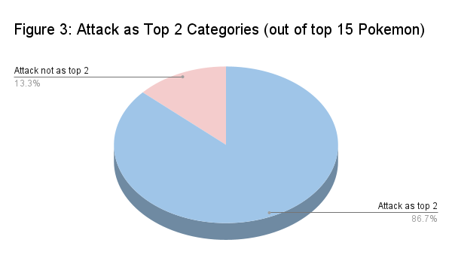


Question 2
Are Pokémon with the highest total stats always the ones with the highest attack stat? Or do Pokémon tend to be balanced across all stats?
Notes:
24

Slide 4

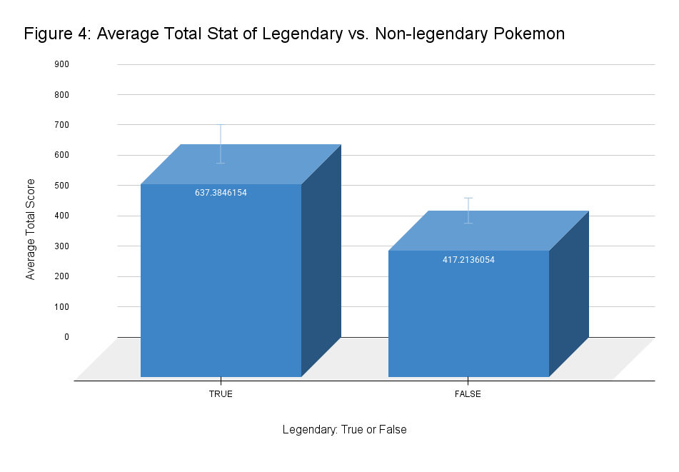



Question 3
Are legendary Pokémon actually superior to non-legendary Pokémon across all stats, or do they only dominate in certain areas? Where exactly does the "legendary advantage" show up?
Covers more than 70% of the Earth's surface, making it the largest ecosystem on our planet.
Some areas experiencing warm tropical waters and others enduring freezing temperatures in polar regions.

Slide 5
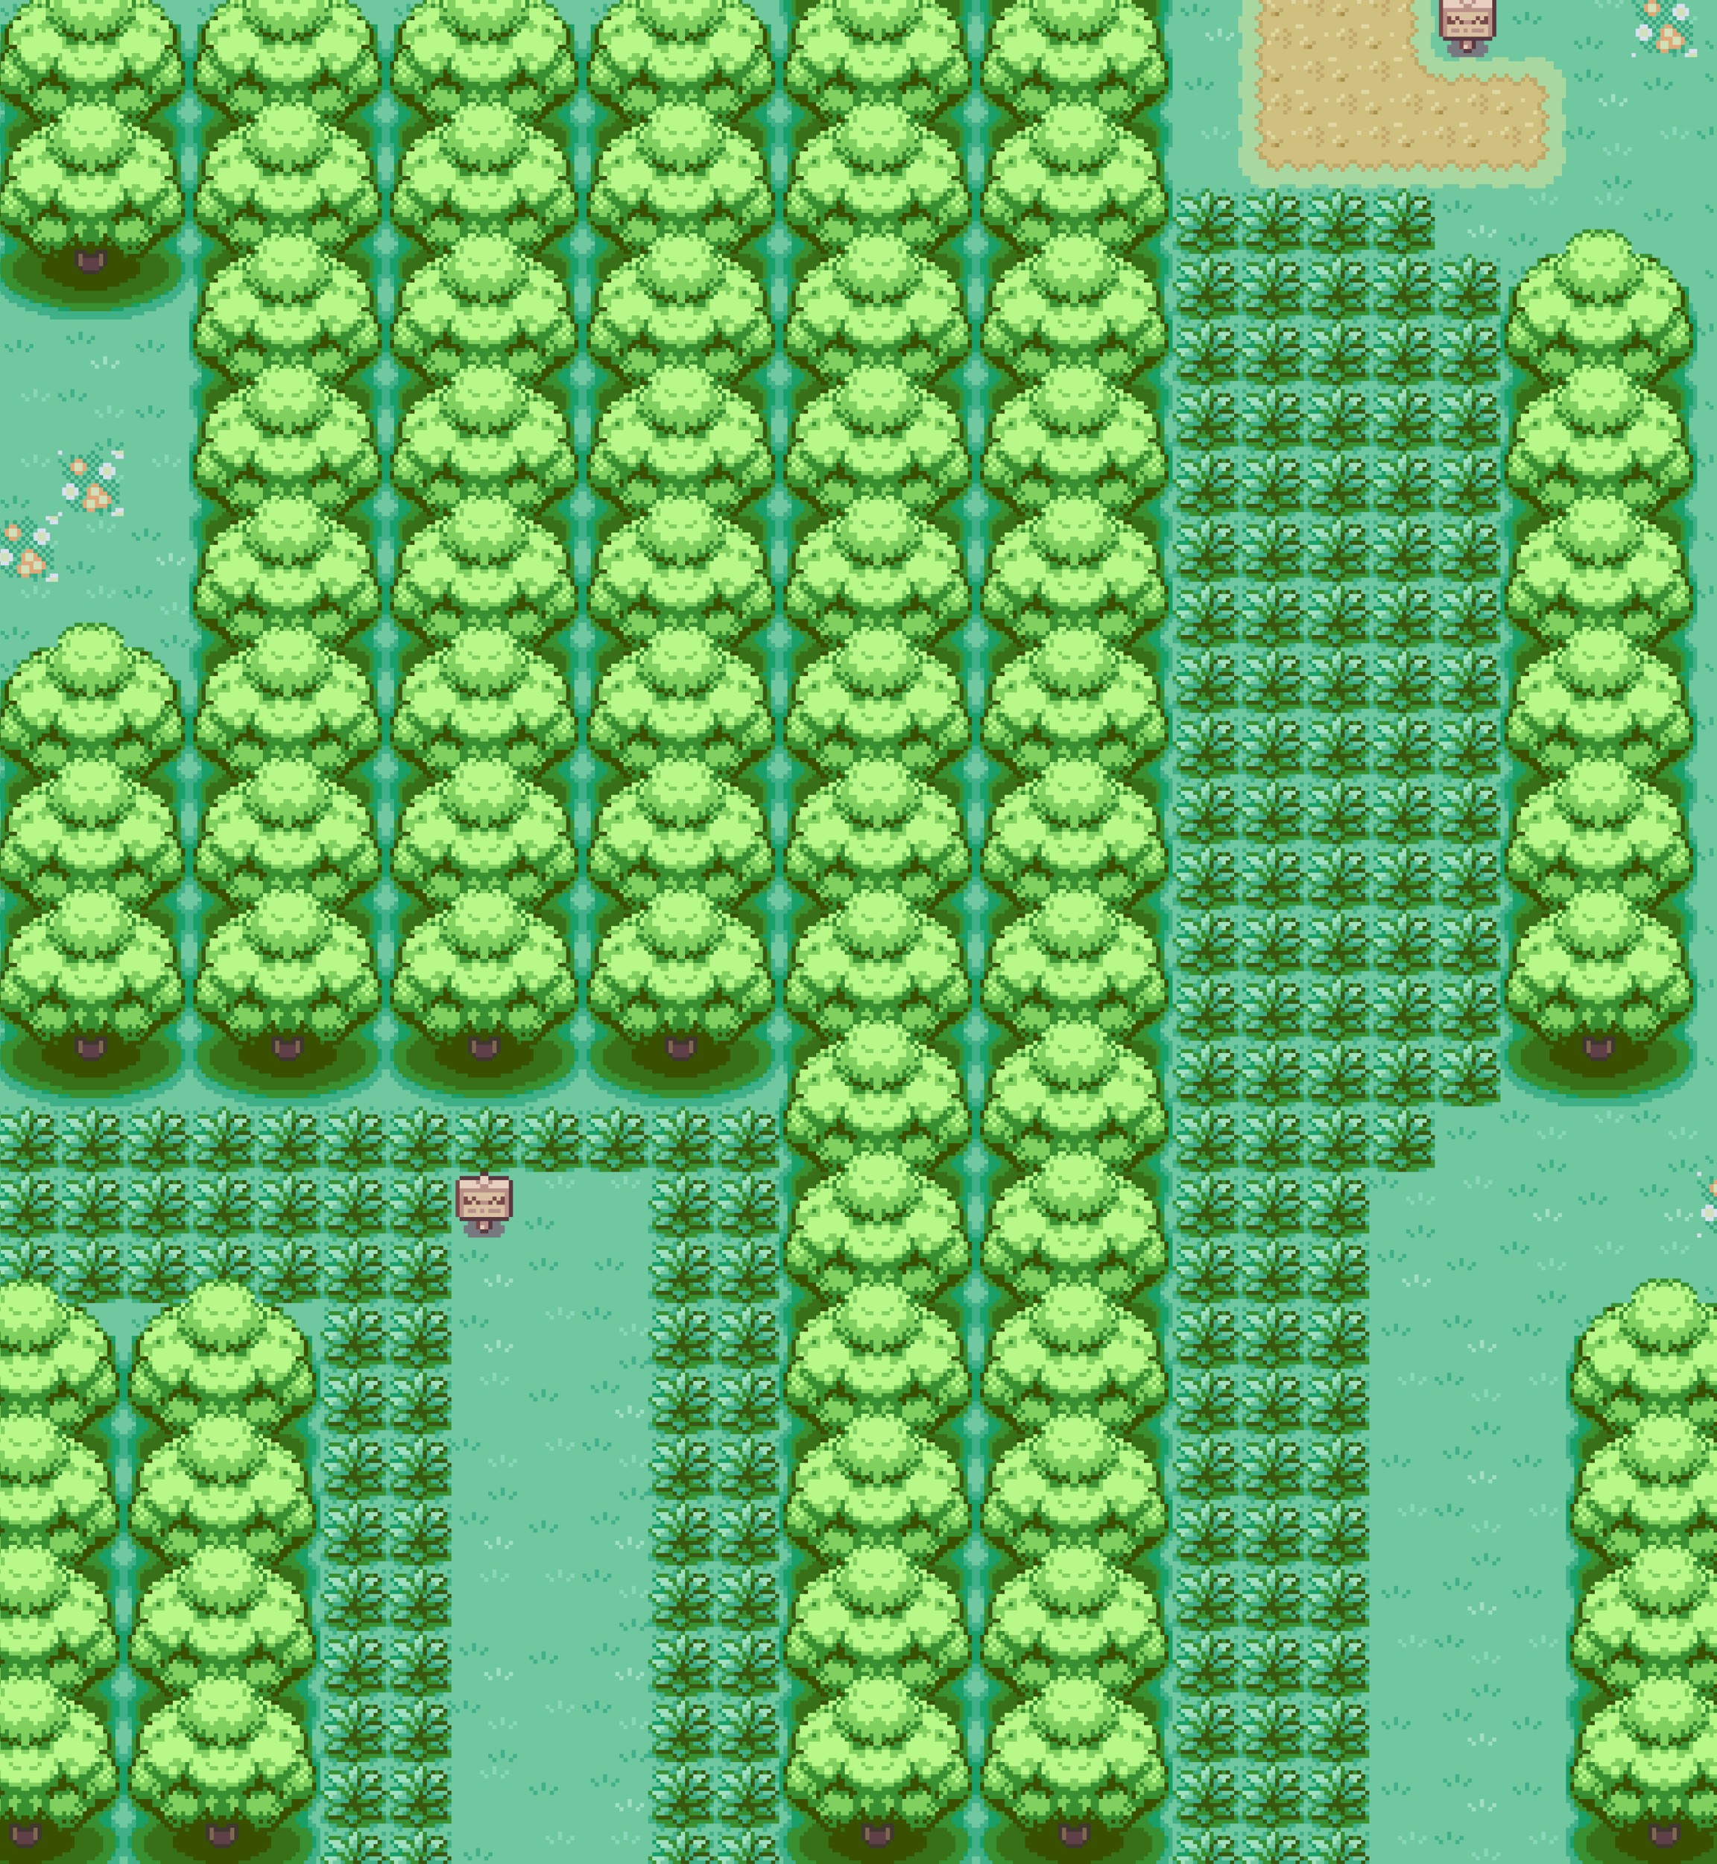
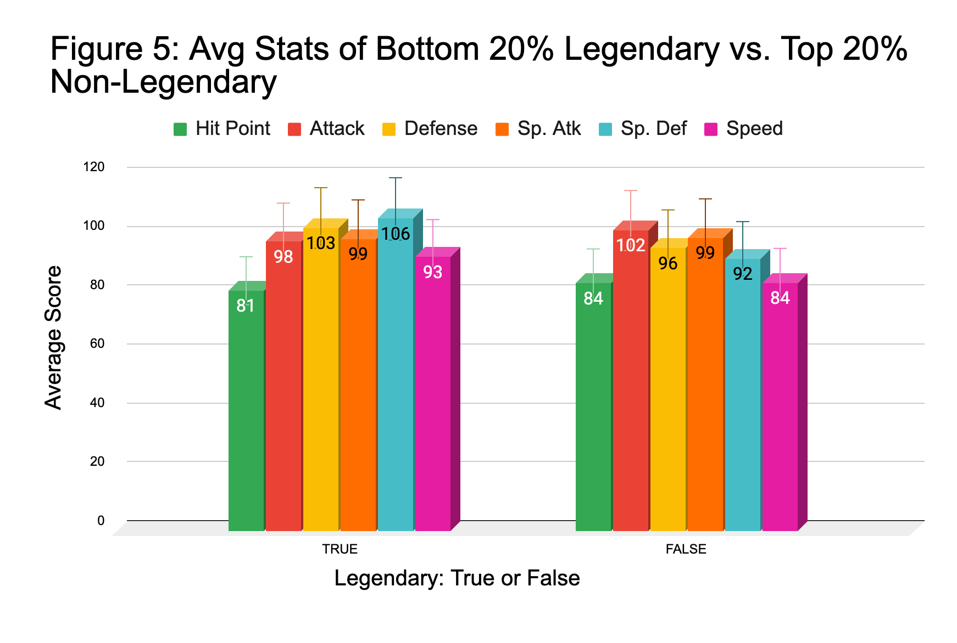
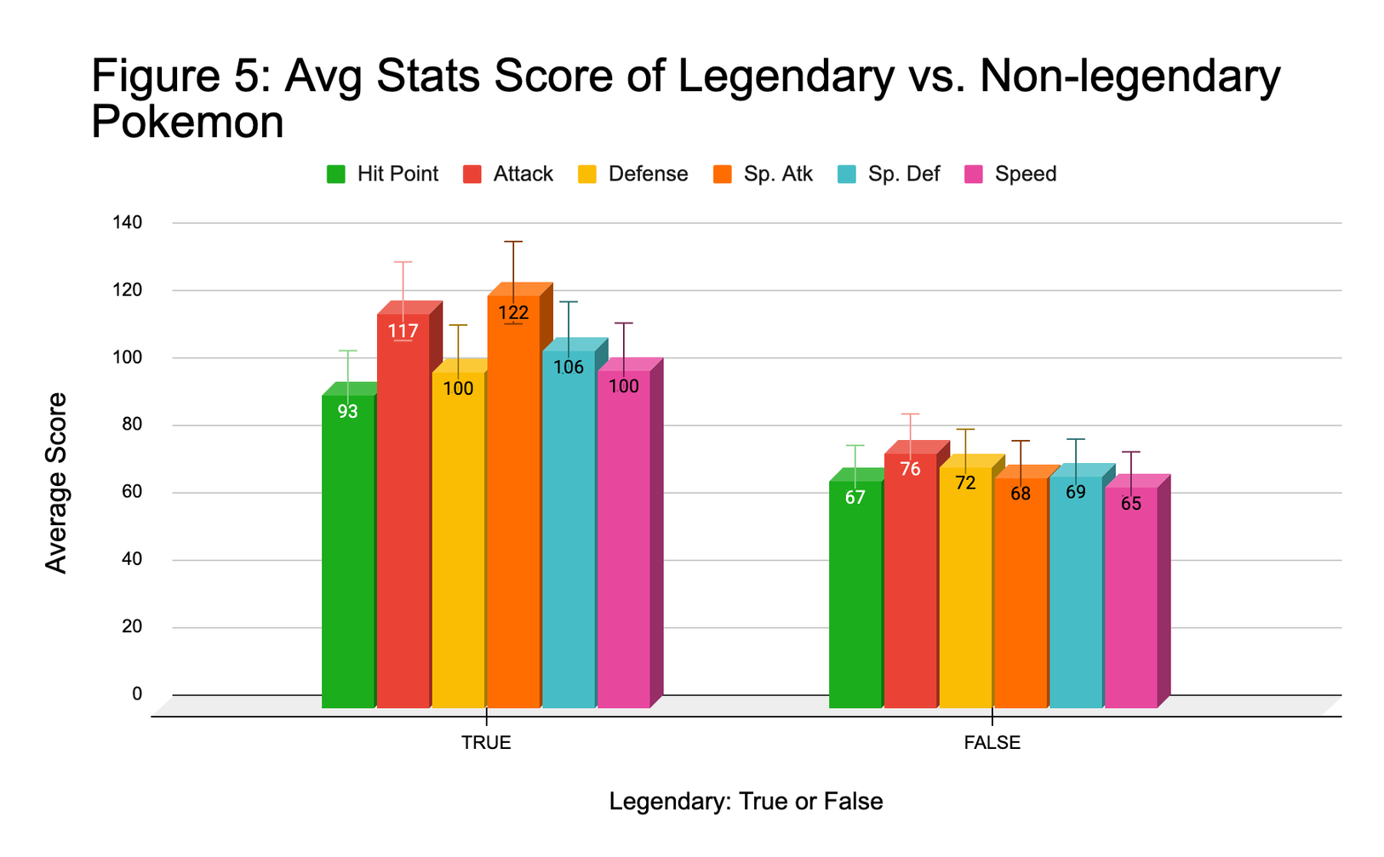
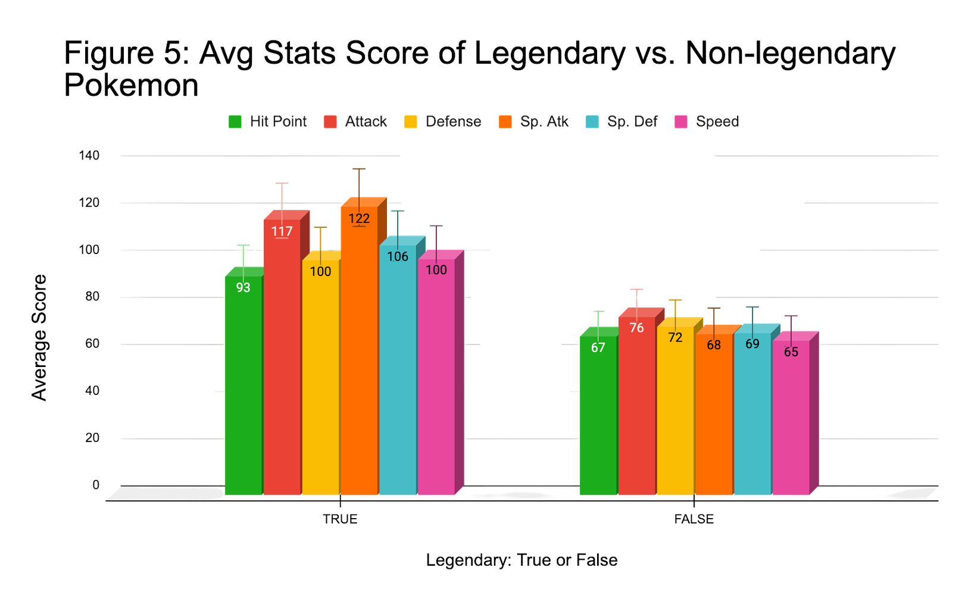


Question 3 cont.

Slide 6








Conclusion
& Further Research
Generations are balanced over time
Pokemon with the highest attack stat do tend to have a higher stat overall
There is a difference between the average total stat of a legendary Pokemon and non-legendary Pokemon, however the differences are not always vast
Data Link: https://www.kaggle.com/datasets/abcsds/pokemon

Slide 7





Thank You!
Questions?

