Slide 1

Networking for Entrepreneurs

Slide 2

What does networking mean to you?
Networking is a buzzword that is thrown around a lot in the business world, but what does it really mean for entrepreneurs? - Discuss

Slide 3

What is networking?
The act of building relationships and connections with people who can help you achieve your goals.
Whether it's finding customers, partners, investors, or mentors, networking is a crucial part of building a successful business.

Slide 4

Networking for Entrepreneurs
For entrepreneurs means recognizing the value of building relationships and connections with others in your industry.
Creating a network that can support you and your business in various ways, and help you achieve your goals.

Slide 5

Prepare
Know your worth
Business card
Elevator pitch
Context sensitive
Business etiquette
Always arrive on time
Dress appropriately
Pay attention to names
Introduce others
Maintain eye contact
Give clues that you are paying attention
Don't interrupt
Dining etiquette
E mail etiquette
Telephone etiquette
Online meeting etiquette

Slide 6
How do you build a strong professional network?
Be intentional about who you connect with. Look for people who have skills, knowledge, and connections that you admire. Attend networking events, join industry groups and participate in online communities to meet new people.
When you meet someone new, follow up with them. Send a quick email or connect with them on LinkedIn. Key is keep in touch over time.
Be a valuable resource to others. Offer to help others and be generous with your time and knowledge. When you help others, they are likely to remember you and be there to support you

Slide 7

Benefits of networking for Entrepreneurs
Finding new opportunities
Gaining valuable insights
Building relationships with industry leaders and mentors
Staying current with industry trends
Improving your personal brand

Slide 8

Finding the right networking events
Identify your goals
Research your options
Ask your friends for recommendations
Attend regularly
Be selective

Slide 9
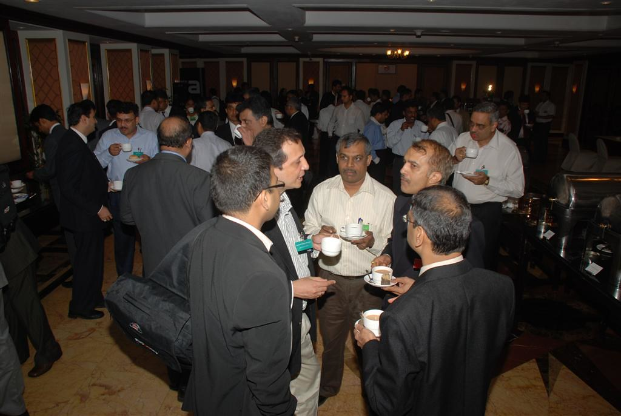
Making meaningful connections at networking events
Be yourself
Only one item/ drink or plate in hand
Listen – more than talking
Follow up after the event
Offer value to those you meet
Be memorable- Bring business cards, have a unique elevator pitch, or come up with a creative way to leave a lasting impression.

Slide 10

Leverage your network to grow your business
Ask for introductions
Share your goals - Let your network know what you're looking for.
Offer to help
Stay in touch
Be a resource

Slide 11

Building relationships with industry leaders and mentors
Identify potential mentors
Reach out
Be prepared- come prepared with questions and be ready to listen. Show that you are interested in their experience and that you value their advice.
Offer value to your mentors
Stay in touch

Slide 12

Networking strategies for introverted entrepreneurs
Find the right events- smaller and more intimate
Prepare in advance
Focus on quality , rather than quantity – focus on a few meaningful connections
Ask open ended questions
Follow up

Slide 13
Role of technology in modern networking
Online networking: LinkedIn, Twitter, and Facebook allow entrepreneurs to connect with others from all over the world..
Virtual events: With the rise of virtual events, entrepreneurs can attend networking events from the comfort of their own homes
Automated tools: Email marketing, WhatsApp groups, FB groups, make it easier to keep track of contacts and follow up with others.
Artificial intelligence : AI is being used to match entrepreneurs with others who are likely to be a good fit.

Slide 14
Staying connected and maintaining your network
Keep in touch: Regularly reach out to your network to see how they're doing. email, phone calls, or a quick message on social media.
Offer help: When you can, offer to help others in your network. This can be as simple as making an introduction or sharing a resource.
Attend events: Attend events and conferences related to your industry.
Give back: When you achieve success, make sure to give back to your network. This can be through mentorship, offering advice, or even just being a sounding board.
Stay organized: Keep track of your contacts and their information. Use a CRM or other tool to help you stay organized and make the most of your network.

Slide 15

Elevator pitch
A brief (think 30 seconds!) way of introducing yourself, getting across a key point or two, and making a connection with someone. Eg:
Who do you work with?
What service do you provide?
How do you provide that service?
What is your unique selling point (USP) (what makes you different to others in the same field)
What problem are you solving for customers?
Call to action

Slide 16
Entrepreneur connect
Each entrepreneur goes around room, connecting with another
Introductions to each other – shake hands , exchange visiting cards, eye contact
1 minute elevator pitch by person
Questions and discussion with partner
Good bye
Connect with another person

