Slide 1

Data Analysis Essentials – Project Review 1
VEHICLE FUEL ANALYSIS SYSTEM
Problem Statement • Dataset • Preprocessing • Initial Data Output
UNDER THE GUIDANCE OF K.VYDEHI
TEAM MEMBERS
Lanka Bala Tripura Sundari — 25B11CS513
Podugu Anusri — 25B11CS760
Pilli Gnaneswari — 25B11CS756
Akula Hansika — 25B11CS029

Slide 2

DOMAIN & PROJECT OVERVIEW
Automotive Domain & Data Analytics
VEHICLE
• Vehicles differ in engine specifications, dimensions, fuel type, transmission and efficiency.
• Fuel efficiency is influenced by factors such as engine size, cylinders, vehicle dimensions and fuel type.
• Data analytics can be used to compare vehicle specifications and identify fuel-efficiency patterns.
• Our project analyzes Cars India data to understand vehicle fuel efficiency and support data-driven decisions.
FUEL • ENGINE • EFFICIENCY
REAL-WORLD FUEL DATA
Analyze → Compare → Understand
Modern vehicles display fuel-economy information, making fuel efficiency a practical data-analysis problem.
ADITYA UNIVERSITY • DATA ANALYSIS ESSENTIALS – PROJECT REVIEW 1

Slide 3
PROBLEM STATEMENT
Vehicle owners and fleet managers need a clear way to understand fuel efficiency and compare vehicles. Manual comparison of many vehicle specifications can be time-consuming and may not reveal useful relationships.
OUR PROJECT ADDRESSES THIS BY:
*Manual analysis of vehicle fuel data makes it difficult to track fuel consumption and vehicle efficiency.
*Identifying fuel-consumption trends and comparing vehicle performance is challenging without proper data analysis.
*A data-driven system is needed to analyse and visualise fuel data, identify unusual usage, and provide meaningful insights.
ADITYA UNIVERSITY • DATA ANALYSIS ESSENTIALS – PROJECT REVIEW 1

Slide 4
OBJECTIVES
→
Analyze
Analyze vehicle specifications and fuel-efficiency values.
→
Compare
Compare vehicles using fuel type, engine and efficiency attributes.
→
Perform
Perform data-quality and missing-value analysis.
→
Study
Study relationships between vehicle characteristics and fuel efficiency.
→
Visualise
Present findings through meaningful charts and comparisons.
ADITYA UNIVERSITY • DATA ANALYSIS ESSENTIALS – PROJECT REVIEW 1

Slide 5
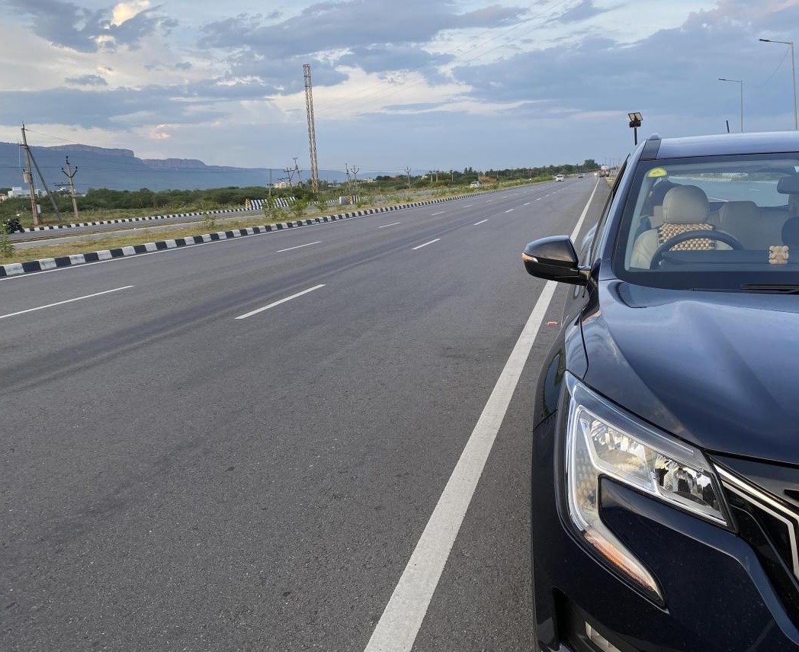
REAL WORLD EXAMPLE AND IMPORTANCE
REAL-WORLD SCENARIO
WHY IS OUR PROJECT IMPORTANT?
USER
Needs a vehicle for daily travel
VEHICLE FUEL
ANALYSIS
ANALYZE
COMPARE
↓
Understand vehicle characteristics
Compare different vehicles
MANY CARS
Different fuel, engine, size and efficiency
↓
Fuel
Efficiency
COMPARISON
Which vehicle gives better fuel efficiency?
EFFICIENCY
DECISIONS
Study fuel-efficiency patterns
Support informed vehicle analysis
↓
INDIAN ROAD CONTEXT
Fuel • Engine • Performance
OUR SYSTEM
Analyze → Compare → Identify patterns
Vehicle type, fuel, engine and driving conditions all affect the way efficiency is understood.
↓
DATA-DRIVEN CHOICE
Use evidence from the dataset
ADITYA UNIVERSITY • DATA ANALYSIS ESSENTIALS – PROJECT REVIEW 1

Slide 6
DATASET SELECTION & SOURCE
SELECTED DATASET
DATA PIPELINE
Cars India Dataset
CSV format • 156 records • 24 attributes
›
›
›
CSV DATA
PYTHON
PANDAS
ANALYSIS
WHY DID WE SELECT THIS DATASET?
The supplied Cars India CSV is loaded into a Pandas DataFrame for inspection, cleaning and analysis.
• Directly related to the vehicle and fuel-efficiency project.
• Contains vehicle, engine, fuel, efficiency and safety-related attributes.
• Contains both numerical and categorical data.
• Suitable for data cleaning, preprocessing, comparison and visualization.
• Provides a practical basis for studying fuel-efficiency patterns.
156
24
CSV
records
columns
format
ADITYA UNIVERSITY • DATA ANALYSIS ESSENTIALS – PROJECT REVIEW 1

Slide 7

DATASET UNDERSTANDING
Cars India Dataset — attributes and their meaning
# | ATTRIBUTE | DESCRIPTION
1 | Model | Car model name
2 | Maker | Vehicle manufacturer
3 | Type | Vehicle/body type
4 | Seats | Number of seats
5 | Displacement | Engine displacement
6 | Length | Vehicle length
7 | Width | Vehicle width
8 | Height | Vehicle height
9 | Wheelbase | Distance between front and rear axles
10 | No_of_Cylinders | Number of engine cylinders
11 | Fuel | Fuel type
12 | Engine Type | Type of engine
13 | Transmission | Transmission type
14 | Front Brake | Front braking system
15 | Rear Brake | Rear braking system
16 | Drive | Drive configuration
17 | Turning Radius | Minimum turning radius
18 | Fuel Tank Capacity | Fuel tank capacity
19 | Boot Space | Boot/luggage capacity
20 | Fuel Efficiency | Fuel efficiency / mileage
21 | Emission Type | Emission standard/type
22 | Tyre Size | Tyre specification
23 | Variants | Number of variants
24 | NCAP Rating | NCAP safety rating
156
Records
24
Columns
ADITYA UNIVERSITY • DATA ANALYSIS ESSENTIALS – PROJECT REVIEW 1
Dataset structure: 156 records × 24 attributes

Slide 8
DATASET FEATURES
VEHICLE IDENTITY
ENGINE
FUEL
Model
Maker
Type
Seats
Displacement
No. of Cylinders
Engine Type
Fuel
Fuel Tank Capacity
Fuel Efficiency
DIMENSIONS
TRANSMISSION
SAFETY & OTHER
Length • Width • Height
Wheelbase
Turning Radius
Transmission
Front Brake • Rear Brake
Drive
Emission Type
Tyre Size
NCAP Rating • Variants
ADITYA UNIVERSITY • DATA ANALYSIS ESSENTIALS – PROJECT REVIEW 1

Slide 9
DATA COLLECTION & IMPORT
DATA COLLECTION PROCESS
Dataset
›
CSV File
›
Python
›
Pandas DataFrame
DATA IMPORT
import pandas as pd
df = pd.read_csv("Cars India Dataset.csv")
df.head()
df.shape
df.info()
INITIAL CHECK
Inspect the first rows using df.head().
DATASET SIZE
df.shape confirms 156 rows and 24 columns.
DATA TYPES
df.info() identifies numeric and categorical columns.
ADITYA UNIVERSITY • DATA ANALYSIS ESSENTIALS – PROJECT REVIEW 1

Slide 10
DATA CLEANING & PREPROCESSING
Preparing vehicle data for reliable analysis
01
MISSING VALUES
02
DUPLICATE VALUES
62 missing cells were identified across 8 columns.
0 duplicate rows were found in the supplied dataset.
03
DATA TYPES
04
OUTLIERS
Separate numerical and categorical attributes for appropriate preprocessing.
Inspect numerical columns such as displacement, dimensions and fuel efficiency before analysis.
PREPROCESSING FLOW
›
›
›
›
RAW DATA
CHECK
CLEAN
TRANSFORM
READY
ADITYA UNIVERSITY • DATA ANALYSIS ESSENTIALS – PROJECT REVIEW 1

Slide 11
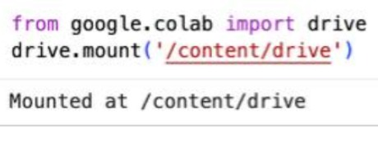
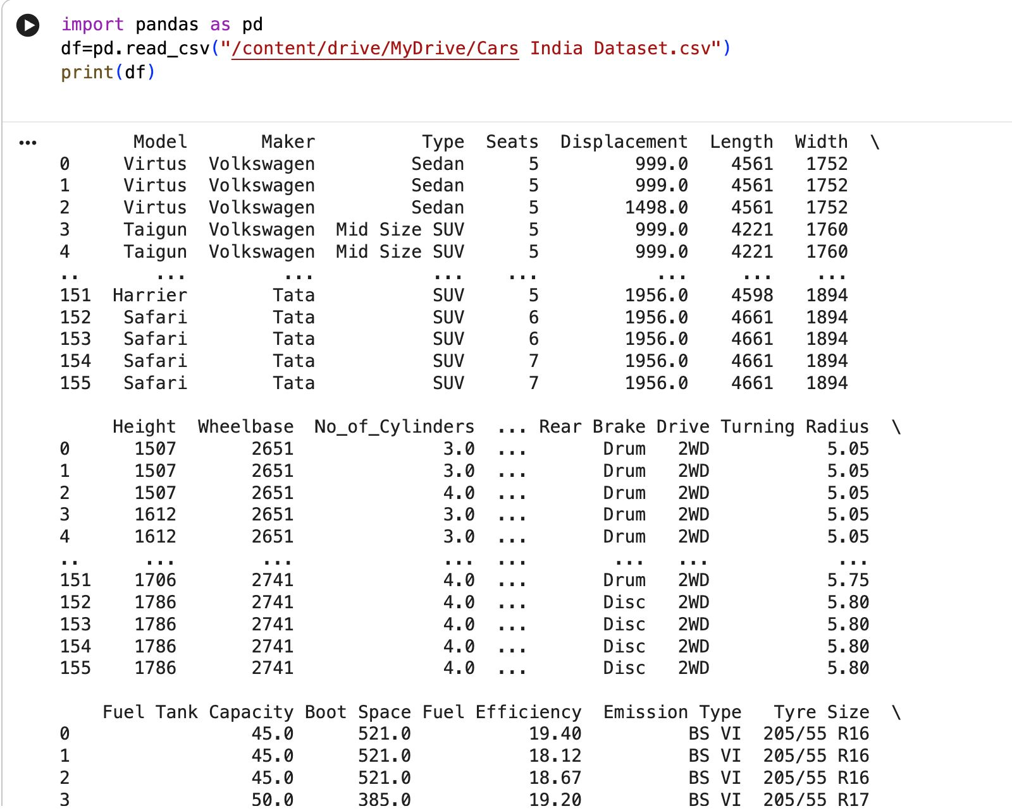
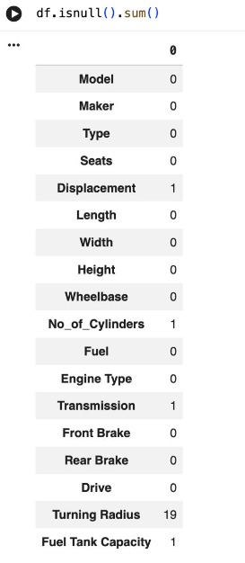
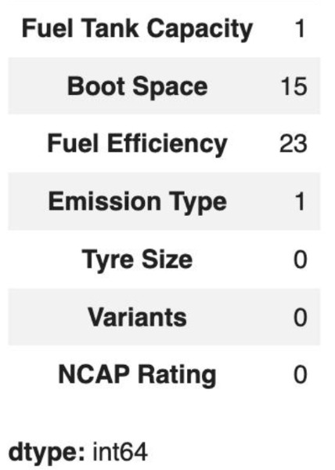
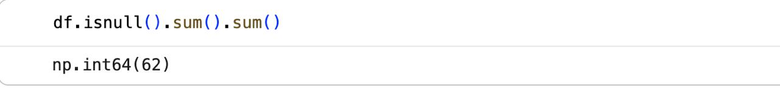
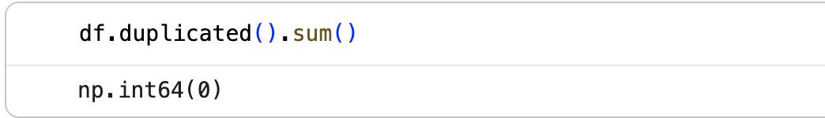
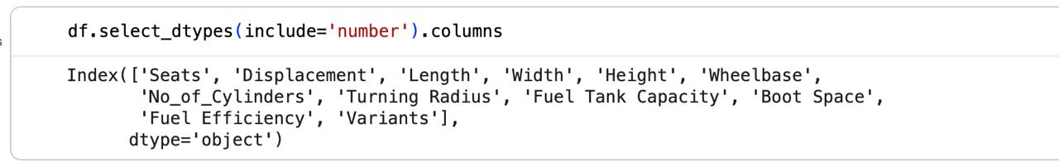
INITIAL DATA OUTPUT
DATASET READING & INITIAL CHECK
MISSING VALUES
KEY OUTPUTS
156 records • 24 columns • 62 missing cells • 0 duplicate rows
Main missing-value concentrations: Fuel Efficiency, Turning Radius and Boot Space.
ADITYA UNIVERSITY • DATA ANALYSIS ESSENTIALS – PROJECT REVIEW 1

Slide 12
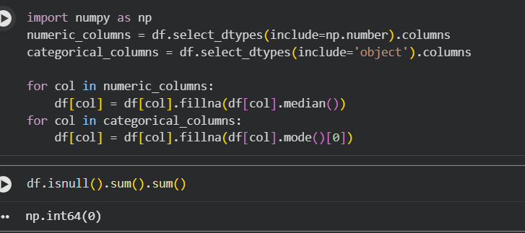
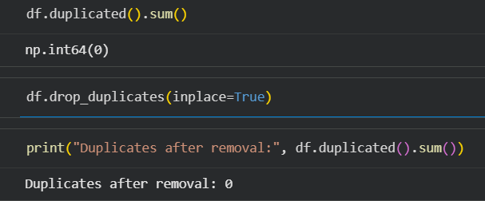
MISSING VALUE TREATMENT
Handling missing data without changing the original notebook code
MISSING VALUES
DUPLICATE CHECK
Numerical columns → median
Categorical columns → mode
Check duplicate rows before finalizing the cleaned dataset.
Result after treatment: missing values = 0
Result: 0 duplicate rows
ADITYA UNIVERSITY • DATA ANALYSIS ESSENTIALS – PROJECT REVIEW 1

Slide 13
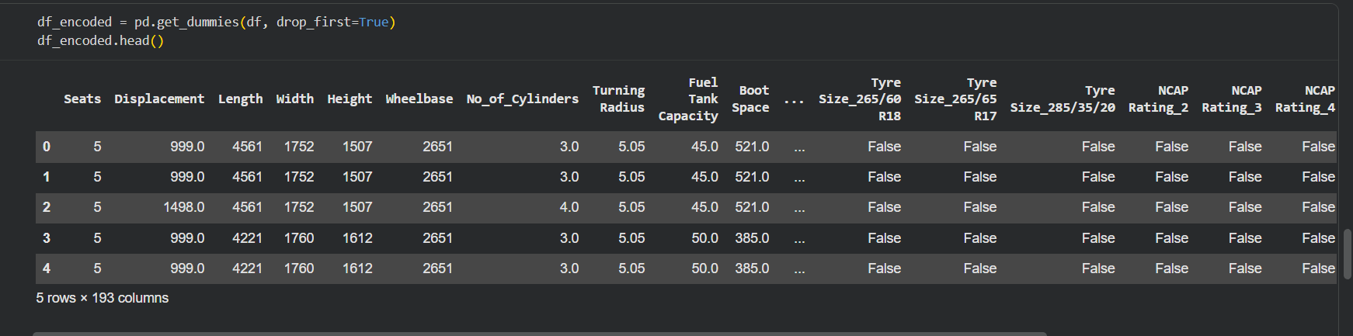
CATEGORICAL DATA ENCODING
Converting categorical attributes into numerical features for analysis
ENCODING
The original code uses pd.get_dummies() to convert categorical values into numerical columns.
Original notebook encoding output shown; final analysis focuses on the 9 selected attributes.
ADITYA UNIVERSITY • DATA ANALYSIS ESSENTIALS – PROJECT REVIEW 1

Slide 14
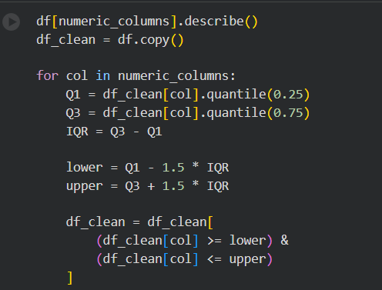
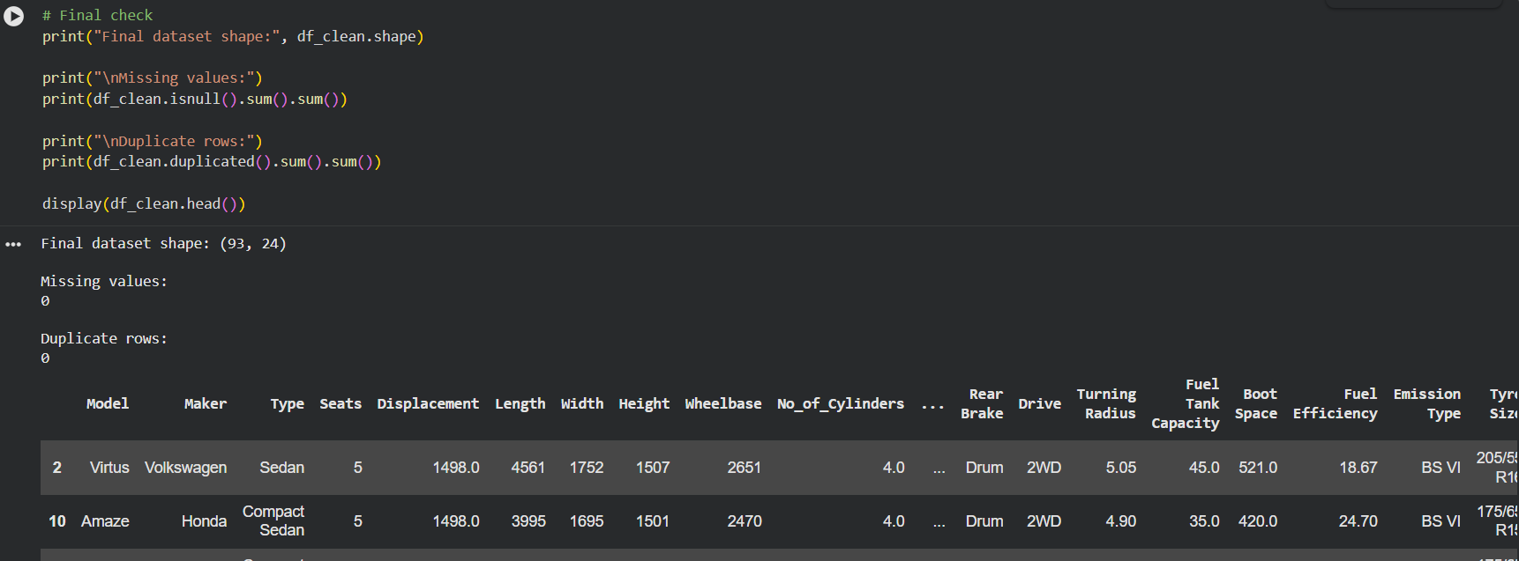
OUTLIER HANDLING & FINAL CHECK
Checking numerical values and validating the cleaned dataset
OUTLIER CHECK
The original code applies the IQR rule to numerical columns.
FINAL DATA CHECK
Notebook result
93 rows × 24 columns
0 missing values
0 duplicate rows
Q1 / Q3 → IQR → lower & upper bounds
ADITYA UNIVERSITY • DATA ANALYSIS ESSENTIALS – PROJECT REVIEW 1

Slide 15
WHAT WE WILL DO NEXT
OUR NEXT JOURNEY
PREPARE
›
ANALYZE
›
VISUALIZE
›
INSIGHT
PREPARE
ANALYZE
VISUALIZE
INSIGHT
Handle missing values, validate data types and prepare analysis-ready data.
Study fuel types, fuel efficiency and relationships with vehicle characteristics.
Create bar charts, line charts, comparisons and other meaningful plots.
Identify useful fuel-efficiency patterns and summarize the findings.
Final Goal: Meaningful vehicle fuel-efficiency analysis based on data
ADITYA UNIVERSITY • DATA ANALYSIS ESSENTIALS – PROJECT REVIEW 1

Slide 16

VEHICLE FUEL ANALYSIS SYSTEM
VEHICLE FUEL
ANALYSIS SYSTEM
Data-driven analysis of vehicle fuel efficiency
Data-driven analysis of vehicle fuel efficiency
PREPARE → ANALYZE → VISUALIZE → INSIGHT
PREPARE → ANALYZE → VISUALIZE → INSIGHT
THANK YOU
THANK YOU
Team: Bala Tripura Sundari • Anusri • Gnaneswari • Hansika
Bala Tripura Sundari • Anusri • Gnaneswari • Hansika

Slide 17
DATA ANALYSIS
The cleaned Cars India dataset is analysed to identify fuel-efficiency patterns and compare vehicle performance.
Fuel Efficiency Analysis
Analyze and compare the Fuel Efficiency values of different vehicles to understand mileage variations.
• Manufacturer-wise Analysis
Group vehicles by Maker and compare their fuel efficiency to identify differences among manufacturers.
• Engine Size vs Mileage Analysis
Study the relationship between Engine Displacement and Fuel Efficiency to understand how engine size is associated with
mileage.
MAIN ATTRIBUTES: Maker, Displacement, Fuel, and Fuel Efficiency

Slide 18
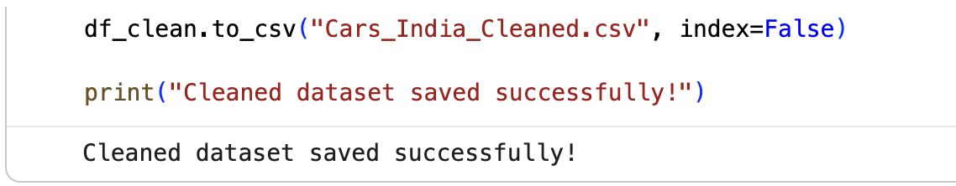
CLEANED DATASET EXPORT
1. Exporting Cleaned Data
After completing preprocessing, the cleaned DataFrame is saved as a CSV file for further analysis.
Purpose:
Stores the cleaned dataset permanently.
index=False prevents the DataFrame index from being added as an extra column.
Creates the file Cars_India_Cleaned.csv.

Slide 19
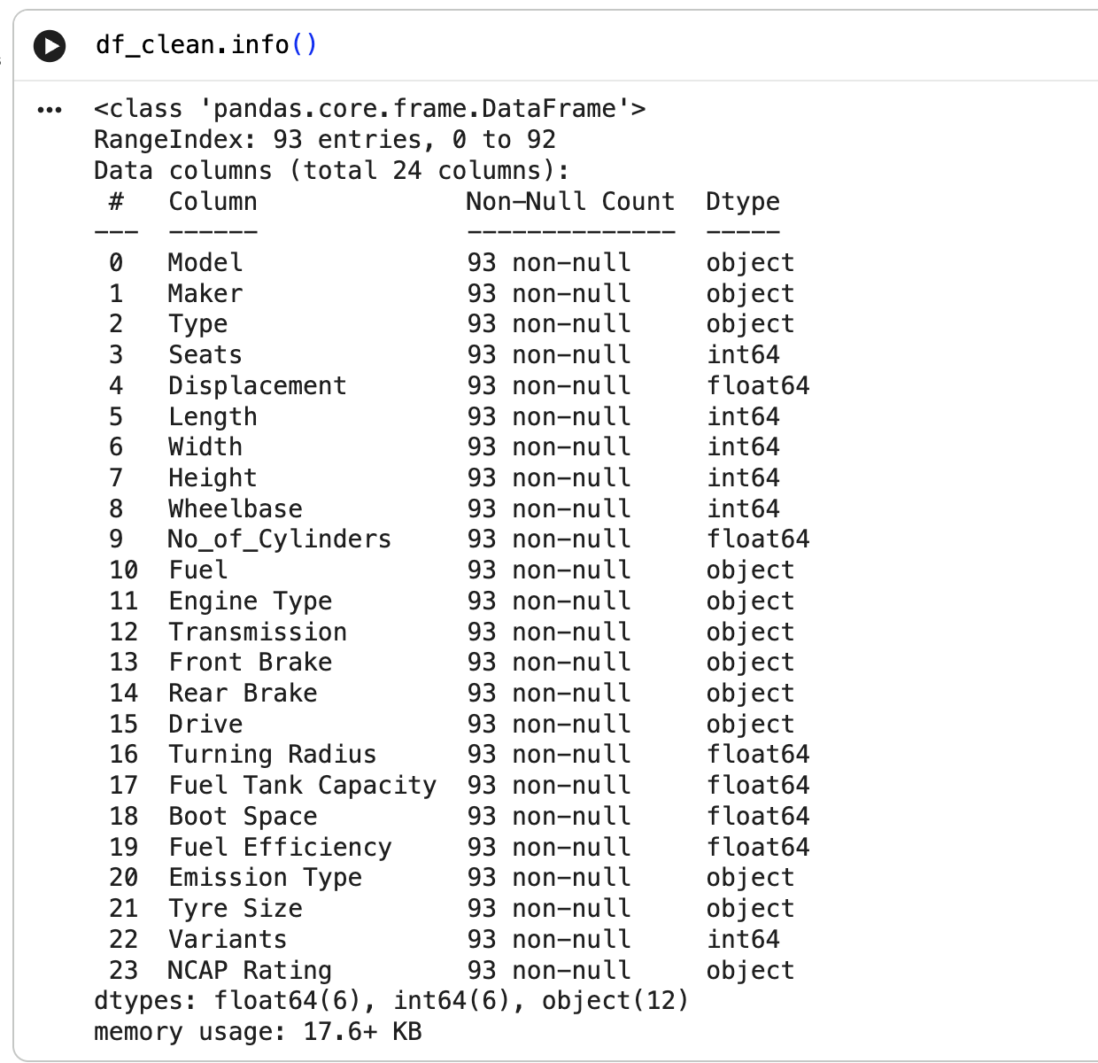
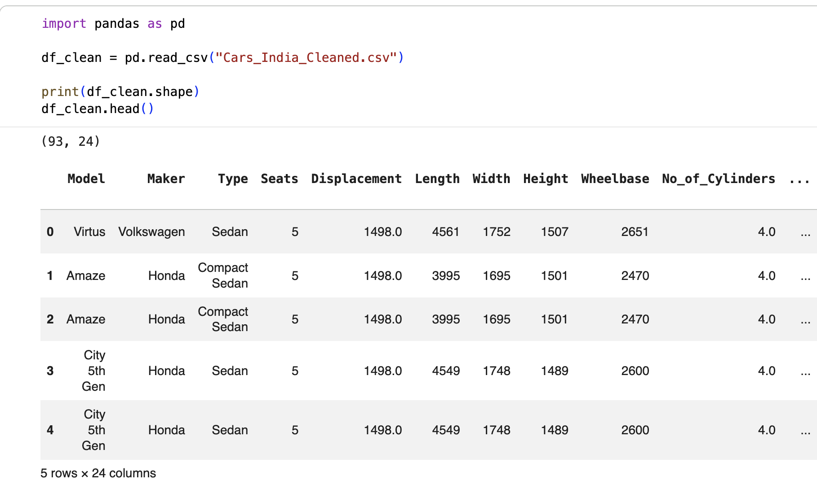
CLEANED DATASET READING
2. Reading the Cleaned Dataset
The newly created CSV file is then loaded again using Pandas for data analysis.

Slide 20
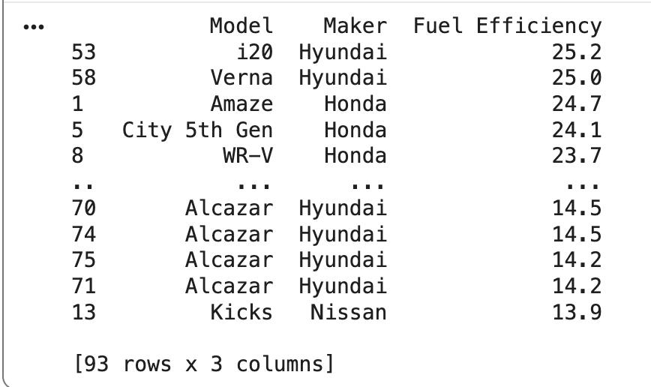
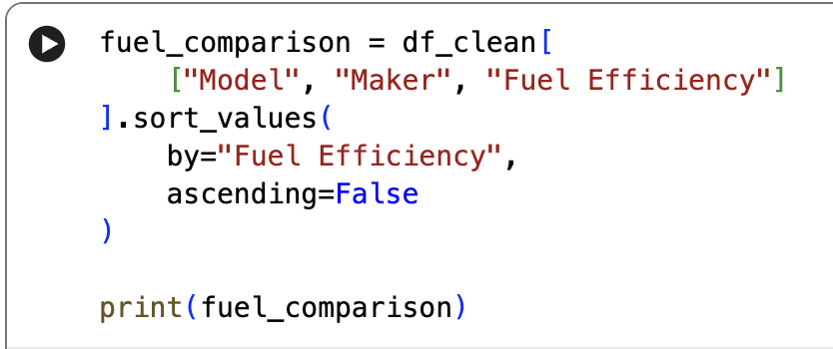
FUEL EFFICIENCY COMPARISION
Fuel efficiency is compared across individual vehicle models to understand the variation in mileage.
Operations Performed:
Loaded the cleaned dataset using Pandas.
Selected Model, Maker, and Fuel Efficiency.
Sorted vehicles by fuel efficiency.
Arranged results from highest to lowest.
Compared values across vehicle models.
OUTPUT:

Slide 21
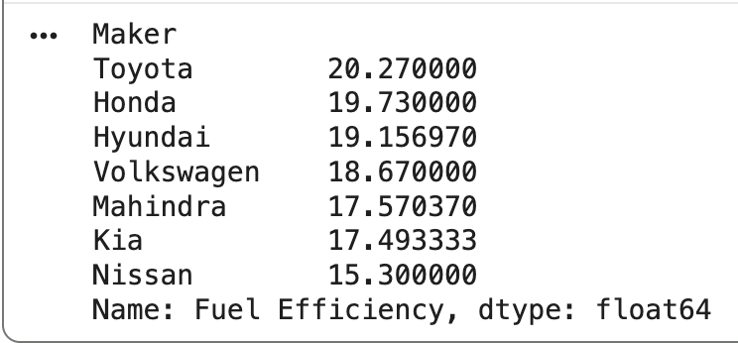
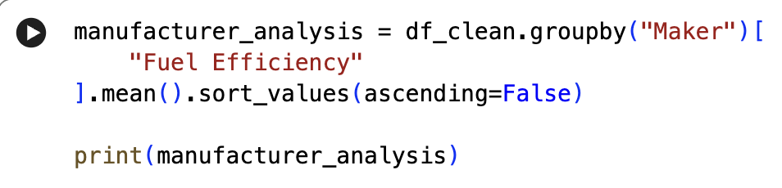
MANUFACTURER-WISE ANALYSIS
The analysis examines whether average fuel efficiency differs among vehicle manufacturers.
Operations Performed:
Grouped vehicles by Maker.
Used Fuel Efficiency for comparison.
Calculated mean fuel efficiency for each manufacturer.
Sorted averages in descending order.
Compared efficiency across manufacturers.
OUTPUT:

Slide 22
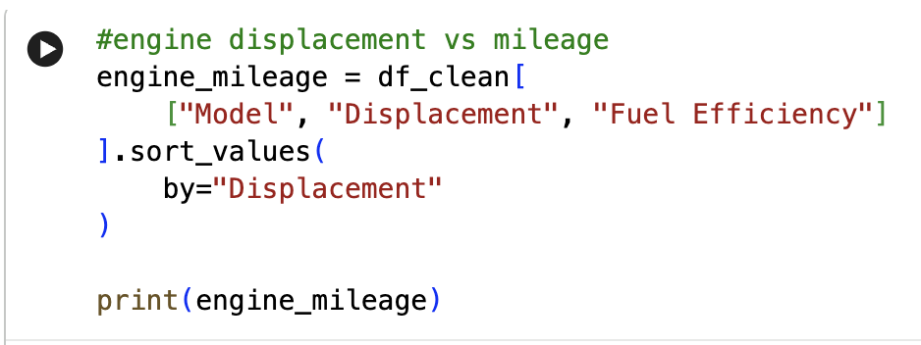
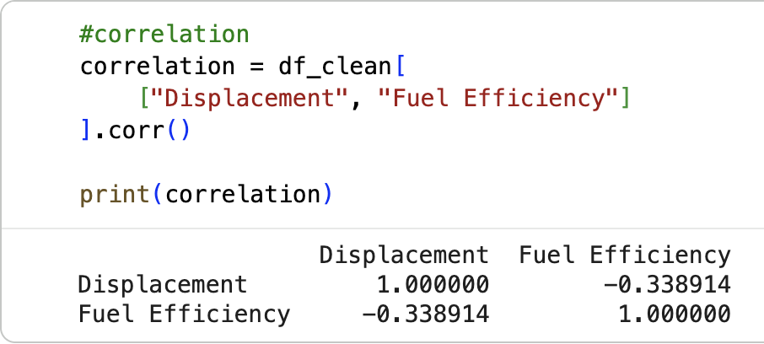
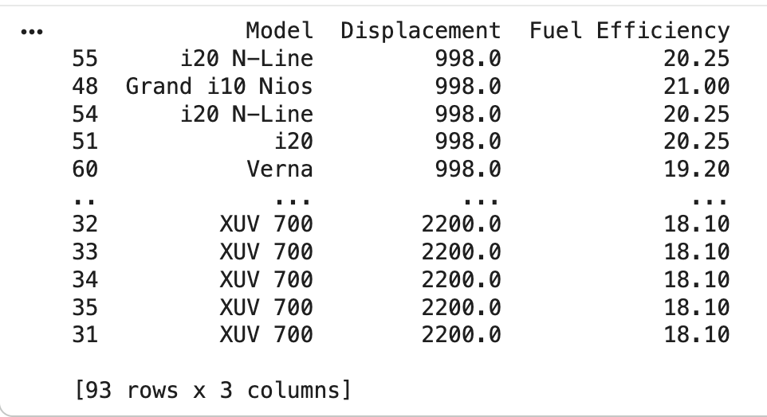
ENGINE SIZE VS MILEAGE ANALYSIS
To examine the relationship between engine size and vehicle mileage.
Operations Performed:
Used Displacement as engine size and Fuel Efficiency as mileage.
Selected Model, Displacement, and Fuel Efficiency.
Sorted vehicles by Displacement.
Compared fuel efficiency across different engine sizes.
Calculated the correlation coefficient between Displacement and Fuel Efficiency.
OUTPUT:

Slide 23
DATA VISUALIZATION
After analyzing the cleaned vehicle dataset, results are visualized using Python and Matplotlib to identify relationships,
compare manufacturers, and understand fuel-efficiency distribution.
Visualization | Chart Type | Purpose | Data Used
Engine Size vs Mileage | Scatter Plot | Shows the relationship between engine size and fuel efficiency | Displacement + Fuel Efficiency
Manufacturer-wise Fuel Efficiency | Bar Chart | Compares average fuel efficiency of different manufacturers | Maker + Average Fuel Efficiency
Fuel Efficiency Distribution | Histogram | Shows how fuel-efficiency values are distributed across vehicles | Fuel Efficiency

Slide 24
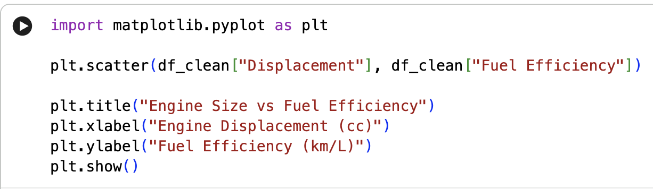
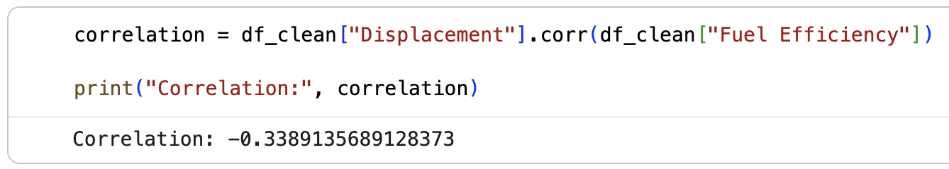
ENGINE SIZE VS MILEAGE
Scatter Plot
Compares engine size with fuel efficiency
Each point represents a vehicle
Shows how fuel efficiency varies with different engine sizes
Helps observe the relationship between engine displacement and mileage

Slide 25
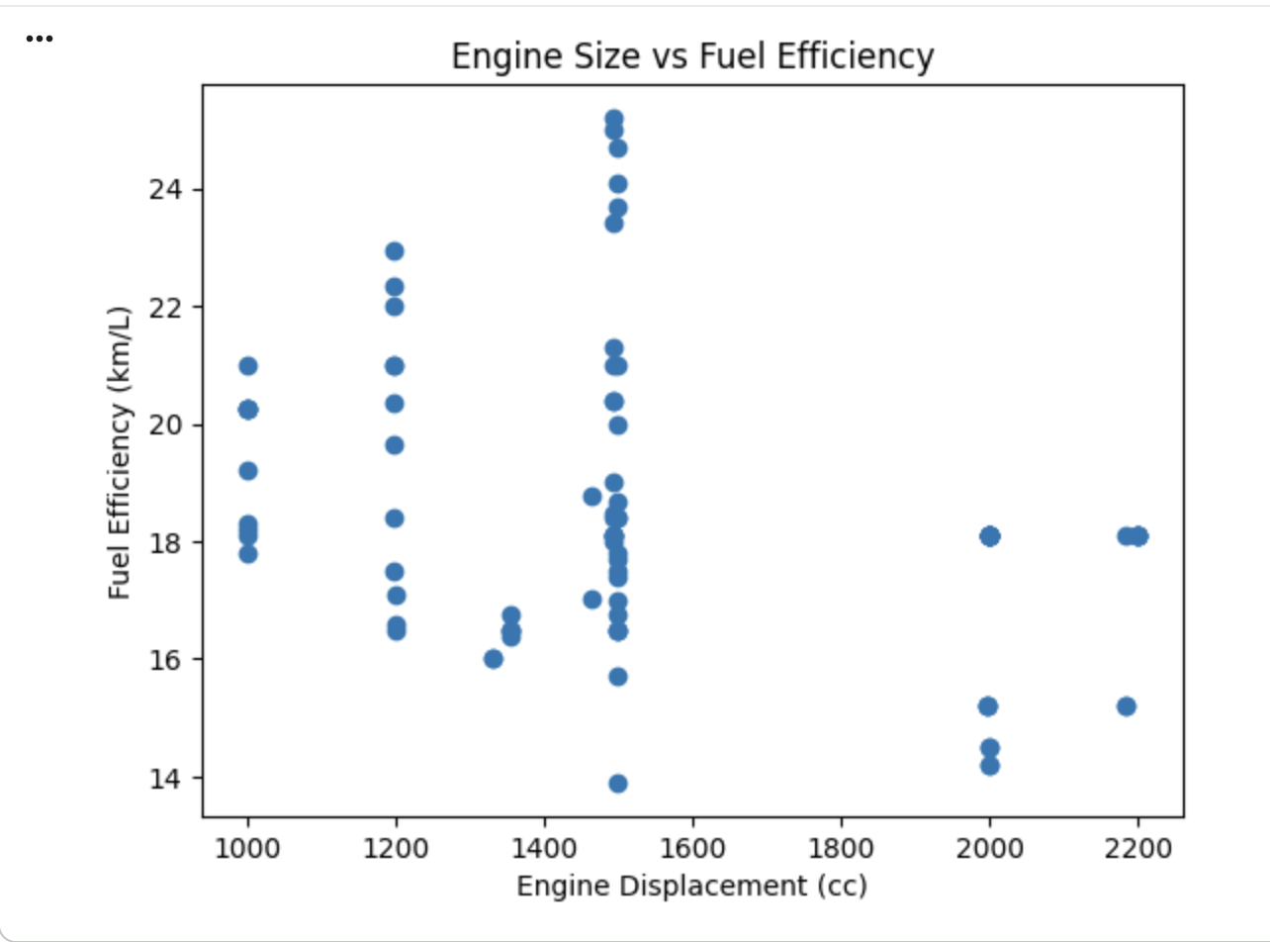
SCATTER PLOT
Title: Engine Size vs Mileage
X-axis:
Engine Size (Displacement)
Y-axis:
Mileage (Fuel Efficiency)

Slide 26
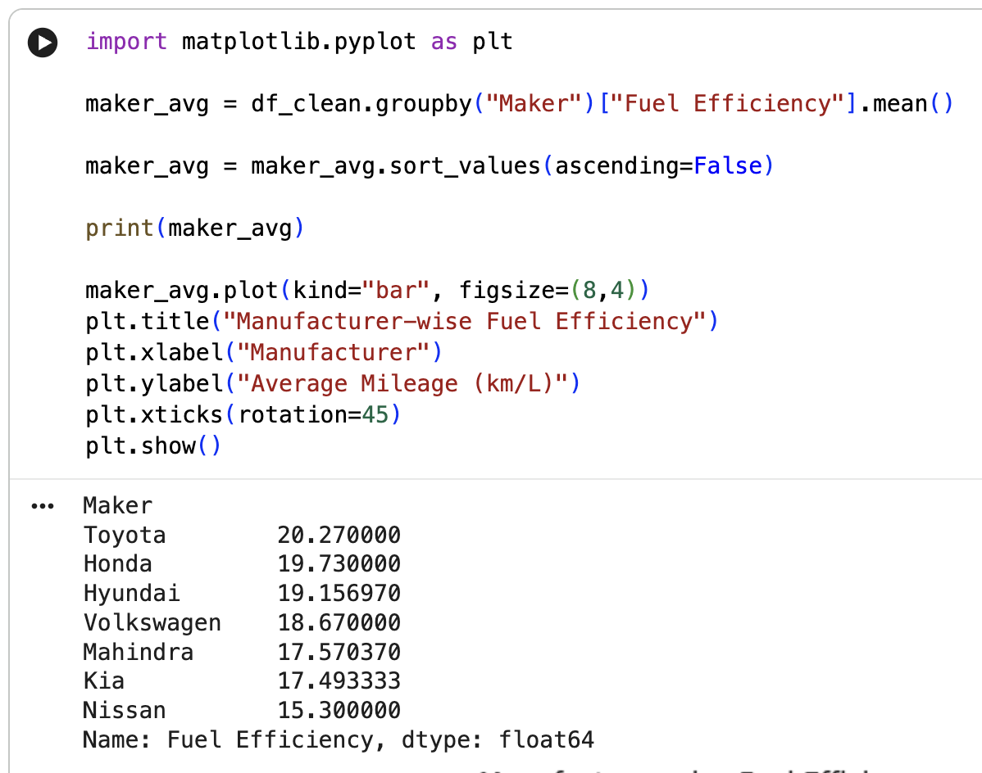
MANUFACTURER-WISE FUEL EFFICIENCY
Bar Chart
Compares average fuel efficiency across manufacturers
Shows differences in average mileage between manufacturers
Makes manufacturer-wise fuel-efficiency comparison easier
Helps identify how fuel efficiency varies across manufacturers

Slide 27
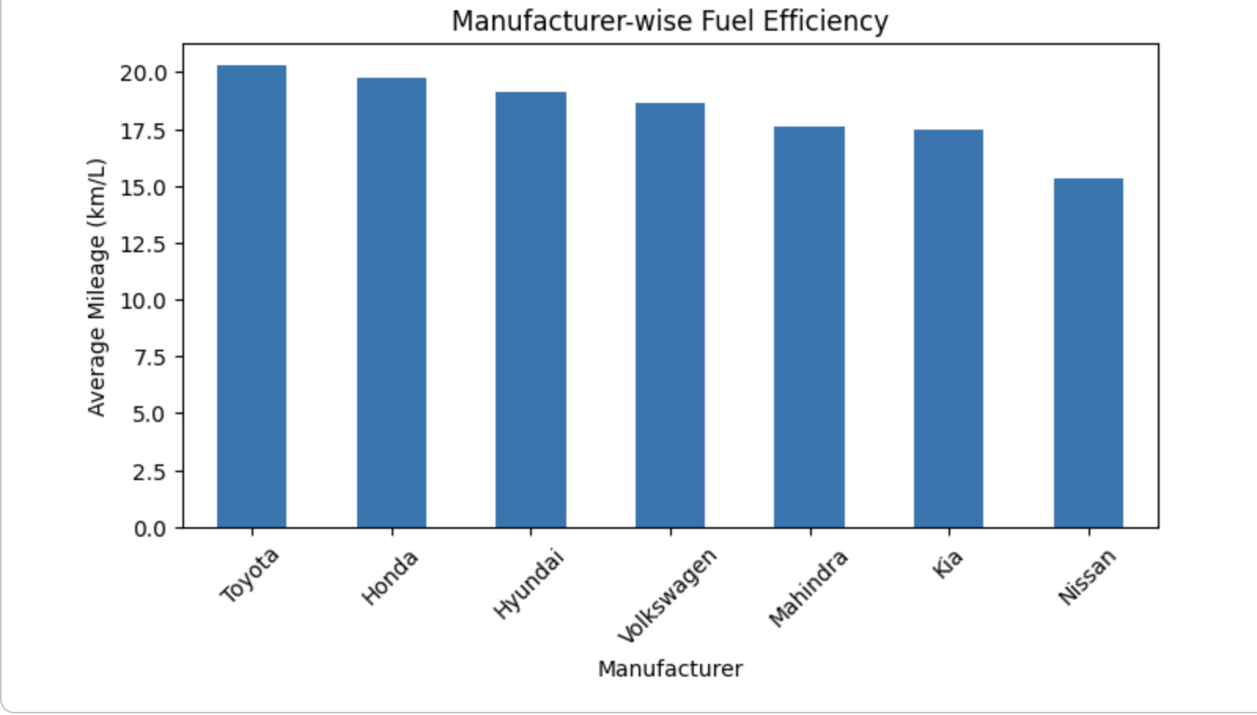
BAR CHART
Title: Manufacturer-wise Average Fuel Efficiency
X-axis: Manufacturer
Y-axis: Average Fuel Efficiency

Slide 28
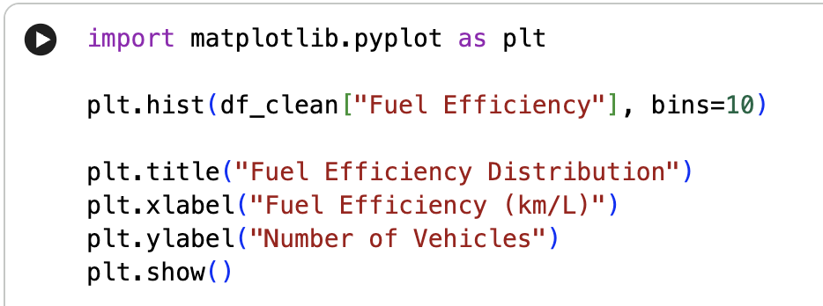
FUEL EFFICIENCY DISTRIBUTION
Histogram
Shows the distribution of fuel-efficiency values
Groups fuel-efficiency values into intervals
Helps identify commonly occurring mileage ranges
Shows how fuel-efficiency values are spread across the dataset

Slide 29
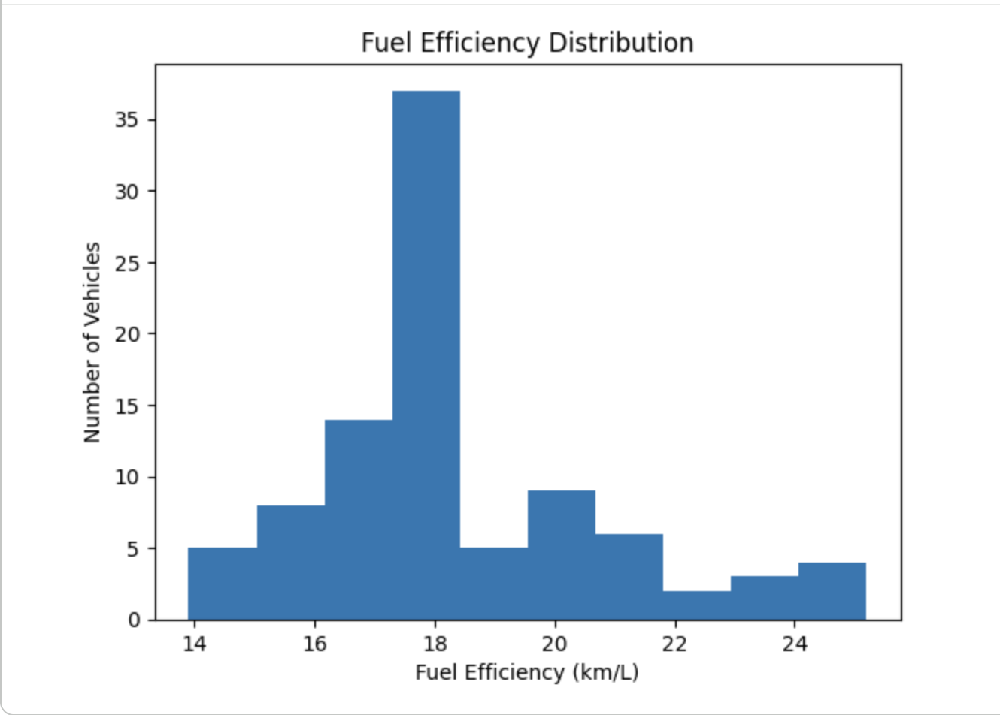
HISTOGRAM
Chart Title:
Fuel Efficiency Distribution
X-axis:
Fuel Efficiency
Y-axis:
Number of Vehicles

Slide 30
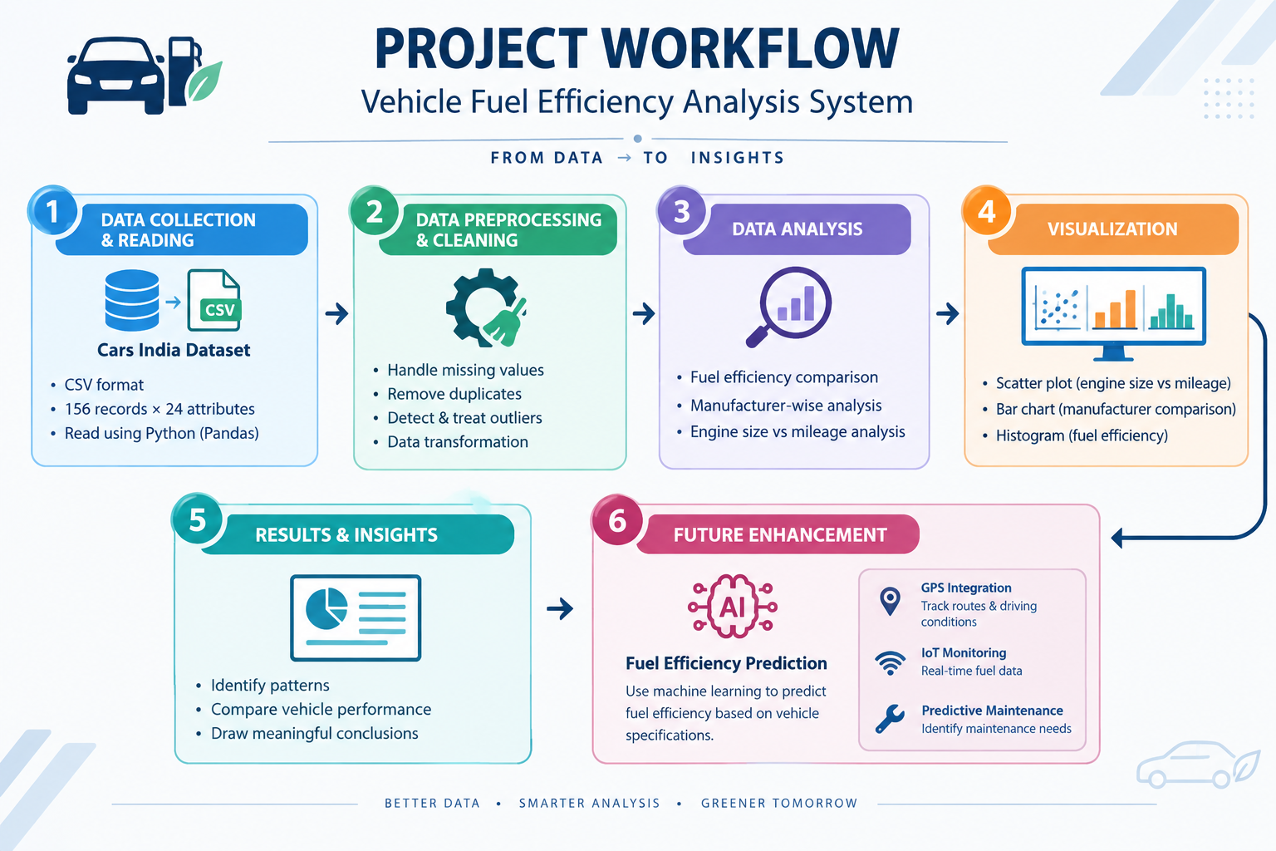

Slide 31

FUTURE ENHANCEMENTS
1. GPS Integration
Track vehicle location and trip routes.
Improve fuel-efficiency analysis.
2. IoT Fuel Monitoring
Collect real-time fuel-consumption data.
Monitor fuel usage and performance.
3. Predictive Maintenance
Identify maintenance needs early.
Detect performance issues.
4. AI-Based Forecasting
Predict future fuel consumption.
Support better fuel planning.

Slide 32
CONCLUSION
Vehicle data was cleaned, analyzed, and visualized using Python.
Analyzed fuel efficiency, manufacturer performance, and engine size vs. mileage.
Used scatter plots, bar charts, and histograms for visualization.
Helps identify fuel-efficiency patterns and vehicle performance.
Future enhancements include real-time monitoring and intelligent fuel management.
THANK YOU…

