Slide 1
Spotify Artist Extractor
Amir Lankarani

Slide 2
Presentation Roadmap
Goals Overview
Design Overview
Goals In-Depth
Results
Projects

Slide 3
Goals
Maximize Unique Artists
Desire ≈ 11,000,000
Diverse demographics
Grab outliers
Optimize Speed
Use all CPU cores
Eliminate down time
Bypass rate limit
Avoid Redundancies
No duplicate searches
Reduce overhead
Write only as needed
Notes:
When deciding how to tackle this project, I went through several stages of execution

Slide 4
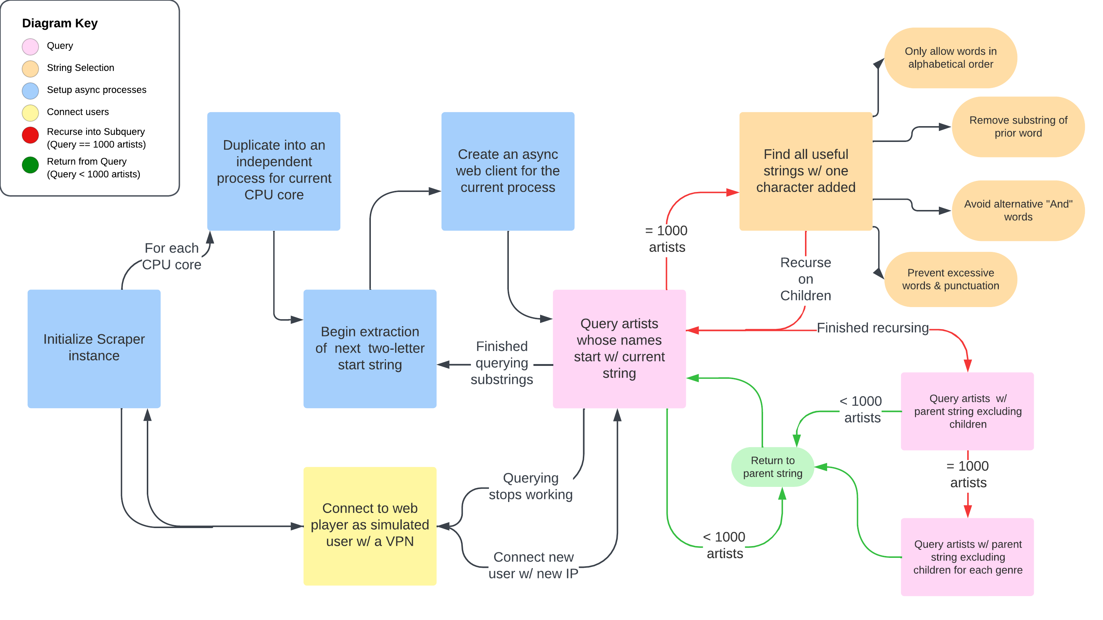
Setup

Slide 5
Async Multiprocessing

Slide 6
Overview
Querying

Slide 7
Overview
String Recursions

Slide 8
Overview
Returning from Recursion

Slide 9
Overview
Genre Search

Slide 10
Overview
Overall

Slide 11
Goal 1: Maximize Artists
Notes:
Incomplete - Results limited to 1000 split into 20 pages; means any search that should have over 1000 results will not include many correct results Limited – no functionality to search a precise term; can’t search an ordered series of words; missing search for many chars that exist in artist’s names (eg dollar sign)
Ambiguous – only one single search query is given as an example of all possible search queries, no source code provide, and there’s no explanation of what search characters are valid, what terms do what, and how to compose different type of queries
Inconsistent – artist:”...” will always provide all possible artists whose name starts with that word unless the word can be used as “and” or “in” in certain languages meaning that “e”, “y”, etc don’t find artists whose names start with e or y; it will usually not autocorrect when using this implementation but in some cases it does for some reason; sometimes having a substring of the prior word as next word will make next word irrelevant but sometimes it treats them as two different words
Puzzle

Slide 12
Problems w/ Spotify’s API
Incomplete
Results capped at 1000 split into 20 pages
Limited
Missing basic search functions
Ambiguous
No source code or variable guide
Inconsistent
All search methods have many exceptions
Makes figuring out queries is like a puzzle
Notes:
First, Spotify’s API is very incomplete. All results are limited to 1000 artists split into 20 different URLs. This means that any search that should have over 1000 results will not include many correct results, and so we have to try to find queries limited to under 1000 artists Next, Spotify’s API is very limited in that there’s no functionality to search for precise terms or a precise series of words, and it doesn’t allow us to search for many special characters that exist in artist’s names such as a dollar sign
Ambiguous – only one single search query is given as an example of all possible search queries, no source code provide, and there’s no explanation of what search characters are valid, what terms do what, and how to compose different type of queries
Inconsistent – artist:”...” will always provide all possible artists whose name starts with that word unless the word can be used as “and” or “in” in certain languages meaning that “e”, “y”, etc don’t find artists whose names start with e or y; it will usually not autocorrect when using this implementation but in some cases it does for some reason; sometimes having a substring of the prior word as next word will make next word irrelevant but sometimes it treats them as two different words; it also sometimes repeats artists between different pages of a search giving us no method to find the artists that were lost by this duplication

Slide 13
Query URL
name
artists associated with the provided artist and/or name
repetitive searches and queries more often reach max
“name”
artists associated with the provided name as opposed to the artist themselves
including similar artist names overblows search functionality
artist:name
artists whose names include all words provided
inconsistent often returning artists that don’t start w/ word
artist:“name”
only artists whose names include all words provided
not include artists w/ words in reverse order if their popularity is 0
Rectified by repeating searches in reverse alphabetical
Ex: https://api.spotify.com/v1/search?q=artist:“charli%20xcx"&type=artist&limit=50
Notes:
2pac -> include artists like Biggie and Snoop Dogg
2pac -> include artists like 3pac or Pack.FM
2pac -> include artists like 2pa or 2p
2pac -> include only artists like 2pac or 2pack
Means very unpopular artists may be missed by queries
Ex 1: 2pac -> 2pac, The Notorious B.I.G., Makaveli, 2pack, etc
Ex 2: “2pac” -> 2pac, 2pack, Makaveli, 2pac feat. 3xkrazy, etc not notorious big
Ex 3: artist:2pac -> 2pac, 2pack, 2pak not makaveli
Ex 4: artist:”2pac” -> 2pac, 2pack not 2pak or makaveli

Slide 14
Querying Method
Start at 2-character strings
Recursive string extensions
A string’s search wholly represented by searching the string w/ each possible letter added and w/ no letter added
If Spotify can’t show all results (over 1000 artists), recurse to search longer string variants of the current string
“Not” chaining
Repeat search of parent string excluding results from popular children to isolate artists w/ just the current string
EG artist:”ka” NOT artist:”kan” NOT artist:”kaz”...
Genre searching
If “not” chain still has 1000 results, repeat this search for each of the 6213 genres on Spotify
Returns diverse range of artists satisfied by relevant search string
Notes:
2-char strings are manageable enough to provide results in a reasonable amount of time without being so fast that a new async client has to constantly be prepared
Ex 1: “ka” -> “kan”, “kaz”

Slide 15
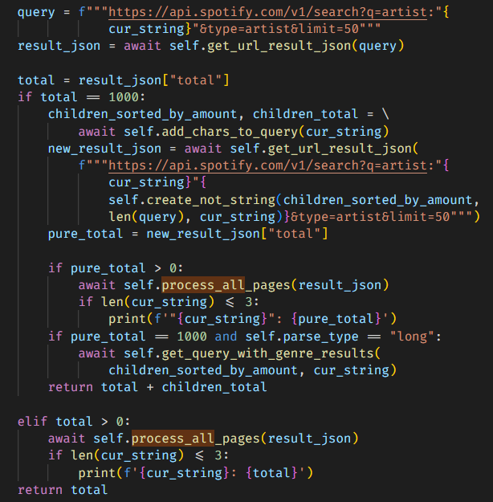
Querying Method
Notes:
2-char strings are manageable enough to provide results in a reasonable amount of time without being so fast that a new async client has to constantly be prepared
Ex 1: “ka” -> “kan”, “kaz”

Slide 16
Filtering Queries
Allowed characters
a:z, 0:9
“.”, “_” – if one word w/out punctuation
Max spaces limited preventing large recursion depth
Avoiding repetition
Alphabetical queries prevent multiple searches of a word set
Substring of prior word skipped as it is ignored by query
Skip “and” words
and, e, en, et, ja, nd, und, y -> same results
Next steps
Run genre searches
Run reverse alphabetization
Repeat search for foreign character sets
Use overlapping offsets to avoid inconsistent pages
Notes:
a. Allowed characters
2. All results below limit when single punctuation included
b. Eliminating repetitive searches
1. Spotify queries typically don’t care about word order when multiple words provided. Hence, word sets searched alphabetically to avoid repeat searching a set for each permutation of the words
2i. skipped since ignored by query
2ii. But query variations of prior word & duplication of prior word.
2iii. Checking variations of each substring costly so limit to some string length (only checking first letter variations right now)
c. Cascading effect when multiple in a query, such as if a query has en, ja, e, and nd it will treat it as a single and allowing for a massively increasing recursion depth
- However, still need to search variations of these strings so we merely skip querying
d.
1. Reverse alphabetization overcompensates for priorly described problem of artist:” “ skipping word series in the opposite order when popularity is 0
2. Genre

Slide 17
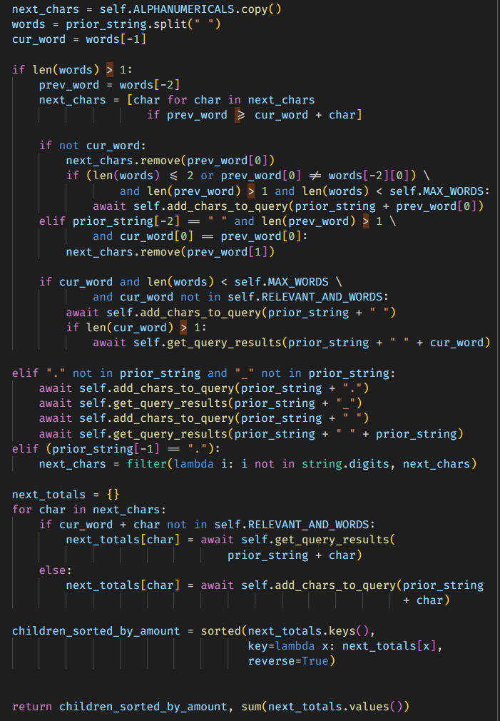
Filtering Queries
Notes:
a. Allowed characters
2. All results below limit when single punctuation included
b. Eliminating repetitive searches
1. Spotify queries typically don’t care about word order when multiple words provided. Hence, word sets searched alphabetically to avoid repeat searching a set for each permutation of the words
2i. skipped since ignored by query
2ii. But query variations of prior word & duplication of prior word.
2iii. Checking variations of each substring costly so limit to some string length (only checking first letter variations right now)
c. Cascading effect when multiple in a query, such as if a query has en, ja, e, and nd it will treat it as a single and allowing for a massively increasing recursion depth
- However, still need to search variations of these strings so we merely skip querying
d.
1. Reverse alphabetization overcompensates for priorly described problem of artist:” “ skipping word series in the opposite order when popularity is 0
2. Genre

Slide 18
Goal 2: Optimize Speed
Notes:
Incomplete - Results limited to 1000 split into 20 pages; means any search that should have over 1000 results will not include many correct results Limited – no functionality to search a precise term; can’t search an ordered series of words; missing search for many chars that exist in artist’s names (eg dollar sign)
Ambiguous – only one single search query is given as an example of all possible search queries, no source code provide, and there’s no explanation of what search characters are valid, what terms do what, and how to compose different type of queries
Inconsistent – artist:”...” will always provide all possible artists whose name starts with that word unless the word can be used as “and” or “in” in certain languages meaning that “e”, “y”, etc don’t find artists whose names start with e or y; it will usually not autocorrect when using this implementation but in some cases it does for some reason; sometimes having a substring of the prior word as next word will make next word irrelevant but sometimes it treats them as two different words
Puzzle

Slide 19
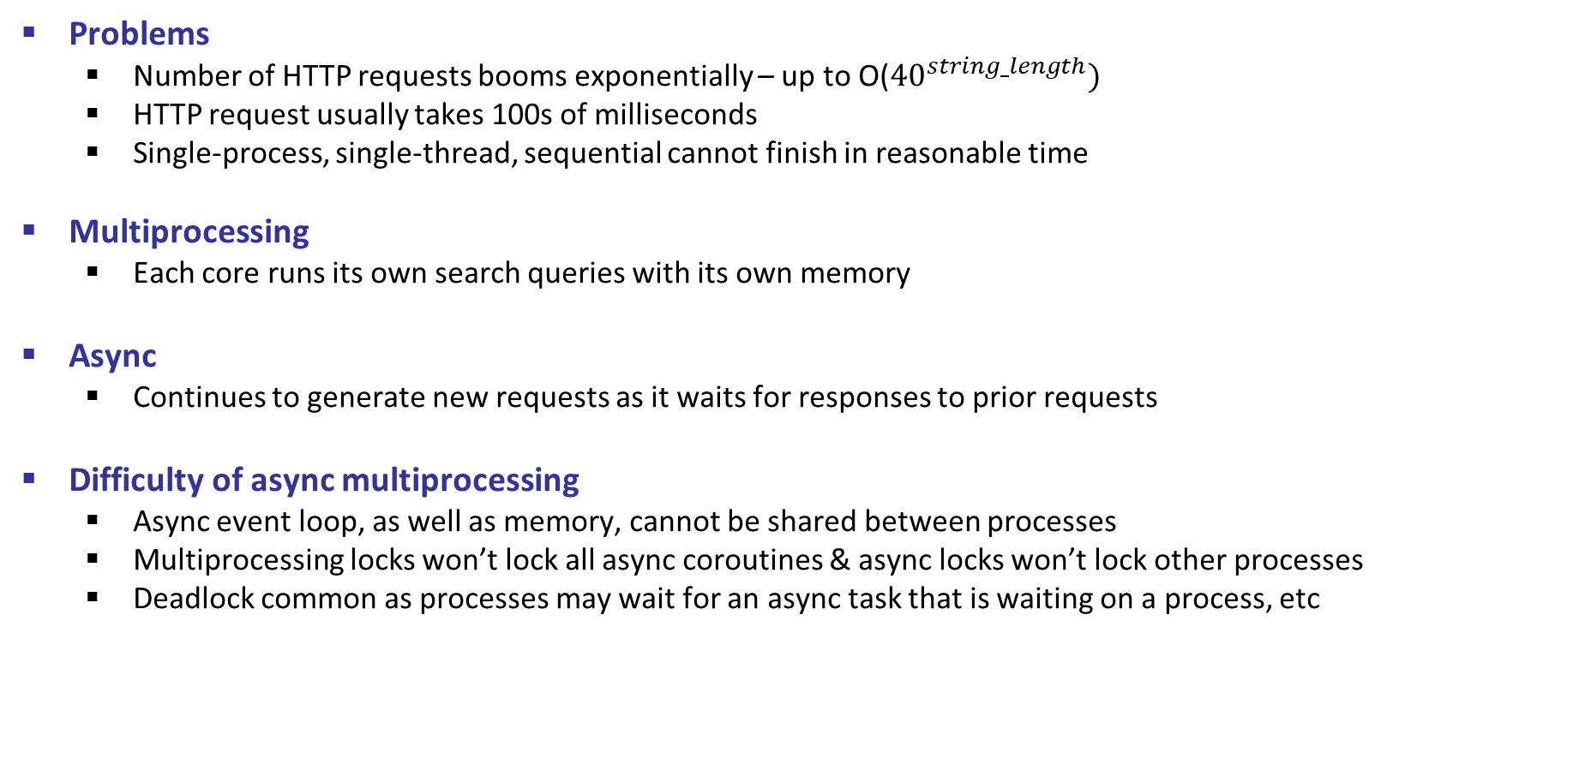
Speed Issues
Problems
Number of HTTP requests booms exponentially – up to O(${40}^{string_length})$
HTTP request usually takes 100s of milliseconds
Single-process, single-thread, sequential cannot finish in reasonable time
Multiprocessing
Each core runs its own search queries with its own memory
Async
Continues to generate new requests as it waits for responses to prior requests
Difficulty of async multiprocessing
Async event loop, as well as memory, cannot be shared between processes
Multiprocessing locks won’t lock all async coroutines & async locks won’t lock other processes
Deadlock common as processes may wait for an async task that is waiting on a process, etc

Slide 20
Async Multiprocessing
Tools
Process Pool Executor
Asyncio
HTTPX
Locks
Original facilitation method
Manager process creates a server to share async-safe locks and memory between processes
Read-write locks for writing all artists after finishing a batch
Another lock to have only one process change VPN
Simplified Code
Final facilitation method
Avoid shared memory by having cores act fully independently
Only write results for 2-char substring
Use these files to later extract all unique artists
Only process 1 can change VPN
Notes:
1. Each CPU core has its own event loop facilitating async operations
- Assign each CPU core to its own pool using Process Pool Executor, a specialized form of process pooling in the concurrent futures package made to allow each process pool to map its own set of async operations
- These async operations on a specific core are facilitated using an event loop created by the conventional asyncio run function which moderates the many functions waiting at any moment
- When a function is run is based upon an async HTTPX client initialized as a context handler which will automatically trigger a waiting function whenever it starts waiting for an HTTP request and facilitates multiple simultaneous requests at once
Saves lots of overhead, avoids unnecessary wait, and frees up an extra process

Slide 21
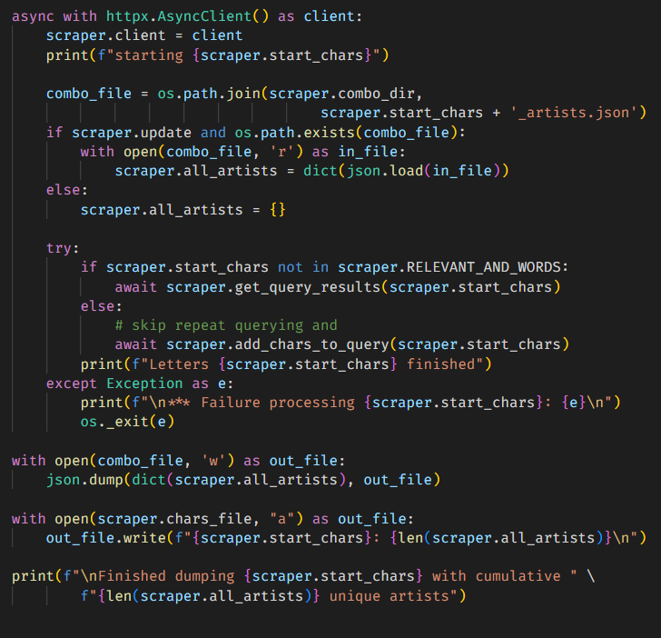
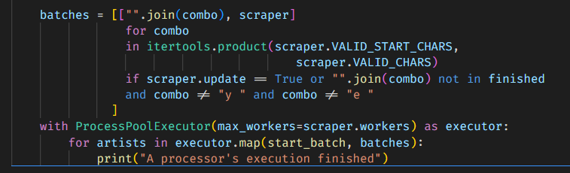
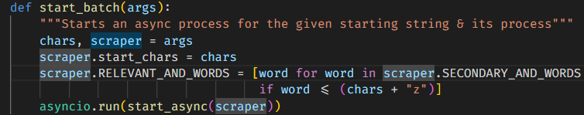
Async Multiprocessing
Notes:
Saves lots of overhead, avoids unnecessary wait, and frees up an extra process

Slide 22
Avoiding Limits
Conventional Ingestion
Create a web app through Spotify’s API to facilitate connections
Problem: rate limit activates after only a few minutes & lasts about 20 hours
Conventional solution: delay time between queries
My Solution
Create HTTP requests simulating a user exploring Spotify’s web player
Allows for unlimited queries w/ unlimited speed using only 3 accounts
Method
Create a few dummy Spotify accounts & extract their cookies
Inject cookies into the async HTTPX web client using headers
Deal w/ rare slow-downs by changing VPN address & switching users
Next Steps
Create explicit async gathering points to speedup processing
Notes:
Typical solution is way too slow for this program and won’t ever allow all artists to be queried
Method: Use Spotify’s API as normal
Spotify may slow down or stop responding to queries after awhile
Async gathering points needed because the increased speed has resulted in certain artists not being written despite the query being run

Slide 23
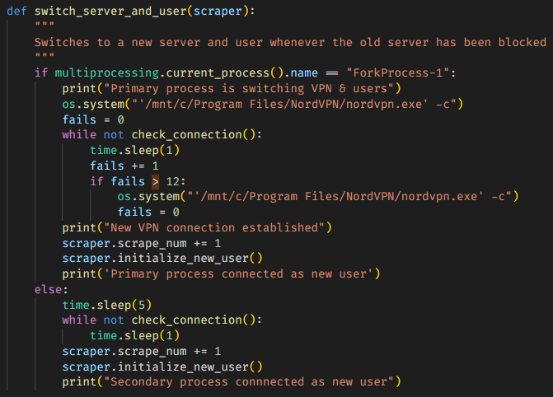

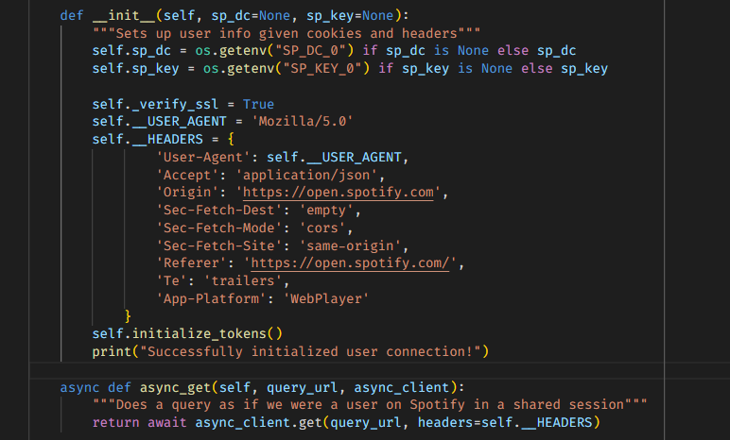
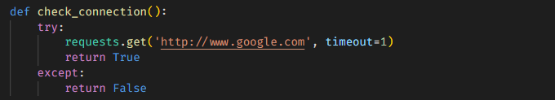
Avoiding Limits
Notes:
Typical solution is way too slow for this program and won’t ever allow all artists to be queried
Method: Use Spotify’s API as normal
Spotify may slow down or stop responding to queries after awhile

Slide 24
Overview
Overall

Slide 25
Final Results
≈ 12,000,000 artists
Greater than supposed 11 million artists
≈ 1.5 days
Exception: “pa” and “ja”
Improvement effects
Large increase in speed
Uncertain/inconsistent effect on artist count
Flaws
Repeated searching still exists
Lack artists w/ foreign characters
Inconsistent results pages -> miss artists
Other Methods
Initial search through artists in each genre prior to BFS through related artists of unsearched artists until no new artists remain
Check each artist on RYM or Musicbrainz on Spotify
Use popularity filtering instead of genre
Notes:
“pa” and “ja” took an extra day due to the “1

