Slide 1
ANAMAYA.
Google IO Extended Hackathon-2019
Women Safety and Women Empowerment
Be Hygiene, make society Hygiene

Slide 2
Problem:
In public places almost every women faces the problem of using washrooms. But most of the washrooms are government run and they are either closed or unhygienic and others are pay and use wash rooms.

Slide 3
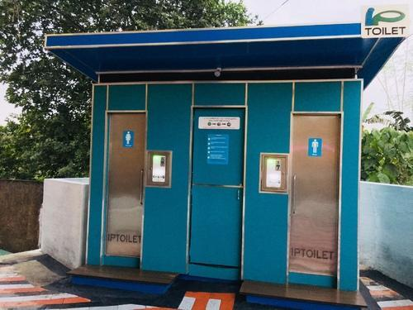
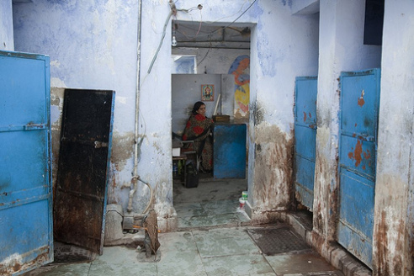

Slide 4
Proposed Solution:
Indian act Sarais,1867.
We made all the accessible washrooms located on google maps, and also rating them which helps the user to know its cleanliness.
They can even make donations and contribute for construction of toilets.

Slide 5
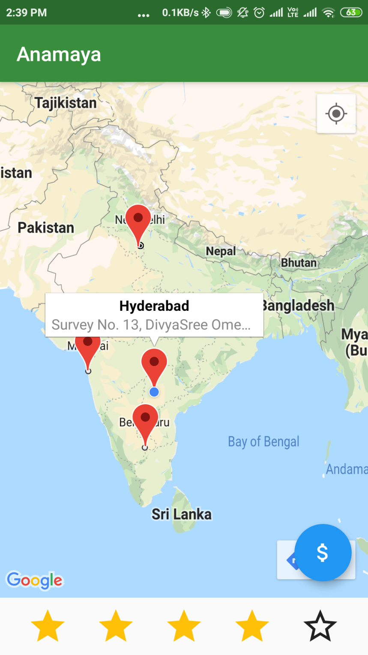

Slide 6
Finally, we aim to build a society in which the illness caused by unhygienic environment to women are reduced.

Slide 7
Thank You.
Lanke Hemanth Kumar.
Rashed Md.

