Slide 1
PA2
A walkthrough

Slide 2
Overview
Emulate a link layer and a network layer protocol
2 Independent Sections
Go Back N (link layer)
Distance Vector Protocol (network layer)
Will combine the 2 sections such that both algorithms working in tandem

Slide 3
Go Back-N
Implement the Go-Back-N (GBN) protocol on top of UDP to guarantee that all packets can be successfully delivered to the higher layers in the correct order
To emulate an unreliable channel, the receiver and the sender need to drop an incoming data packet or an ACK, respectively, with a certain probability

Slide 4
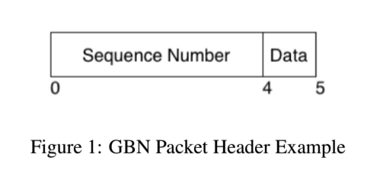
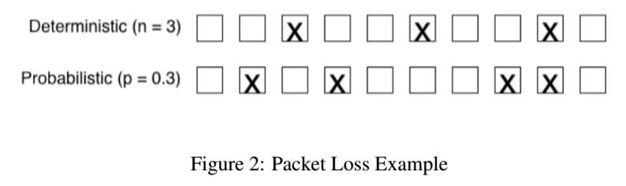
Go Back-N: Details
One program “gbnnode”
Two node instances, sender and receiver
Both node processes will be on the same machine but different port numbers
Data packet: 1 character
Loss emulation: probabilistic or deterministic

Slide 5
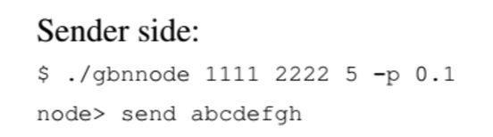

Go Back-N: Setup
Two nodes, sender and receiver

Slide 6
Go Back-N: Loss Rate Calculation
After transmission, sender and receiver each report:
Loss rate = # packets dropped / total # packets
A test: In probabilistic mode, actual loss rate should converge to command line drop probability p

Slide 7
Distance Vector Protocol
Objective: Implement a simplified version of a routing protocol in a static network.
Use the Bellman-Ford algorithm to build and update the routing tables
UDP should be used to exchange the routing table information among the nodes
We assume that that all the nodes run on the same machine and they all have the same IP address
Each node can be identified uniquely by a (UDP listening) port number, which is specified by the user

Slide 8
Keeping track of Routing Table
Upon the activation of the program, each node should construct the initial routing table and keep it locally
The node with the last keyword will send out its routing table first
Using Bellman-Ford, each node will keep updating its routing table as long as neighboring nodes send their updated routing tables information
If there is any change in the routing table, a node should send the updated information to its neighbors.
NOTE: Each node should send its routing table information to its neighbors at least once.

Slide 9

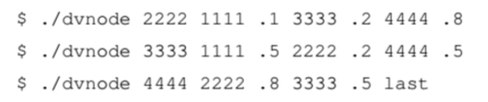
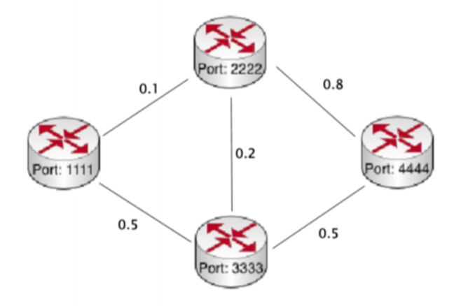
Initializing Network Topology
=

Slide 10
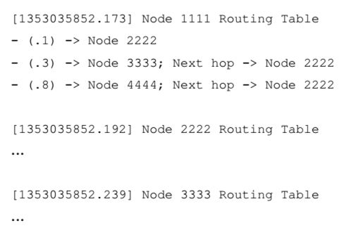
Status Messages!
Make sure to follow the status messages specified (Don’t do anything fancy please)

Slide 11
Please note all the assumptions in this section
Max Nodes = 16
Links and distances (costs) specified at start and stay static throughout test
Distance is same in both directions
Use UDP (if you did PA1 then you already know how!)

Slide 12
Combination
GBN part + DV routing part to emulate a computer network with dynamic link state
Goal is to integrate code you’ve already written.

Slide 13
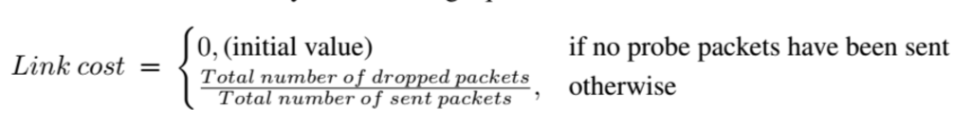
Dynamic Links
Use code from GBN section
Probe packets instead of char messages
Loss rate calc: simplified
Only probabilistic packet drop
ACKs never dropped
Window size == 5

Slide 14
Probe packets
Probe packets sent continuously, loss rate updated
Each link connects two nodes, specify sender node and receiver node
Probe packets sent in one direction
Senders only get Link loss rate when receiver sends over Routing Table update

Slide 15
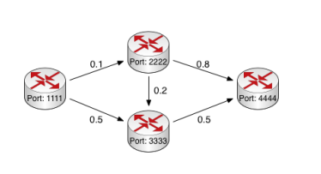
$ ./cnnode 1111 receive send 2222 3333 (receiving list is empty)
$ ./cnnode 2222 receive 1111 .1 send 3333 4444
$ ./cnnode 3333 receive 1111 .5 2222 .2 send 4444
$ ./cnnode 4444 receive 2222 .8 3333 .5 send last (sending list is empty)

Slide 16
Simple Example

Slide 17
Simple Example

Slide 18
Testing
We will be running your code on Google Cloud Machines using Ubuntu 14.04 LTS
Please run and test your code in this environment
Java, Python, and C allowed (same rules as PA1)
We will only be using Java 7 and JDK 1.7 (Not Java 8)

Slide 19
Some Tips
Start early
Make sure a step works before going on to the next one
When we ask for command line arguments we actually mean command line arguments
Don’t submit class or executable files
Don’t submit your eclipse package structure
Java does not need a Makefile as long as the readme specified the main class

Slide 20
Notes from PA1
Please submit .zip archives
Remove logging / debugging print statements in final submission
Submit README as text file

