Slide 1
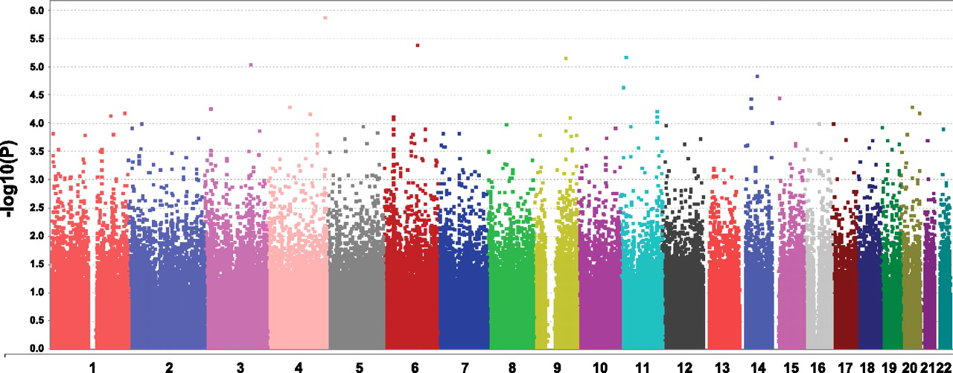
Genomics: Meta-Analysis
Kristine Lan (University of Michigan), Rushill Sheth (University of Missouri), Michael Thompson (Umass Amherst)
Advising by: Gonçalo Abecasis, Sayantan Das, Hyun Min Kang

Slide 2
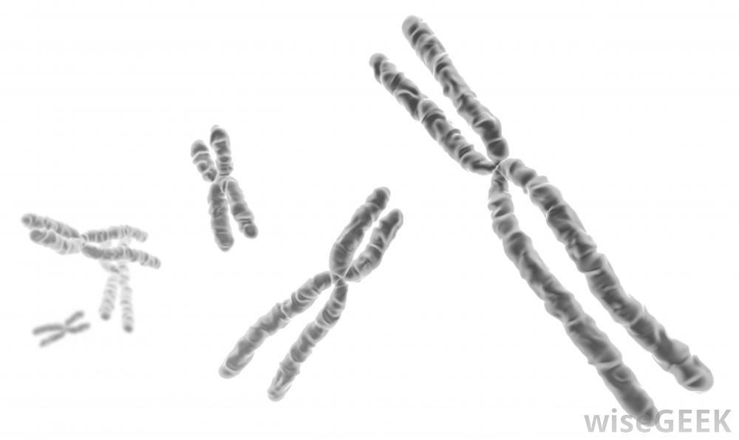
Motivation
Original Question: Find patterns and derive conclusions about Type II Diabetes through Meta-Analysis
Meta-Analysis: Combining multiple independent studies together to create a larger data set to find patterns and derive new conclusions.
Genome-wide association studies (GWAS) on rare genetic variants
Notes:
Motivation should allude to goal

Slide 3

Single Study Rare Variants GWAS
Phenotype Simulation
10,000 cases + controls (with various % cases)
Genotype Simulation
Given disease prevalence (0.1%)
risk allele frequencies (0.1% ~ 50%)
and multiplicative relative risks (0.125 ~ 5.0)
Calculate the allele frequencies for cases and ctrls
Simulate individual genotypes based on the frequency estimates

Slide 4
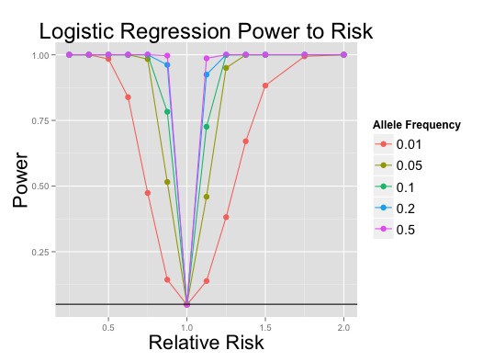
Project Outline
Logistic Regression
Score Test
Allele Proportion Test
Fisher’s Exact Test
Genotype | Phenotype
A / A | CTRL
A / G | CASE
G / G | CTRL
A / G | CASE
Apply data to
Acquire
p-value
Simulation
Parameters
Weights
Find Ideal test
for meta-analysis
Visualization

Slide 5
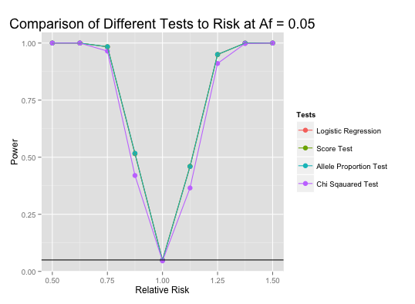

Slide 6

What We Learned
Statistical coding language R
Creating/simulating a human genome
Statistical methods (logistic regression, score test, allele frequency test, chi-squared test)
De-bugging
Simulating power tests takes a long time

Slide 7
References

