Slide 1

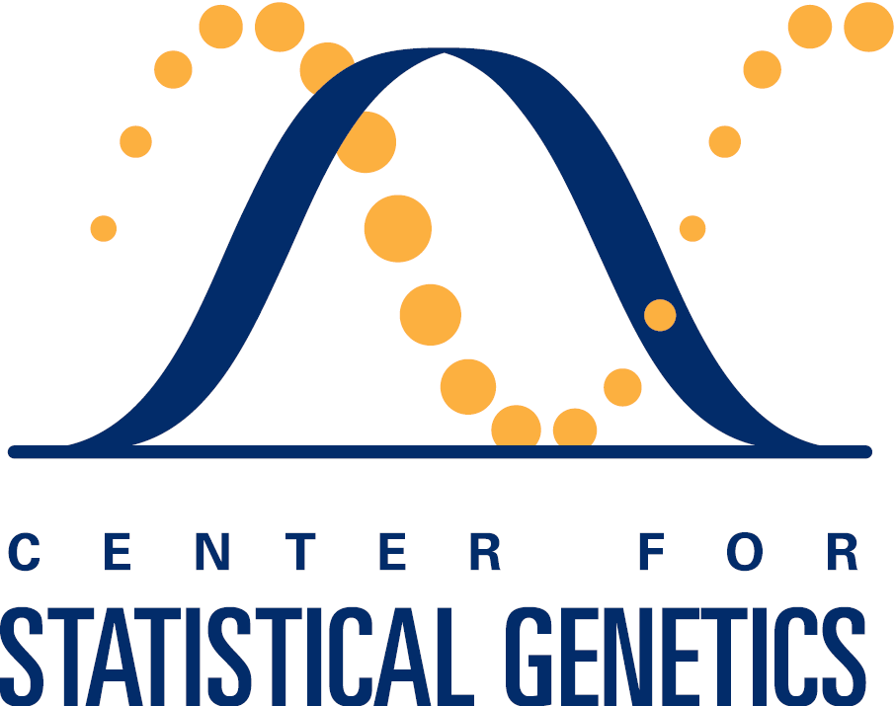
Genomics Meta Analysis
Kristine Lan(University of Michigan), Rushil Sheth(University of Missouri), Mike Thompson(University of Massachusets-Amherst)
Introduction
Procedure
Graphs
Meta-Analysis: Combine many independent studies to create a larger data and derive new conclusions.
Find patterns and derive conclusions about Type II Diabetes through Meta-Analysis
Genome-wide association studies (GWAS) on rare genetic variants
Wut we learned

