Slide 1

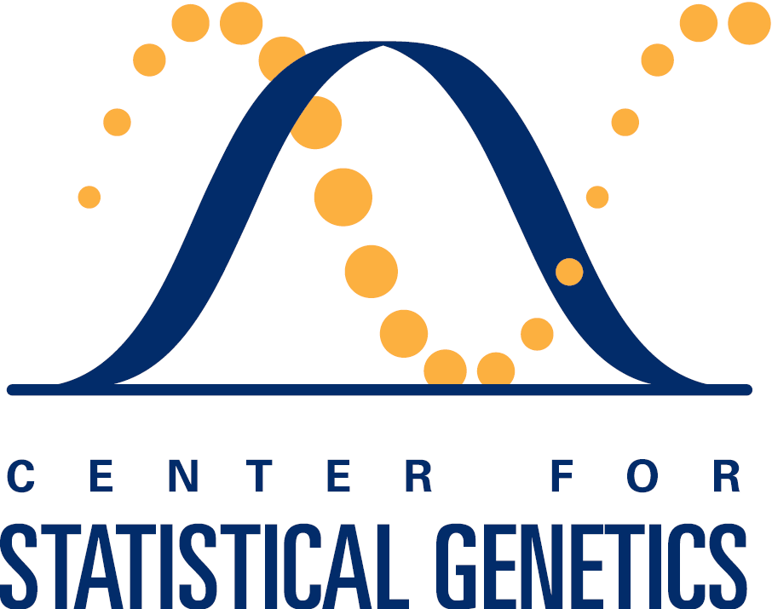
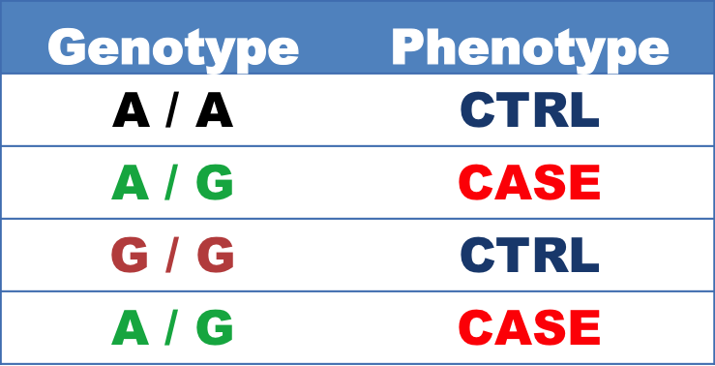
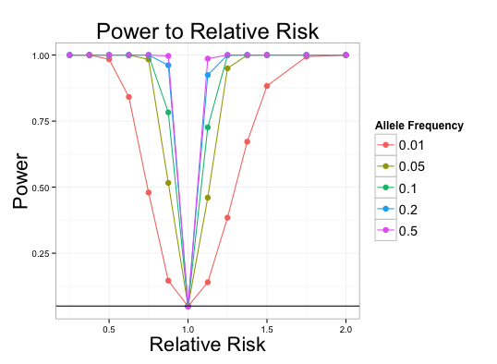
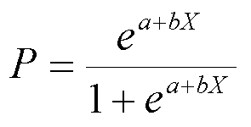
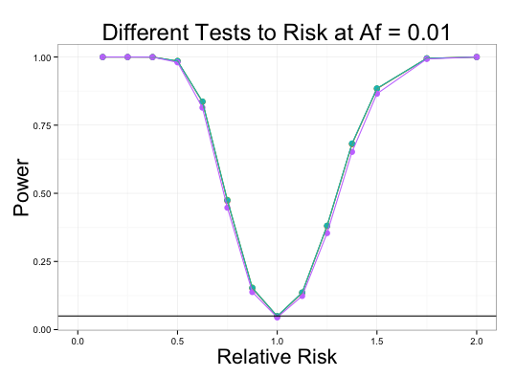
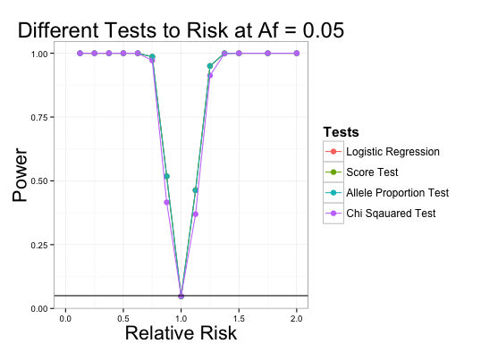
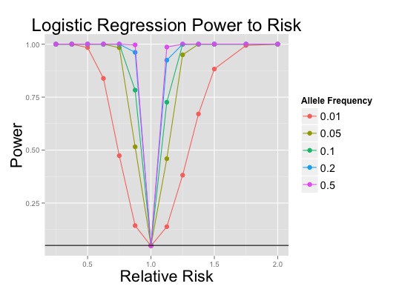
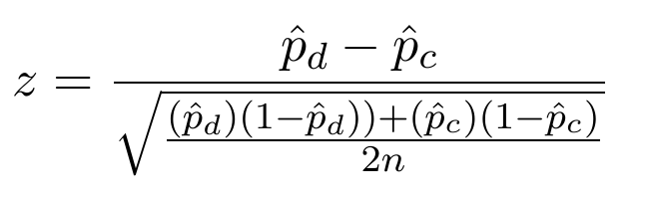
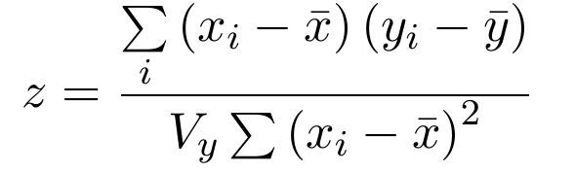
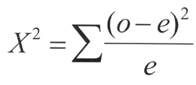
Genomics Meta Analysis
Kristine Lan(University of Michigan), Rushil Sheth(University of Missouri), Mike Thompson(University of Massachusetts-Amherst)
Motivation and Objectives:
Project Outline
Meta-Analysis: Combining multiple independent studies together to create a larger data set to find patterns and derive new conclusions.
Original Question: Find patterns and derive conclusions about Type II Diabetes through Meta-Analysis
Genome-wide association studies (GWAS) on rare genetic variants
Logistic Regression
Score Test
Allele Proportion Test
Fisher’s Exact Test
Apply data to
Acquire
p-value
Single Study Rare Variants GWAS:
Phenotype Simulation
10,000 cases + controls (with various % cases)
Genotype Simulation
Given disease prevalence (0.1%)
risk allele frequencies (0.1% ~ 50%) and multiplicative relative risks (0.125 ~ 5.0)
Calculate the allele frequencies for cases and ctrls
Simulate individual genotypes based on the frequency estimates
Parameters
weights
Find Ideal test
for meta-analysis
Equations
Graphs
Logit(Odds Ratio) Function:
Proportions Test
Score Test
Fisher’s Exact Test:

