Slide 1
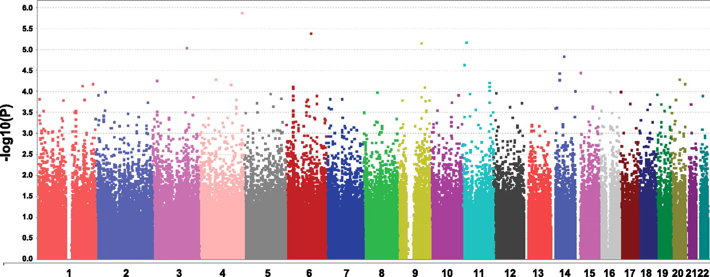
Genomics: Meta-Analysis
Kristine Lan, Rushill Sheth, Michael Thompson
Advising by: Gonçalo Abecasis, Sayantan Das, Hyun Min Kang

Slide 2

Motivation
Genome-wide association studies (GWAS) on rare genetic variants
Increase precision and pattern detection by acquiring larger dataset
Meta-analysis: “conducting research about previous research”
Disease prevalence: 0.0001
Notes:
Motivation should allude to goal

Slide 3
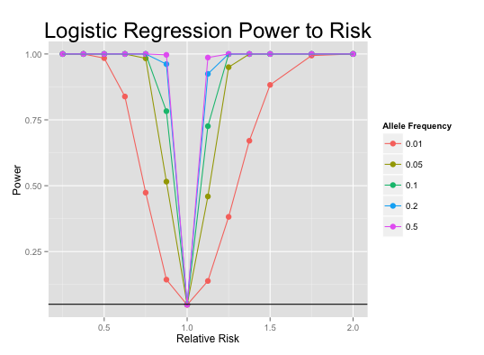
Project Outline
Genotype | Phenotype
aa | healthy
Aa | sick
AA | sick
Aa | healthy
Logistic Regression
Score Test
Allele Proportion Test
Chi-squared Tests
Apply data to
Acquire
p-value
Simulation
-parameters
-weights
-minimization
Ideal test
for meta-analysis
Visualization

Slide 4
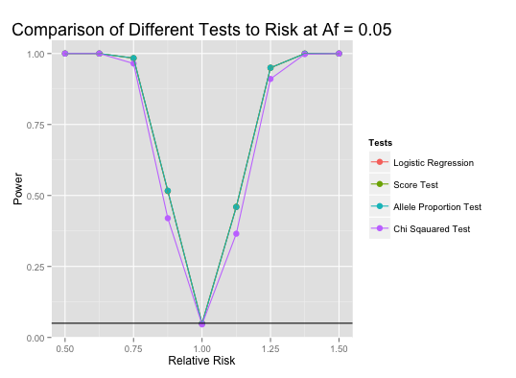

Slide 5

What We Learned
R
GitHub
Using the internet as a resource
Genome simulation techniques
Statistical methods: Logistic Regression, score test, … etc

Slide 6
References
Wikipedia-Meta-analysis

