Slide 1
Infrastructure Models Ecosystem Introduction 2025 Grid Science Winter School
David M Fobes
Information Systems & Modeling Group
2025/01/06
LA-UR-25-20073

Slide 2
Schedule
Part 1 (Monday):
Overview of InfrastructureModels.jl Ecosystem – David Fobes
PowerModelsITD.jl – Juan Ospina (Presented by David Fobes)
PowerModelsONM.jl – David Fobes
PowerModelsProtection.jl – Jose Tabarez
Part 2 (Wednesday)
GasModels.jl – Sai Hari
GasTranSim.jl – Sai Hari
Advanced Problem Development – David Fobes

Slide 3
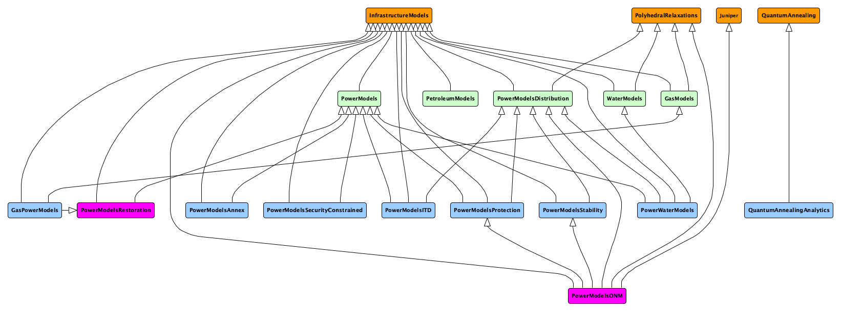
InfrastructureModels.jl Ecosystem

Slide 4
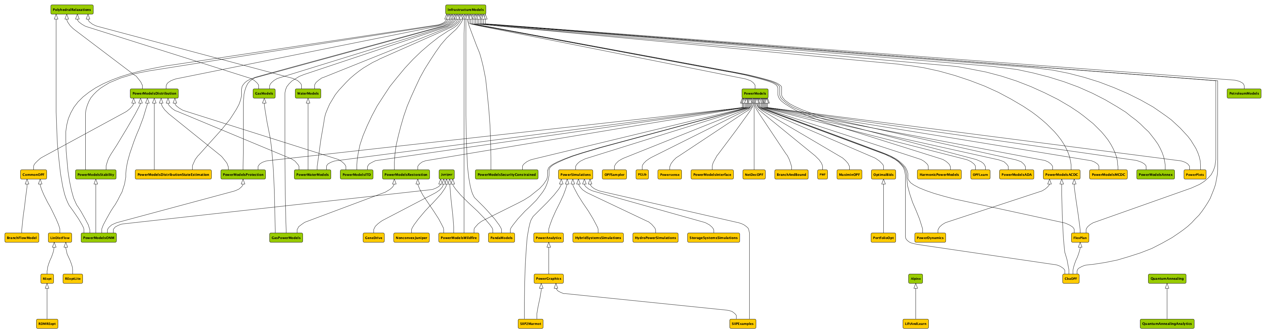
InfrastructureModels.jl Ecosystem

Slide 5


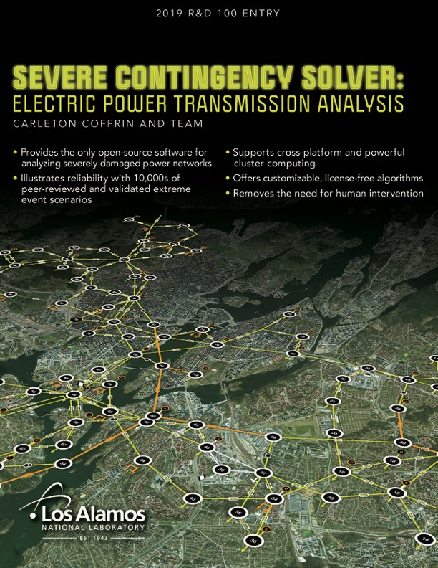
https://youtu.be/toLSJX_swFU
https://youtu.be/XYRzs7BrY1I

Slide 6
Key Power Systems Modeling Packages
PowerModels.jl: Transmission network optimization
PowerModelsRestoration: Optimal Restoration + MLD for Transmission
PowerModelsDistribution.jl: Distribution network (multiconductor) optimization
PowerModelsITD.jl: Integrated Transmission + Distribution optimization
PowerModelsONM.jl: Active distribution network optimization (multiconductor mixed-integer problems)
PowerModelsProtection.jl: Fault studies for either Transmission or Distribution
PowerModelsStability.jl: Small signal stability for distribution (experimental)

Slide 7
Key Gas Pipeline Modeling Packages
GasModels.jl: Optimization of natural gas pipelines
GasTranSim.jl: Transient Simulation of natural gas pipelines
PetroleumModels.jl: Optimization of petroleum pipelines

Slide 8
Key Other Infrastructure Modeling Capabilities
WaterModels.jl: Water distribution network optimization
PowerWaterModels.jl: Power distribution network + water distribution co-optimization
GasPowerModels.jl: Natural gas pipeline + power transmission co-optimization

