Slide 1
Using the D‐Wave 2X Quantum Computer to Explore the Formation of Global Terrorist Networks
John Ambrosiano (A‐1), Benjamin Sims (CCS‐6), Randy Roberts (A‐1)
April 27, 2017
Notes:
Content Slide Notes
“UNCLASSIFIED” marking of slides is not a security requirement and may be deleted from the Slide Master (View › Master › Slide Master). In general, slides should be marked “UNCLASSIFIED” if there is potential for confusion or misinterpretation of something that could be deemed classified. For guidance on marking slides containing classified and unclassified controlled information, see the Protecting Information Web site at http://int.lanl.gov/security/protectinfo/.

Slide 2
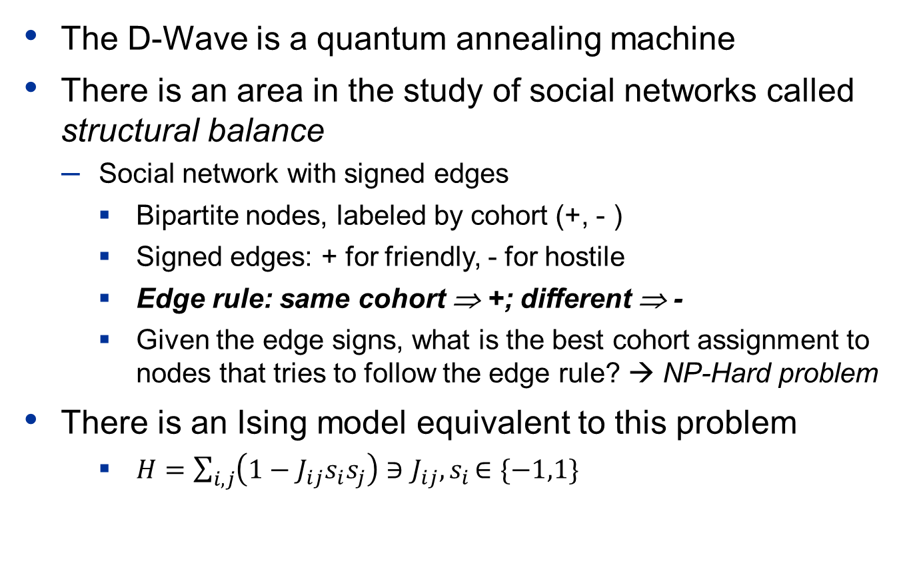
Using the D‐Wave 2X to Explore Structural Balance Sensitivity in Radical Social Networks
The D-Wave is a quantum annealing machine
There is an area in the study of social networks called structural balance
Social network with signed edges
Bipartite nodes, labeled by cohort (+, - )
Signed edges: + for friendly, - for hostile
Edge rule: same cohort ⇒ +; different ⇒ -
Given the edge signs, what is the best cohort assignment to nodes that tries to follow the edge rule? → NP-Hard problem
There is an Ising model equivalent to this problem
$H=\sum_{i,j}{\left(1−J_{ij}s_{i}s_{j}\right)∋J_{ij}{,s}_{i}∈\{−1,1\}}$
My two friends are enemies
(me)
(me)
(friend)
(enemy)
(friend)
(friend)
(balanced)
(unbalanced)
Effectively measures the number of edge rule violations
PNAS ∣ December 27, 2011 ∣ vol. 108 ∣ no. 52 ∣ 20953–20958

Slide 3
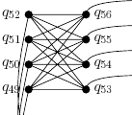
Exploring Signed Social Networks with D-Wave
We performed a series of experiments in calculating structural balance on signed-social networks, comparing D-Wave to a simulator on fully-connected graphs
Challenges:
Arbitrary networks don’t map to the D-Wave topology – even a triangle is hard
chain
next cell
next cell
Chaining nodes together to make the topology you want – a process called embedding – is also NP-hard
Given the current D-Wave machine topology, and the number of q-bits available, the maximum number of fully-connected, simulated nodes* is about 49 on a perfectly fabricated machine
Much of the overhead in executing a job on the D-Wave is communication and initialization, which can be many times more than D-Wave annealing time of 20 microseconds
*Out of approximately 1152 q-bits

Slide 4
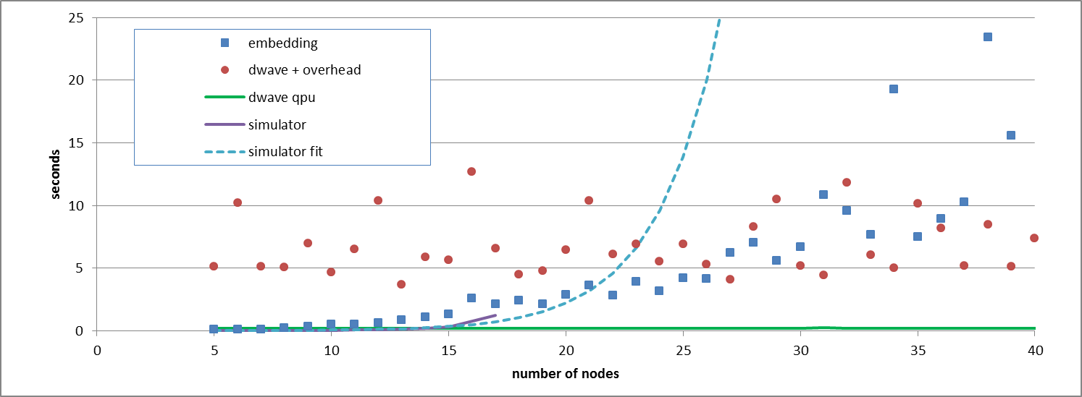
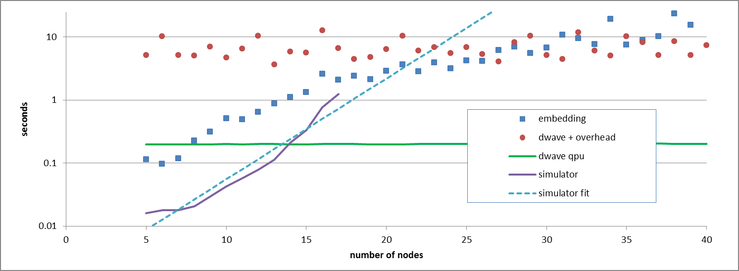
D-Wave Performance on a Complete Graph
Simulator fails at 18 nodes (embedded)

Slide 5
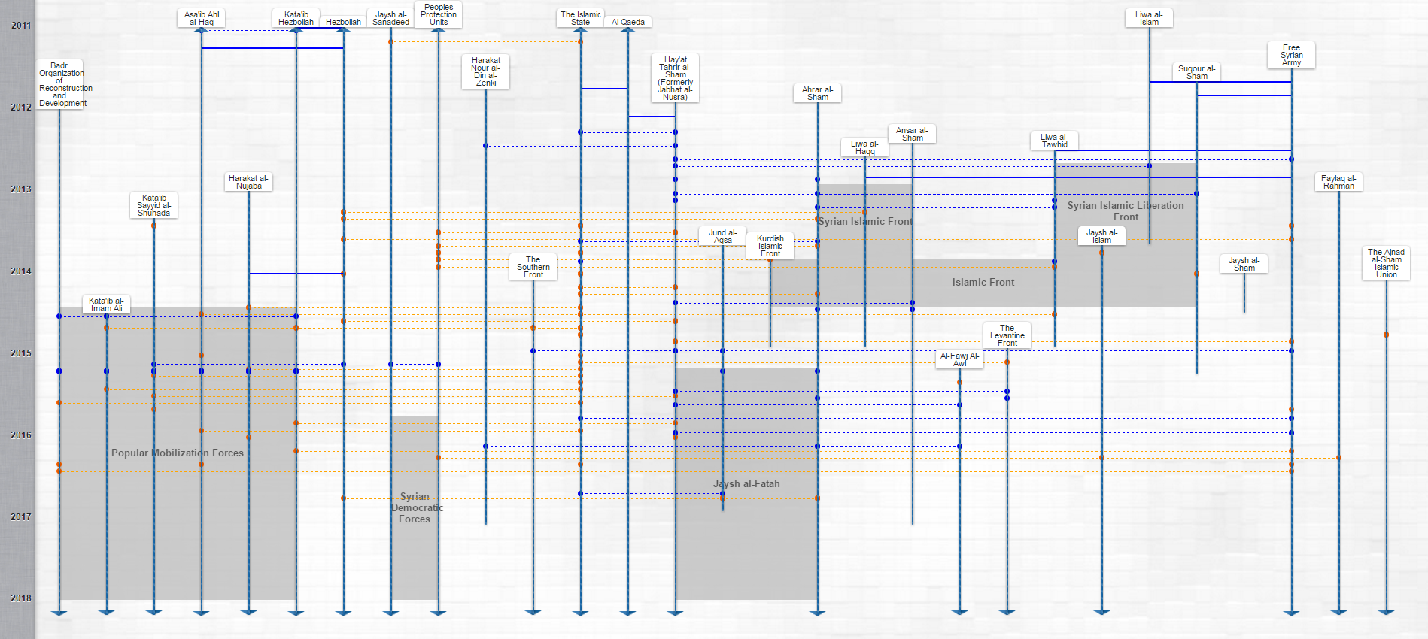
Real World: Stanford Mapping Militants Project
Project identifies patterns in the evolution of militant organizations, in specified conflict theatres, and provides interactive visual representations (http://web.stanford.edu/group/mappingmilitants/)
Syrian Theater Timeline

Slide 6
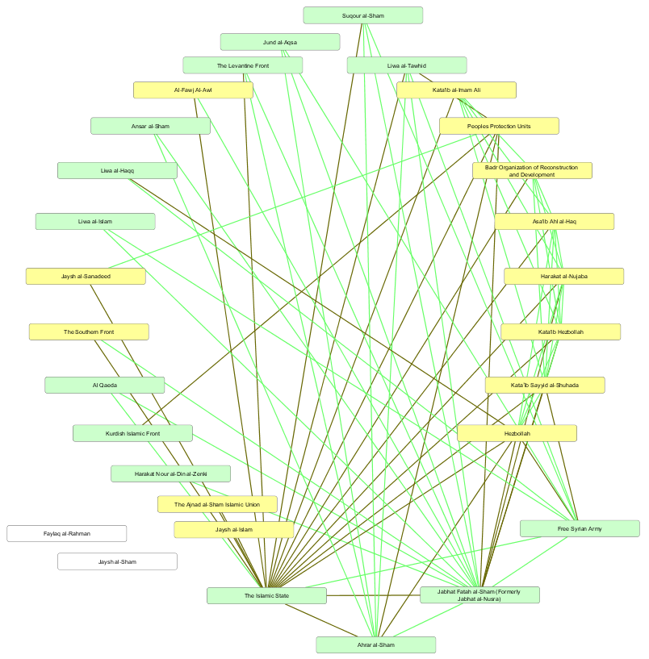
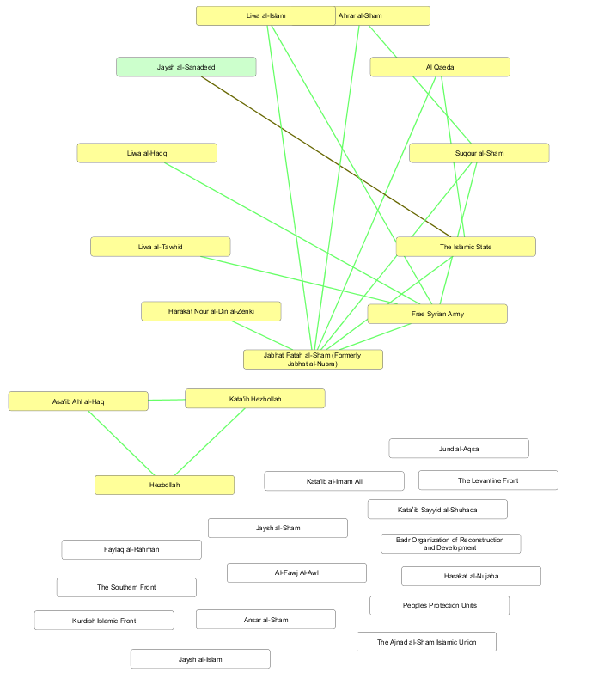
Syrian Theater Networks
Green edge ⇒ friend
Brown edge ⇒ enemy
Green node ⇒ Cohort 1
Yellow node ⇒ Cohort 2
imbalanced cycle
2013 Imbalance = 0
2016 Imbalance = 9
balanced cycle

Slide 7
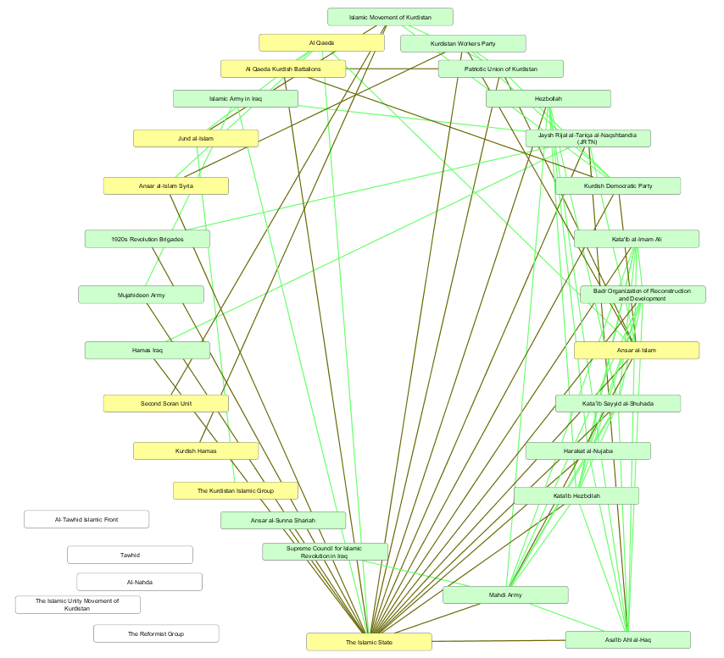
Iraq Theater Network
2016 Imbalance = 6
balanced cycle

Slide 8
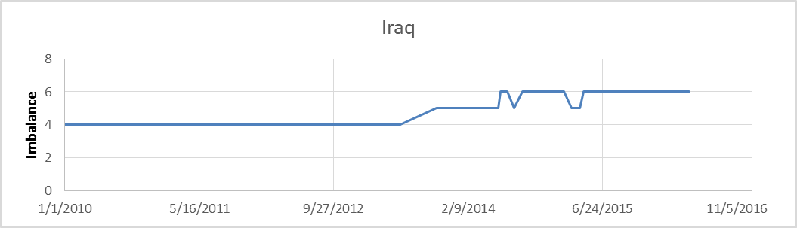
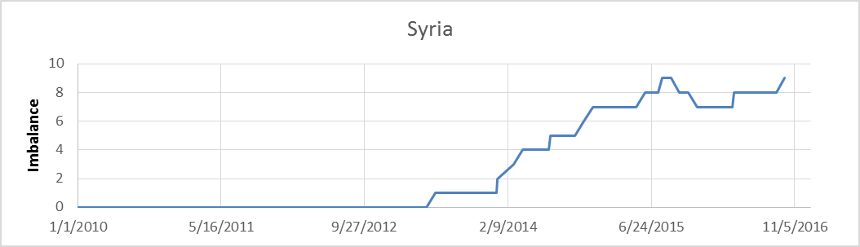
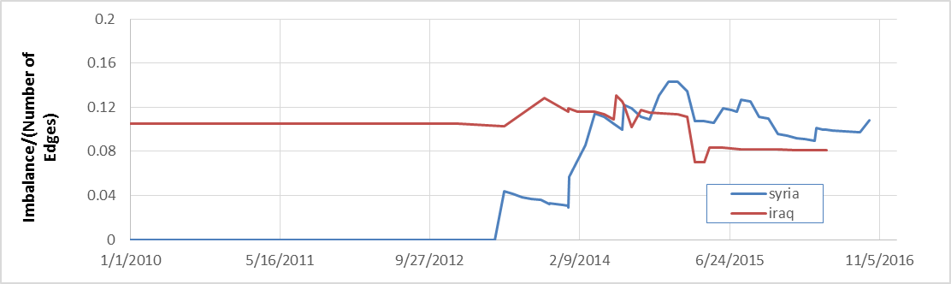
Balance Over Time
In the time window shown, the imbalance in Syria has increased by 4 times, but the imbalance per edge is nearly constant
What does it mean?
Are inter-group relationships adaptive to local imbalances?

Slide 9
Dynamic Relaxation of Network Imbalance
We use the D-Wave as an accelerator chip in a dynamic relaxation simulation ⇒ only need to embed the problem once
Given a social network with only edges assigned {J_{ij}}
Find the node assignment {s_{i}} and net imbalance (H) in the ground state using the D-Wave (quantum step)
Perturb the edge assignments, based on local edge rule violations (classical step) based on the probability that an improperly assigned edge changes sign. Two cases:
The probability is proportional to the imbalance/(number of edges)
The probability is proportion to 1/(the imbalance)
Return to (2)

Slide 10
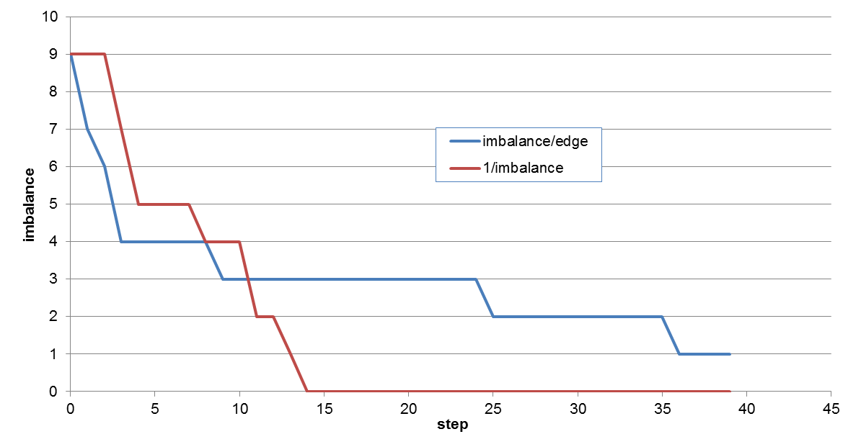
Relaxation Over Time
Each time an edge violating the rule is changed, a new global solution is obtained
It is nonetheless curious that these curves are monotone
Edge Change Probability Models

Slide 11
Summary Experience
We have used the D-Wave to explore some aspects of signed social networks
We have encountered several challenges – some expected and some not
The number of nodes that can be accommodated is relatively small (~49 out of 1152)
Embedding is a costly computation that doesn’t scale well
Surprisingly large communications and initialization overhead
Perhaps a “domain-iterative” method, with a pre-embedded scaffold on each sub-network domain, would allow a D-Wave-accelerated computation on very large networks
We have chosen to explore applications that will fit within our D-Wave machine without using multiple domains, specifically for estimating the structural imbalance in mappings of terrorist groups and their interrelations
In these very preliminary results, we have noticed that, for an extended period in one instance, the imbalance per edge seems to remain fairly constant while the size and imbalance in the network increase
We have also contrived a “dynamical” model that requires no re-embedding – the relaxation of an imbalanced network – based on the notion that problematic relationships (those that violate the edge rule) may spontaneously change sign with some given probability
Curiously, although these spontaneous changes intended to reduce imbalance are local, the global imbalance appears to decrease monotonically

Slide 12
Interpretations and Thoughts of Future Work
Sociological research shows unbalanced networks may be associated with greater levels of violence (Nakamura et al. 2011)
A balanced network can be cleanly divided into 2 factions
Research on gangs suggests unbalanced relationships are associated with greater violence between rival gangs, possibly due to increased ambiguity about factional allegiances
Hypothesis: increased imbalance in Syria network in 2013-2014 is due to conflicts among rebel groups that arose at this time due to entry of ISIS into the conflict
This might be demonstrated through sensitivity studies
Caveat: Initial rise in imbalance could be artifact of data collection
Correlation with violence could be established using validated casualty data, if available

