Slide 1
Endpoint Detection: Rust & eBPF for HPC user activity monitoring
Skip McGee, HPC
Thomas Bertschinger, HPC
June 26, 2025
LA-UR-25-26155

Slide 2
Table of Contents
Problem Definition
Identified Solutions
Tech Review
Panhandle
Performance
Future
What are we trying to do and why
What existing solutions should we consider and evaluate?
Understanding eBPF and developing projects
Implementing a solution
Assessing the solution we chose
Where could or should we continue to improve?

Slide 3
Background: the changing landscape of HPC
The HPC security model has historically been a hard outer shell and a relatively gooey middle.
HPC has been reluctant to field applications inside the cluster focused on monitoring and securing user workloads, due to performance impact considerations.
LANL collaborating with OpenAI & implementing OpenAI models on Razorback (Testbed) and Venado (Production)
New security paradigm: provide platform security while also providing cybersecurity as a service for externally managed OpenAI services and applications.
The growth of EDR (Endpoint Detection and Response) products has been significant in the last 5-10 years.
Growing emphasis on understanding the ability to apply Zero Trust principles to HPC.
Anticipated workload changes to support GPU-intensive workloads like AI/ML training & inference.

Slide 4
Problem Definition:
Implement effective monitoring of user activity with minimal performance impact
A malicious user probably won’t run `evil.sh`, but we CAN:
  Audit to scope compromise (after the fact)
  Audit to detect exploitation (at/after the act)
  Pattern user behavior ****(before the act)****
  Detect reconnaissance activity ****(before the act)****
We can NOT:
  Significantly degrade node / cluster performance
Security End State:

Slide 5
Identified Solutions
Improve and maintain what we were already doing:
  Custom system auditing (`auditd` rules)
  Syslog forwarding audit and other events (`rsyslog`)
Implement an existing EDR?
Implement a terminal logger, needs to cover:
  Bash
  Zsh
  Tcsh
  other shells
Develop our own solution?

Slide 6
EDR Alternatives
CrowdStrike
SentinelOne
Licensing Costs ($$$)
eBPF
Linux agents (cross platform, but we only run Linux)
Monitoring platform (client / server linking architecture)
Wide focus:
  Desktop => Server
  Lots of applications
  Lots of host configurations
What do these solutions have in common?

Slide 7
eBPF Review
eBPF is old: formerly known as Extended Berkley Packet Filters, integrated into the Linux kernel in 2014, successor to BPF (implemented in the Linux kernel in 1993)
BTF CO-RE (Compile Once - Run Everywhere)
  “a concept to build cross-version kernel eBPF application by building in a single binary by bringing together the BTF type information, libbpf and the compiler.”
Languages: C, Go, Rust, Python
Multiple different projects that are worth mentioning:
  BCC Tools
  Rust: libbpf-rs, aya
eBPF is resource limited (especially memory)
Exposed program types include tracepoints, user probes and kernel probes

Slide 8
The Aya Rust Project
Pros:
  Write Rust, compile into CO-RE compliant eBPF bytecode: “Support for the BPF Type Format (BTF), which is transparently enabled when supported by the target kernel. This allows eBPF programs compiled against one kernel version to run on different kernel versions without the need to recompile.” https://github.com/aya-rs/awesome-aya
  Provide a single binary that contains the entire program (minimize host dependencies): “aya doesn't require a kernel build or compiled headers… or a C toolchain” https://github.com/aya-rs/awesome-aya
  Leverage Rust workspaces for userspace, common and eBPF programs & exposes standard eBPF methods: “Support for function call relocation and global data maps, which allows eBPF programs to make function calls and use global variables and initializers” https://github.com/aya-rs/awesome-aya
  There is significant development in this space: https://github.com/zoidyzoidzoid/awesome-ebpf
Cons:
  Currently in the unstable nightly build (as of rustc 1.90.0-nightly)
  Limited documentation
  Linux Kernel >= 4.3 for a majority of features

Slide 9
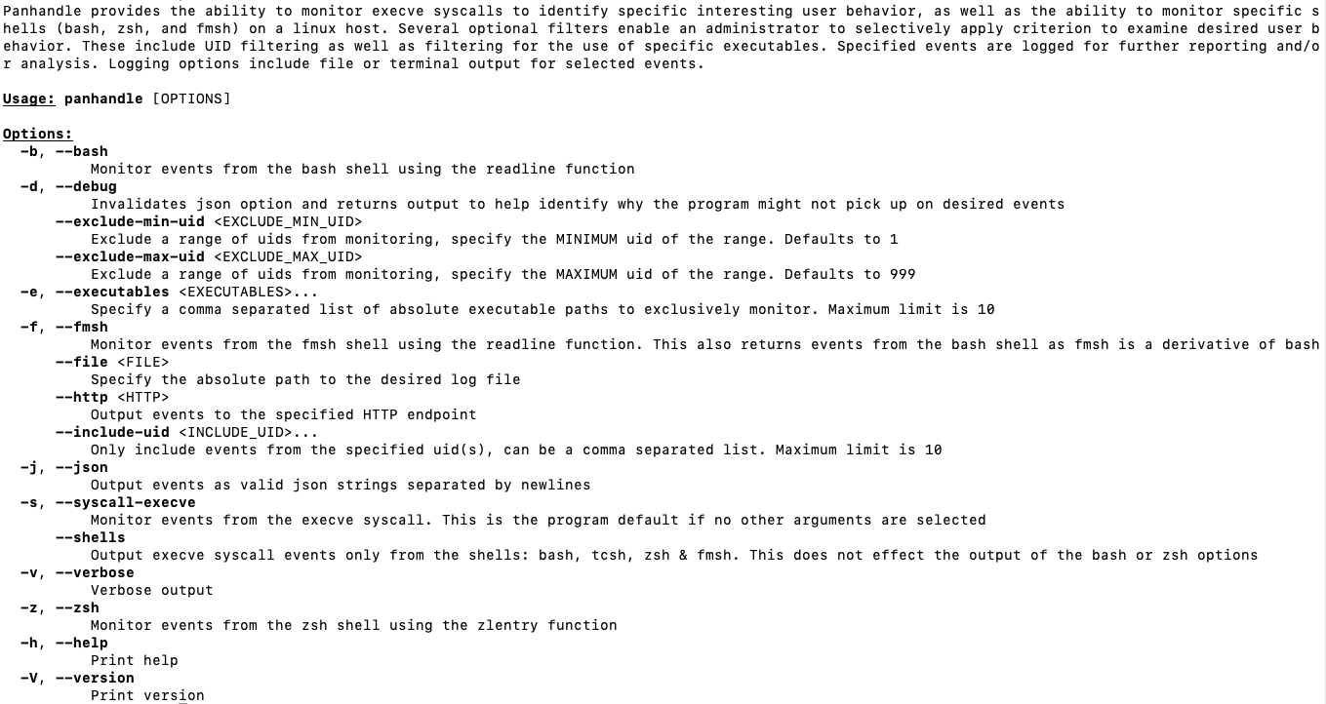
Panhandle
Filter by uid
Target shell and/or execve syscall
Human or JSON results
Console, file or http output

Slide 10
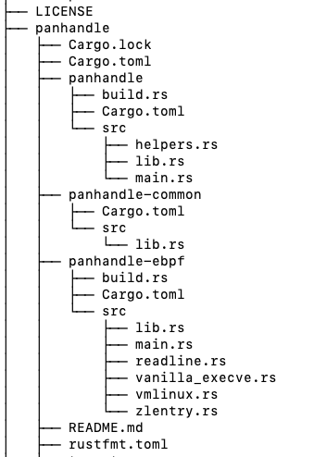

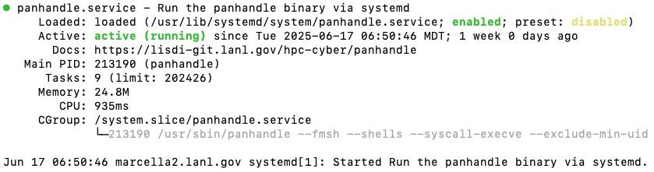
Panhandle Components
RPM Contains:
Binary
Man page
Systemd Service
Userland program (CLI, argument parsing, output)
Common (shared) methods, structs, etc.
eBPF Program(s)
Systemd Service:

Slide 11
Panhandle Output (Bash Shell Example)
Human readable, `panhandle --bash --file /var/log/panhandle/panhandle.log`:
17:08:44 [INFO] moniker: elvis, entry: uname -a, command: bash, uid: 77777, pid: 1604000, gid: 66666, tgid: 1604000, ts_utc: '2025-06-24_17:08:44'
17:08:46 [INFO] moniker: elvis, entry: whoami, command: bash, uid: 77777, pid: 1604000, gid: 66666, tgid: 1604000, ts_utc: '2025-06-24_17:08:46'
17:08:52 [INFO] moniker: elvis, entry: bash evil.sh, command: bash, uid: 77777, pid: 1604000, gid: 66666, tgid: 1604000, ts_utc: '2025-06-24_17:08:52'
JSON, `panhandle --bash –json --file /var/log/panhandle/panhandle.log`:
17:09:40 [INFO] {"moniker": ”elvis", "entry": "whoami", "command": "bash", "uid": " 77777 ", "pid": "1604000", "gid": " 66666 ", "tgid": "1604000", "ts_utc": "2025-06-24_17:09:40"}
17:09:43 [INFO] {"moniker": ”elvis", "entry": "uname -a", "command": "bash", "uid": " 77777 ", "pid": "1604000", "gid": " 66666 ", "tgid": "1604000", "ts_utc": "2025-06-24_17:09:43"}
17:09:45 [INFO] {"moniker": ”elvis", "entry": "bash evil.sh", "command": "bash", "uid": " 77777 ", "pid": "1604000", "gid": " 66666 ", "tgid": "1604000", "ts_utc": "2025-06-24_17:09:45"}

Slide 12
Panhandle Output (Execve Syscall Example)
Human readable, `panhandle --syscall-execve –file /var/log/panhandle/panhandle.log`:
17:16:49 [INFO] moniker: elvis, filename: /usr/bin/bash, command: bash, uid: 77777, pid: 1604264, gid: 66666, tgid: 1604264, args: [bash,evil.sh,], envs: [SHELL=/bin/bash,HOSTNAME=vegas.lanl.gov,KRB5_PKCS11=PKCS11:/usr/lib64/pkcs11/libnetpkcs11.so,MODULES_VERBOSITY=concise,
PWD=/home/elvis,KRB5CCNAME=FILE:/tmp/krb5cc_77777_TNRWne,LOGNAME= elvis,XDG_SESSION_TYPE=tty,HOME=/home/ elvis,LANG=en_US.UTF-8, SSH_CONNECTION=777.777.777.777 55122 666.666.666.666 22,XDG_SESSION_CLASS=user,TERM=xterm-256color,], ts_utc: '2025-06-24_17:16:49'
JSON, `panhandle --syscall-execve --file /var/log/panhandle/panhandle.log `:
17:20:44 [INFO] {"moniker": ”elvis", "filename": "/usr/bin/bash", "command": "bash", "uid": ”77777", "pid": "1604295", "gid": ”66666", "tgid": "1604295", "args": ["bash", "evil.sh"], "envs": ["SHELL=/bin/bash", "HOSTNAME=vegas.lanl.gov", "KRB5_PKCS11=PKCS11:/usr/lib64/pkcs11/libnetpkcs11.so", "MODULES_VERBOSITY=concise", "PWD=/home/elvis ", "KRB5CCNAME=FILE:/tmp/krb5cc_77777_TNRWne", "LOGNAME=elvis", "XDG_SESSION_TYPE=tty", "HOME=/home/elvis ", "LANG=en_US.UTF-8", "SSH_CONNECTION=777.777.777.777 55122 666.666.666.666 22", "XDG_SESSION_CLASS=user","TERM=xterm-256color"], "ts_utc": "2025-06-24_17:20:44" }

Slide 13
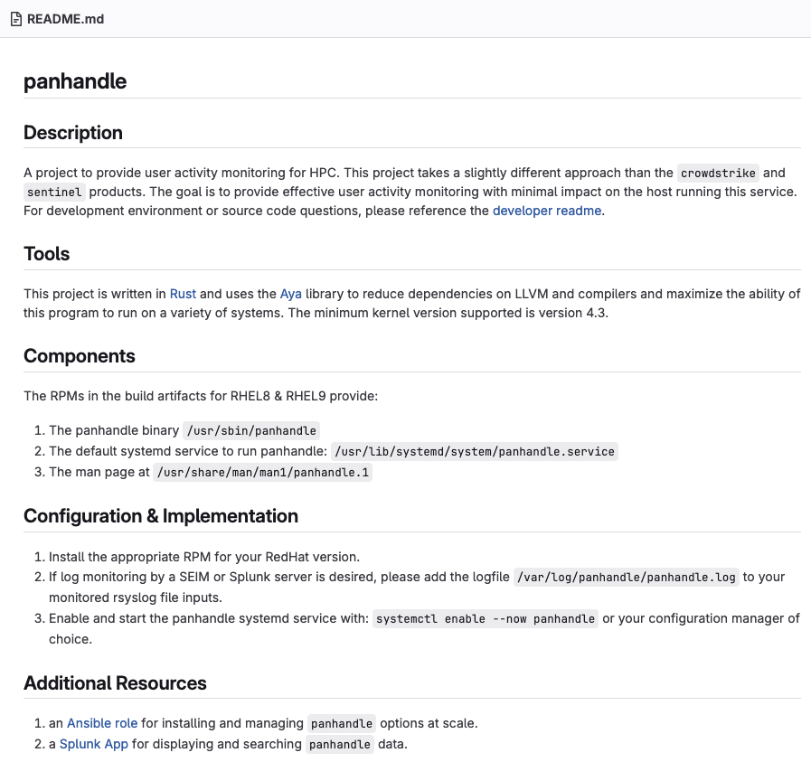
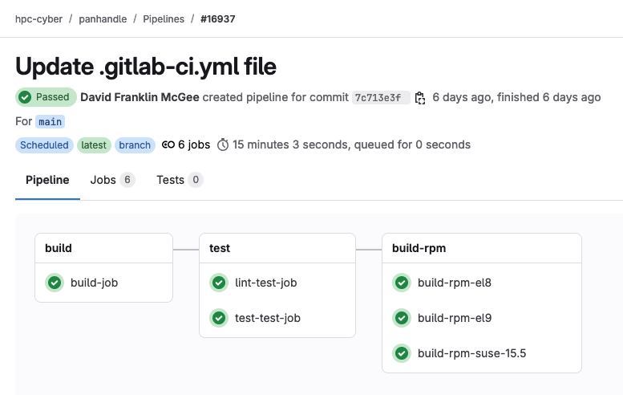
GitLab Project + CI
CI Lint, Test, build binary release, build rpms (ARM + AMD builds)
GitLab project for collaboration

Slide 14
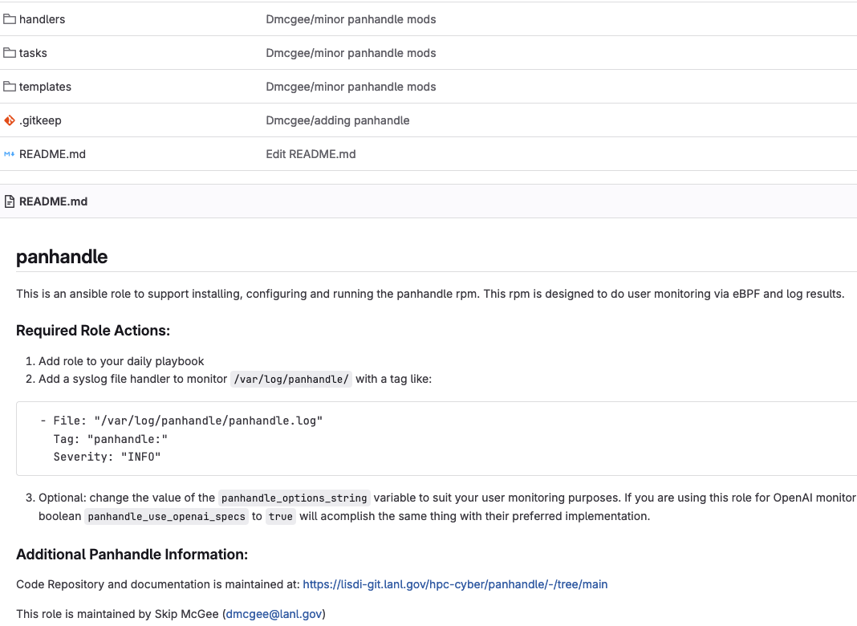
Ansible Role
Install rpm
Set up custom system configs
Expose OpenAI defaults as a boolean
Enable system service file customization
Manage service
Rsyslog file handler or http logger
Panhandle Ansible role

Slide 15
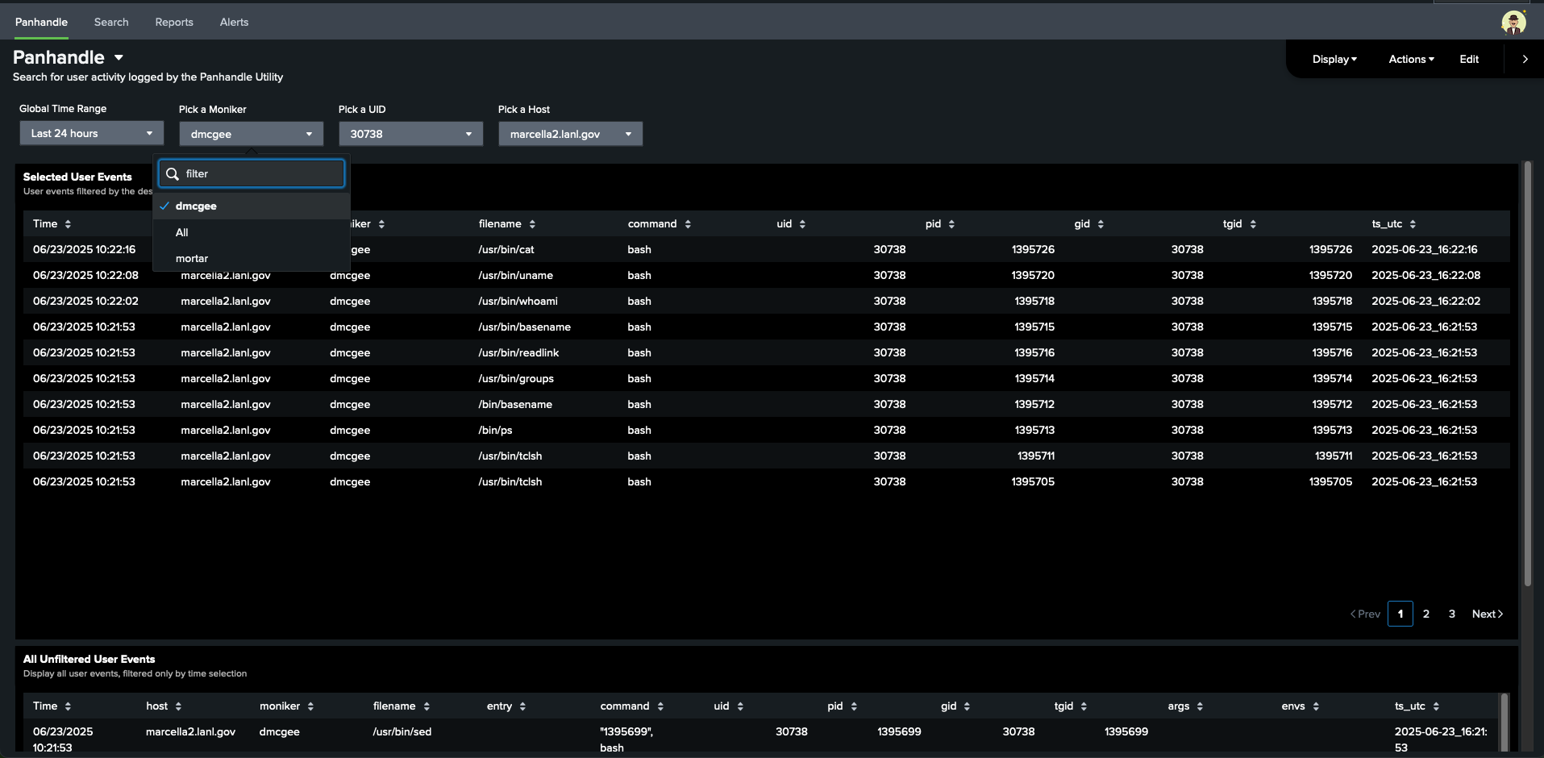
Splunk Monitoring App
Filter by:
Moniker
UID
Host
Time
Future:
  Top/Tail
  Additional analytics
moniker
uid
host
moniker
moniker2
monikers
uid
tgid
hosts
Unfiltered entries
Panhandle Splunk App

Slide 16
Performance Testing
  Dynamic service: workload increases with user activity
  Razorback (Testbed for OpenAI, SLES)
  Selene (Testbed for OpenCHAMI, RHEL8)
  Test suite: Pavilion because that is what our PRE team uses (detail in next slide)
  Anticipated performance impacts:
    gigaflops (computing speed impacted by background system processes)
    memory (memory will be used by the process)
    filesystem: write to a single log file when configured (negligible file size, <1MB when run for 7 days)
    network: only uses network directly when the http option is selected to send the same data/size as the log file
    other process impacts: rsyslogd file handler addition (trivial impact for a single file addition, this service is already used for monitoring other log files)

Slide 17
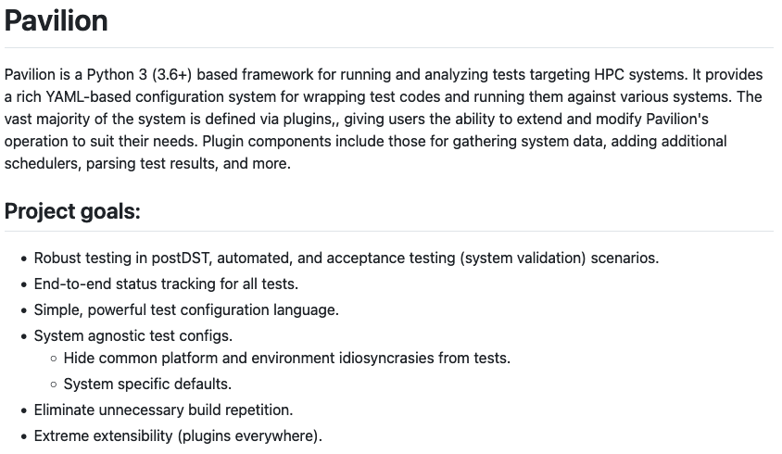
Performance Test Suite (Pavilion)
What is Pavilion?
  Used to configure test inputs and problem sizes
The High Performance Conjugate Gradients (HPCG) Benchmark:
  “uses a preconditioned conjugate gradient (PCG) algorithm to measure the performance of HPC platforms with respect to frequently observed, yet challenging, patterns of execution, memory access, and global communication.” https://icl.utk.edu/files/print/2021/hpcg-sc21.pdf
How did we set it up?
  Razorback: `pav run hpcg -c schedule.include_nodes=nid001030 -c schedule.slurm.sbatch_extra='--mem=20G --ntasks=12’`
  Selene: `pav run hpcg -c schedule.slurm.sbatch_extra='--ntasks=2 --mem-per-gpu=40G --gpus-per-task=1' -c schedule.include_nodes=se003`

Slide 18
GigaFlops Performance Test Results (Razorback)
Max/Min Difference (GFlops): | 0.03538
Variation from Median Performance (%) | 0.00461443
Average Node Performance (GFlops) | 7.6639
Median Node Performance (GFlops) | 7.66726
multiple runs
Test Number | Panhandle Status
1 | Control (Not Running)
2 | OpenAI Options
3 | Control (Not Running)
4 | Gateway Options
5 | Control (Not Running)
6 | FMSH monitoring
7 | Control (Not Running)
Test #
Sequential

Slide 19
GigaFlops Performance Test Results (Selene)
Max/Min Difference (GFlops): | 0.0273
Variation from Median Performance (%) | 0.01336597
Average Node Performance (GFlops) | 2.05098235
Median Node Performance (GFlops) | 2.0425
Test Number | Panhandle Status
1 | Control (Not Running)
2 | OpenAI Options
3 | Control (Not Running)
4 | Gateway Options
5 | Control (Not Running)
6 | FMSH monitoring
7 | Control (Not Running)
Test #
Sequential

Slide 20
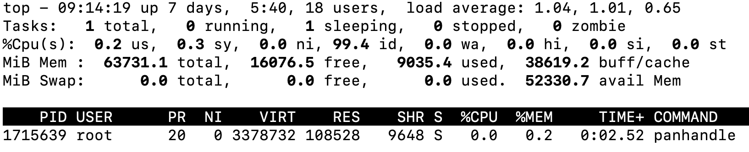
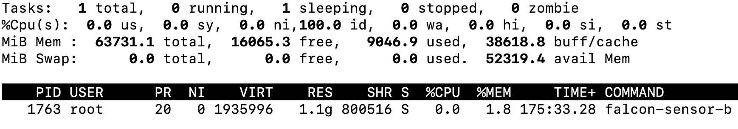
Memory Useage Results (RHEL8 Gateway Node)
The running Panhandle service memory Resident Set Size:
  113.9 MB:
The running CrowdStrike service memory Resident Set Size :
  1.1697 GB
Top from running process:
  Panhandle:
  CrowdStrike:

Slide 21
Performance Assessment
Both the best and worst runs were made while `panhandle` was running
The impact of `panhandle` to user job compute performance is within the system noise
`panhandle` consumes more memory than any other system resource
`panhandle` improvements should focus on reducing memory useage
The `panhandle` service used between 1/9-1/10 the memory of the running CrowdStrike service
`panhandle` has significantly less system impact than running CrowdStrike
Caveat: this is system integration testing so the service impact may vary depending on system configurations

Slide 22
Future
  Monitoring: Splunk application refinement
  Behavioral patterning
    This can be as obvious as anything !=`ssh frontend` from a gateway
  Reconnaissance identification?
  Exploit attempt identifications? Perhaps based on Proof of Concept Exploits?
  Potential `panhandle` feature additions
    Machine Learning model integration?
    Response capability (initially to meet OpenAI requests)
    What is the impact of additional features?

Slide 23

Review
Labor Costs:
    10 hours research and design
    200 hours programming
    10 hours testing
    5 hours integration
    Total: 225 hours
Hardware Costs: N/A
Performance Impact:
    No significant node performance impact
Results:
    Increased security monitoring
    Established a platform for future features

Slide 24
Questions

