Slide 1

Summary of Data Structure and Availability
Lauren J Beesley AND LANL Infectious disease forecasting team

Slide 2
Some basic stats
7076 time series
7076 time series
68 diseases
68 diseases
68 diseases
2,343,562 nonzero observations

Slide 3
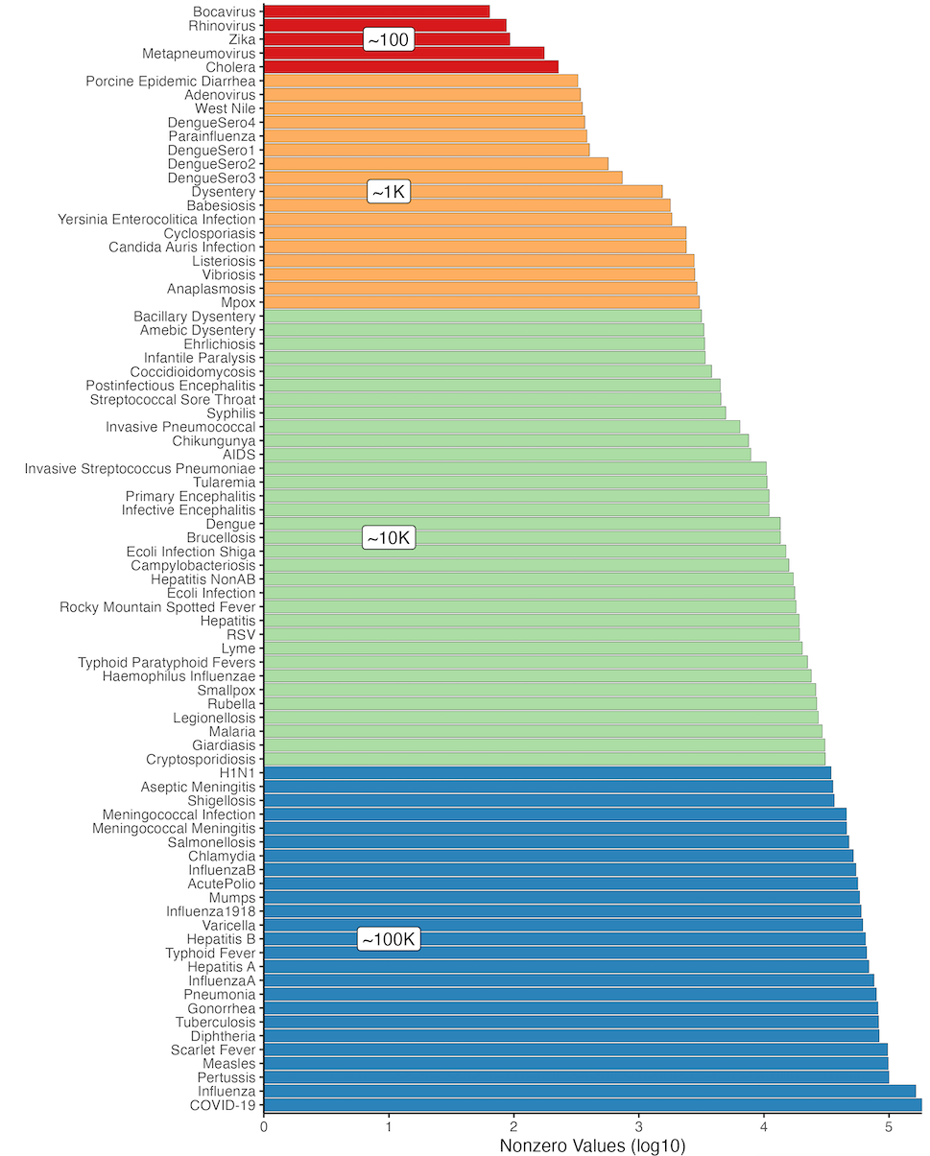
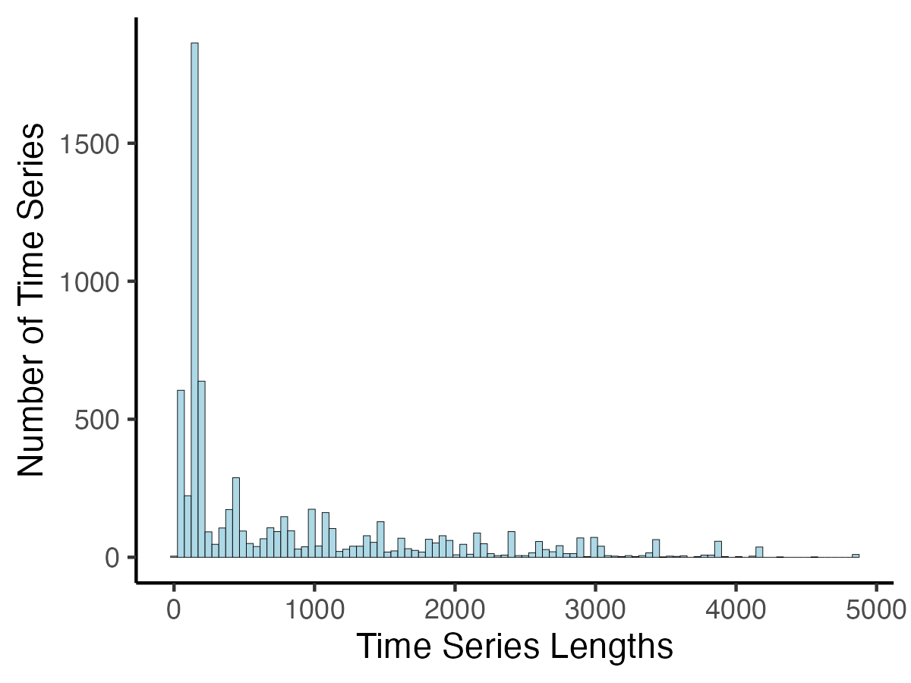
Amount of Data Available
Many time series across a variety of diseases
Often, data available for multiple locations
Dengue fever, influenza, and hepatitis subtypes
Number of Nonzero Observations per Disease
Lengths of All Weekly or Monthly Time Series

Slide 4
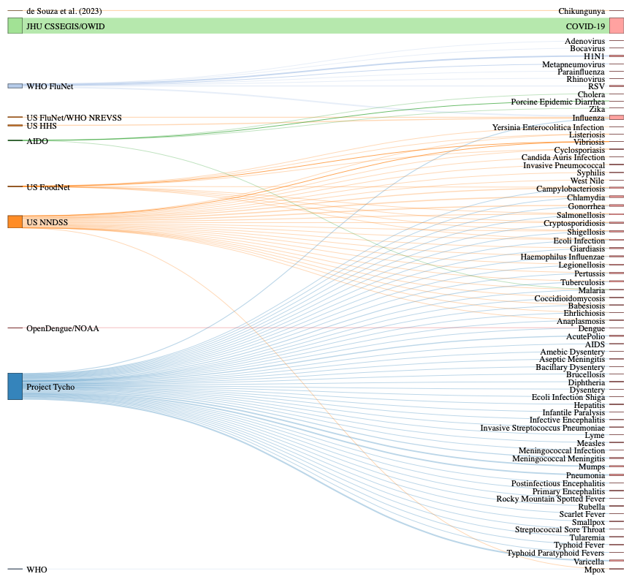
Sankey Diagram of Data
Left = Data Sources
Right = Diseases
Some diseases have available data from multiple data sources

Slide 5
Time Coverage for Weekly Data
Excludes monthly FoodNet data
Multiple data sources may cover similar time periods

Slide 6
Structure of _Organized_Lists Data
Indexing Different Time Series
Data for Single Time Series
Disease_Source.RDS
List[[1]]$ts
List[[1]]
List[[1]]$ts_dates
List[[1]]$ts_dates_actual
List[[2]]
List[[1]]$ts_measurement_type
List[[3]]
List[[1]]$ts_geography
List[[1]]$ts_time_cadence
…
…
List[[x]] Elements Correspond to Different Time Series, e.g.,
Different Locations
Different Time Scales (e.g., daily or weekly)
Different Outcomes (cases, deaths, hospitalizations, etc.)

Slide 7
Data Fields for Each Time Series Entry
Time Series Characteristic | Description
ts | Time Series Observations
ts_dates | Processed/clean dates of observations case to regular daily/weekly cadence. For US FoodNet monthly data, dates are recorded in a YEAR_MONTH format.
ts_dates_actual | Raw dates of observations in original data. NA values indicate days/weeks not included in raw data (Excluding Project Tycho)
ts_dates_start_actual | Start of raw observation intervals after converting to incidence (Project Tycho Only)
ts_dates_end_actual | End of raw observation intervals after converting to incidence (Project Tycho Only)
ts_disease | Disease name
ts_measurement_type | Incidence/deaths/hospitalizations
ts_geography | Location Name (not standardized across data streams)
ts_first_time | First date of observations
ts_last_time | Last date of observations
ts_time_cadence | Monthly/weekly/daily
ts_scale | Counts/proportion

