Slide 1
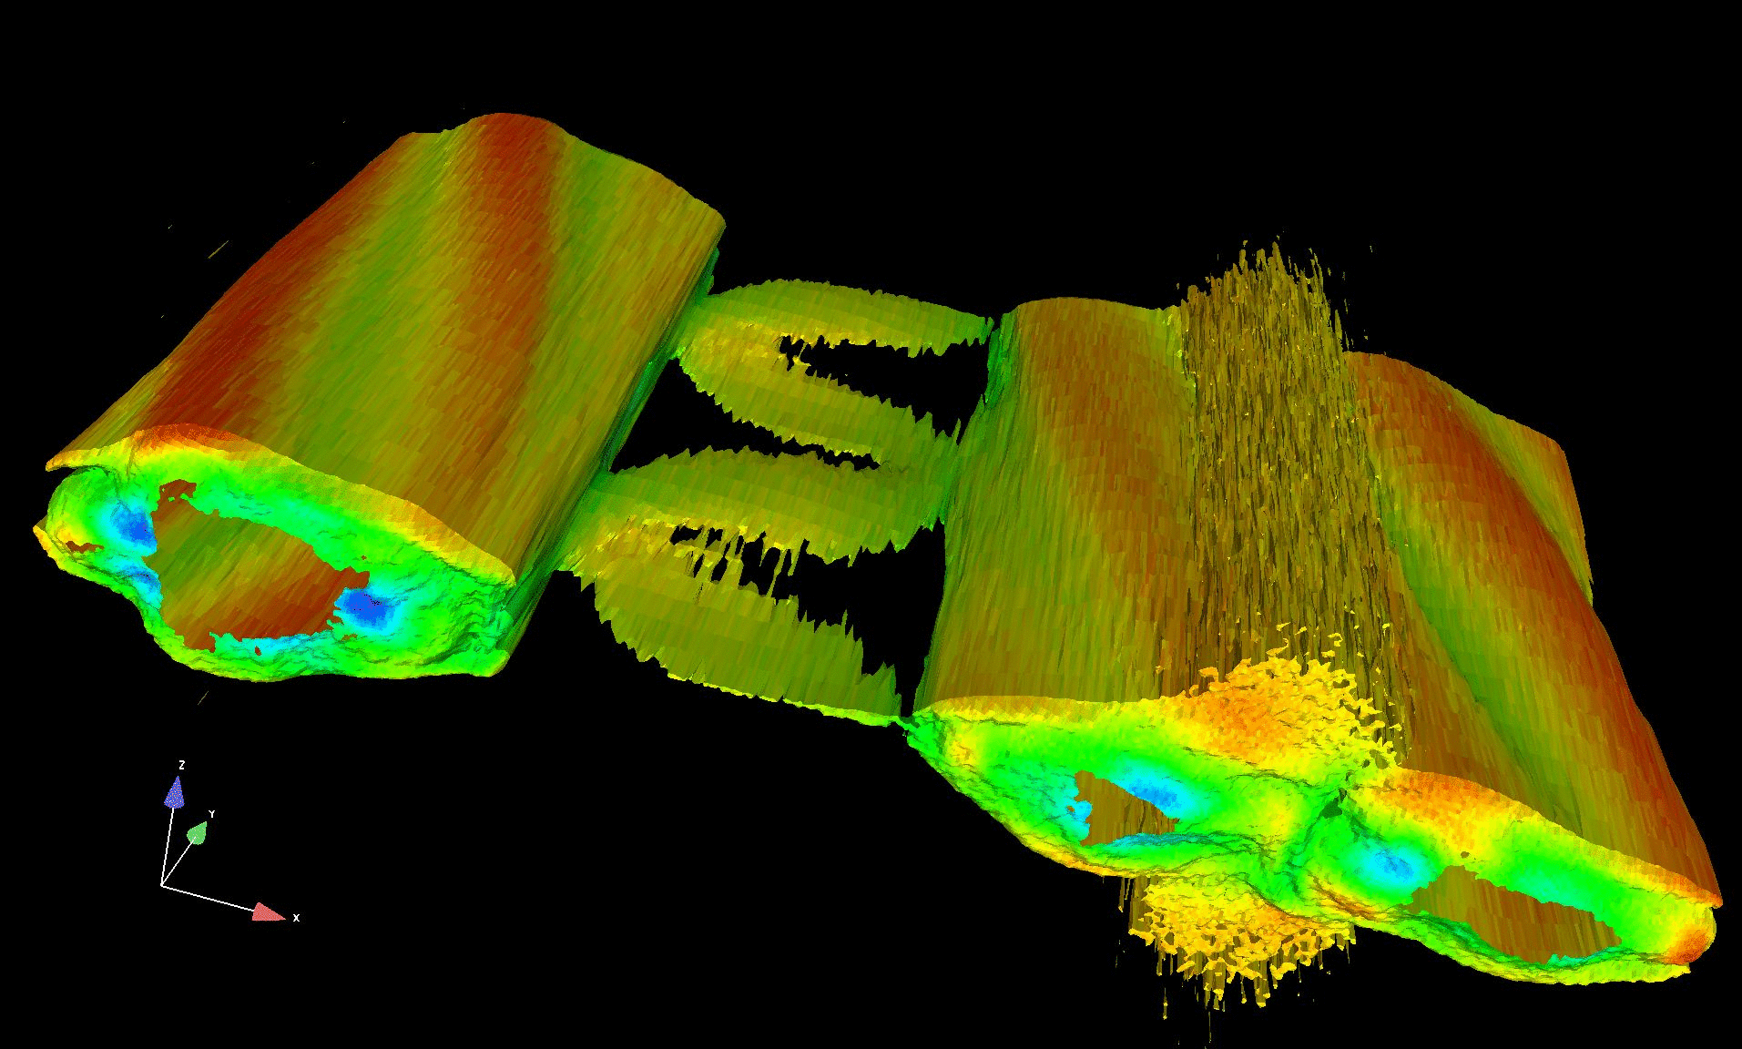
Toward Petaflop Scale First Principles Plasma Simulation
K. J. Bowers*, B. J. Albright
L. Yin, B. Bergen and T. J. T. Kwan
Los Alamos National Lab
* Guest Scientist. Presently at D. E. Shaw Research LLC, New York, NY

Slide 2
Overview
Introduction
VPIC methods
VPIC implementation
VPIC applications
Conclusions

Slide 3
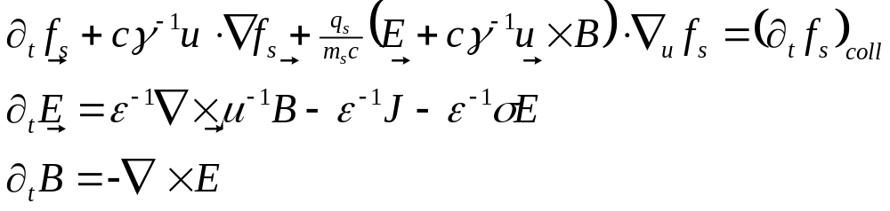
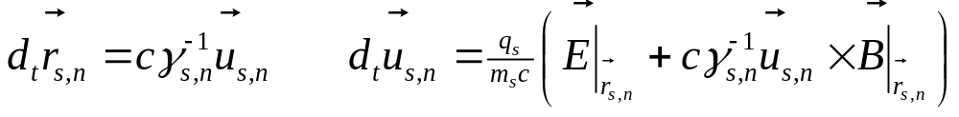
Particle-in-cell overview
VPIC integrates the relativistic Maxwell-Boltzmann system in a linear background medium:
Direct discretization of f_{s} is prohibitive; f_{s} is sampled by particles:
Computational particles have same the f_{s} outside the collision term
A smooth J is determined by the particles; as a result, E, B and J can be sampled on a mesh and interpolated to and from particles

Slide 4
Why PIC?
First principles
  Very few physical approximations (can even include atomic and quantum effects in collisional term)
No closure relations
  Handle non-thermal (kinetic) effects
Continuity equation is implicitly enforced
Field and particle representation allows complicated boundary conditions to be implemented
  Thermionic / Fowler-Nordheim / secondary emission; conductors / dielectrics / impedance walls …

Slide 5
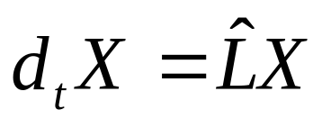
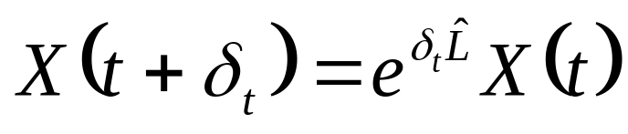
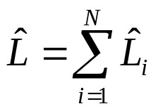
Operator splitting
For a well-behaved operator, the operator equation:
has the formal solution:
If L can be split into the sum of N well-behaved operators:
a 2nd order approximation of the operator exponential is:

Slide 6
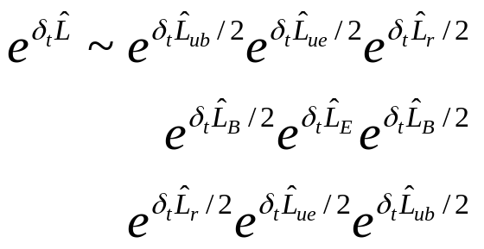
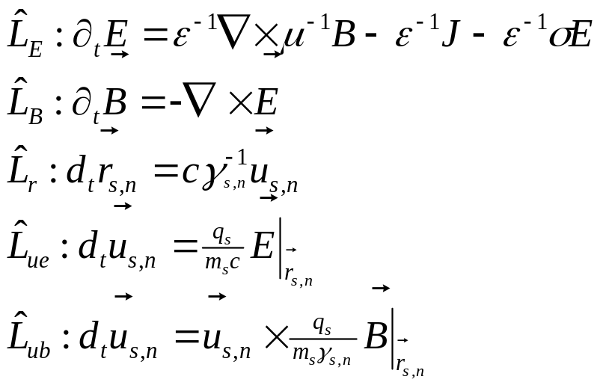
Operator splitting (cont)
One splitting for the relativistic Maxwell-Boltzmann equations is:
where:

Slide 7
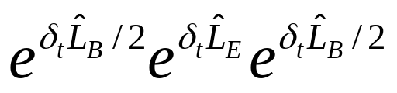
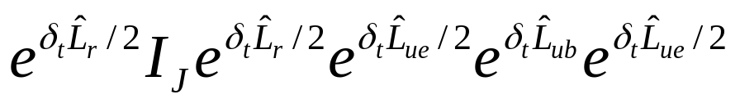
VPIC time discretization
Repeatedly applying this splitting and grouping particle and field updates separately yields VPIC’s field advance:
and VPIC’s particle advance:
(I_{J} means J for the field advance is computed but the state is unchanged)
Thus, a mixture of leapfrog and velocity Verlet is used to advance E, B and r from t to t+δ_{t} and u from t-δ_{t}/2 to t+δ_{t}/2
This underlying time discretization has robust theoretical properties; reversible, phase space volume conserving, ...

Slide 8
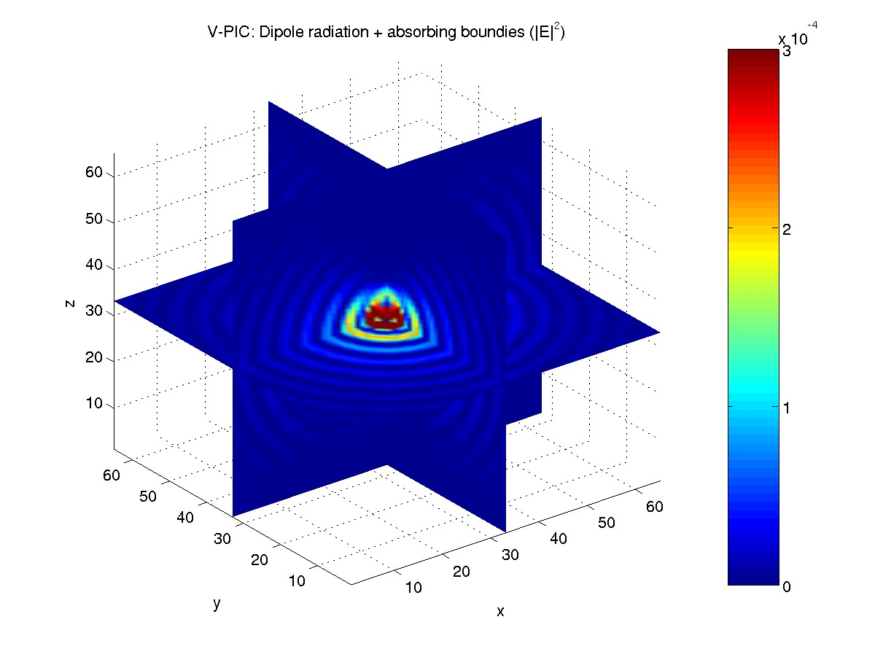
VPIC space discretization
B_{z}
B_{x}
B_{y}
E_{z}, J_{z}
E_{y}, J_{y}
ρ
E_{x}, J_{x}
Simulation divided into a regular mesh of Cartesian cells with potentially irregular (cell-aligned) boundaries
E, B and J are sampled staggered on a Yee mesh (Yee 1966)
Many boundary conditions supported (e.g. Higdon 1986)

Slide 9
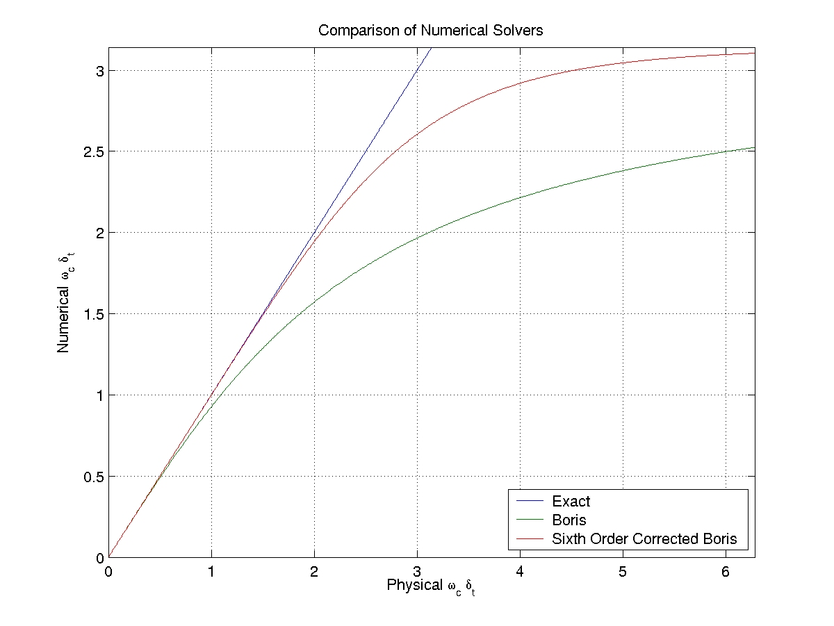
VPIC particle advance
Given particle fields, L_{r}, L_{ue} and L_{ub} can be applied exactly (in exact arithmetic)
If L_{ub} applied exactly, high frequency cyclotron motion are aliased to lower frequencies
6th order L_{ub} approximation (reversible, energy conserving, phase-space volume conserving and unconditionally stable) used to prevent this (also used in Blahovec et al 2000)
Nearly exact L_{ub} for low physical cyclotron frequency; asymptotes to Nyquist frequency otherwise and more efficient to compute

Slide 10
VPIC particle advance (cont)
Particle fields obtained with an “energy conserving” interpolation; for example, E_{x} is bilinearly interpolated from the four E_{x} edge samples and B_{x} is linearly interpolated from two B_{x} face samples of the cell containing a particle
Not as smooth as a trilinear “momentum conserving” interpolation but consistent with a finite element time domain formulation and it generalizes to more general meshing strategies (Eastwood et al 1995)
Easier to implement in simulations with non-trivial boundary conditions as no resampling of field components is required

Slide 11
VPIC particle advance (cont)
Villasenor-Buneman charge conserving current accumulation; J satisfies discretized continuity of charge for a nodal trilinear ρ accumulation (Villasenor and Buneman 1992)
Particle motion during step is diced into streaks, one for each cell passed through; all streaks made in a cell are accumulated to J samples associated with that cell
Computationally expensive but provides robust particle-boundary interaction detection and eliminates issues with Gauss’ law violations

Slide 12
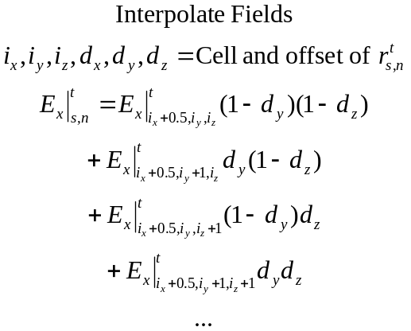
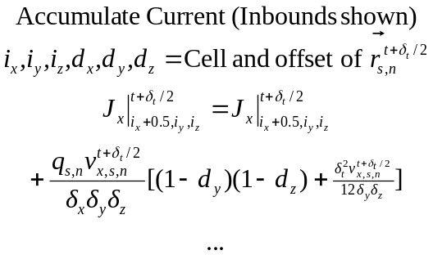
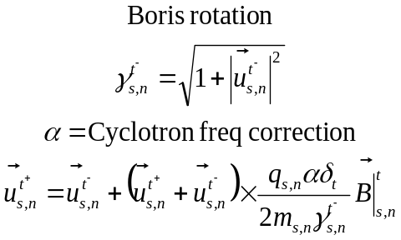
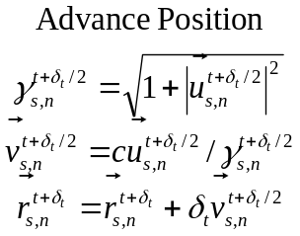
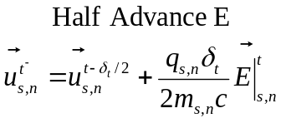
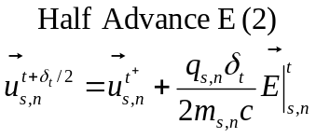
VPIC particle advance summary
B_{z}
B_{x}
B_{y}
E_{z}, J_{z}
E_{y}, J_{y}
E_{x}, J_{x}

Slide 13
VPIC field advance
For diagonal tensor ε, μ and σ, given the curls, L_{E} and L_{B} can be applied exactly (in exact arithmetic)
Curls computed via 2nd order finite differencing
In finite precision, arithmetic error can cause Gauss’ law violations to accumulate over time. To accommodate, VPIC periodically applies Marder passes (Marder 1987) tuned specifically to clean arithmetic error induced Gauss’ law violations
While this method is local and inexpensive, because J is charge conserving, it suffices to use it infrequently to keep Gauss’ law satisfied to near machine precision

Slide 14
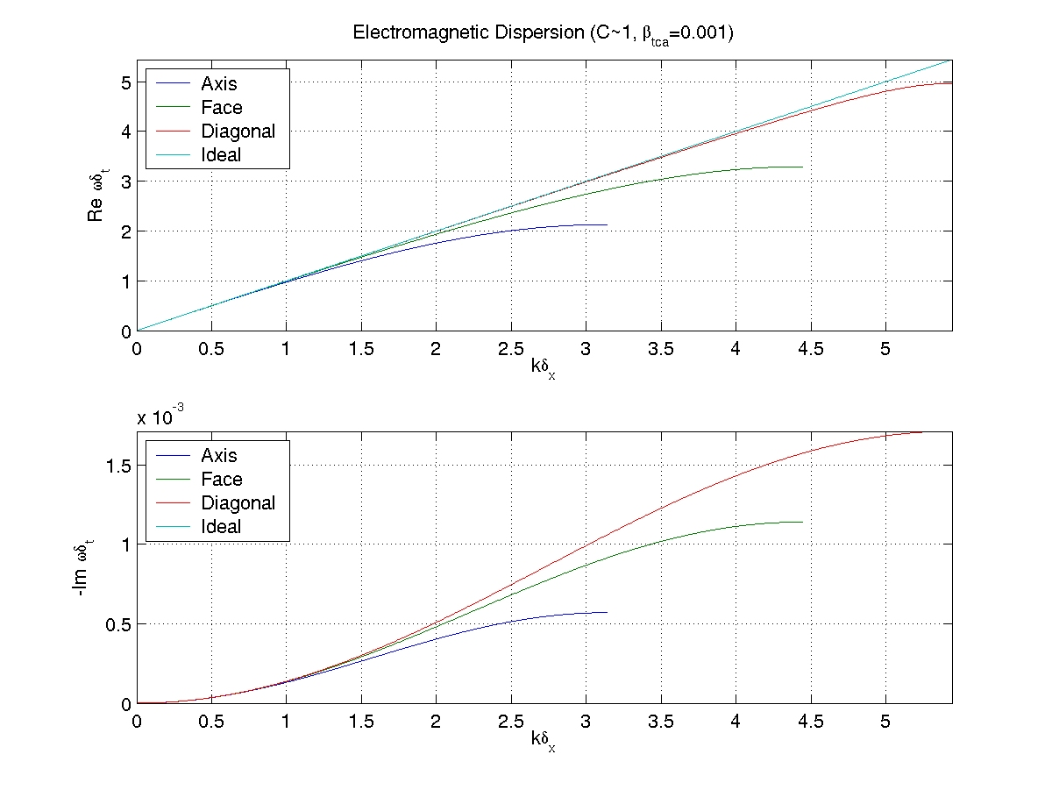
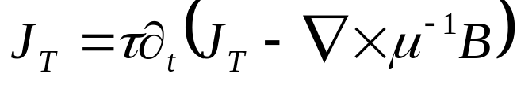
VPIC field advance (cont)
For short wavelengths, the discretized speed of light can deviate significantly from c and particles can generate non-physical Cherenkov radiation at these wavelengths
To reduce this noise, the background medium also has a tunable divergence free current response:
that damps this spurious radiation on a time scale τ
Same method used in Eastwood et al 1995

Slide 15
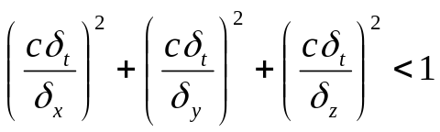

VPIC stability considerations
In vacuum, the field advance reduces to a FDTD method and the simulation must satisfy the Courant condition:
Additionally, the particle advance usually requires:
where ω_{p} is the plasma frequency and λ_{d} is the Debye length. Given particles cannot exceed c, satisfying the Courant condition and the Debye criterion typically is sufficient
Though simulations are stable for any physical cyclotron frequency, it is usually desirable to resolve it to keep dynamics accurate.
Sampling f_{s} typically requires between tens and thousands of particles per cell (depending on the simulation) to avoid non-physical computational particle collisional effects.

Slide 16
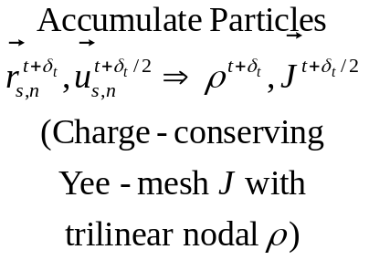
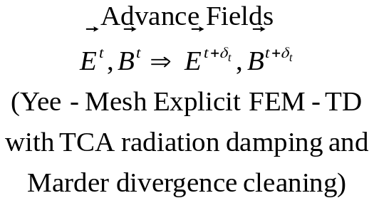
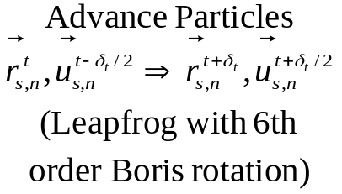
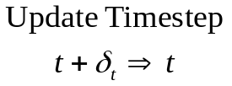
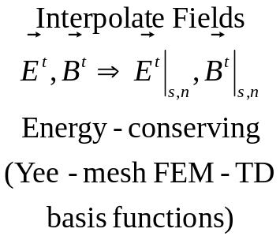
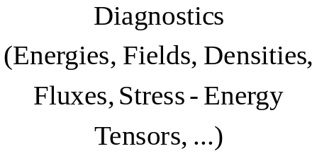
VPIC methods summary
Lagrangian
Eulerian

Slide 17
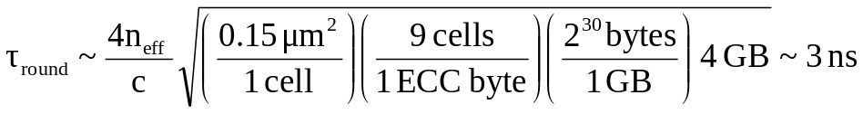
The speed of light is too slow
Consider a node with 3.0 GHz CPUs and 4 GB of ECC DRAM:
  The characteristic time for a signal to propagate around the memory chips, considering only the speed of light:
  This is already ~9 CPU clocks; enough time for ~36 single precision floating point operations
  This is incredibly optimistic; other delays (RAS/CAS, sense amplifiers, chipset translation, bus arbitration …) increase this greatly
~0.15 μm² (65nm process)

Slide 18
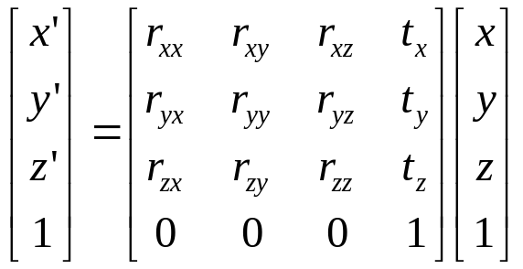
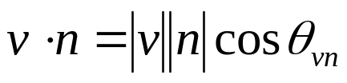
HPC is a niche market
Modern CPUs are designed for videogames. Floating point intensive games use single precision and high compute / data ratio operations:
  4x4 matrix vector multiply
  Short vector dot product
  ...
Large vector AXPY’s (ax + y) are slow; memory interfaces are not optimized for these (compute / data ratio is too low)
Many CPUs have SIMD (single-instruction-multiple-data) extensions for single precision floating point 4-vectors (e.g. SSE, AltiVec ...)
v
n

Slide 19
Node structure
Local
Memory
CPU
Local
Mass
Storage
Registers
Core
Core
Registers
L1 Cache
L1 Cache
L2 Cache
Bus Interface
L2 Cache
Motherboard Chipset
CPU
Network
Interface
To
other
nodes
L2 Cache
Bus Interface
L2 Cache
L1 Cache
Core
Core
L1 Cache
Registers
Registers
Memory performance has improved much slower than CPU performance over recent decades
To compensate, modern CPUs use a deep memory hierarchy with faster (though smaller and more limited) “cache” memories close to the CPU

Slide 20
Implementation rules of thumb
Achieving high performance requires minimizing latency, bandwidth and computation, in roughly that order
As physical constraints are noticeable, the ratio between CPU and memory performance (particularly latency) should not be expected to improve significantly in the near future
As computation and storage are virtually free compared to data motion, replicating computations and/or data is often worthwhile.
Operation |  | Time | Rel Cost
Data | Internode | 10 μs | 100,000
Access | Memory | 50 ns | 500
(Latency) | L2 cache | 5 ns | 50
 | L1 cache | 1 ns | 10
Data | Internode | 5 ns | 50
Movement | Memory | 0.5 ns | 5
(32-bit) | L2 cache | 0.2 ns | 2
 | L1 cache | 0.1 ns | 1
Sing Prec | FLOP | 0.1 ns | 1

Slide 21
More implementation guidelines
Because of finite c, data needed for node computations in VPIC is spatially localized to that node or very nearby; internode latency and bandwidth are naturally optimized
Local data motion is the dominant concern in VPIC
Unfortunately, on most processors, programmers have no control over cache; a CPU heuristically caches data it anticipates will be needed
Minimizing local data motion requires grouping data needed to perform critical operations contiguously (spatial locality) and reusing recently accessed data (temporal locality) as much as possible

Slide 22
The compiler will not save you
Programming languages are far more restrictive than most developers expect. For example, in strict ANSI C99, this floating point optimization is illegal (floating point addition not associative):
Likewise, this cannot be unrolled / pipelined (last might be INT_MAX):
while this can (but only if x and v are restricted by the programmer):
If seemingly simple optimizations are problematic, it is unrealistic to expect the compiler to reorganize critical data structures and rewrite complicated loops to optimize existing codes designed around large vector AXPY operations for modern architectures
y = b + c;
z = (a + b) + c;
y = b + c;
z = a + y;
for( int i=first; i<=last; i++ ) x[i] += v[i]*dt;
for( int i=first; i< stop; i++ ) x[i] += v[i]*dt;

Slide 23
Obvious PIC implementation
Obvious PIC implementation:
  Each particle property and field component is stored in a separate array
  Particles are stored in no particular order
  Field samples are directly accessed by the particle advance
  Particles positions are stored in a global coordinate system
Fields are accessed randomly as particles are advanced
  If fields do not fit in cache, many accesses require memory transfers
  Several accesses per component to load samples from non-contiguous locations
~37 memory accesses per particle for VPIC’s particle advance
  Computing the addresses requires float to int conversion or worse (slow)
  Cache is not helpful; it cannot anticipate memory accesses
  Because memory transfers tend to have much a larger granularity under the hood than these accesses, more data than requested is actually transferred

Slide 24
Single precision
Single precision is significantly faster than double precision as you can exploit 4-vector SIMD and halve data movement
For typical time steps, cell dimensions and particles per cell, discretization error far exceeds single precision arithmetic error; single precision should be acceptable provided it does not introduce non-physical artifacts (e.g. large violations of otherwise conserved quantities during the simulation)
VPIC uses single precision to help achieve high performance but takes care to numerically stabilize operations (e.g. arithmetic errors respect physical symmetries); many successful tests against double precision codes

Slide 25
Single pass processing and particle data layout
It is desirable to limit the number of times a particle is accessed during a time step lest performance be limited by moving particle data to and from memory. Single pass processing achieves this:
for each particle,
interpolate E and B
update u and compute movement
update r and accumulate J
if an exceptional boundary hit,
save particle index and
remaining movement
end if
end for
To further minimize the cost of moving particle data, particle data is stored contiguously, memory aligned and organized for 4-vector SIMD
As a result, the inner loop streams through particle data once using large aligned transfers under the hood—the ideal access pattern
typedef struct {
float dx, dy, dz; int i; // Cell offset (on [-1,1]) and index
float ux, uy, uz, q; // Normalized momentum and charge
} particle_t;

Slide 26
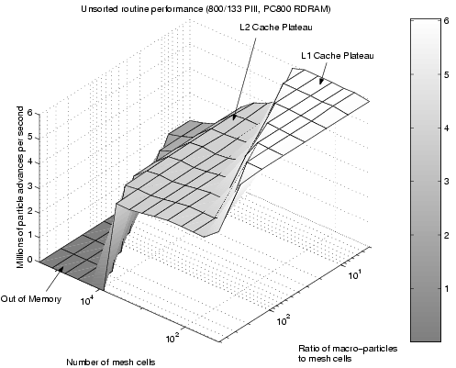
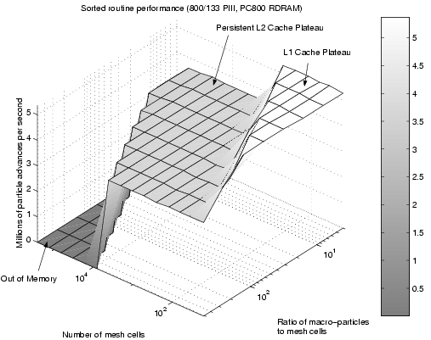
Particle sorting
Particles are periodically sorted by the containing cell index. Because the particles do not move far per time step, sorting is infrequent—every tens to hundreds of time steps. Sorting can be done rapidly in O(N) operations (Bowers 2001)
As a result, all the particles in a given cell are processed approximately sequentially and the field data necessary for these particles is loaded once from memory and cached
Particle sorting allows various collisional methods to be implemented efficiently

Slide 27
Field interpolation
To make field interpolation efficient, for each cell, interpolation coefficients are precomputed before the particle advance and saved in a contiguous, aligned, 4-vector SIMD compatible layout:
Because particles are sorted, coefficients are accessed approximately sequentially in large aligned transfers a near minimal number of times
Even though the coefficients require over 3 times the storage as the raw fields, the net impact is to reduce memory transfers to minimal levels by making more efficient use of cache
Approach generalizes to other interpolation methods
typedef struct {
float ex, dexdy, dexdz, d2exdydz;
float ey, deydz, deydx, d2eydzdx;
float ez, dezdx, dezdy, d2ezdxdy;
float bx, dbxdx, by, dbydy;
float bz, dbzdz, pad0, pad1;
} interpolator_t;

Slide 28
Position representation
Positions are given by the containing cell index and the offset from the cell center, normalized to the cell dimensions
  Determining which interpolation coefficients to load is trivial
  Field interpolation and current accumulation can use particle offsets directly
  Each cell has identical numerical properties regardless how the cell mesh is translated, oriented or reflected
y
dy
i
dx
x
  Generalizes naturally to other methods (e.g. curvilinear meshes)
  Requires that the particle offset coordinate system be transformed when a particle crosses into a neighboring cell. This cost is trivial and can be elegantly incorporated into the charge conserving current accumulation

Slide 29
Position representation (cont)
This representation is critical in single precision
When an absolute position representation is used, some coordinate information encodes the containing cell index; less information is available to encode the offset. This loss can be severe
Consider a single precision 1d simulation with 2¹⁰ = 1024 cells over the domain (0,1):
  Absolute representation: positions in cell 0 have a worst case absolute resolution of 2⁻²⁴/2¹⁰ ~ 6e-11 while positions in cells 512-1023 have a resolution of 2⁻²⁴ ~ 6e-8---three orders of magnitude worse
  Index plus offset representation: all positions have a worst case absolution resolution of 2⁻²⁵/2¹⁰ ~ 3e-11 (the sign provides one bit of resolution) regardless of cell---better than the absolute representation everywhere (by orders of magnitude in most places) with no numerical anisotropy

Slide 30
Current accumulation
Given the single precision usage and SIMD compatible data layouts, all particle processing described above is ideal for 4-vector SIMD. Unfortunately, current accumulation is not. Determining the cells through which a particle passed varies from particle to particle; one particle might remain in the cell in which it started while the next might cross through several
To utilize 4-vector SIMD, VPIC exploits that particles do not cross cell boundaries often. VPIC advances 4 particles at a time with 4-vector SIMD by assuming none of the 4 particles cross cell boundaries. Particles that do cross are detected and make no current contributions during this process. These particles are processed in scalar code subsequently
Like the interpolation coefficients, current contributions from particle motion in a cell are made to a contiguous aligned set of partial currents. These are post-processed into J prior to the field advance. The same benefits described for field interpolation apply

Slide 31
Exceptions
During cell crossing current accumulation, if a particle hits an “exceptional” boundary (e.g. needs communication to a neighboring node, needs absorbed, needs refluxed, ...), the index and remaining particle movement are saved to an exception list for later processing. This has several benefits:
  No additional passes through the particles are necessary
  Slow application specific is cleanly separated from the high performance general particle advance
  Exception handling does not pollute the caches while the particle advance is running

Slide 32
4-vector SIMD
// Interpolate ex for the next 4 particles
load_4x4_tr( interp_coeff[ i(0) ].QUAD( ex, dexdy, dexdz, d2exdydz ),
interp_coeff[ i(1) ].QUAD( ex, dexdy, dexdz, d2exdydz ),
interp_coeff[ i(2) ].QUAD( ex, dexdy, dexdz, d2exdydz ),
interp_coeff[ i(3) ].QUAD( ex, dexdy, dexdz, d2exdydz ),
ex, dexdy, dexdz, d2exdydz );
ex = (ex + dy*dexdy) + dz*(dexdz + dy*d2exdydz);
Unfortunately, programming languages (e.g. C, FORTRAN) are not expressive enough (e.g. data alignment restrictions) to allow compilers to use 4-vector SIMD in operations as complex as those in VPIC
To compensate, VPIC has a C language extension that allows C-style portable 4-vector SIMD code to be written and converted automatically to high performance 4-vector SIMD instructions on a wide variety of platforms. A similar approach was used in Bowers et al 2006

Slide 33
VPIC on IBM’s Cell CPU
Cell CPU
VPIC was recently ported to IBM’s Cell CPU (same processor as Sony PlayStation 3). Each CPU contains one general purpose core (“PPE”) and eight high performance specialized 4-vector SIMD cores (“SPE”)
Each SPE can only directly access 256KB of high performance memory specific to it. This “local store” is analogous to cache, but, unlike conventional cache, memory transfers to and from it must be explicitly managed
Though non-trivial, this makes it possible to design high performance application specific cache protocols
Registers
PPE
L2 Cache
L1 Cache
Registers
SPE
SPE
Registers
Local Store
DMA
DMA
Local Store
Registers
SPE
SPE
Registers
Local Store
DMA
DMA
Local Store
Registers
SPE
SPE
Registers
Local Store
DMA
DMA
Local Store
Registers
SPE
SPE
Registers
Local Store
DMA
DMA
Local Store
Bus Interface

Slide 34
VPIC on IBM’s Cell CPU (cont)
On the SPEs, particle data is tripled buffered in blocks of N=512; while a block is processed, the next is loaded and the previous is stored
An N line software cache of read-only interpolation coefficients and read-write partial currents handles inner loop random memory access. It has a fully associative least recently used policy (i.e. a line can hold any cell’s data and the least recently used line is replaced when caching new data); the last N distinct requests are guaranteed to be cached in the local store
Before processing a block, requests are made for all cells referenced in the block. Most of these will already be cached. Memory transfers are initiated for the remainder and block processing begins
Minimal memory transfers are used, memory transfers are overlapped with computation and the inner loop operates exclusively out of local store (cell crossing current accumulation makes additional requests following the inner loop)

Slide 35
VPIC on LANL’s Roadrunner
While such a cache is expensive (large fully associative caches are rarely implemented in hardware for a variety of reasons), each SPE core is faster (even clock-for-clock) than a conventional CPU core at cold particle advances as a result
Presently, VPIC performs at ~0.173 billion cold particles advanced per second per 3.2 GHz IBM Cell CPU (or ~21.6 million cold PA/s per SPE core). For comparison, VPIC runs at ~12.6 million cold PA/s on a single core 2.2 GHz AMD Operton CPU (used for the example simulations), about ~13.7 times slower
As Los Alamos’s Roadrunner supercomputer plans to use ~13,000 3.2 GHz IBM Cell eDP CPUs, a sustained rate up to ~2.25 trillion cold PA/s could be achieved in particle dominated simulations
As a cold particle advance takes ~246 flop per particle (warm particle advances take more, depending on simulation details such as temperature, for cell crossing current accumulation), this is equivalent to ~0.556 petaflop

Slide 36
VPIC Apps I
3d reconnection in an electron-positron plasma; initial configuration is a Harris equilibrium with an intermediate guide field
Shown are electron density isosurfaces (colored by B_{y} where y is the initial J direction) when a dominant diffusion region has formed and is influenced by the drift-kink mode (Lin et al 2007 submitted)
16 billion particles, 1000×100×1000 mesh, 200d_{i} × 20d_{i} × 200d_{i} domain (d_{i} is the ion inertial length) for 1.5 days on 500 AMD Opteron cores

Slide 37
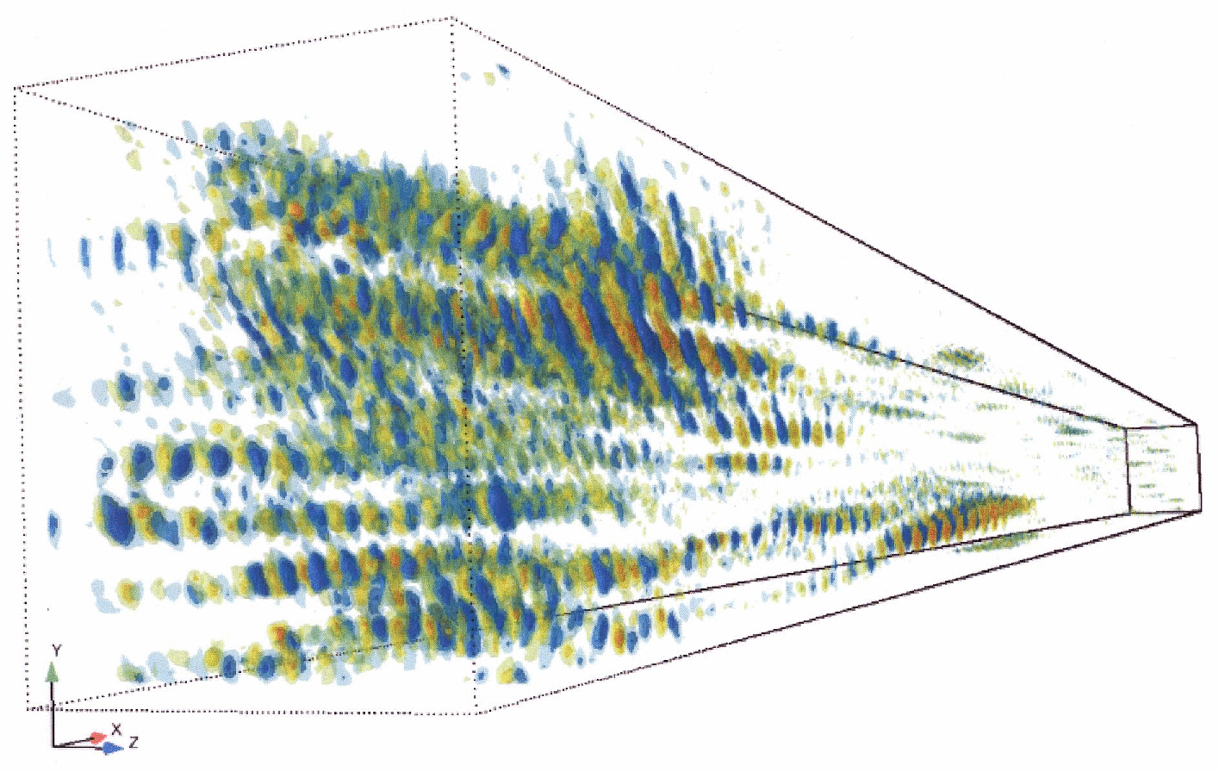
VPIC Apps II
Stimulated Raman scattering in the kinetic regime (kλ_{d} = 0.34, where k is the initial Langmuir wavenumber and λ_{d} is the plasma Debye length)
Shown are longitudinal electric field isosurfaces; the electron plasma waves self-localize to regions of narrow transverse extent and SRS saturates via the trapped electron self-focusing of Langmuir waves (Lin et al 2007 in press)
18 billion particles, 2436×486×486 mesh, 90×18×18 μm domain on 1008 AMD Opteron cores.

Slide 38
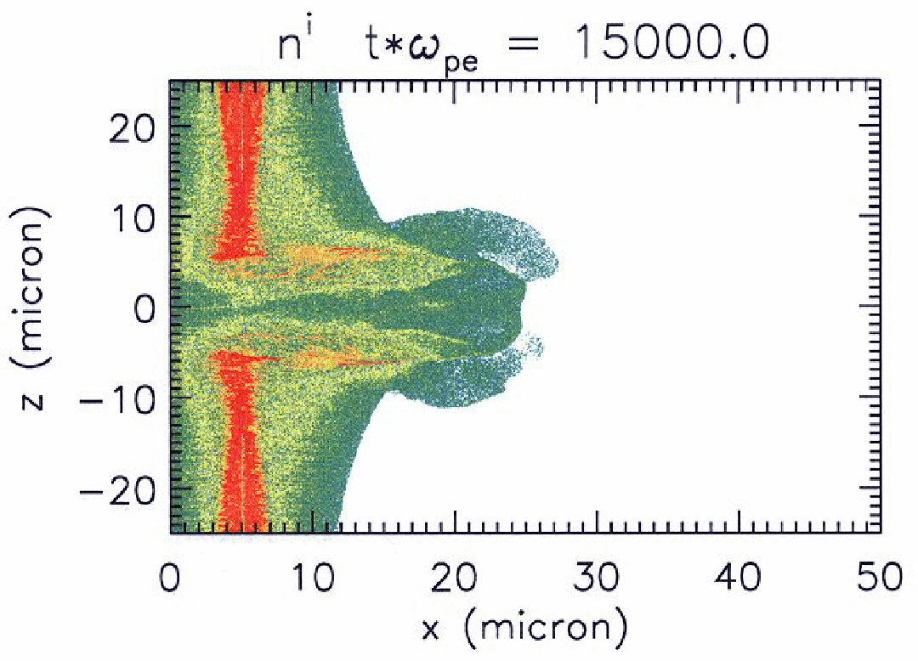
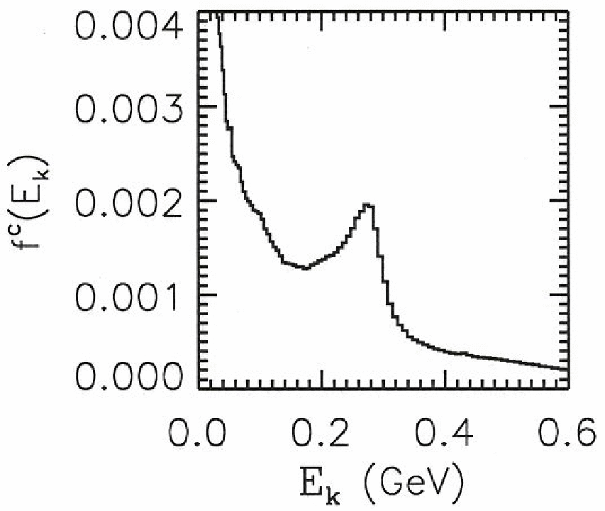
VPIC Apps III
Short-pulse 1 μm laser (gaussian, FWHM 156 fs, intensity 10²¹ W/cm²) on a 30 nm thick solid carbon target (n_{e}/n_{cr} = 660, where n_{cr} is the critical density)
Shown is the ion density and carbon energy spectrum after the pulse has propagated to the right; GeV and quasi-monoenergetic (~275 MeV) carbon ions generated via the “break-out afterburner” mechanism (Albright et al 2007)
2d simulation with ~1.23 billion cells, 50×50 μm domain on 1020 AMD Opteron cores (each species used 1.7×10⁵ #/cell in target)

Slide 39
Conclusions
If the LANL Roadrunner supercomputer is acquired as planned, VPIC simulations will be possible in late 2008 at scales well beyond what is practicable today; simulations with 10¹² particles, 10⁹ cells and 10⁶ time steps may be prosecuted routinely at computation speeds approaching a petaflop
This opens up the possibility for kinetic modeling of 3d magnetic reconnection at high mass ratio, 3d dynamics of stimulated laser scattering in multi-speckles, 3d high resolution ultra-intense laser-matter interaction, ab initio kinetic thermonuclear burn ...
The techniques that enable VPIC’s ultra high performance can be applied to other simulation codes and platforms

Slide 40
Acknowledgments
Work performed under the auspices of the United States Department of Energy by the Los Alamos National Security LLC Los Alamos National Laboratory under contract DE-AC52-06NA25396
The authors thank the assistance of Drs. Hui Li and Bill Daughton
Some 3d visualization was performed using the EnSight Gold software by CEI Inc.; the authors thank Drs. Jeremy Margulies and Eric Nelson for their assistance
Applications shown were run on the LANL Flash and Lightning supercomputers

Slide 41
Help Wanted
Los Alamos needs researchers for performing computational work on Roadrunner and/or with VPIC
For more information, contact Tom Kwan (tjtk@lanl.gov)

