Slide 1
Lab 2: SVM
Zhicheng Dong zdo@kth.se
Qiaolan Luo qiaolan@kth.se

Slide 2
Implementation
1. suitable kernel function
2. objective function and constraint function
3. pre-compute matrix P and train data function
4. compute b function: for bias of the model
5. indicator function: draw decision boundaries and categorize new input data

Slide 3
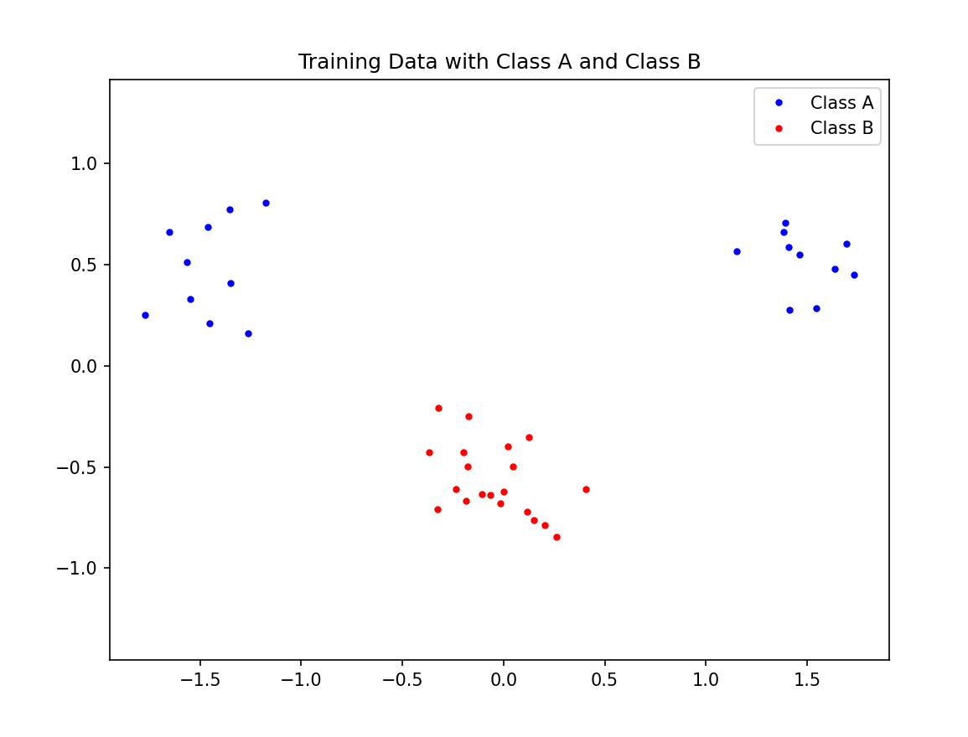
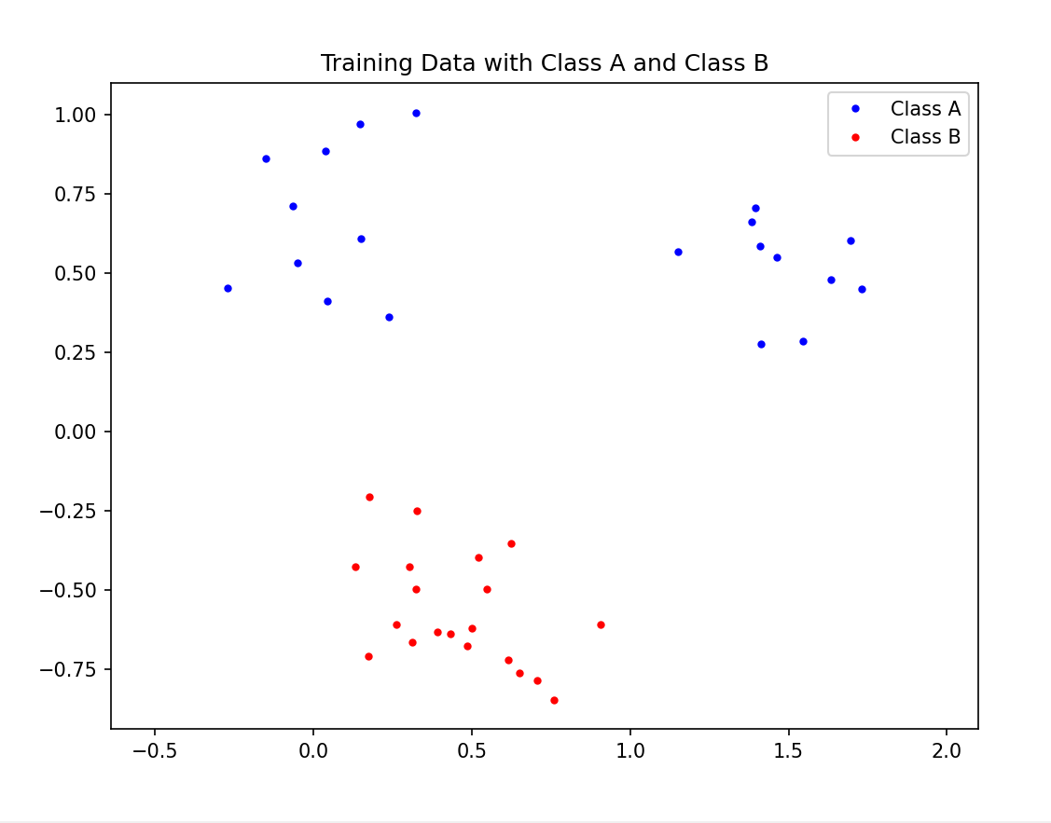
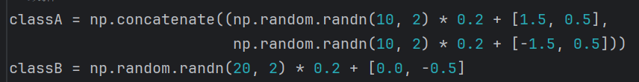
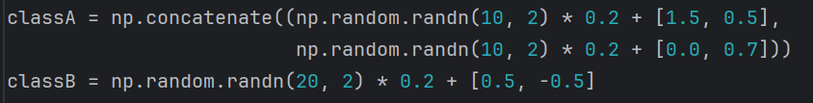
7.1
Move the center of the data cluster: adjust the mean

Slide 4
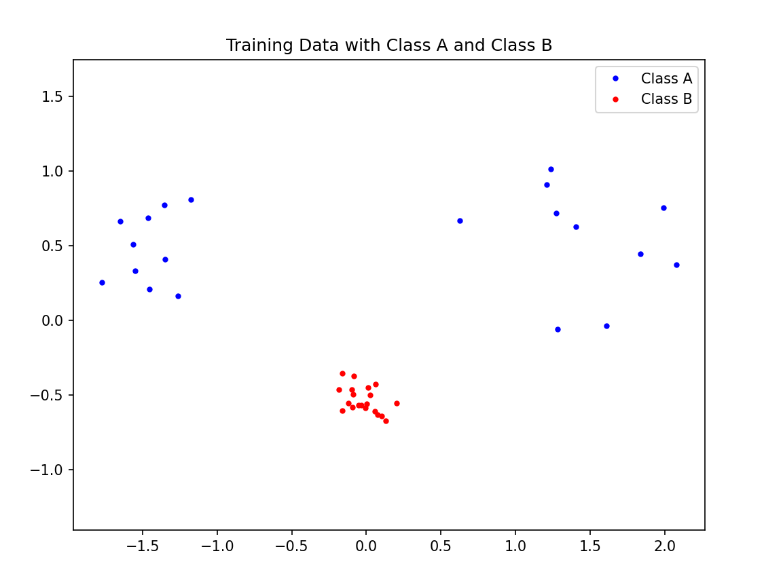
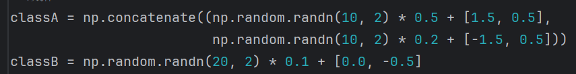
7.1
Change the size of the data cluster: adjust the standard deviation

Slide 5
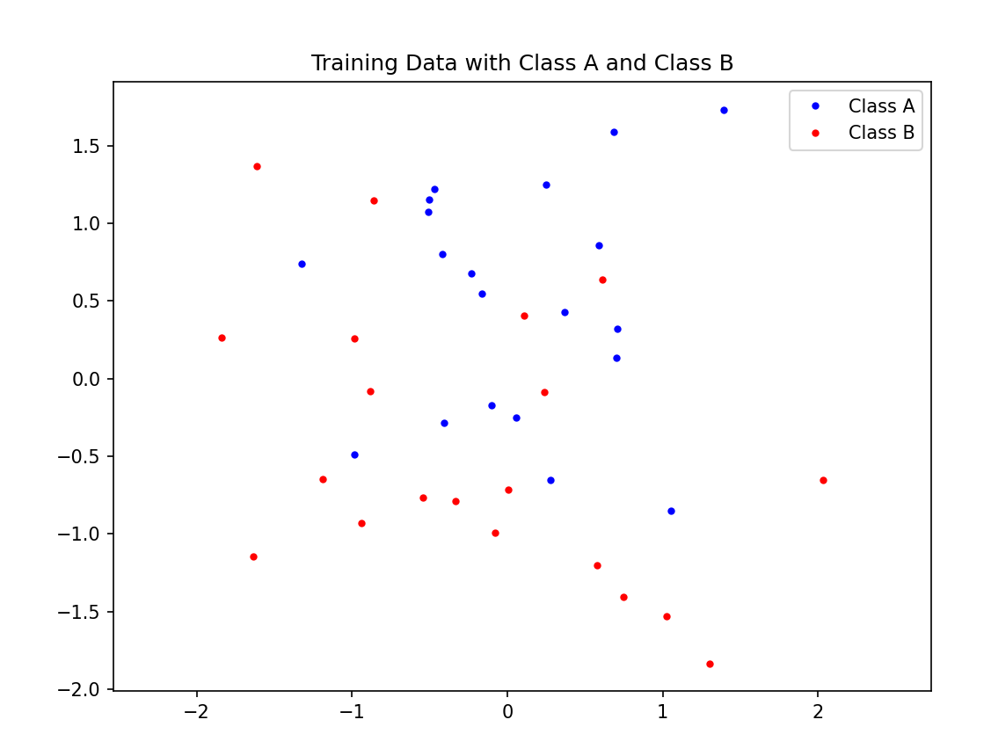
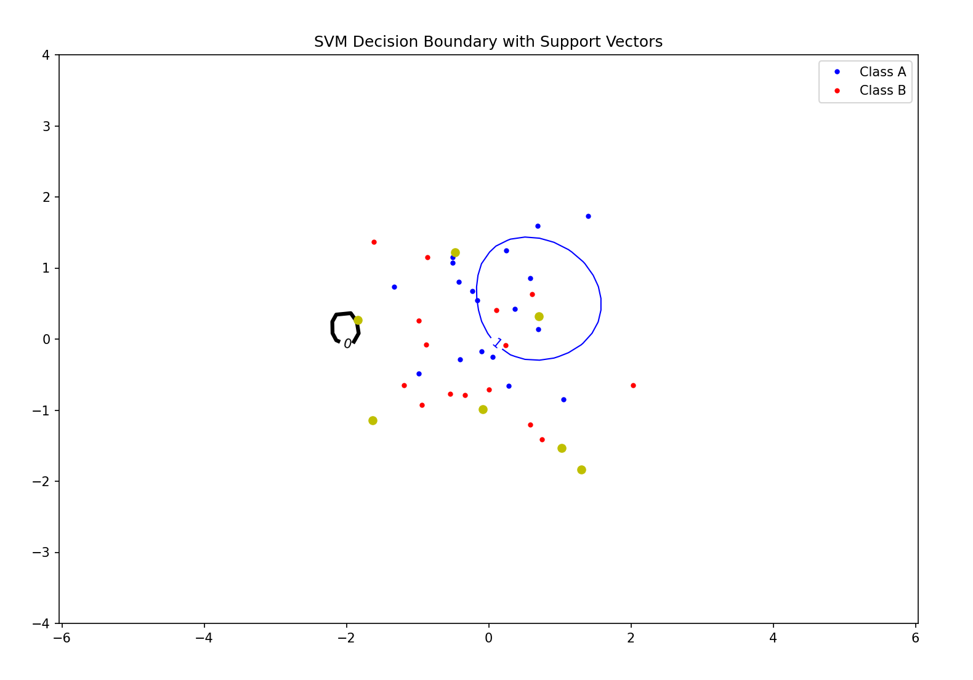
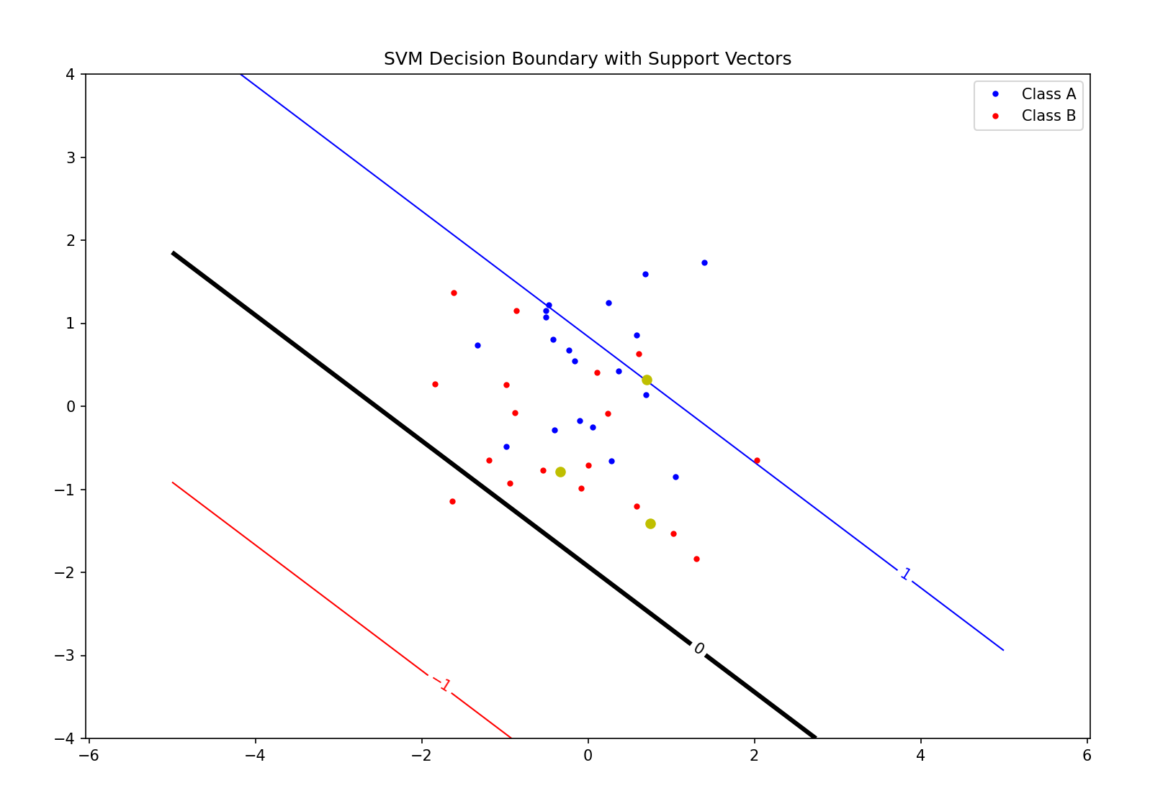
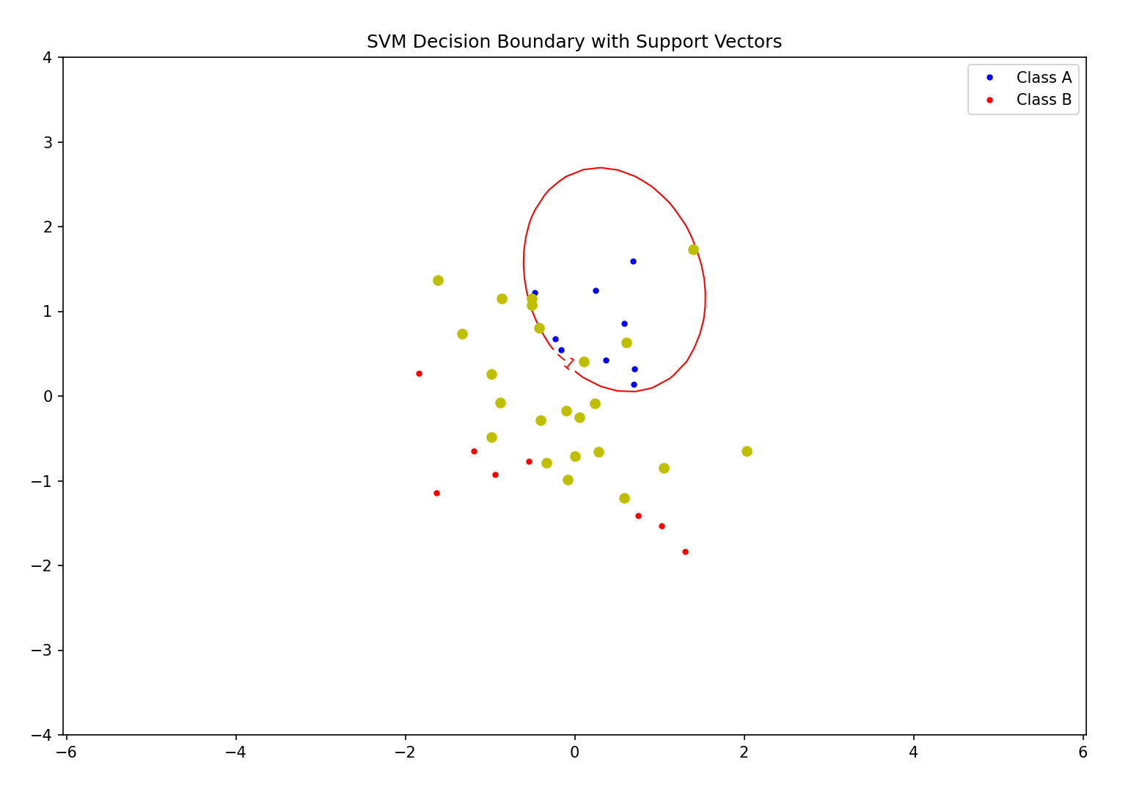
7.1
When the optimizer is hard to find a clear boundary: The data set are very close together or overlap

Slide 6
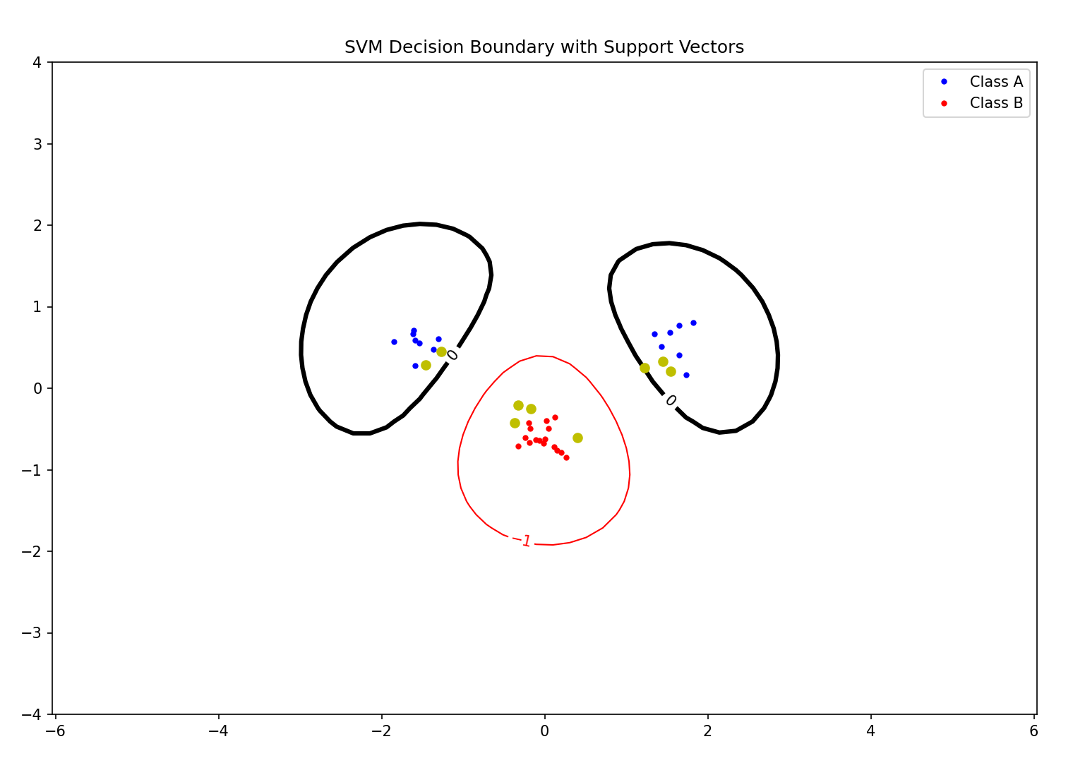
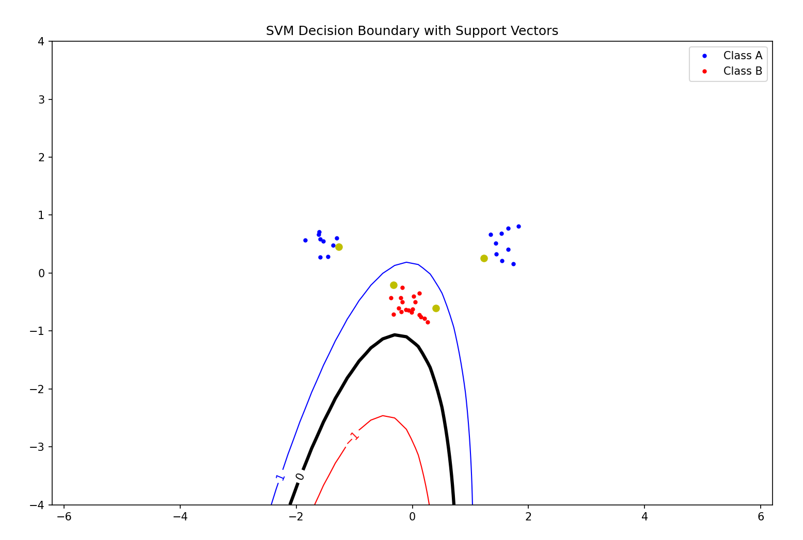
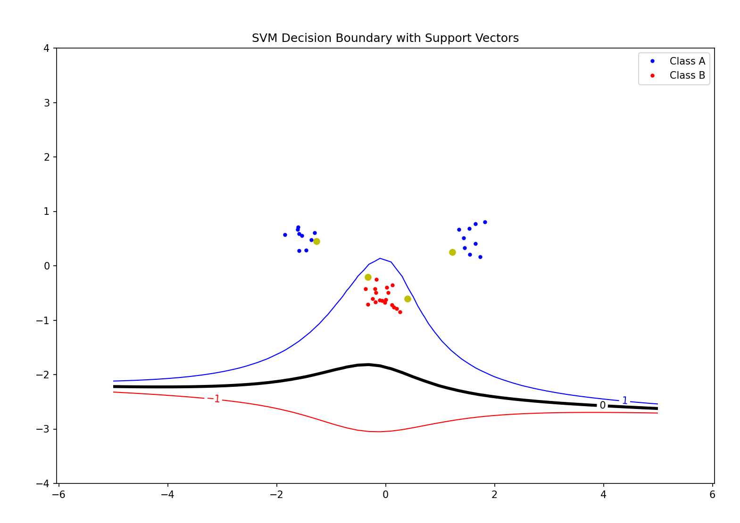
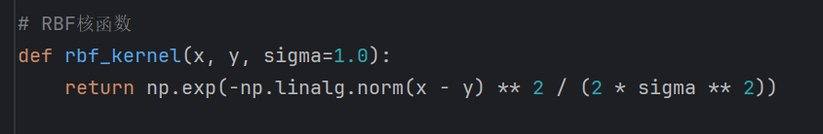
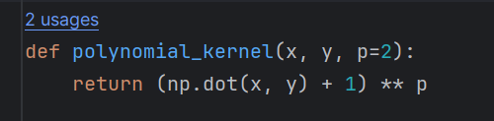
7.2
RBF kernel
Polynomial kernel
P = 2
P = 3

Slide 7
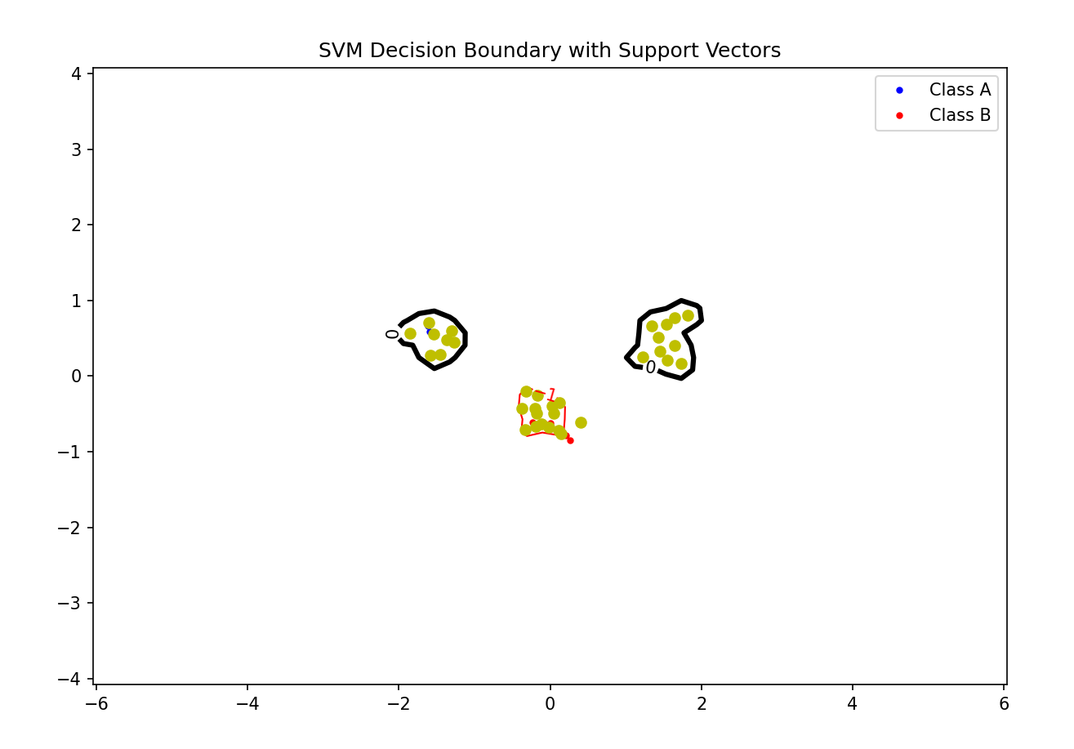
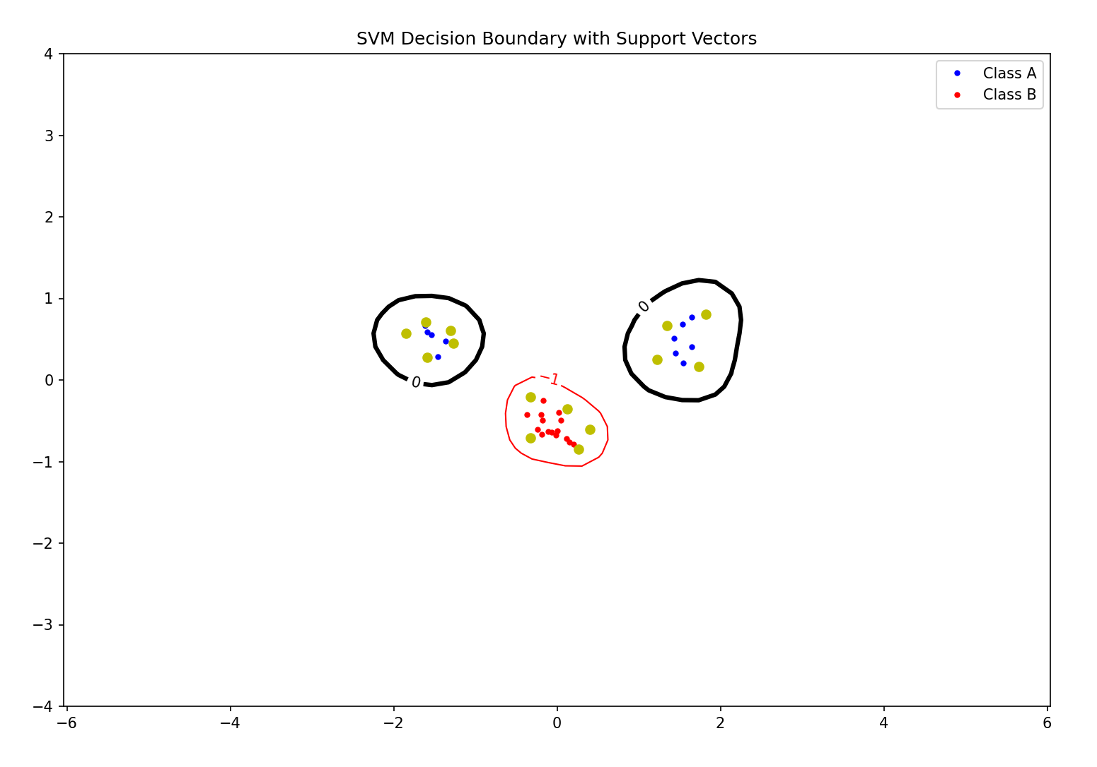
7.3
RBF kernel: σ for control the smoothness of the boundary
σ too small: boundary become complex and convoluted
overfitting, Low bias, high variance
σ too large: boundary become smooth and wide
Underfitting, low variance, high bias
σ = 0.1
σ = 0.5
σ = 1.0

Slide 8
7.3
Polynomial kernel – p : controls the degree of the polynomials
With lower p: simple boundary, enough for simple dataset
High bias, low variance, underfitting
With higher p: more complex boundary
Low bias, high variance, overfitting
P = 2
P = 3

Slide 9
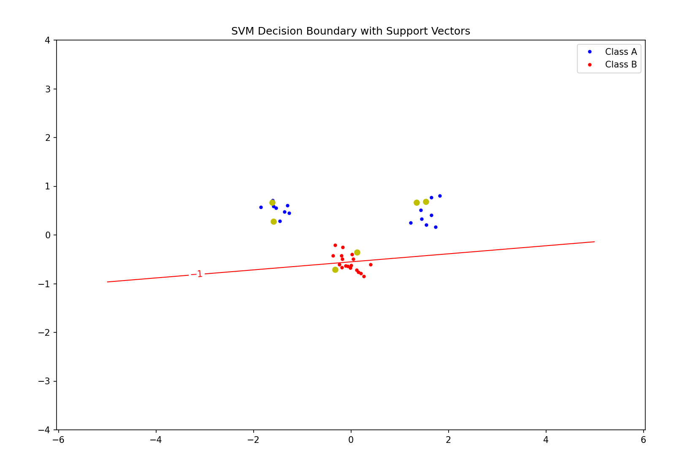
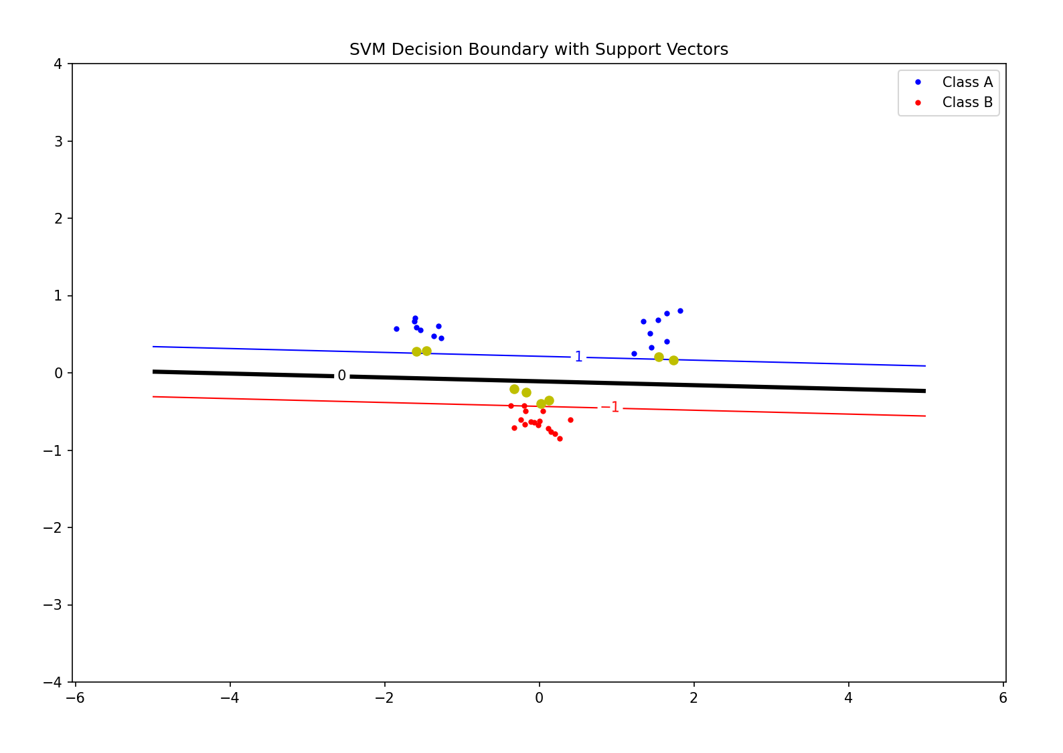
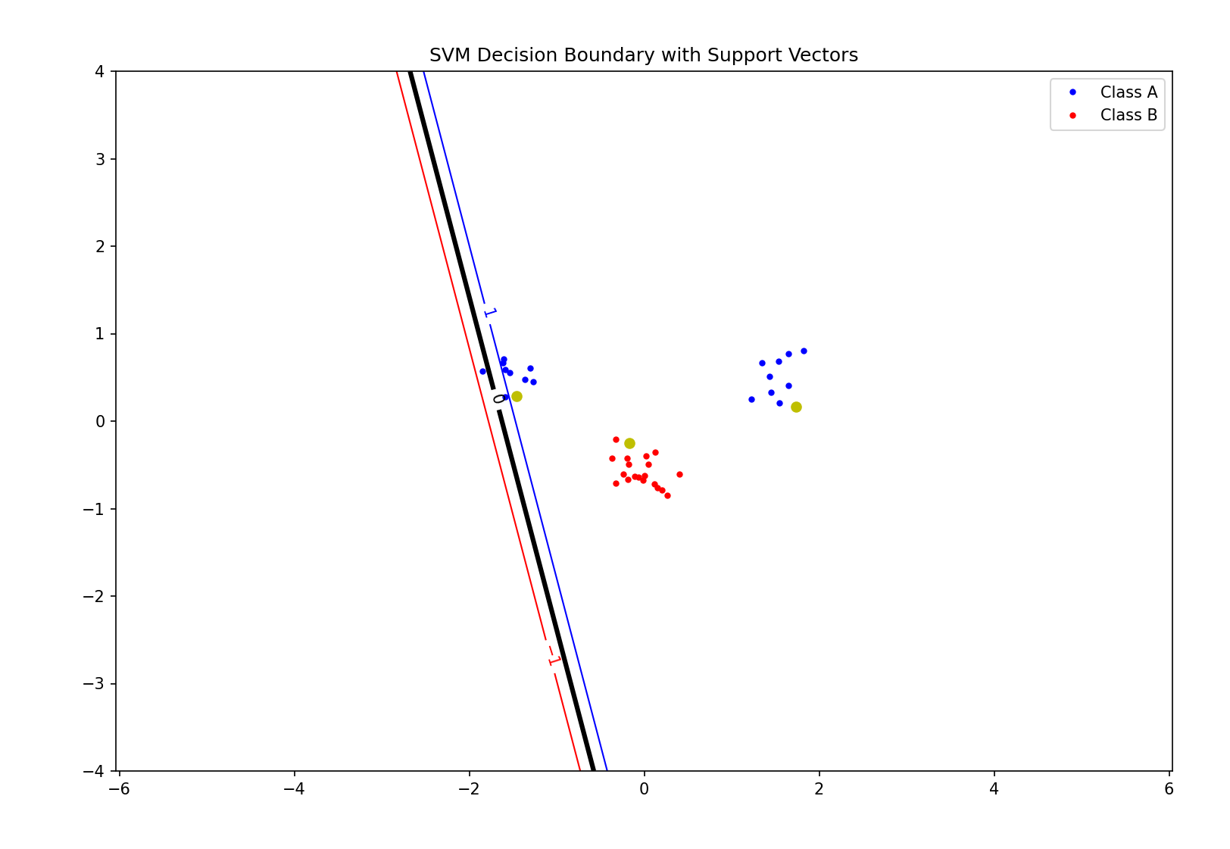
7.4
Slack parameter C: degree of penalization for classification error
Too large: try best efforts to reduce errors, may lead to overfitting
Too small: do not concern about errors, have a poor classification performence
C = 0.1
C = 2.0
C = 5.0

Slide 10
7.5
Try an iterative strategy:
Try a simpler model and moderate relaxation
Adjust model according to its performance on the validation set
Adjust C and kernel parameters through cross-validation and grid search

