Slide 1
Lab 3: BAYESIAN LEARNING AND BOOSTING
Zhicheng Dong zdo@kth.se
Qiaolan Luo qiaolan@kth.se

Slide 2
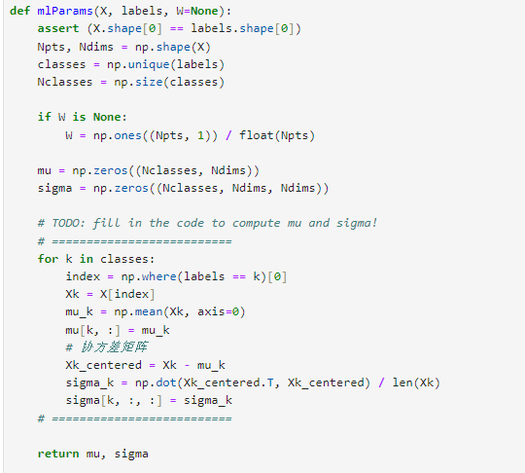
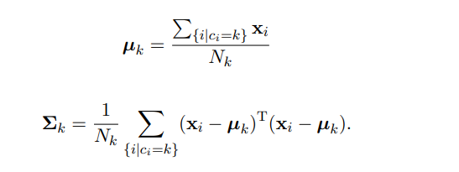
Assignment 1

Slide 3
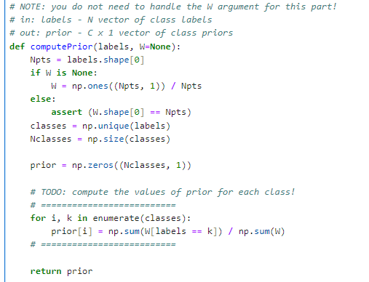
Assignment 2

Slide 4
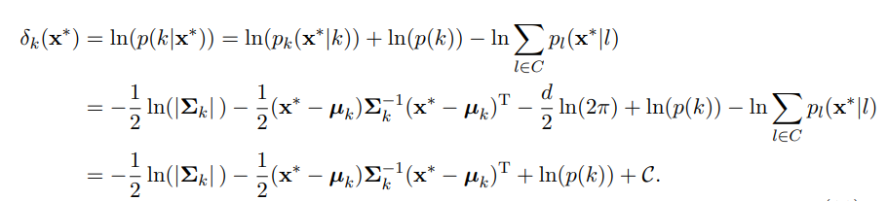
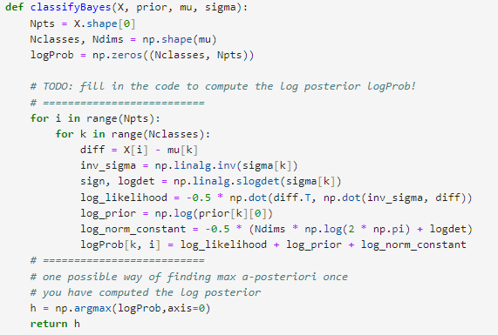
Assignment 2

Slide 5
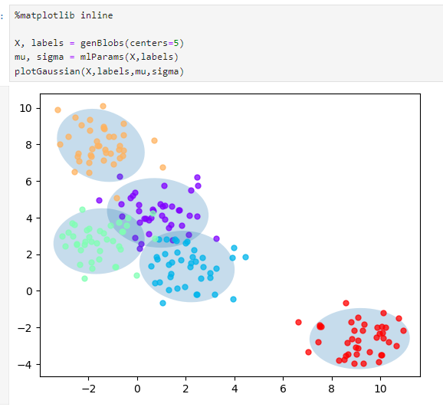
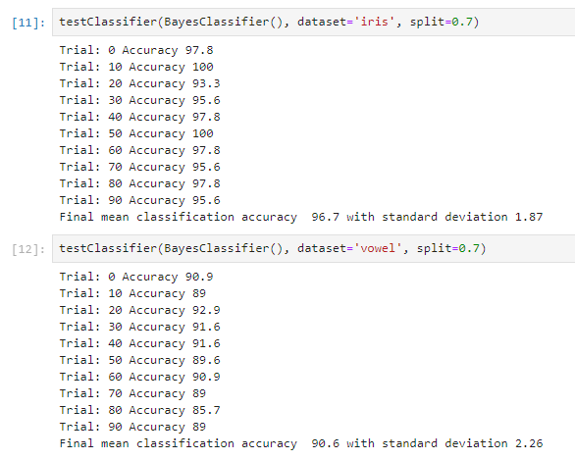
Assignment 3

Slide 6
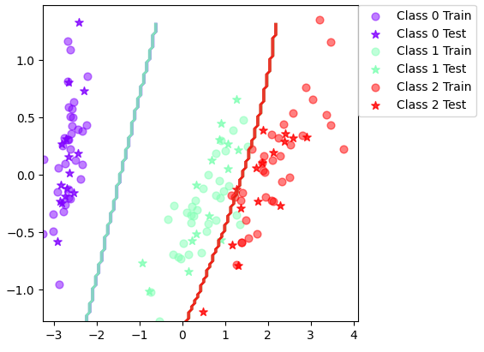
Assignment 3

Slide 7
Q1
a) Features represent distinct properties that do not influence each other or the dataset is large enough to smooth out any dependencies that might exist between features.
b) Features are known to be related. The dataset is small and the dependencies between features are significant.

Slide 8
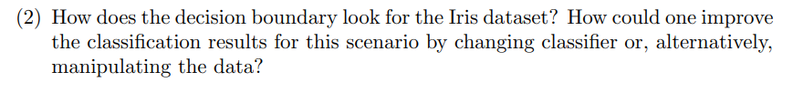
Q2
It use PCA to downscale the feature space to 2 dimensions and classify the dataset.

Slide 9
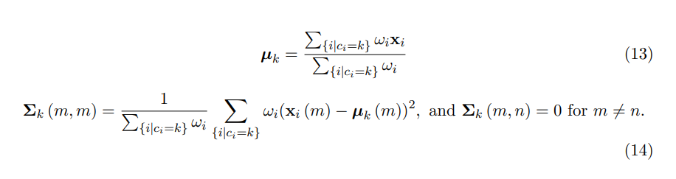
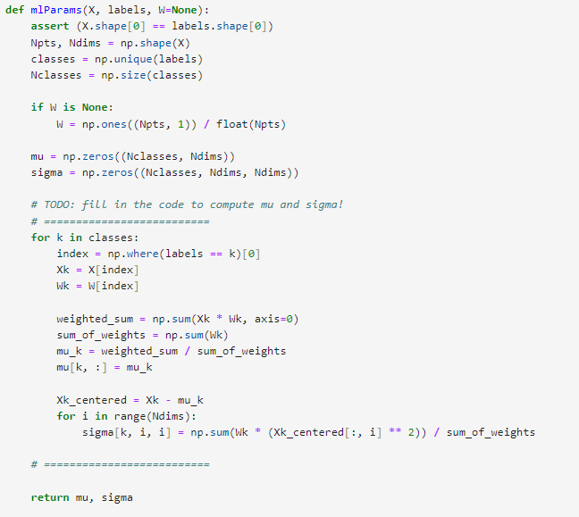
Assignment 4

Slide 10
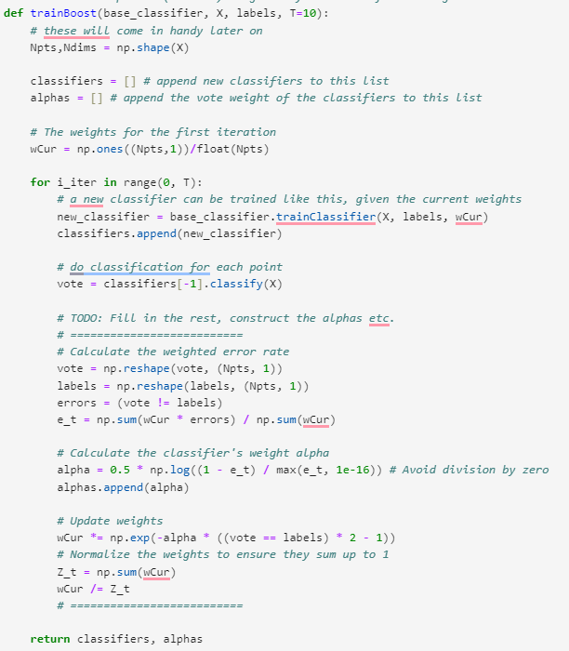
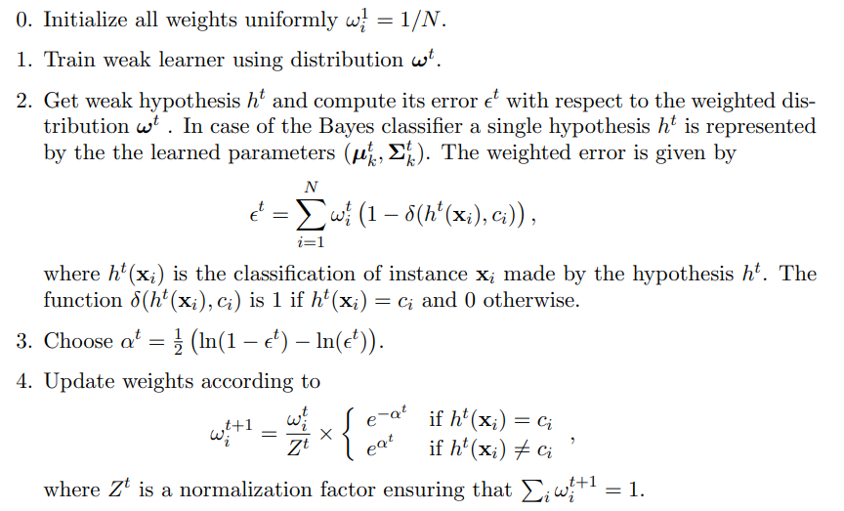
Assignment 5

Slide 11
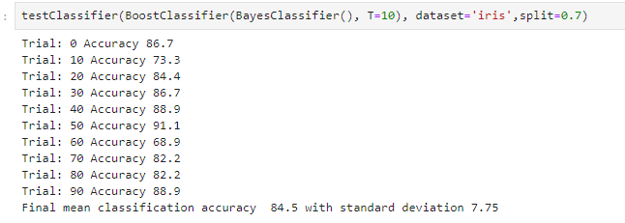
Assignment 5
Boosting methods improve performance by focusing on samples that were misclassified by previous classifiers. For the plain Bayes, it has already accurately classifies certain samples, focusing on misclassified samples may not result in much improvement.

Slide 12
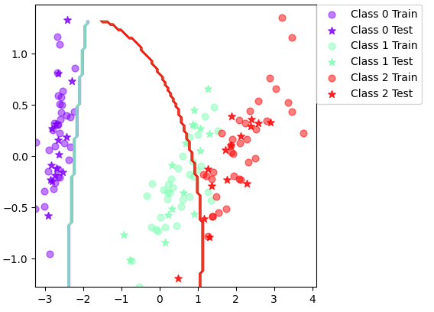
Assignment 5
The boundary is not fitting after boosting

Slide 13
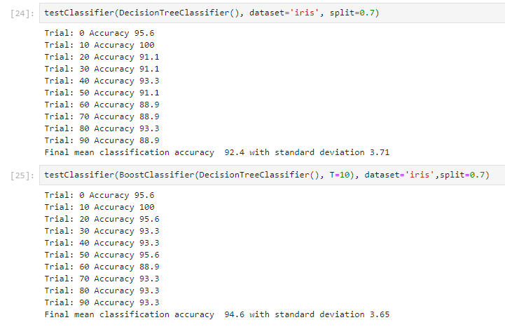
Assignment 6
For decision trees, Boosting usually improves model complexity and performance because individual decision trees may be underfitted due to tree depth limitations.

Slide 14
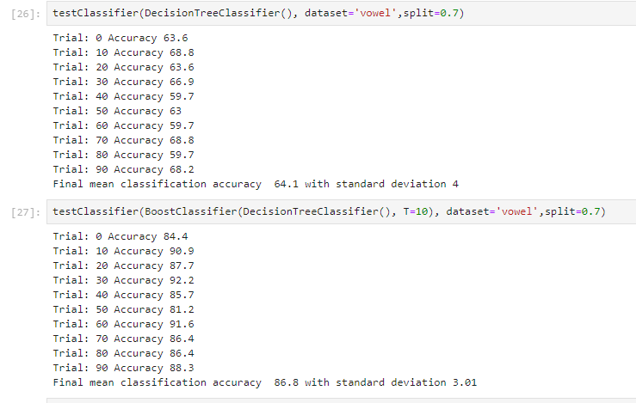
Assignment 6

Slide 15
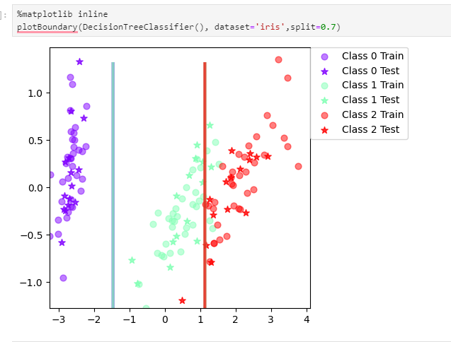
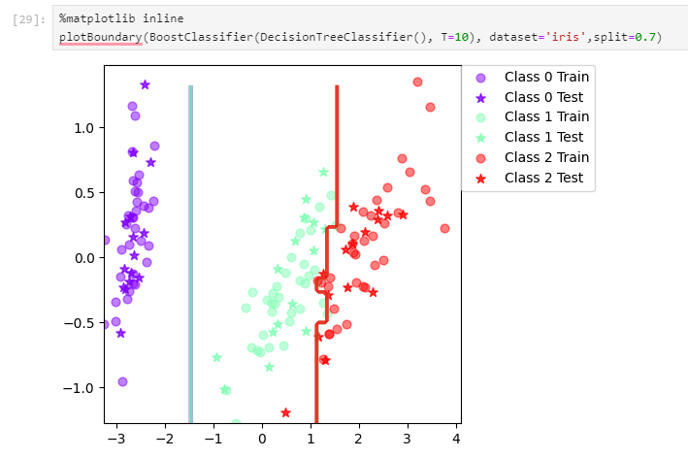
Assignment6
The boundary is more complex.

Slide 16
Assignment 7

