Slide 1
Inter-individual vs inter-area difference in rapid visual adaptation in naïve mice
Lan Luo
2020-09-03

Slide 2
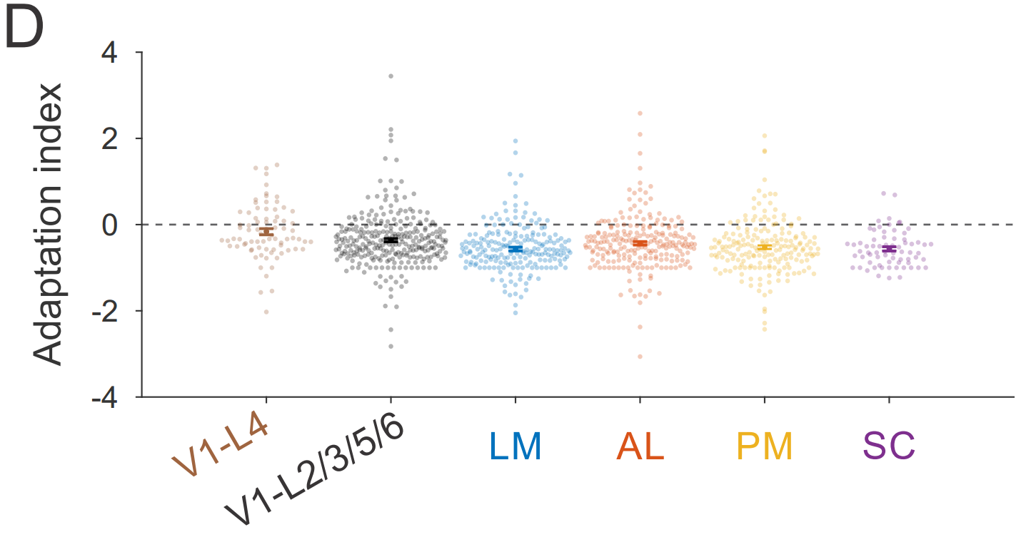
Inter-individual vs inter-area difference in rapid visual adaptation in naïve mice
Jin et al (2020) suggests that adaptation magnitude is similar across some visual areas (V1, SC, LM, AL, PM). However, the dataset has been pooled over multiple mice trained to discern orientation changes
V1 is significantly different from the other areas- HVAs and SC are not different from each other.
Does the magnitude of adaptation vary across naïve individuals as well as areas?

Slide 3
Q1
expand the question to cover some of the ideas that you’re integrating into your grant proposal- how does coding change in the HVAs (you’re not going to get there today, but eventually).
Make it more clear what the richness of the questions you can address are.
whether there is a difference in the amount of adaptation across areas. Show the grand average traces across areas, and the quantification of the adaptation index.

Slide 4
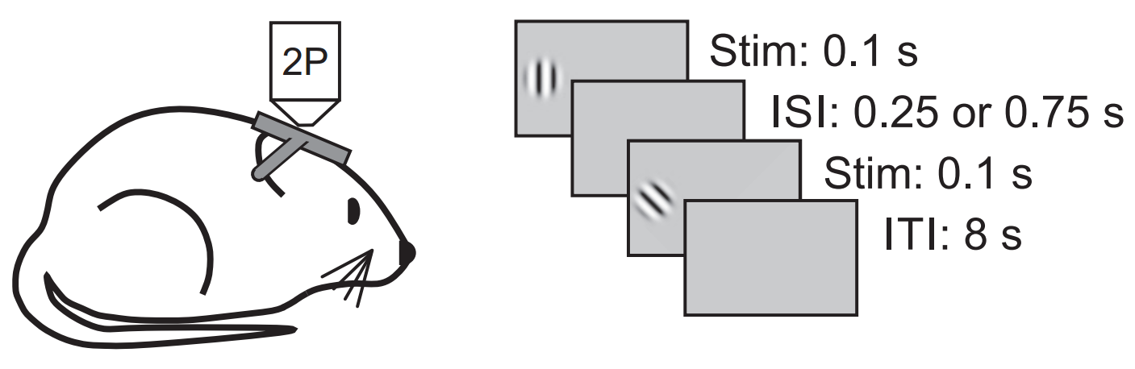
Experiment protocol
Ca imaging from V1 & higher visual areas (LM, LI) of 3 mice
why LI?
explain why you chose these stimulus conditions
adapter:
1 orientation
30% no adapter (0 contrast)
target stimulus:
8 orientations
2 ISI (inter stimulus interval)
~6.5 s

Slide 5
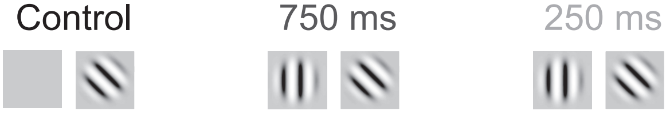
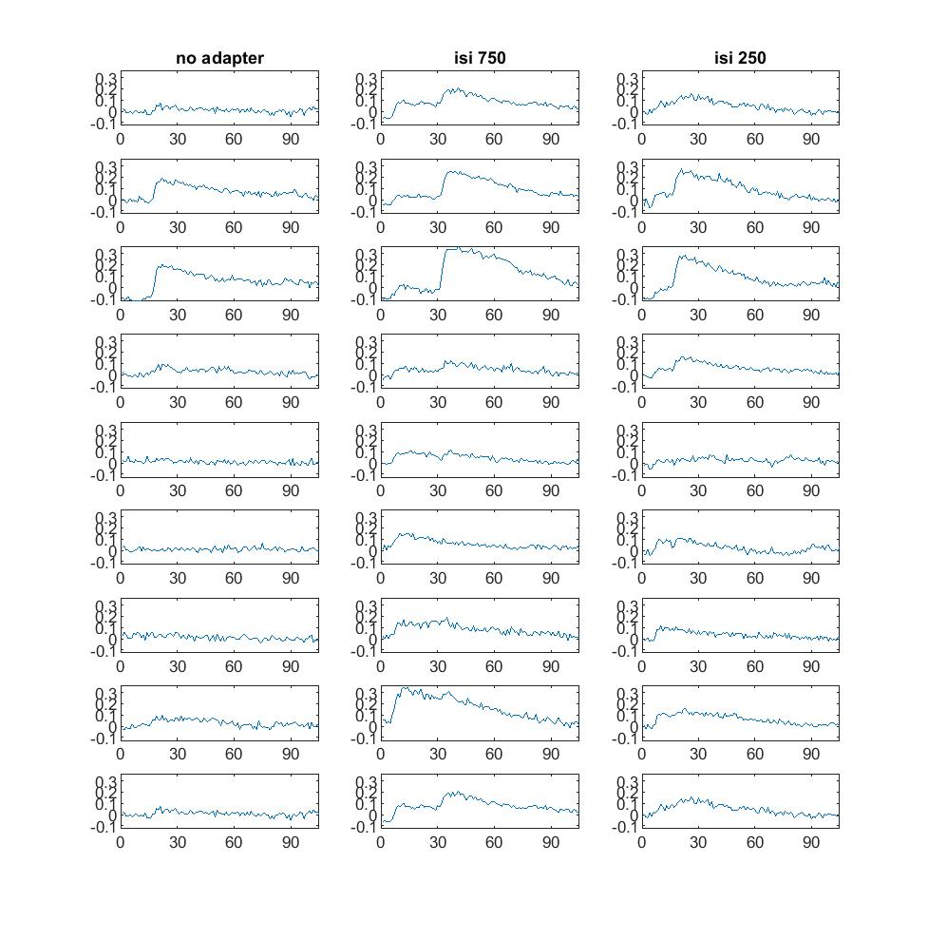
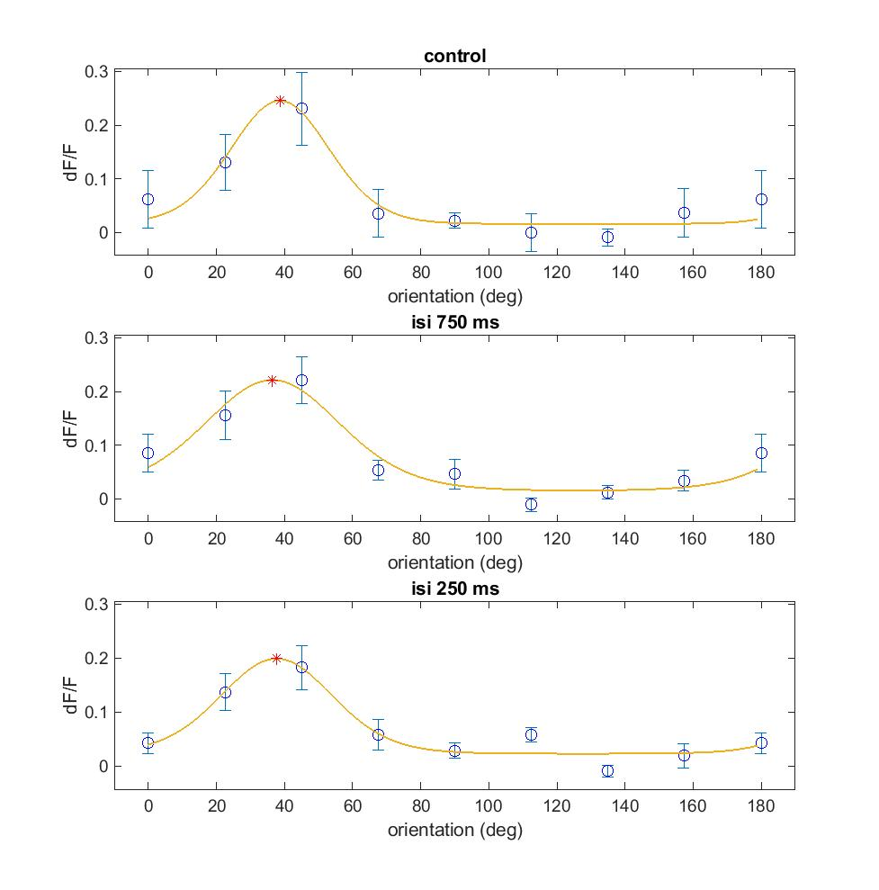
dF/F trace & orientation tuning without vs with adaptation
mismatch between the quantification and the traces. For instance, the 45 deg stimulus after a 750 ms ISI seems to
have a large facilitation of the response- but this doesn’t appear in the mean+/-sem on the right.
Also- doesn’t seem like there’s much adaptation at all- and this cell doesn’t really respond much to the adapter.

Slide 6
Trace of trials average across areas

Slide 7
Adaptation index across areas

Slide 8
Q2
motivation for inter-individual variability.

Slide 9
Trace of trials average across mice

Slide 10
Adaptation index across mice

Slide 11
Trace of trials average across areas by mice

Slide 12
Adaptation index across areas by mice

Slide 13
Conclusion

Slide 14
Future directions for analysis and experiments

