Slide 1
Inter-area and inter-individual difference in rapid visual adaptation of naïve mice
Lan Luo
2020-09-03

Slide 2
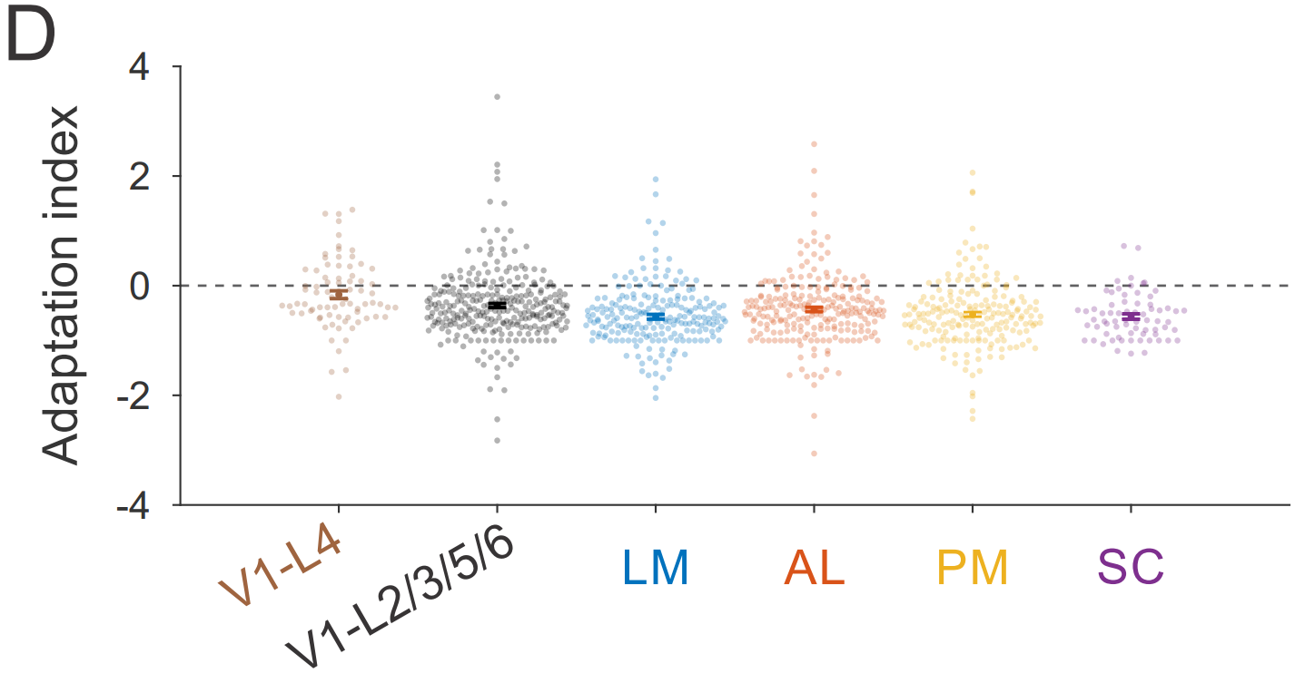
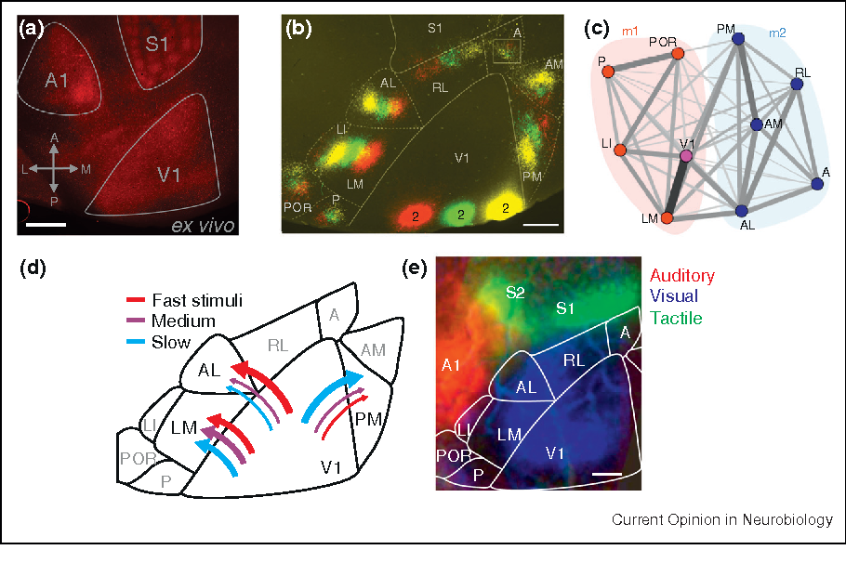
Background
Jin et al. (2020) suggests that adaptation magnitude is similar across some visual areas (SC, LM, AL, PM). However, the dataset has been pooled over multiple mice trained to discern orientation changes
V1 is significantly different from the other areas- HVAs and SC are not different from each other.
Jin et al. (2020)
Wang, Sporns and Burkhalter (2012)

Slide 3
Question 1
Does the magnitude of adaptation vary across naïve individuals as well as areas?
expand the question to cover some of the ideas that you’re integrating into your grant proposal- how does coding change in the HVAs (you’re not going to get there today, but eventually).
Make it more clear what the richness of the questions you can address are.
whether there is a difference in the amount of adaptation across areas. Show the grand average traces across areas, and the quantification of the adaptation index.

Slide 4
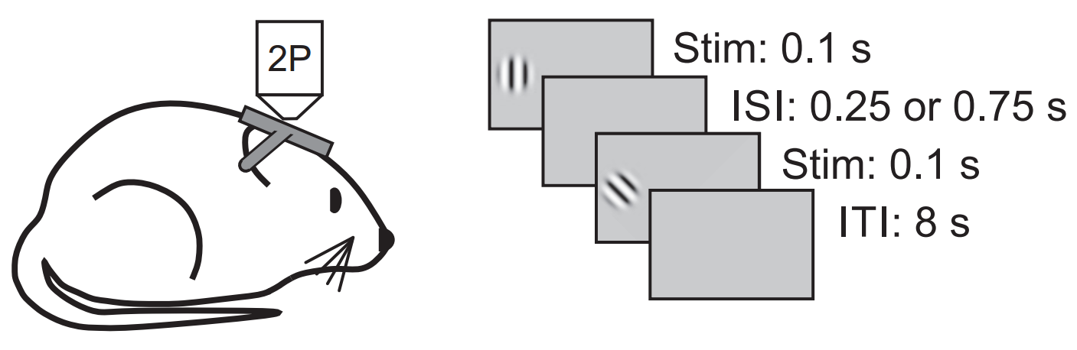
Experiment protocol
Ca imaging from V1 & higher visual areas (LM, LI) of 3 mice
why LI?
explain why you chose these stimulus conditions
adapter:
1 orientation
30% no adapter (0 contrast)
target stimulus:
8 orientations
2 ISI (inter stimulus interval)
~6.5 s
Jin et al. (2019)
Glickfeld et al. (2014)
Notes:
area LI responds to both visual and auditory stimuli

Slide 5
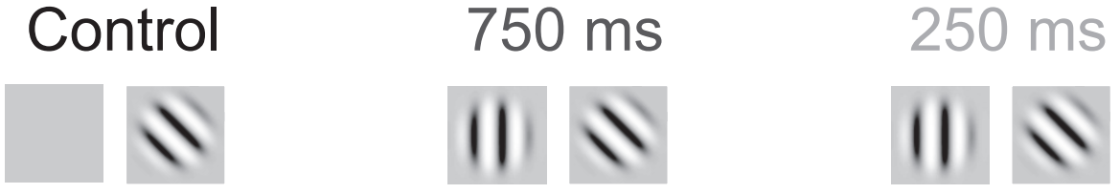
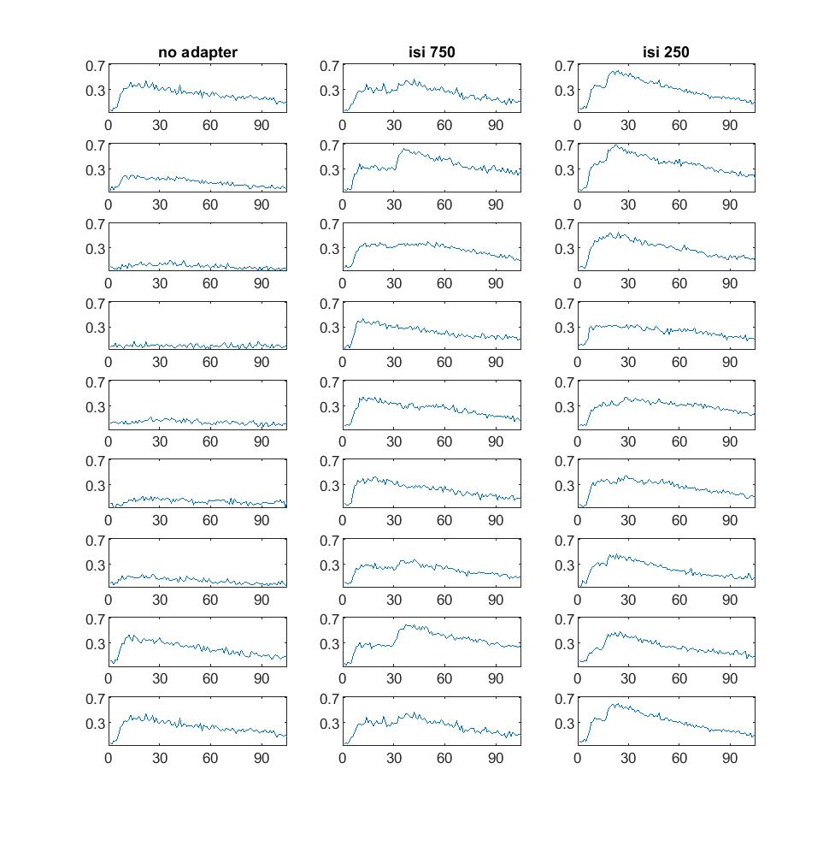
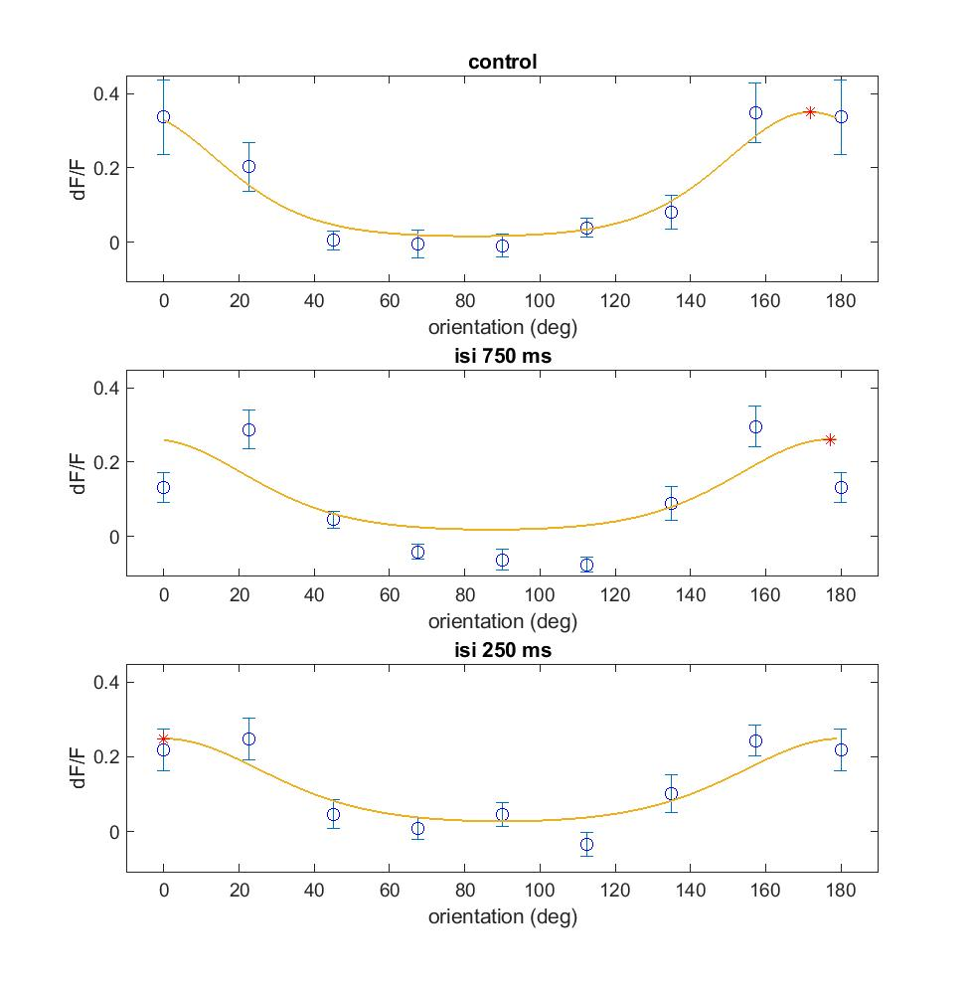
Trace & orientation tuning of a single neuron without vs with adaptation
Notes:
C:\Users\lan\Documents\repos\inter\plot\200728_i1324_V1\fig 2B trace16

Slide 6
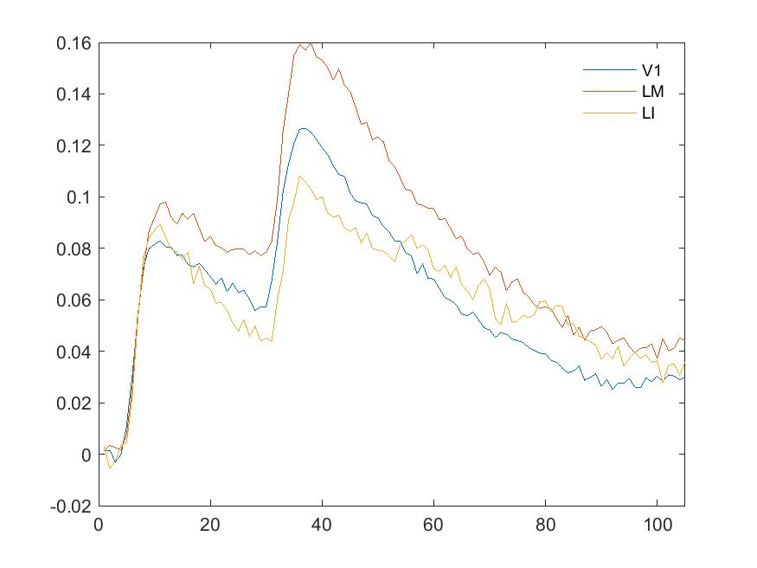
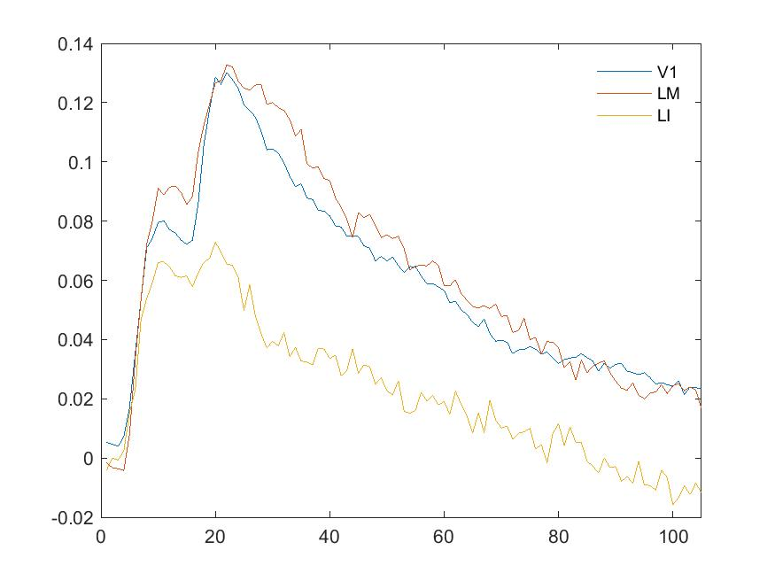
Trace of trials average across areas

Slide 7
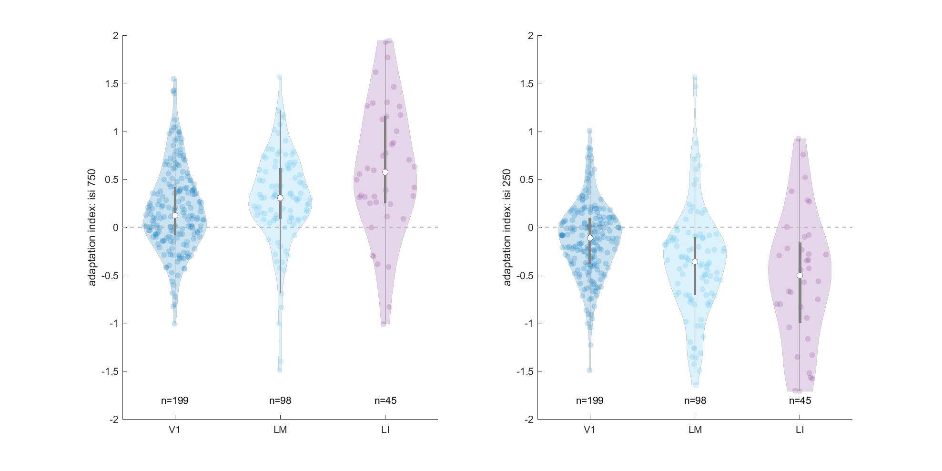
Adaptation index across areas
Notes:
quartiles(2)+-1.57*IQR/sqrt(length(data))

Slide 8
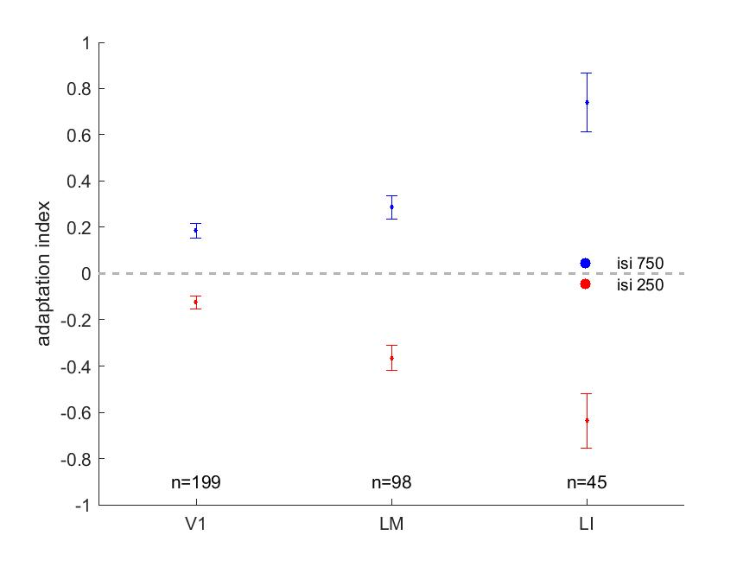
Adaptation index across areas

Slide 9
Q2
motivation for inter-individual variability:
Why mirror image?
Averaged over areas. Hidden variance?

Slide 10
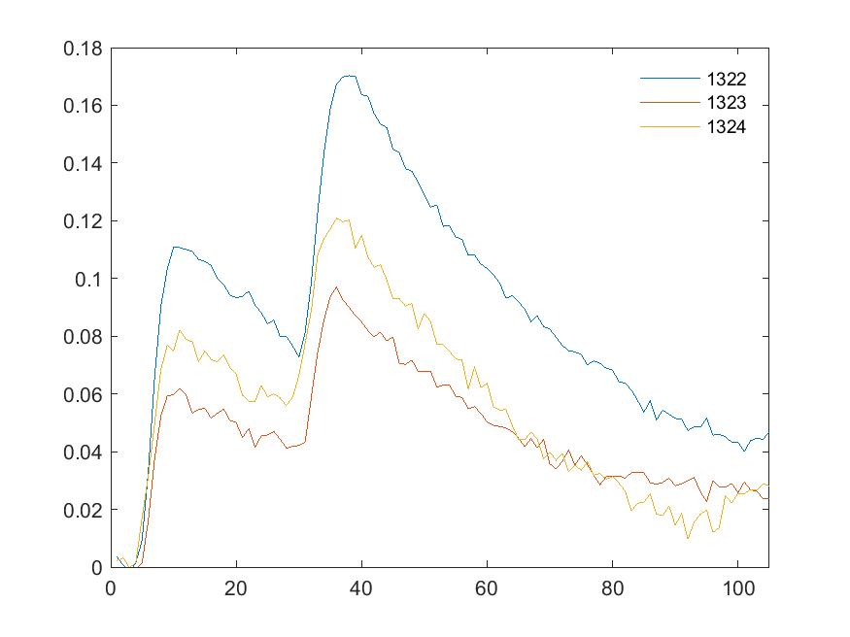
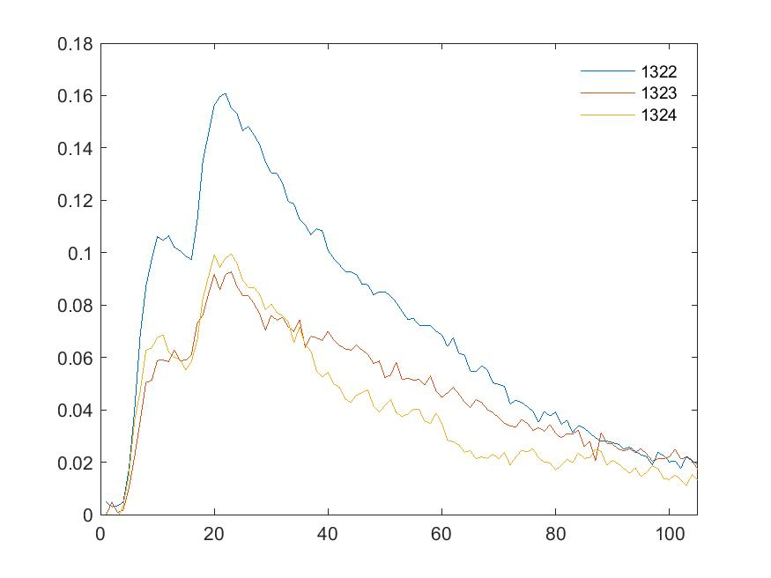
Trace of trials average across mice

Slide 11
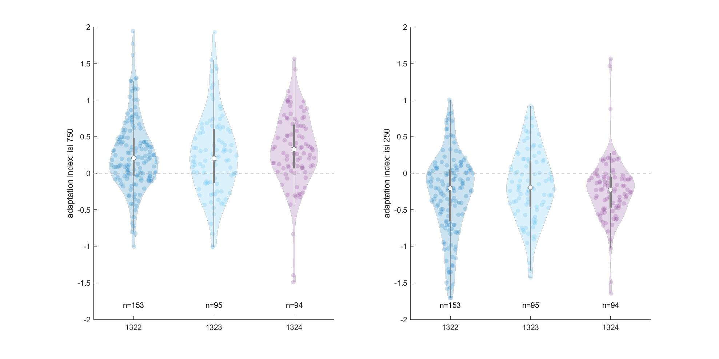
Adaptation index across mice

Slide 12
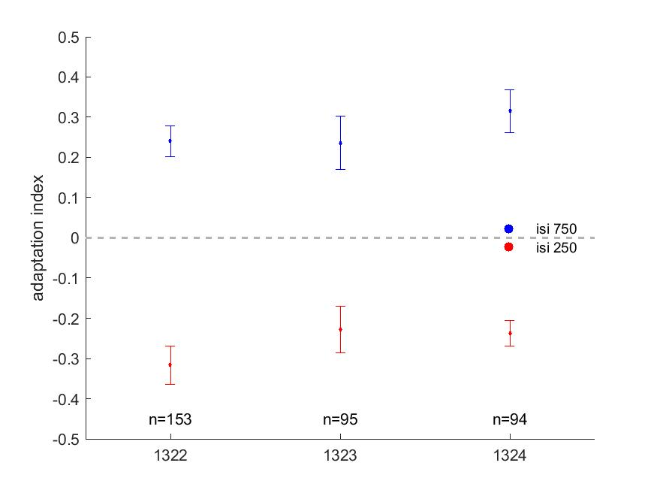
Adaptation index across mice

Slide 13
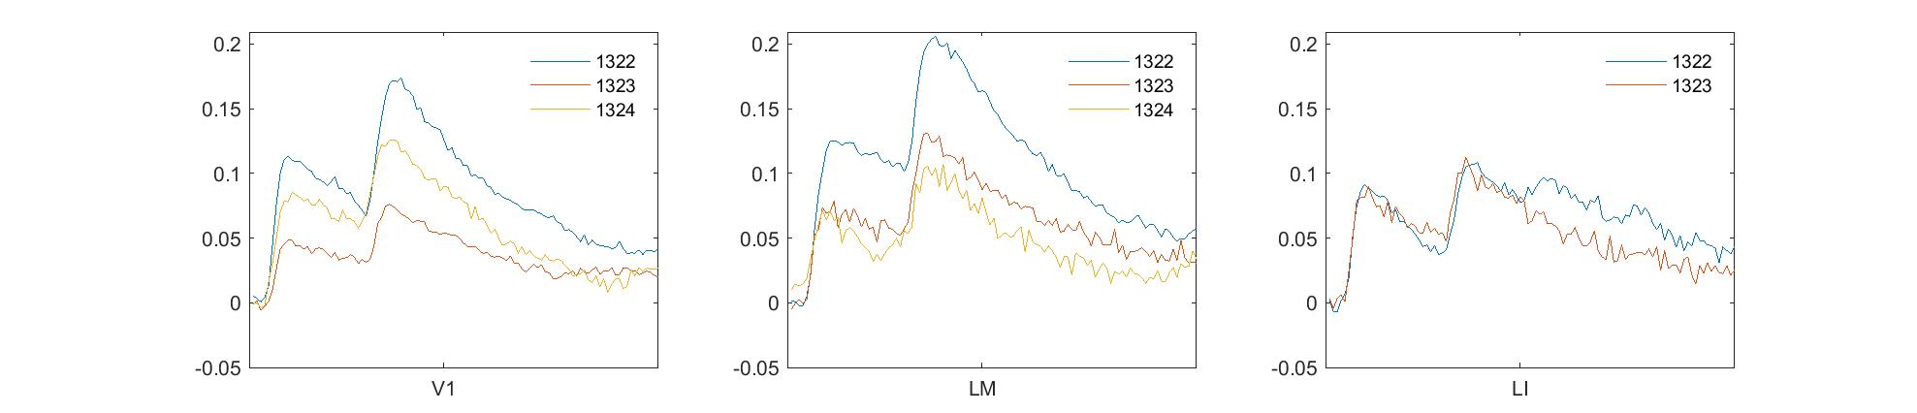
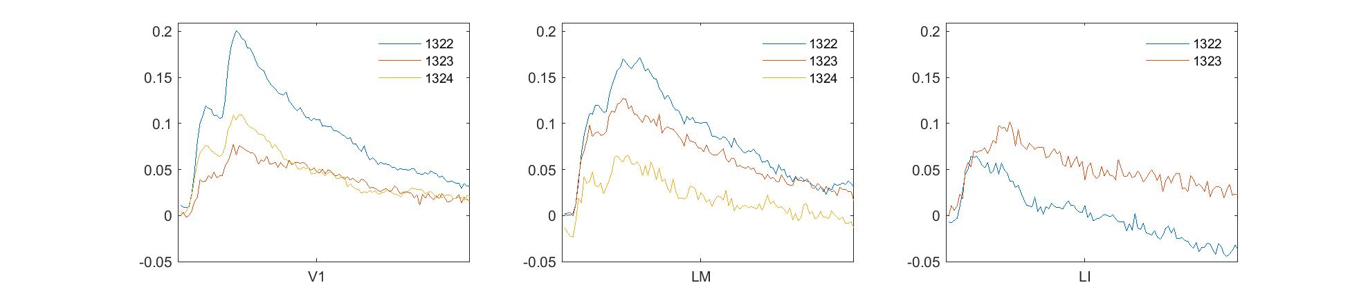
Trace of trials average across areas by mice

Slide 14
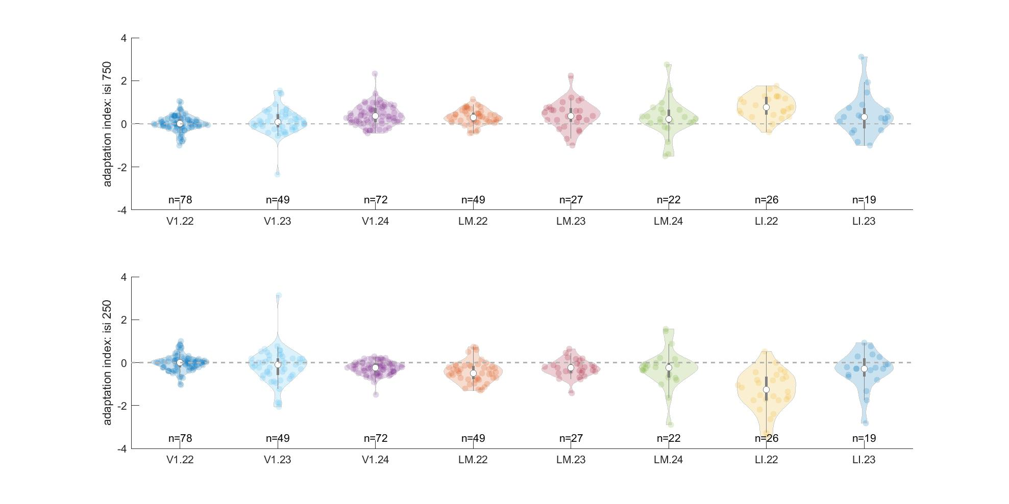
Adaptation index across areas by mice

Slide 15
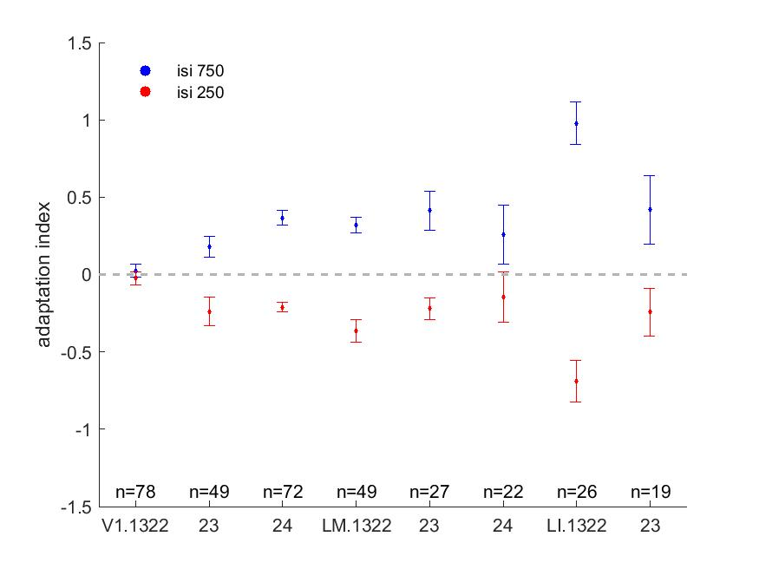
Adaptation index across areas by mice

Slide 16
Conclusion

Slide 17
Future directions for analysis and experiments

