Slide 1
Inter-area and inter-individual difference in rapid visual adaptation of naïve mice
Lan Luo
2020-09-03

Slide 2
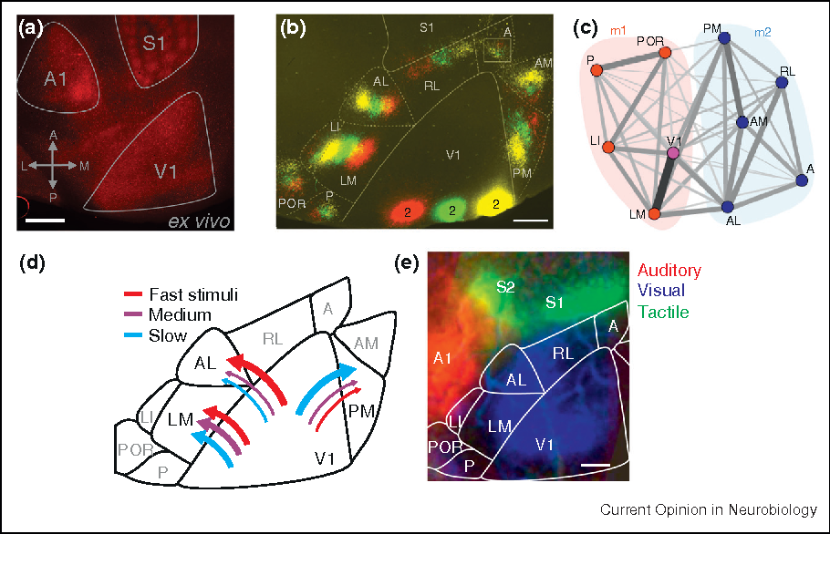
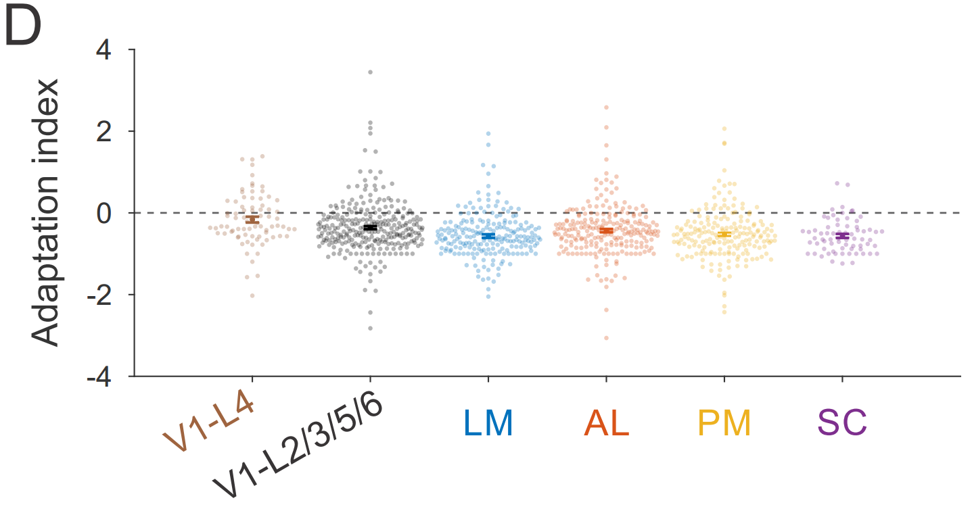
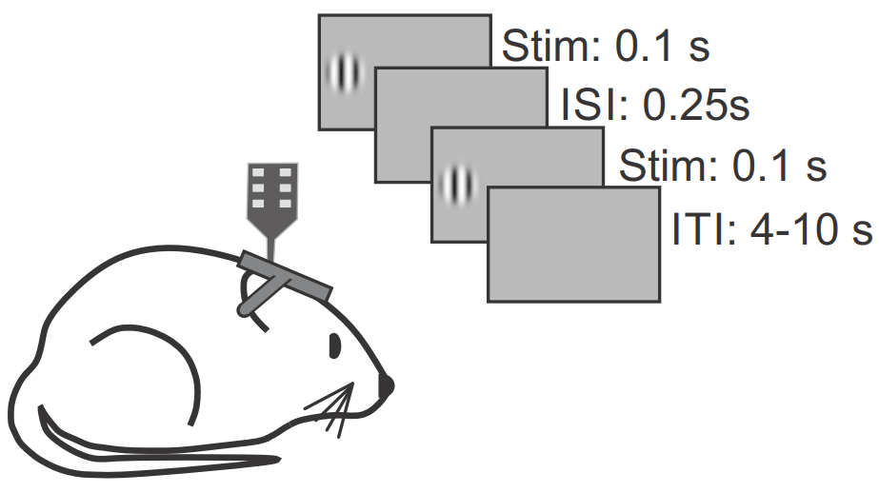
Background
Jin et al. (2020) measured adaptation magnitude across V1, SC, and 3 higher visual areas (HVAs): LM, AL, PM
Adaptation to paired iso-oriented stimuli is prevalent across mouse visual system
Adaptation is stronger in HVAs and SC compared to V1, but similar across HVAs and SC
Jin et al. (2020)
Wang, Sporns and Burkhalter (2012)

Slide 3
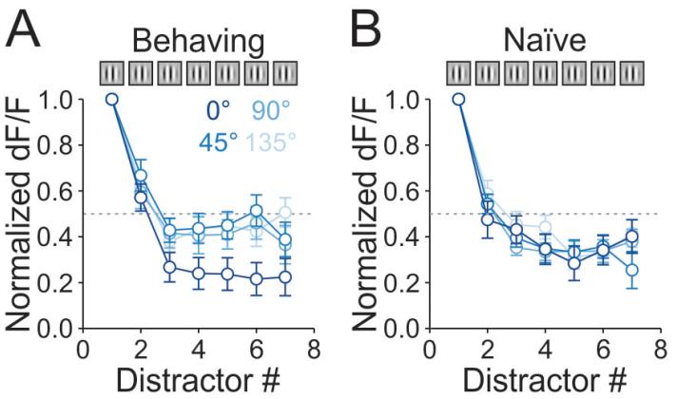
Question
However, the dataset was collected from mice trained to discern orientation changes, and trained behaving mice exhibit a larger adaptation with altered stimulus specificity compared to naïve mice
Is there a difference in the amount of adaptation across V1 and HVAs in naïve mice?
(-> A long-term question: how does coding change with adaptation in the HVAs, and what that means for stimulus encoding accuracy and efficiency?)

Slide 4
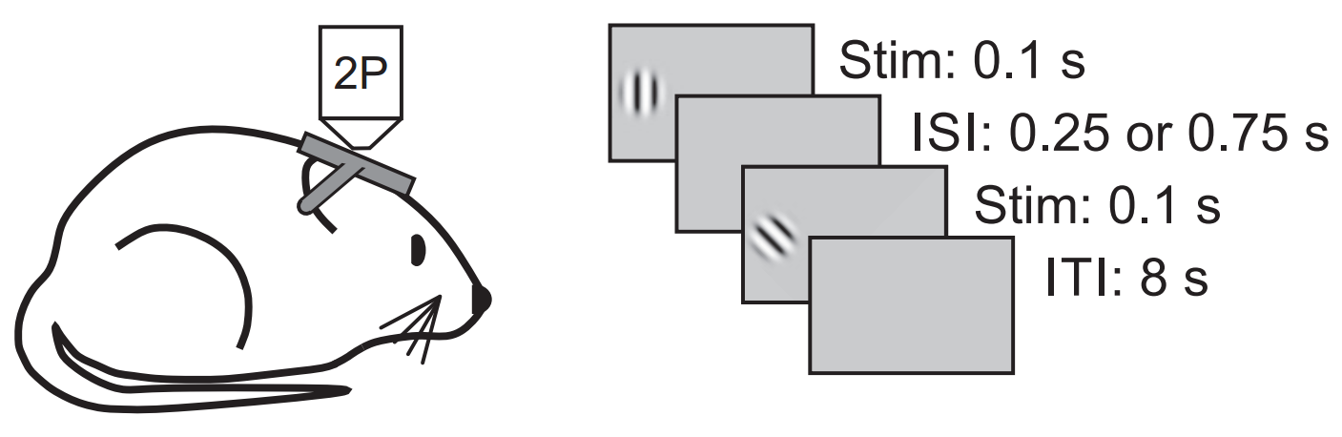
Experiment protocol
Ca imaging in V1 , LM, & LI of 3 mice
adapter:
1 orientation
30% no adapter (0 contrast)
target stimulus:
8 orientations
2 ISI (inter stimulus interval)
~6.5 s
Jin et al. (2019)
Glickfeld et al. (2014)
Notes:
Borderline area LI responds to both visual and auditory stimuli. Hardly recorded from
Why these stim param?

Slide 5
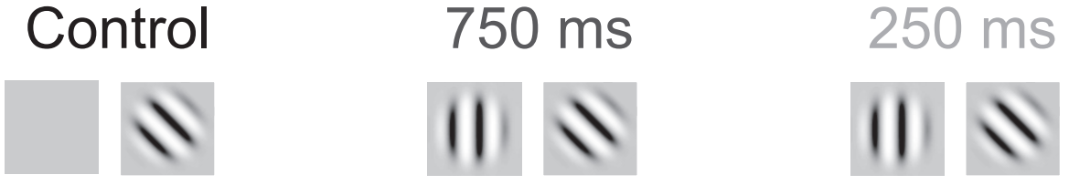
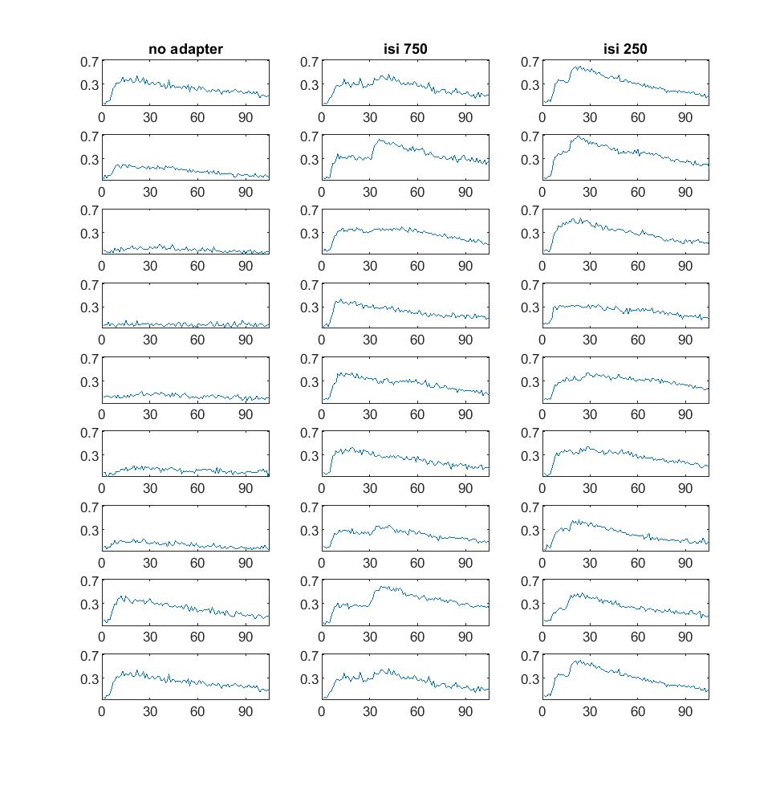
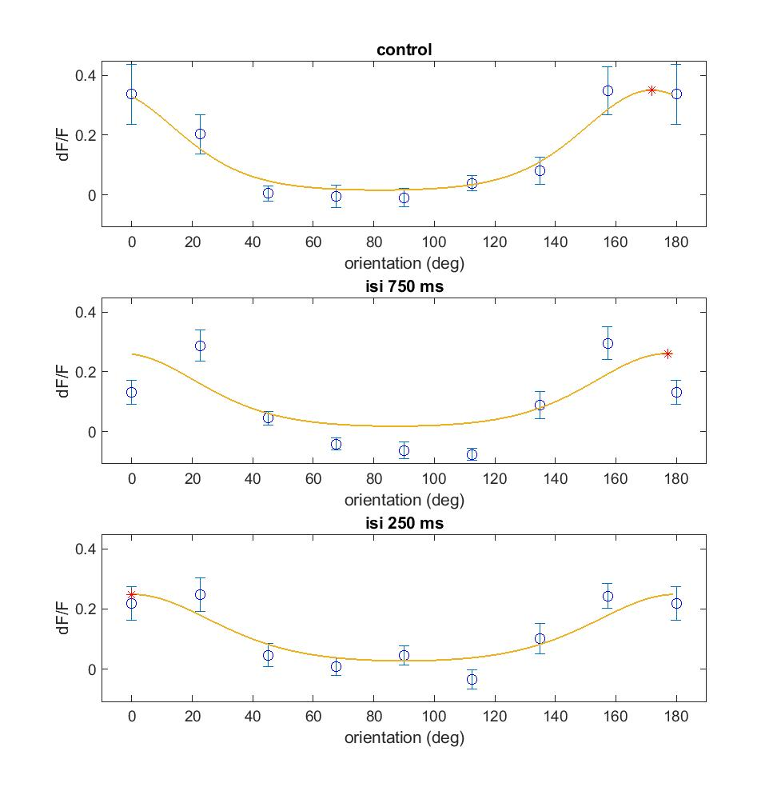
Trace & orientation tuning of a single neuron without vs with adaptation
Notes:
C:\Users\lan\Documents\repos\inter\plot\200728_i1324_V1\fig 2B trace16

Slide 6
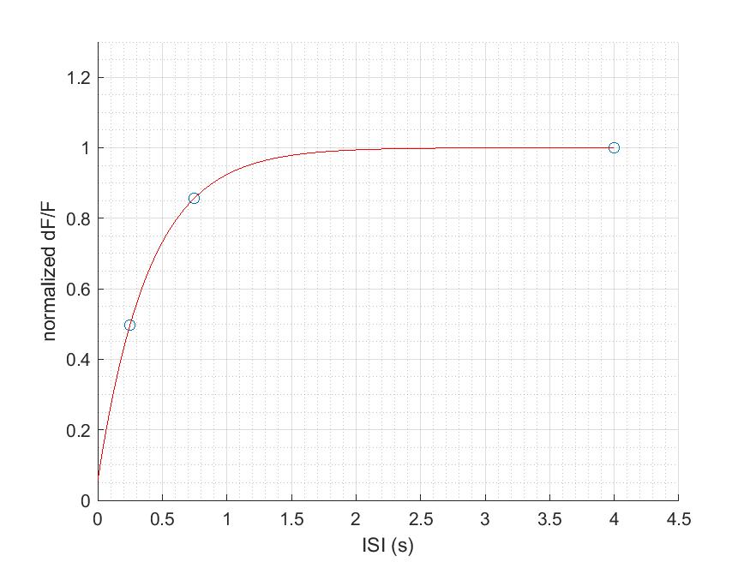
Time course of recovery after adaptation (V1, mouse 1324)

Slide 7
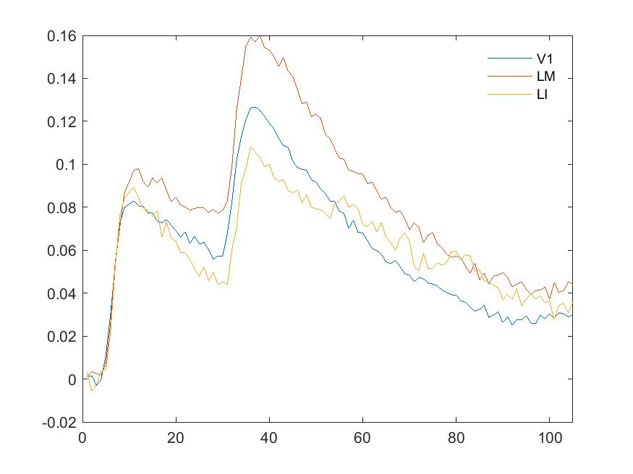
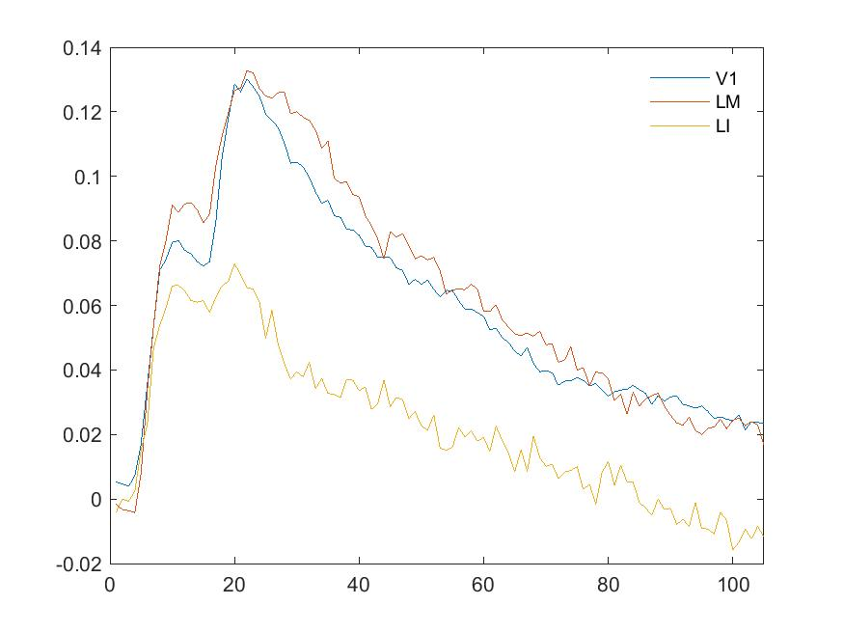
Trace of trials average across areas

Slide 8
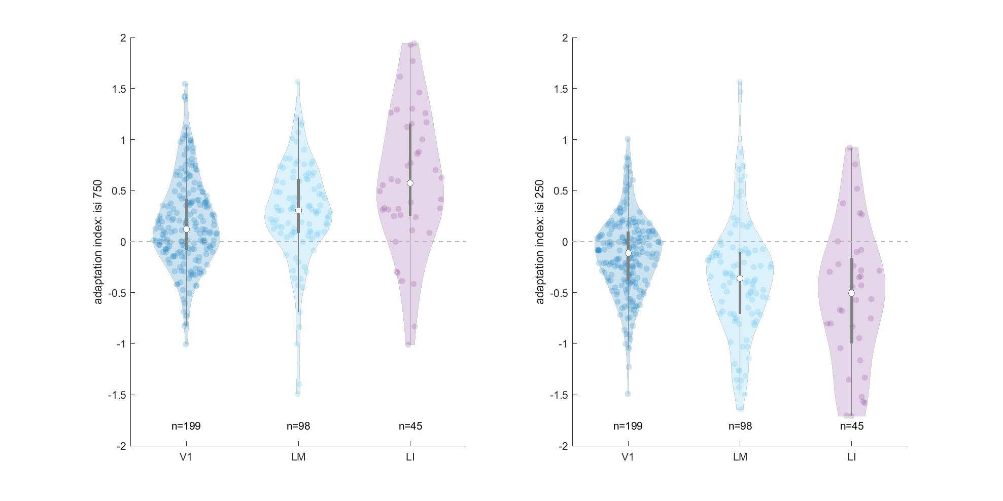
Adaptation index across areas
Adaptation index = ( resp_targ_0deg - resp_adapter ) / resp_adapter for the same cell
Notes:
quartiles(2)+-1.57*IQR/sqrt(length(data))

Slide 9
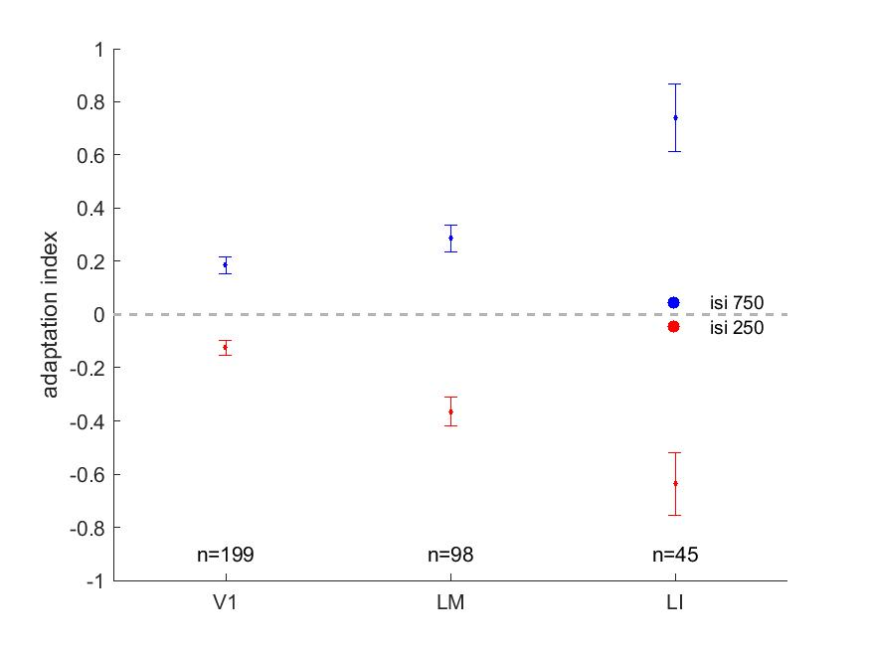
Adaptation index across areas

Slide 10
Question
Jin et al. (2020) dataset has been pooled over multiple mice. Any hidden variance between individual mouse?
Does the magnitude of adaptation vary across naïve individuals as well as areas?

Slide 11
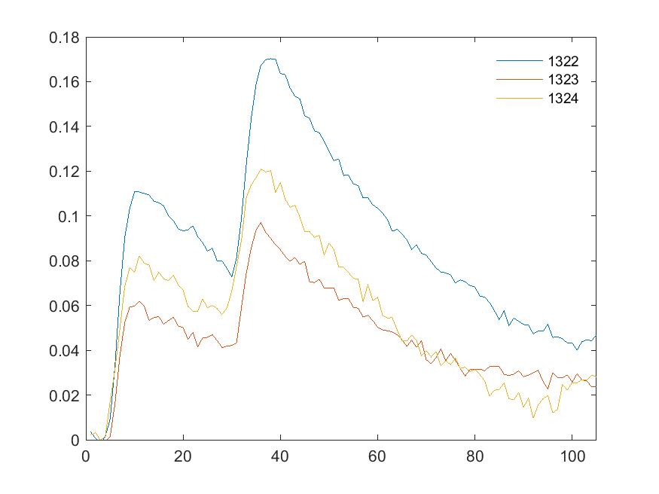
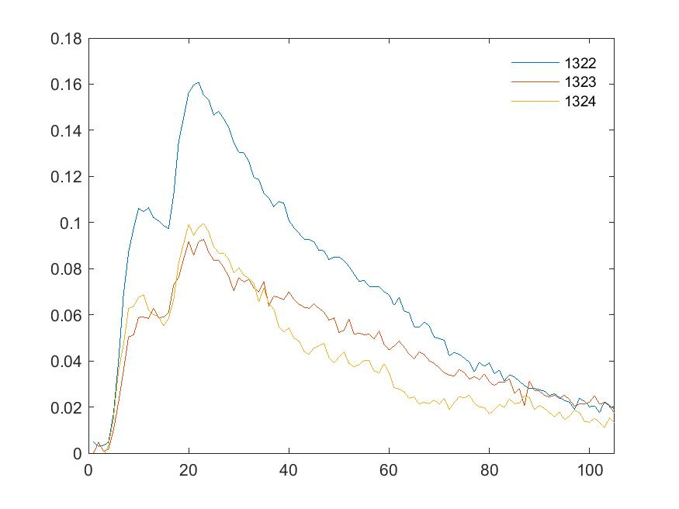
Trace of trials average across mice

Slide 12
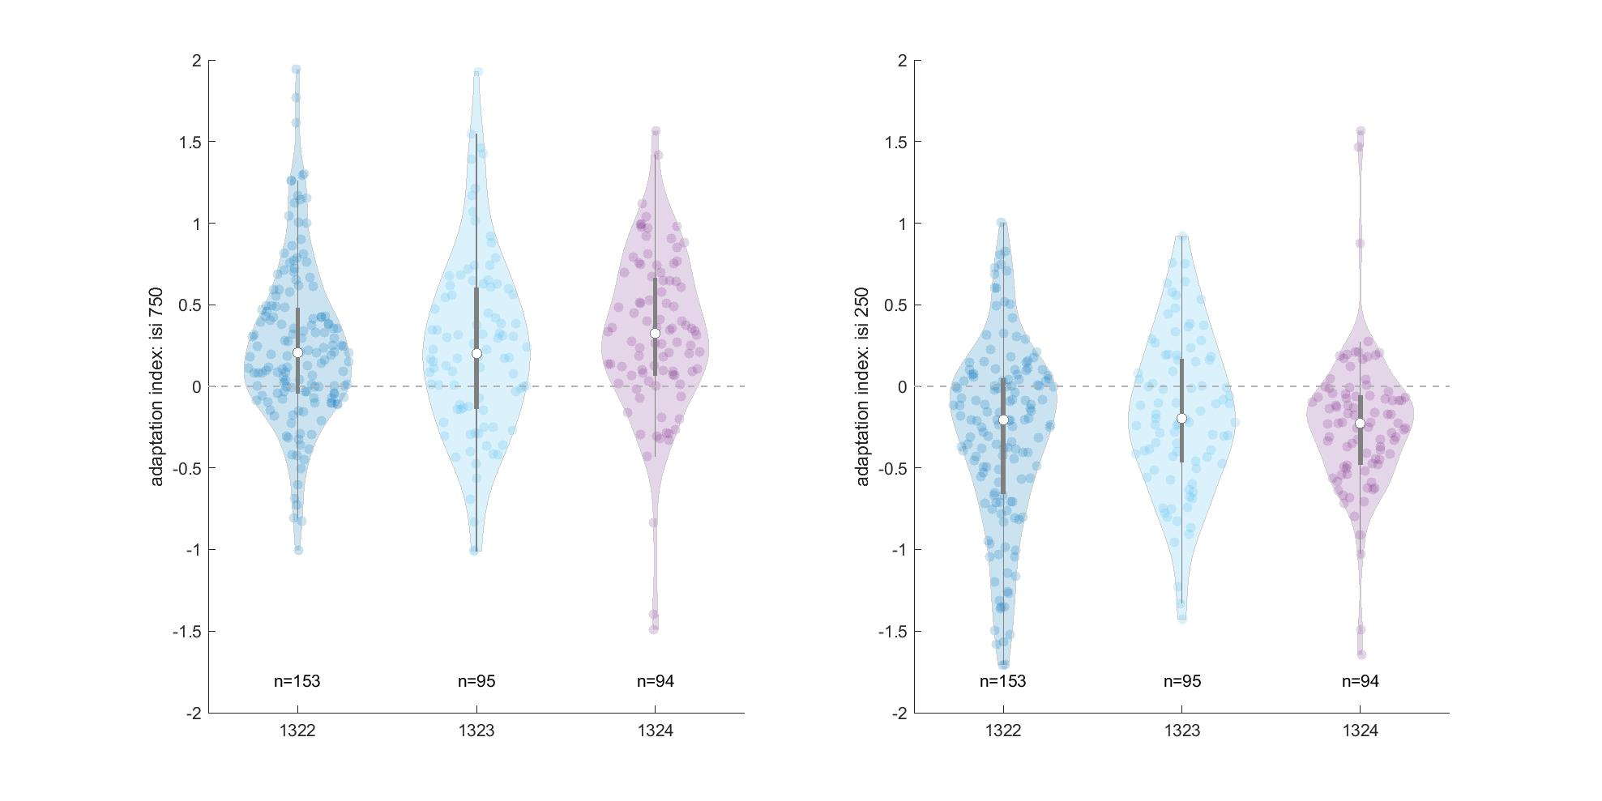
Adaptation index across mice

Slide 13
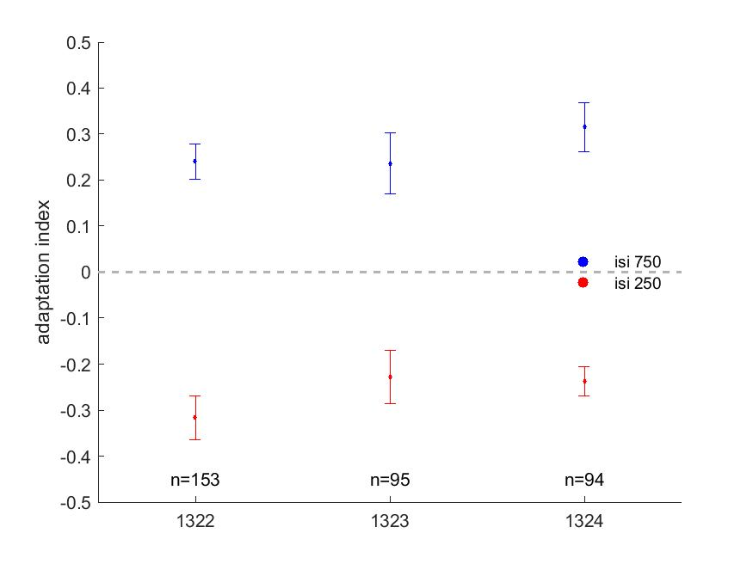
Adaptation index across mice

Slide 14
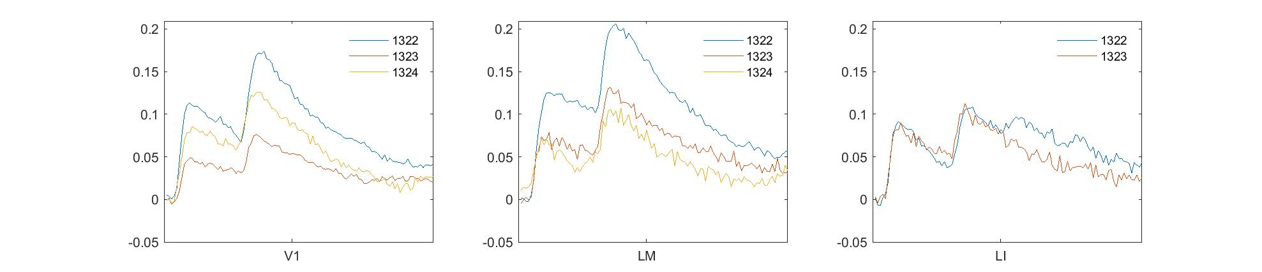
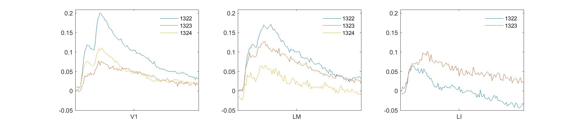
Trace of trials average across areas by mice

Slide 15
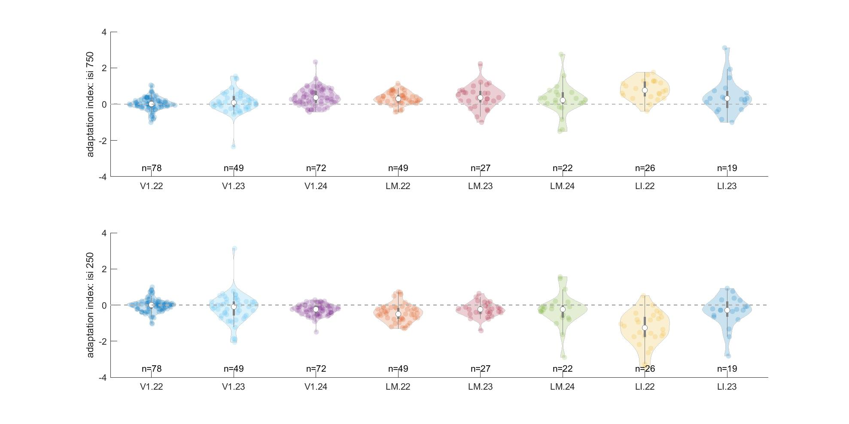
Adaptation index across areas by mice

Slide 16
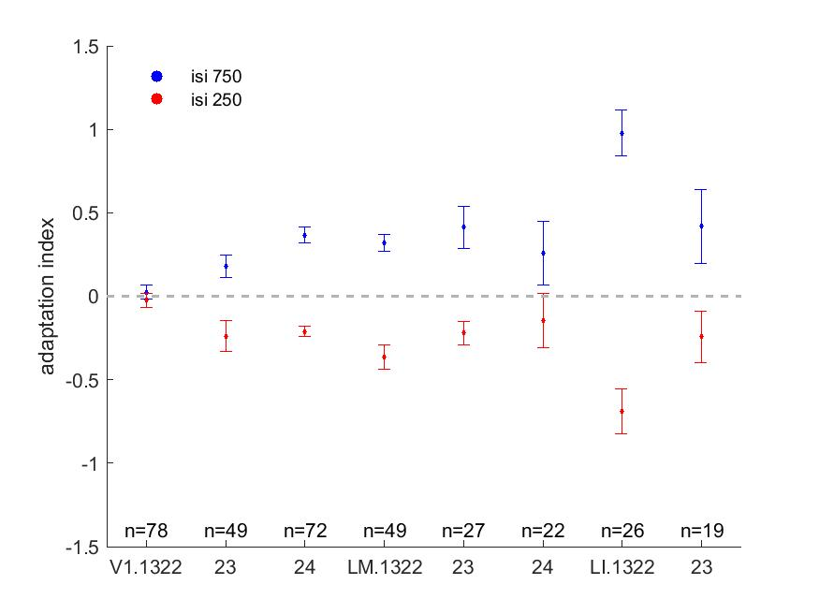
Adaptation index across areas by mice

Slide 17
Conclusion
Adaptation magnitude seems larger in LM & LI than in V1
Adaptation magnitude looks similar across mice, even though the overall visually driven neural activity of a mouse might be higher than other mice

Slide 18
Future directions
Two-way ANOVA / multiple comparison to test the significance of adaptation magnitude differences across areas and mice
What is happening when ISI = 750 ms? Get rid of corresponding outliers in average traces to verify if there really is facilitation after adaptation, or find better way to deal with outliers
Get a larger sample size N
Integrate existing data from other HVAs (AL, PM, more neurons in LM)
Time course of adaptation across HVAs
How does stimulus coding change with different level / specificity of adaptation in HVAs?

