Slide 1
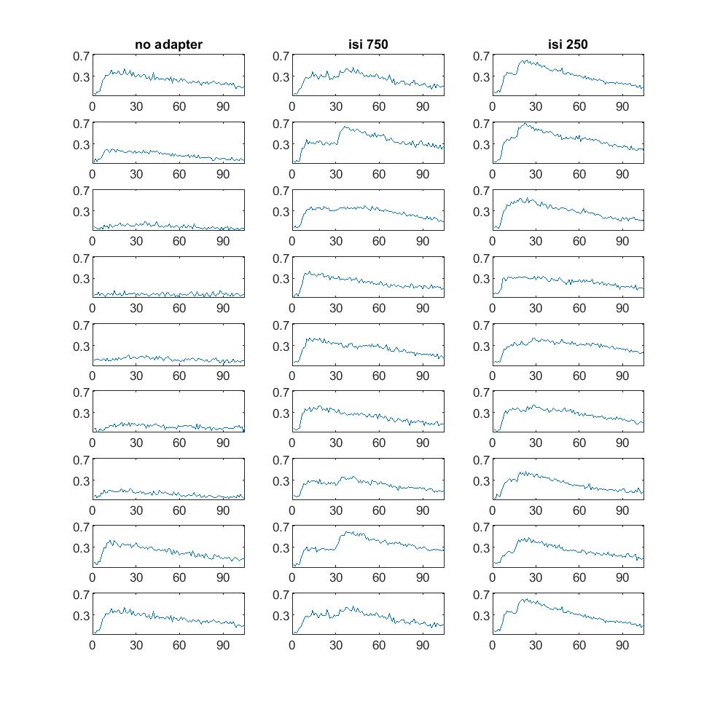
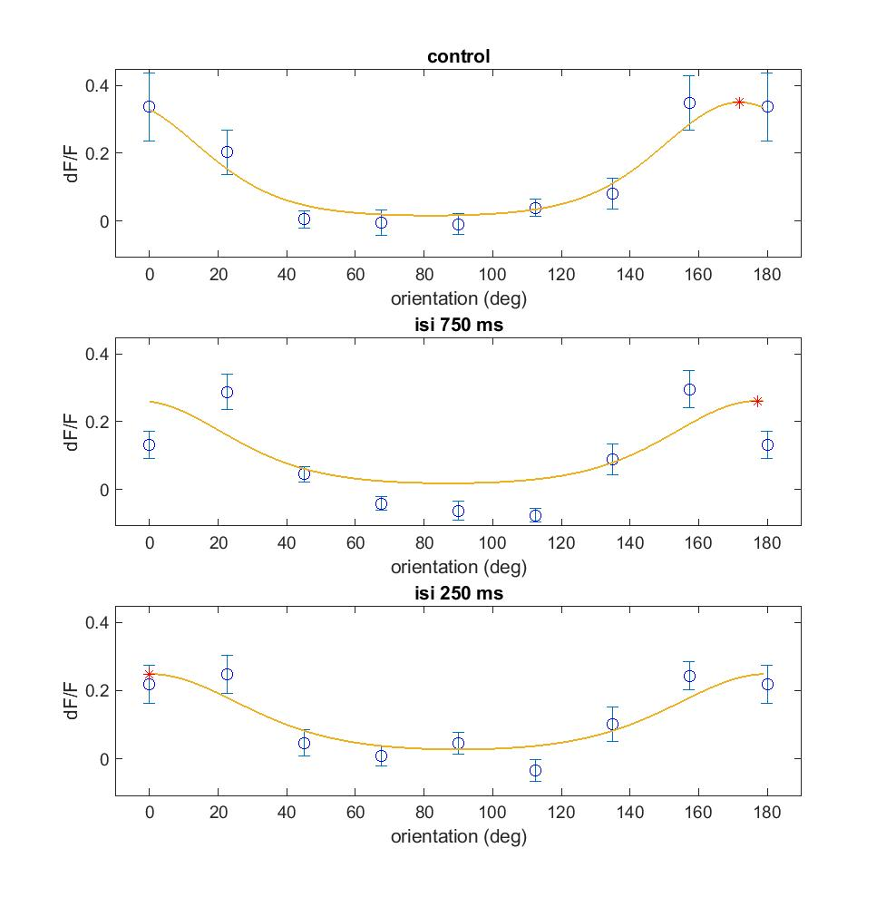
Notes:
C:\Users\lan\Documents\repos\inter\plot\200728_i1324_V1\fig 2B trace16

Slide 2
quartiles(2)+-1.57*IQR/sqrt(length(data))
Vio notch

