Slide 1
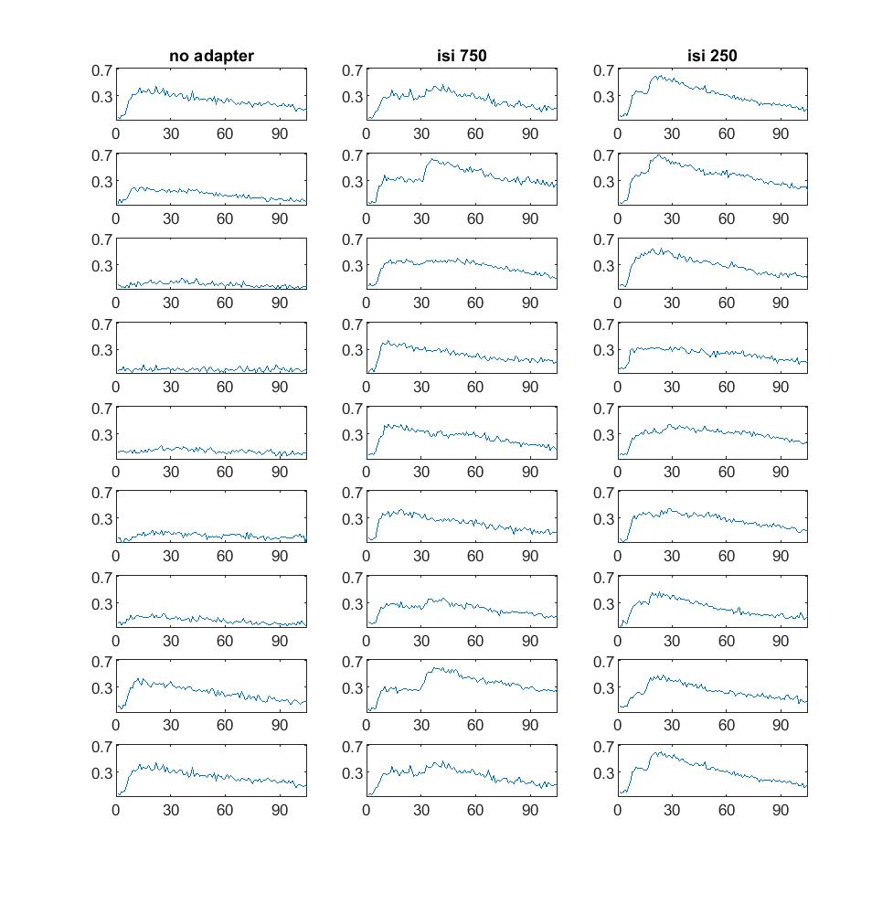
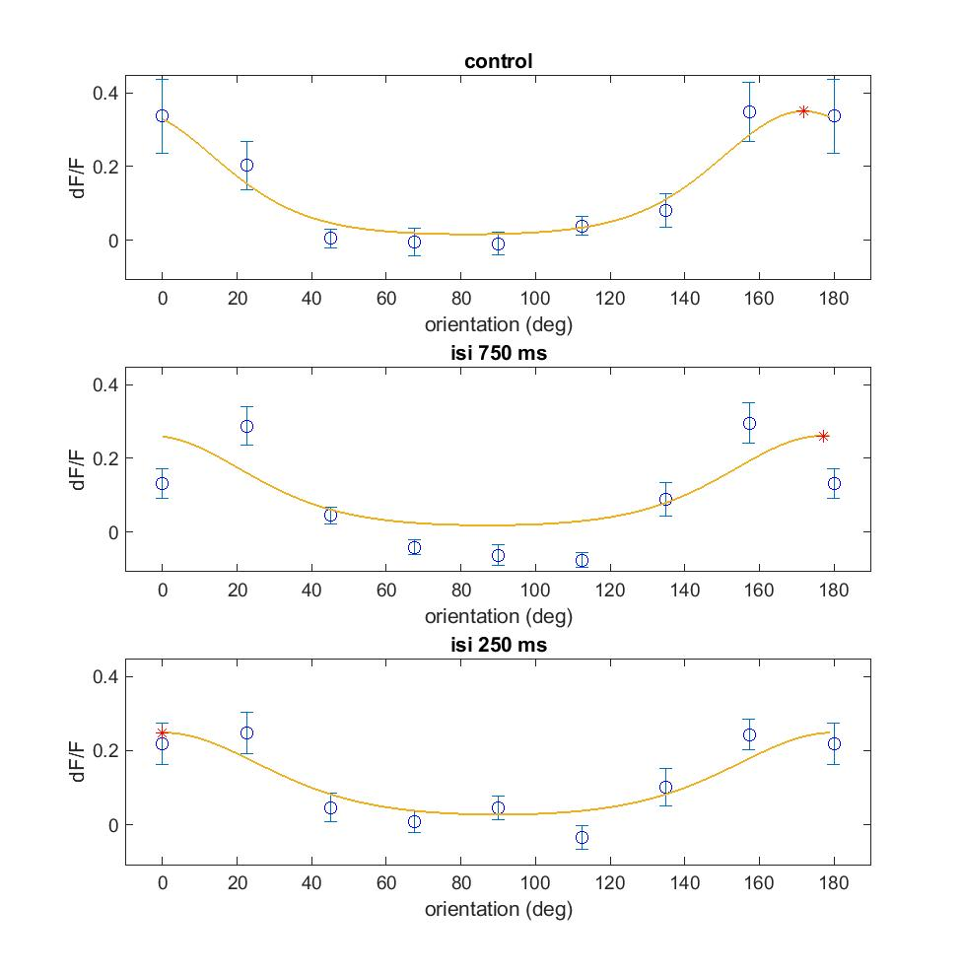
Notes:
C:\Users\lan\Documents\repos\inter\plot\200728_i1324_V1\fig 2B trace16

