Slide 1
Organic Groceries in Toronto
Wang Junyu
2020/05/14

Slide 2
Introduction – Organic lifestyle
Food
Commodities
Transportations

Slide 3
Impact on economic
Production
Retailing
Goverment

Slide 4
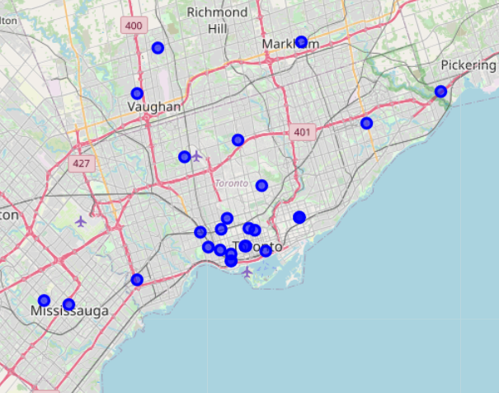
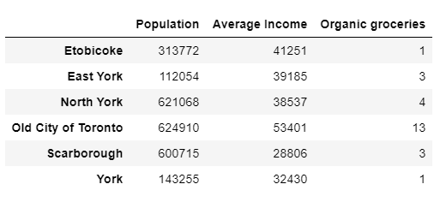
Organic Groceries – Current situation

Slide 5
Result and conclusion
Only 27 groceries, market still small, but may have great potential
Stores mainly in downtown
Etobicoke might be a good choice.
More analysis, such as revenue, are needed to get an insight.

