Slide 1

Habit Tracker API
A RESTful Service for Personal Habit Management
COURSEWORK PROJECT | WEB SERVICES AND WEB DATA
Notes:
Good morning/afternoon, everyone. My name is [Your Name], and today I'll be presenting my coursework project for the Web Services and Web Data module. The project is a RESTful API designed to help users track and manage their personal habits.

Slide 2


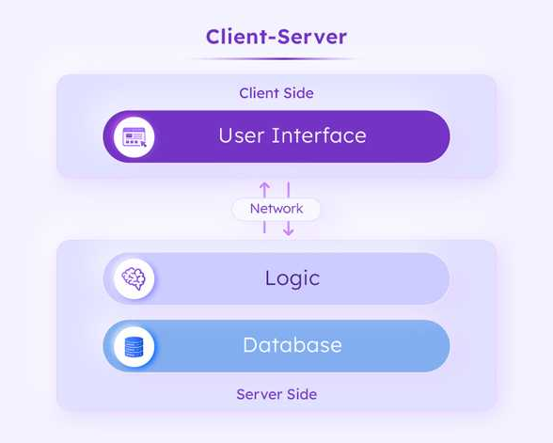



Project Overview: Purpose and Scope
CORE OBJECTIVE
Design and implement a robust, scalable, and well-documented RESTful API to facilitate comprehensive habit tracking.
KEY FUNCTIONALITY
• CRUD Operations for Habit Management | • Data Validation & Integrity • Real-time Statistics (Streaks/Rates) | • Comprehensive API Docs
TARGET AUDIENCE
Individuals seeking a reliable digital solution to monitor, analyze, and improve their daily habits.
System Architecture Diagram
Client-Server Interaction Model
TECH STACK & TOOLS
Java 17 • Spring Boot • Spring Data JPA • H2 DB • Jakarta Validation • OpenAPI
Notes:
The main goal of this project was to build a fully functional RESTful API. It allows users to perform all essential CRUD operations on their habits and also provides a statistics endpoint for insights. The API is built using a modern tech stack, including Java 17 and Spring Boot, which I'll discuss in more detail later.

Slide 3
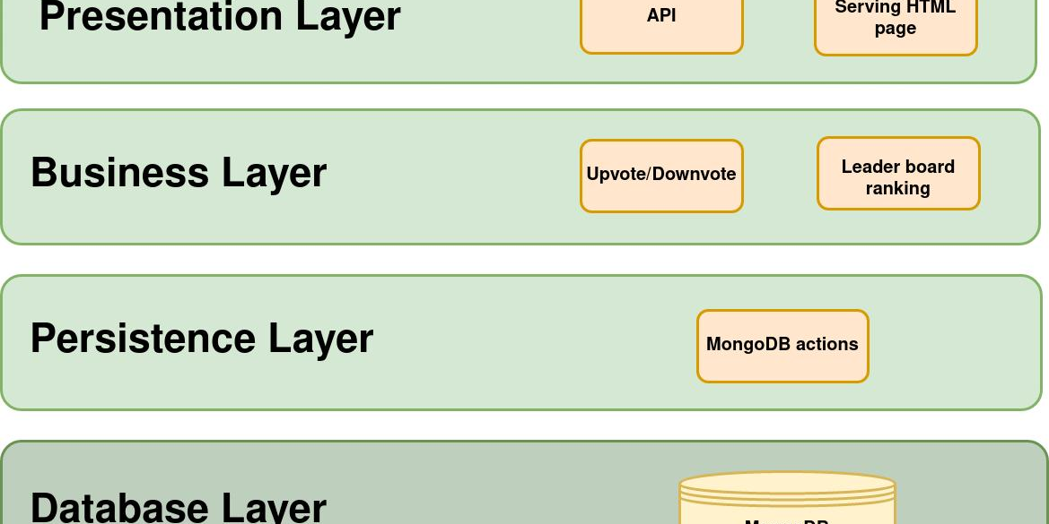
Architecture and Project Structure
Architectural Pattern
Core Packages & Responsibilities
The application is built on a robust layered architecture, strictly adhering to the MVC (Model-View-Controller) design pattern for separation of concerns.
/ controller
/ model (Entity)
Entry point for HTTP requests/responses; maps endpoints to service logic.
Defines core domain entities (e.g., Habit, User) and their database mappings.
Data Flow:Client → Controller → Service → Repository → Database
/ service
/ dto (Data Transfer)
Contains core business logic, validations, and orchestrates data flow between layers.
Objects for secure and efficient communication between client and server layers.
/ repository
/ config & /exception
Data access layer using Spring Data JPA for seamless database interaction.
App configuration classes and a global handler for custom exceptions.
Notes:
To ensure a clean and maintainable codebase, I implemented a layered architecture. The controller receives HTTP requests, the service layer contains the core business logic, and the repository layer handles database interactions. This separation of concerns makes the application modular and easier to test and extend. The project is organized into distinct packages, each with a specific responsibility.

Slide 4
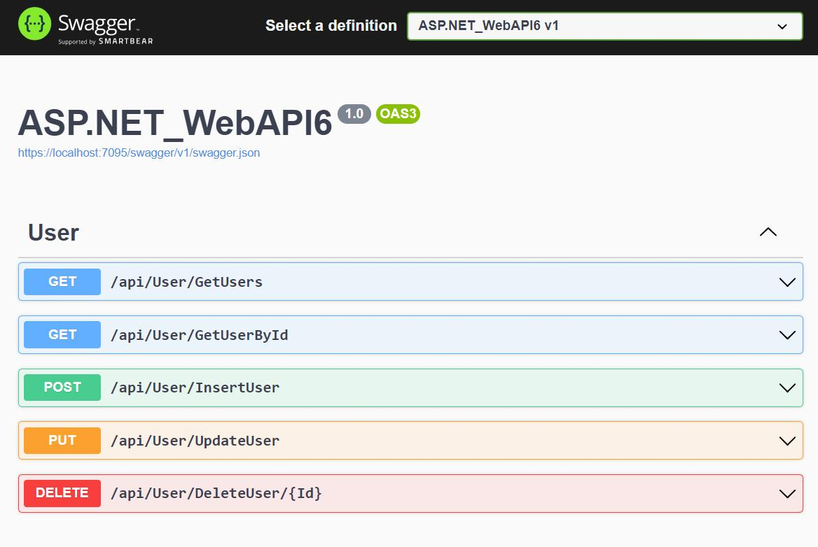


Core API Endpoints
Resource: /api/habits
Interactive API Doc Preview
POST
/api/habits
Create a new habit
GET
/api/habits
Retrieve all habits
GET
/habits/{id}
Get habit by ID
PUT
/habits/{id}
Update existing habit
DEL
/habits/{id}
Delete a habit
GET
/habits/stats
Get habit statistics
JSON Format
All data exchange
HTTP Status
200, 201, 404, etc.
Live documentation view powered by Swagger UI
Notes:
The API exposes a set of standard RESTful endpoints for managing habits. As you can see, it supports all CRUD operations via POST, GET, PUT, and DELETE methods. Additionally, a dedicated endpoint at `/stats` provides users with valuable insights. The API strictly uses JSON and adheres to standard HTTP status codes to communicate the outcome of each request clearly.

Slide 5
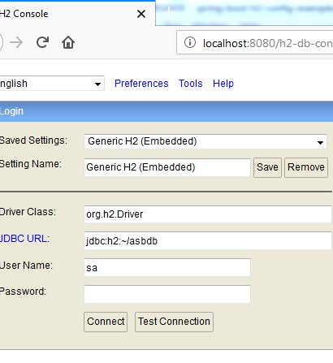


Data Management & Robustness
Database Configuration
Utilizes H2 (in-memory) for rapid testing cycles and Spring Data JPA to eliminate repetitive JDBC boilerplate code, streamlining all CRUD operations.
Data Validation
Integrated Jakarta Validation (Bean Validation) enforces strict data integrity rules (e.g., @NotBlank, @Min) to ensure all incoming API payloads meet business criteria.
Global Exception Handling
A centralized @RestControllerAdvice catches all exceptions, providing consistent, well-structured JSON error responses to improve API usability for consumers.
Notes:
For data persistence, I chose the H2 in-memory database, ideal for easy testing. Spring Data JPA abstracts the complexity of JDBC. To ensure data quality, I integrated Jakarta Validation. Furthermore, a global exception handler was implemented to provide consistent and informative error messages, making the API more robust and user-friendly.

Slide 6
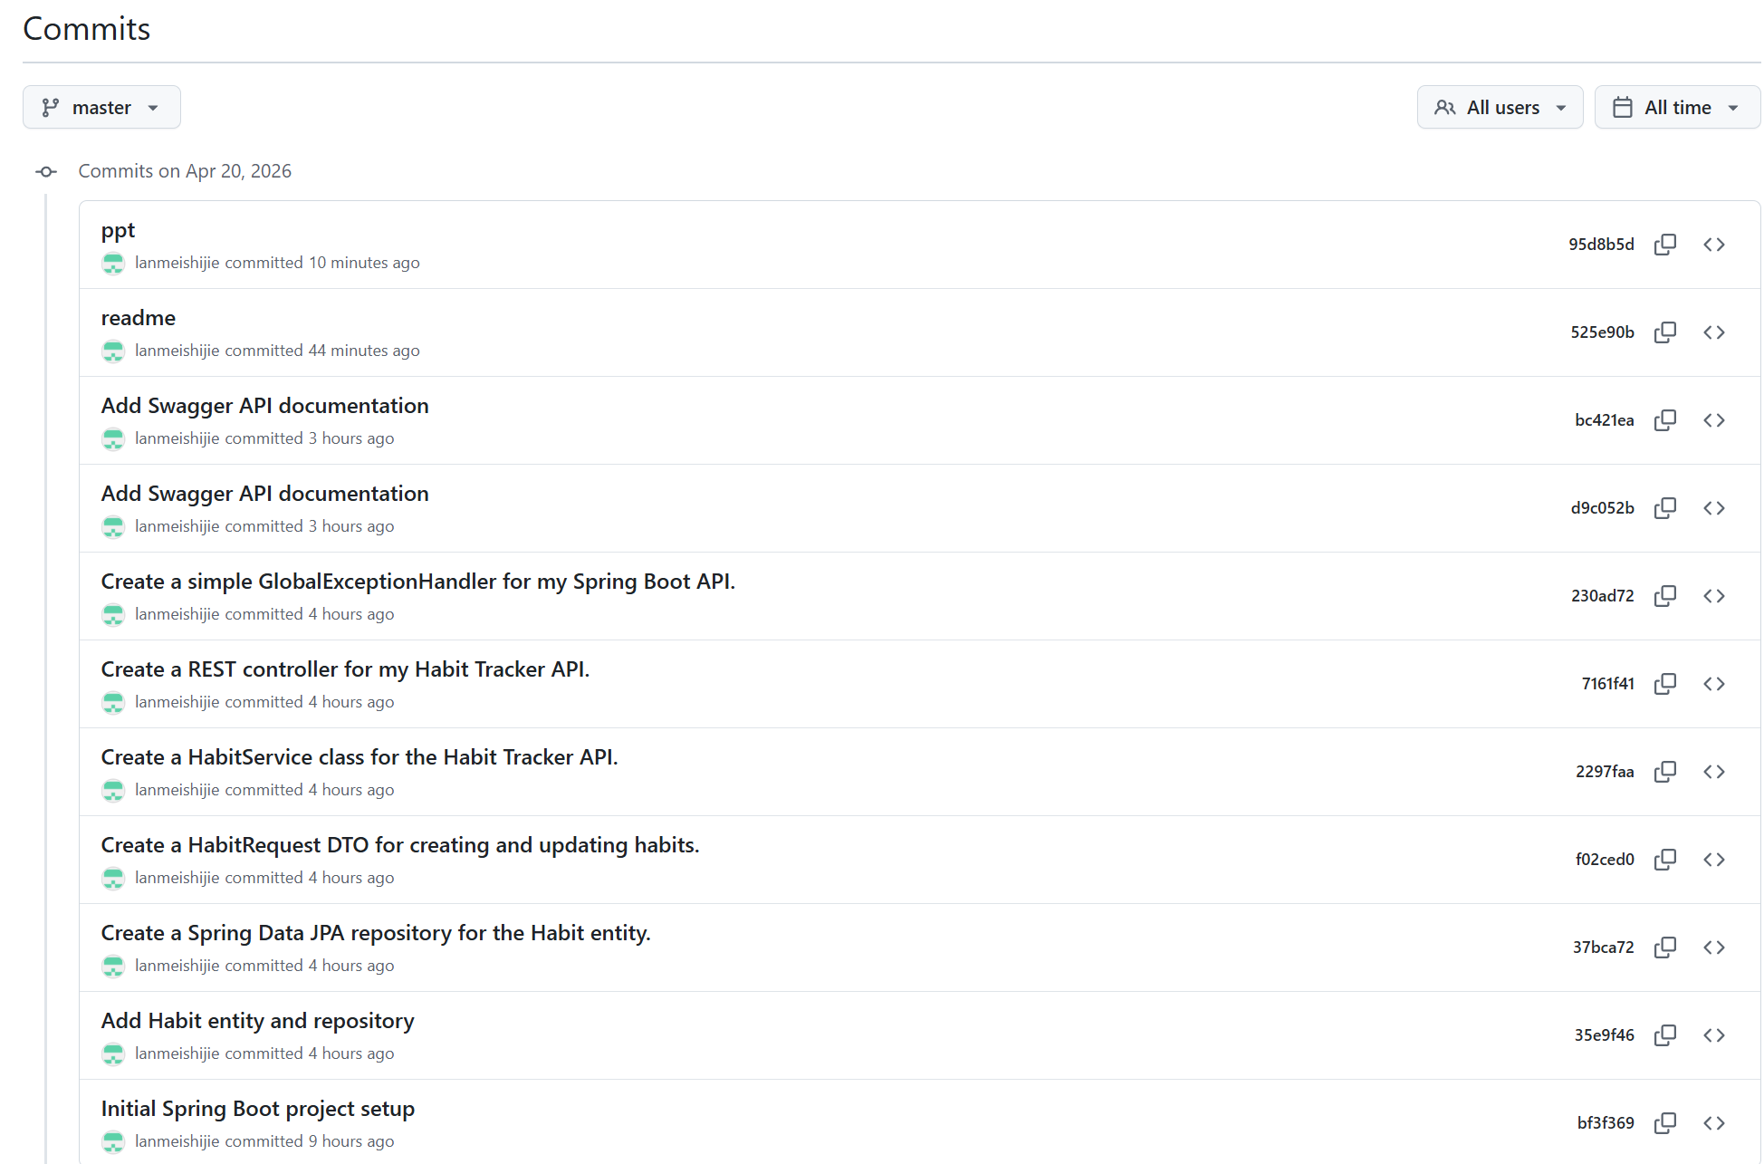
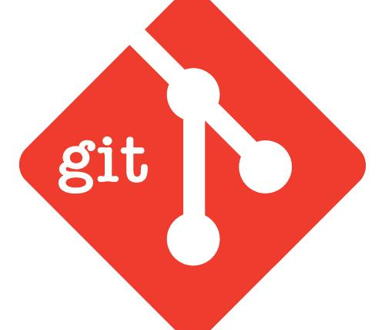
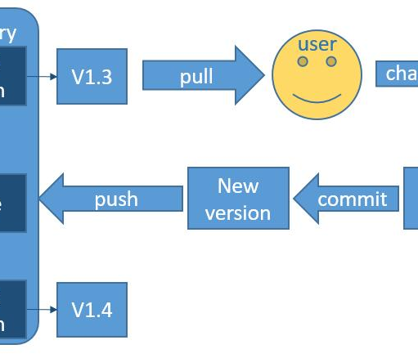
Quality Assurance & Maintainability
API Documentation (Swagger UI)
Version Control (Git)
Springdoc-OpenAPI:Auto-generates interactive docs from code annotations.
Benefit:Provides a live interface for developers to explore, test, and understand API endpoints visually.
Used for full lifecycle source code management, ensuring a complete, immutable history of changes and facilitating seamless team collaboration.
Sample Data Initialization
ACommandLineRunnerbean loads predefined test data into the H2 in-memory database on startup, enabling immediate functional testing without manual setup.
Standard Git Workflow: Pull → Commit → Push → Merge
Notes:
A crucial aspect of any web service is good documentation. I used Springdoc-OpenAPI to generate a Swagger UI, which serves as living documentation.
To make testing easier, I implemented a data loader using CommandLineRunner to populate the H2 database with sample data on startup.
Finally, the entire project was managed using Git for version control, ensuring traceability of all development steps and making collaboration straightforward.

Slide 7





Technical Choices, Reflection, and Conclusion
Rationale for Choices
Project Reflection
Key Conclusions
SelectedJava & Spring Bootfor familiarity. The robust ecosystem enabled focus on core API design, persistence logic, and overall project structure.
Successfully built a fully functional REST API. Mastered DTO patterns for clean contracts, implemented global exception handling, and automated API documentation effectively.
The project fully meets all coursework requirements. It provides a solid foundation for future extensions, such as user auth, complex statistics, or a full frontend.
THANK YOU
Q&A SESSION / ANY QUESTIONS?
Notes:
In choosing the technology stack, I prioritized Java and Spring Boot, which allowed me to focus on core concepts. Reflecting on the project, I'm satisfied with the implementation of the core features. In conclusion, this project has been a valuable learning experience, and the resulting API is robust and ready for potential future enhancements. Thank you for your attention. I would be happy to answer any questions.

