Slide 1
Web Scraping Project
By Lan Mond
lanmond2018@gmail.com

Slide 2
Yoga Retreat Worldwide
Website Introduction
Outline:
Theme: yoga
Retreats
Vacation
Worldwide
7400 retreats
Web: https://www.bookyogaretreats.com/
Question: What if setting up your own retreat?
Incentive:

Slide 3
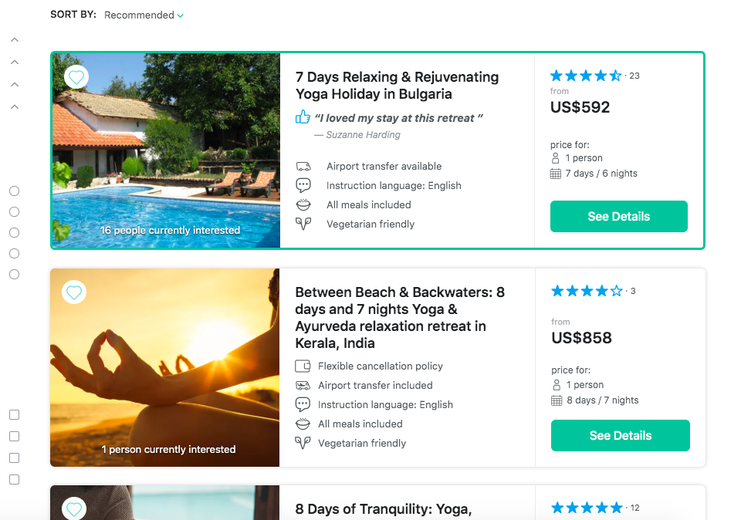
Website Introduction
Outline:
7474 listings
12/page
644 pages

Slide 4
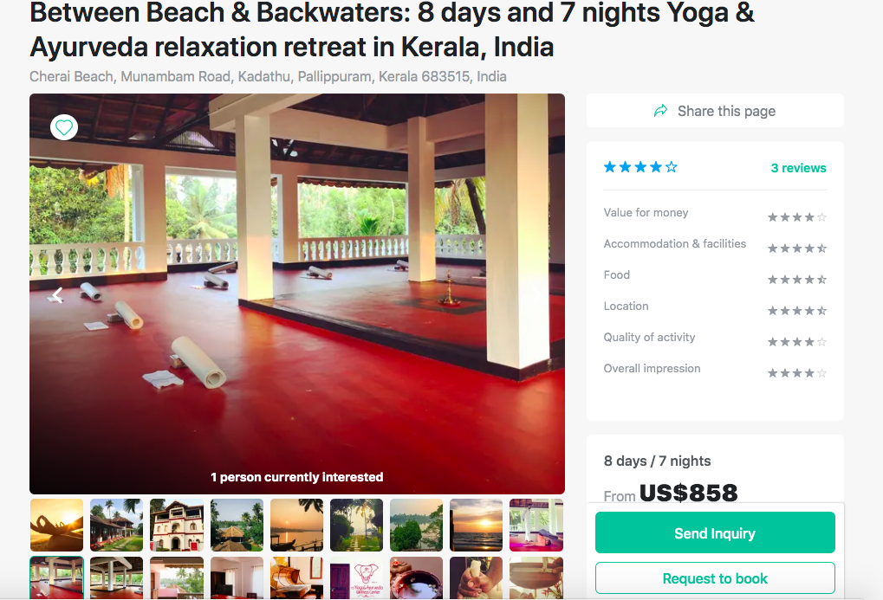
Listing page
Listing features:
Title
Introduction
Highlights
Yoga styles
Yoga skill level
Accommodation
Food
Program
Schedule
Instructors
Airport
Retreat location
Nearby places
What is included
Reviews
Price
Transportation
………

Slide 5
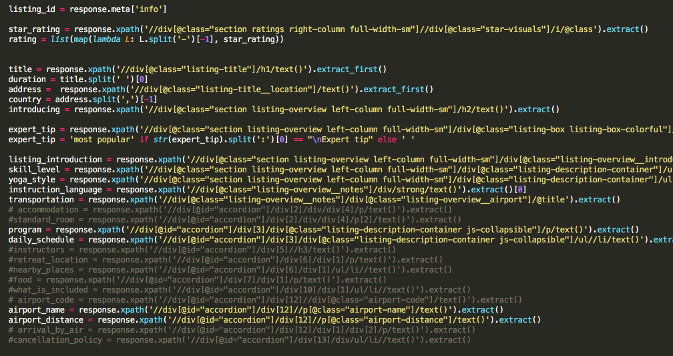
Scraping Tool: Scrapy
Approach:
Rich information availability
get as much data as possible
Speed
Technical Challenges:
Control
Passing data from the higher level to lower level
Collecting average reviews
Potential Problems:
Data needs more cleaning job
Fail to get review details
Fail get price

Slide 6
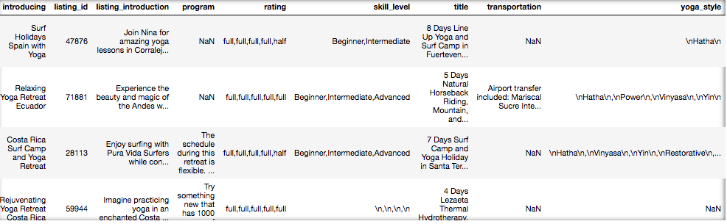
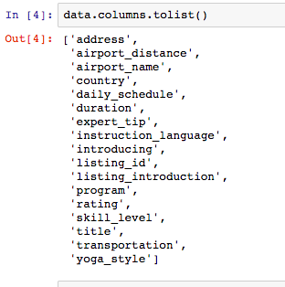
Collected data
Data Structure:
7447 listings over 60 countries
17 variables
Accommodation
Food
Program
Schedule
Instructors
Airport
Retreat location
What is included
Reviews
Price
Transportation
………

Slide 7
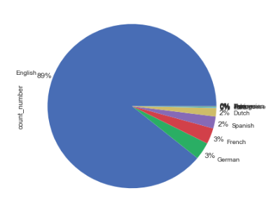
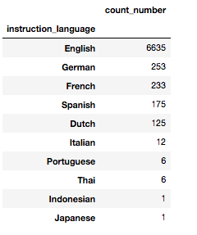
Language Distribution
Observation:
English is the most most adopted language : 89%

Slide 8
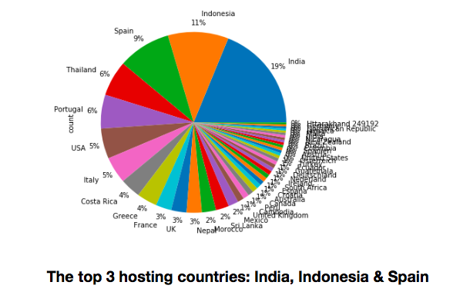
Popularity by Country
Observation:
India: 19%
Indonesia: 11%
Spain: 9%
Thailand: 6%
Portugal: 6%
USA: 5%
Italy: 5%
Costa Rica: 4%

Slide 9
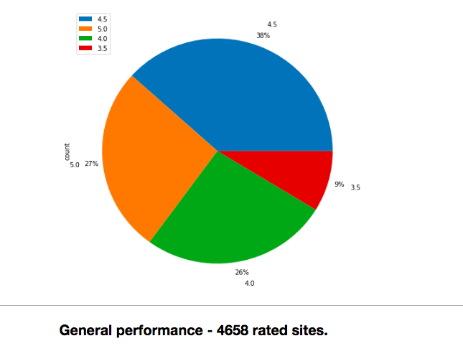
Participants Review Rating Distribution
Observation:
Global general performance is quite good.
5.5: 27%
4.5: 39%
4.0: 28%
3.5: 9%
91% of ratings are 4 and 4 above
No lower than 3.5 ratings.

Slide 10
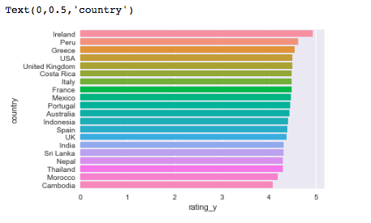
Participants Review Rating by Country
Observation:
Ireland: No.1(10)
Peru: No.2 (77)
USA: No. 4, ranks 6th on retreat counts (399)
India: No. 14, ranks 1st on retreat counts(1387)
Spain: No.12, ranks 3rd on retreat counts

Slide 11

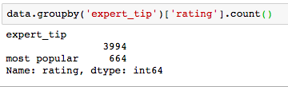
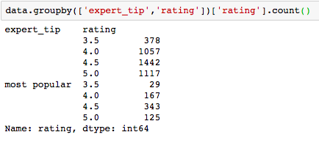
Third Party Rating
Observation:
Most popular: 10.3%
With rating:
Most popular: 14.3%
With most popular:
5.0: 18.9%
4.5: 51.7%
Third party expert tip matters

Slide 12
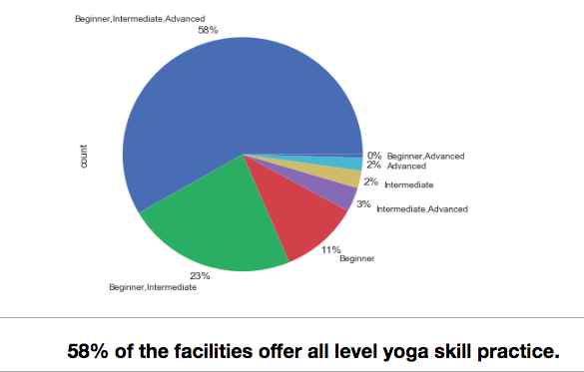
Skill Level
Observation:
All level: 58%
Beginner and Intermedia: 23%
Beginner: 11%
Intermediate and Advanced: 3%

Slide 13
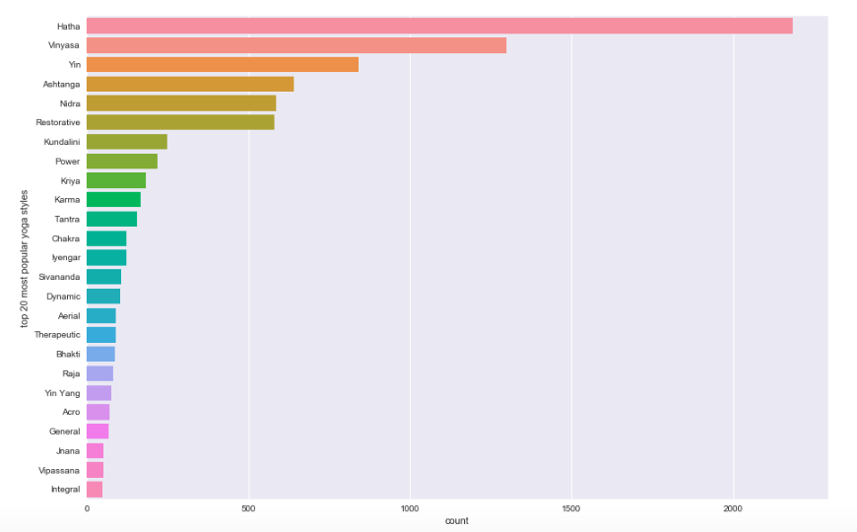
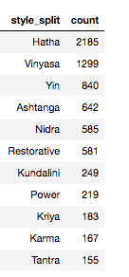
Yoga Style Popularity
Observation:
All level: 58%
Beginner and Intermedia: 23%
Beginner: 11%
Intermediate and Advanced: 3%

Slide 14
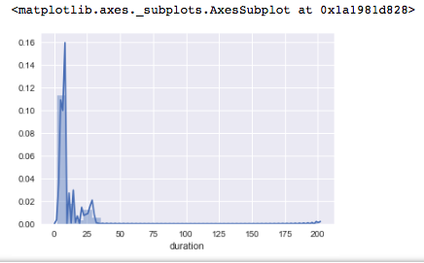
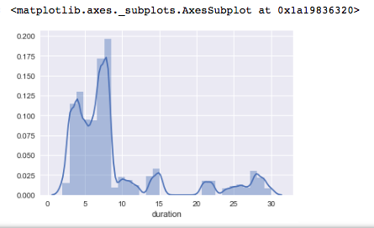
popularity of Lengths of the stay
Observation:
2~8 days length are the most adopted program
There are few of program marked as 200 days.
Outlier ?

Slide 15
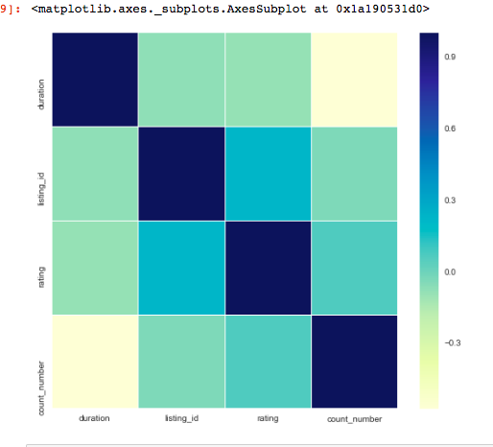
Correlation Ship
Observation:
There is no clear correlation ship between rating, duration, language, country etc.

Slide 16
Possible answers:
Instruction: English
Skill level: all level
Yoga style: consider the vinyasa, astanga etc.
Length of program: 5-8 days
Location: along the coastal line
Third party – expert tip
Palm Beach, America
Next step:
Price
Review details
Family vs One traveller

