Slide 1
Decision Trees: Unpacking Machine Learning's Intuitive Power
Explore how these elegant algorithms transform complex data into clear, actionable decisions

Slide 2
What is a Decision Tree?
A decision tree is a supervised learning algorithm that mimics human decision-making processes, transforming complex datasets into intuitive, visual pathways. Think of it as a digital flowchart that systematically navigates through questions to arrive at predictions.
Visual Structure
Classification Power
Regression Capability
Starts at a root node and branches outward like a tree, creating clear pathways to outcomes
Predicts categories by sorting data through logical conditions and thresholds
Also predicts numerical values by averaging target values at terminal nodes
These versatile algorithms excel at both classification tasks (predicting categories like "spam" or "not spam") and regression problems (predicting continuous values like house prices). Their tree-like structure makes them among the most interpretable machine learning models available.

Slide 3
The Anatomy of a Decision Tree
Understanding the components of a decision tree helps demystify how these algorithms make predictions. Each element plays a specific role in the decision-making process.
01
02
Root Node
Branches
The starting point that represents the entire dataset. The tree begins its journey here, evaluating the most important feature to split on.
Lines representing potential answers or conditions. Each branch corresponds to a specific value or range that moves the algorithm toward a decision.
03
04
Decision Nodes
Leaf/Terminal Nodes
Internal points where further questions are asked. These nodes continue splitting the data based on additional features until reaching a conclusion.
The final outcome or prediction. Once the algorithm reaches these endpoints, no further splits occur, and the prediction is made.

Slide 4

How Decision Trees Learn: The Power of "If-Then-Else"
Learning Through Splitting
Key Algorithm: CART
Decision trees learn by recursively partitioning data based on feature conditions. At each node, the algorithm identifies the optimal feature and threshold that best separates the data into homogeneous subsets.
Classification and Regression Trees (CART) is the most common algorithm for building decision trees. It uses metrics like Gini impurity or entropy to evaluate split quality.
Critical advantage: Unlike distance-based algorithms such as k-NN or SVM, decision trees do not require feature scaling because they use threshold comparisons rather than distance calculations.
The goal is to maximize information gain or minimize impurity at each split, creating increasingly pure groups. This process continues until reaching a stopping criterion like maximum depth or minimum samples per leaf.
Technical Note: The scikit-learn implementation of decision trees requires all features to be numeric, though the underlying concept works with categorical data through encoding strategies.

Slide 5

Why Choose Decision Trees? The Advantages
Intuitive and Interpretable
Minimal Data Preparation
Act as "white box" models where the decision logic is transparent and easy to follow. Stakeholders can trace exactly how predictions are made, unlike opaque "black box" models.
Generally requires less preprocessing compared to other algorithms. No need for normalization, standardization, or handling missing values through complex imputation methods.
Handles Diverse Data
Foundation for Ensembles
Can work with both numerical and categorical data types. While scikit-learn's implementation has limitations, the conceptual framework accommodates mixed data types naturally.
Serves as the building block for powerful ensemble methods like Random Forests, Gradient Boosting, XGBoost, and LightGBM. These advanced techniques combine multiple decision trees for superior performance.

Slide 6
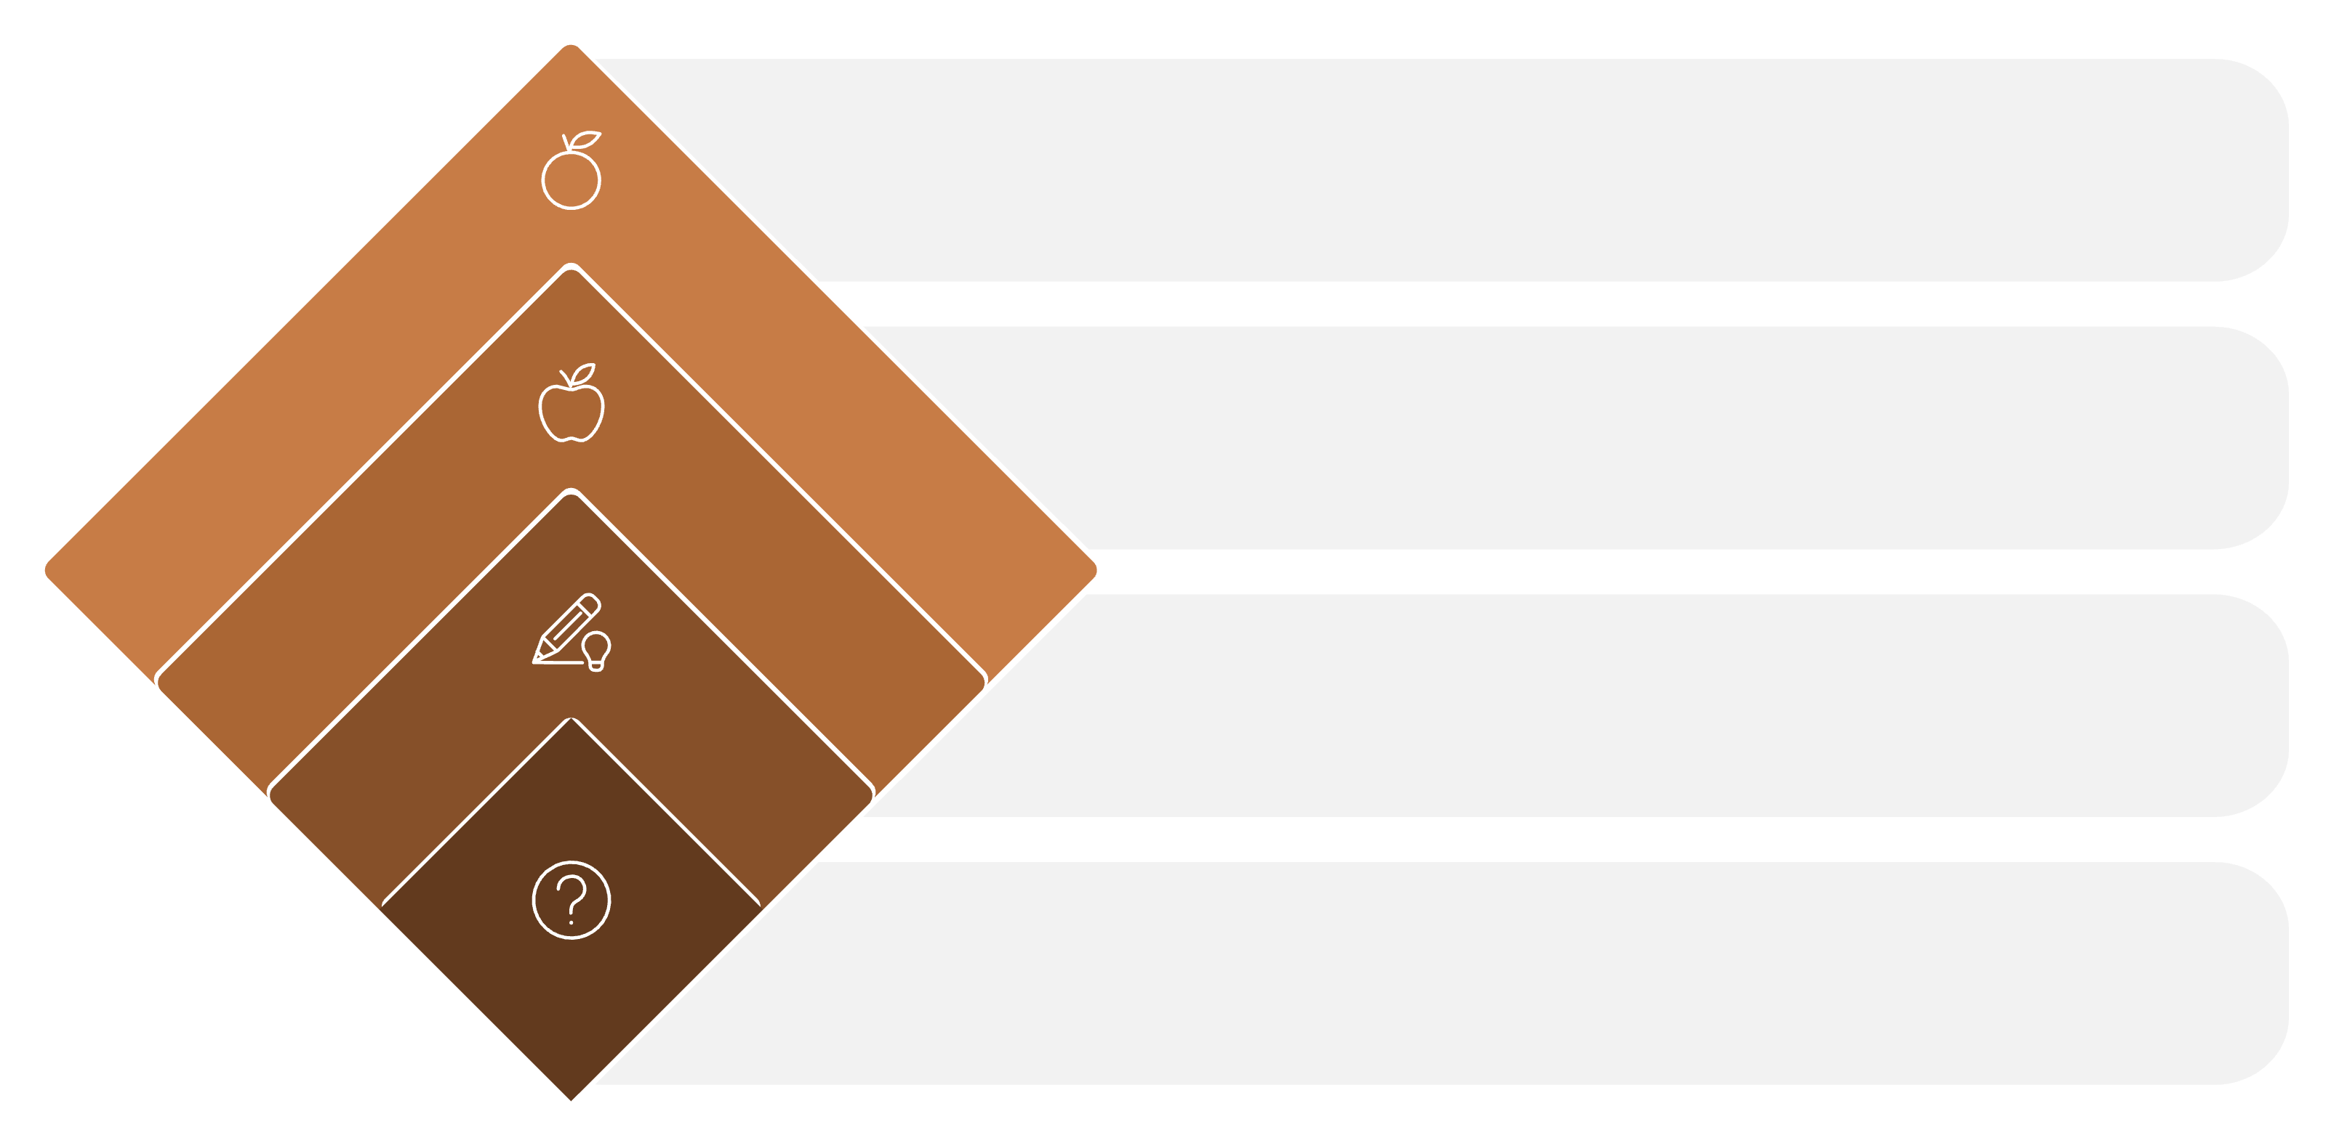
Visualizing Decisions
Is it orange?
Check color if not red
Apple
Predict apple
Is it red?
Check color if round
Is the fruit round?
Start at the root
This simple example illustrates how decision trees make predictions through a series of logical questions. Starting from the root, each decision splits the data based on feature values until reaching a final classification at the leaf nodes.
`

Slide 7
Real-World Applications
Decision trees power critical decisions across industries, from detecting fraud to diagnosing diseases. Their interpretability makes them particularly valuable when understanding the reasoning behind predictions is essential.
Fraud Detection
Medical Diagnosis
Banks and financial institutions use decision trees to identify suspicious transactions by analyzing patterns in spending behavior, location data, and transaction amounts.
Healthcare professionals leverage decision trees to assist in identifying diseases by systematically evaluating symptoms, test results, and patient history to arrive at diagnoses.
Customer Segmentation
Predictive Maintenance
Marketing teams group customers based on purchasing behavior, demographics, and engagement patterns to create targeted campaigns and personalized experiences.
Manufacturing facilities forecast equipment failures by monitoring sensor data, usage patterns, and maintenance history to prevent costly downtime.

Slide 8
Decision Trees: Building Blocks for Smarter Machines
Powerful Yet Accessible
Cornerstone of Predictive Modeling
Foundation for Innovation
Decision trees offer an intuitive entry point into machine learning, making complex predictive modeling accessible to beginners while remaining powerful enough for advanced applications.
As the building block for ensemble methods like Random Forests and Gradient Boosting, decision trees continue to drive innovation in artificial intelligence and machine learning.
Their interpretability and flexibility make them a cornerstone for many predictive modeling tasks, particularly when stakeholders need to understand the reasoning behind predictions.
"The beauty of decision trees lies in their simplicity and transparency—transforming complex data into clear, actionable insights that anyone can understand."

