Slide 1

Vectorization and Communication Based Optimizations
for Walberla
July 27, 2023

Slide 2


Slide 3
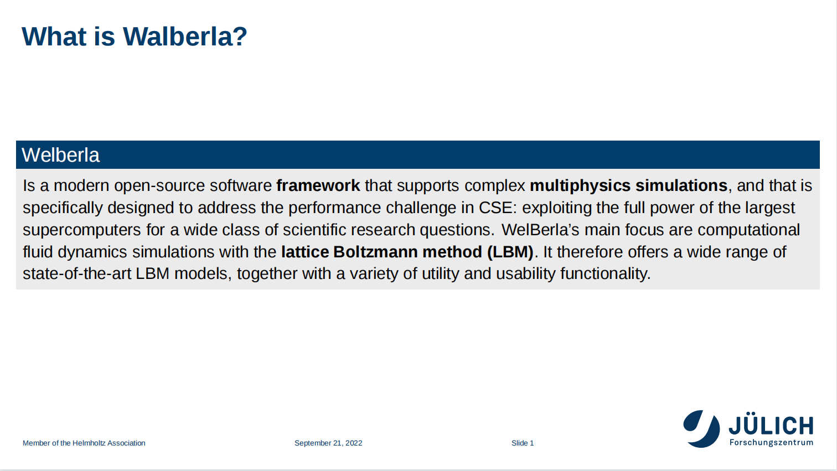
Walberla is a modern open-source software framework that supports complex multiphysics simulations, and that is specifically designed to address the performance challenge in CSE: exploiting the full power of the largest supercomputers for a wide class of scientific research questions. Walberla’s main focus is computational fluid dynamics simulations with the lattice Boltzmann method (LBM). It, therefore, offers a wide range of state-of-the-art LBM models, together with a variety of utility and usability functionality.
July 27 , 2023

Slide 4
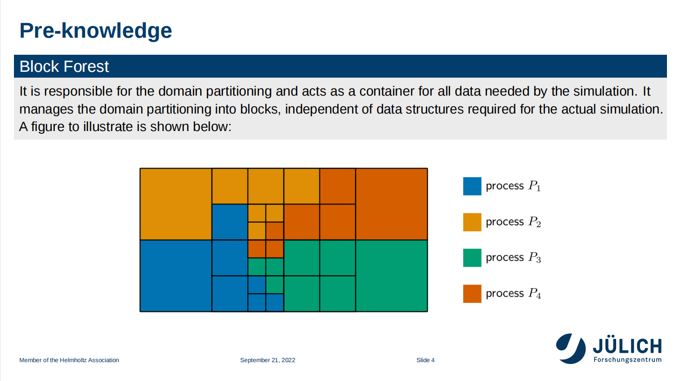
July 27 , 2023

Slide 5
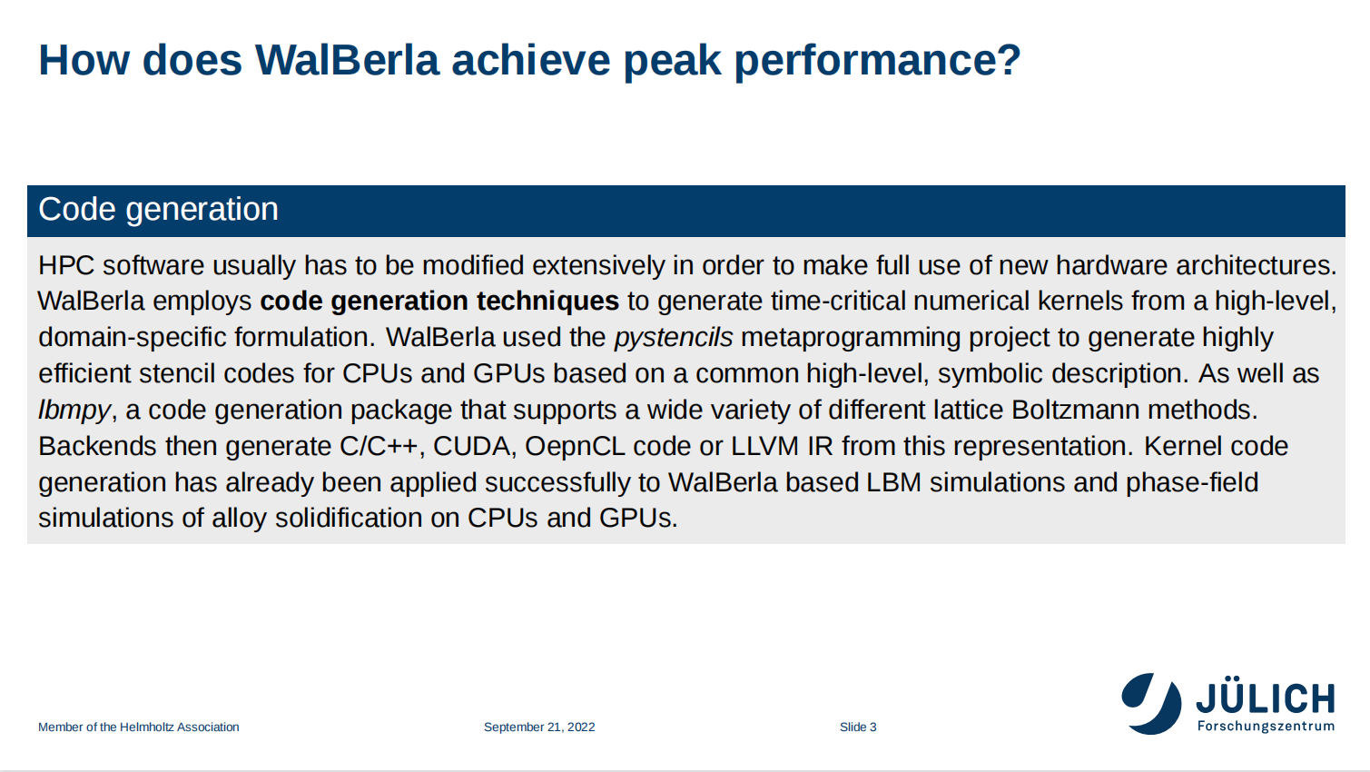
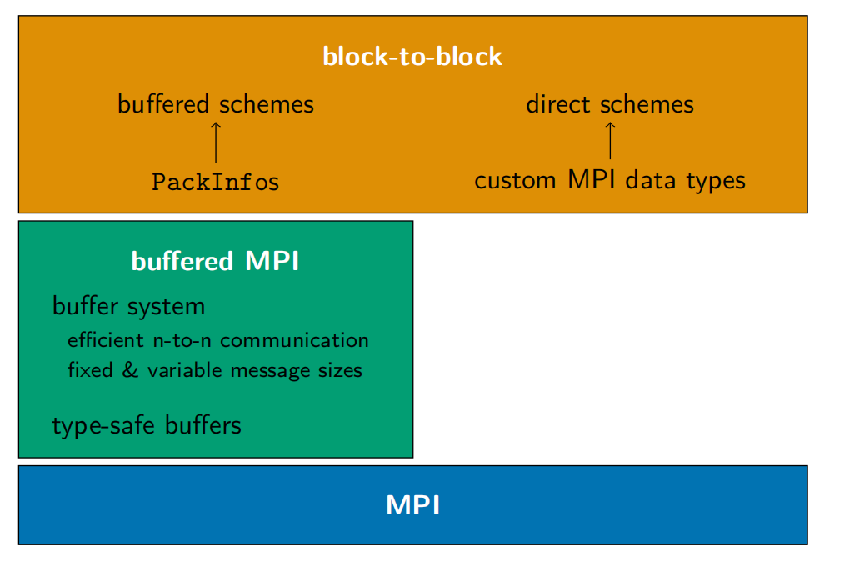
MPI structure in Walberla
MPI Layer
All of the distributed memory parallelization strategies are implemented on top of the Message Passing Interface(MPI). The communication module is organized in a layered structure.
The part we need to consider about is the blockForest, the blockForest is the data that used by all the process, which contains the message about communication. e.g. the size of the message which should be transferred from the neighbor block in the certain direction.
Feburary 14, 2023

Slide 6
Code Generation
Code Generation
HPC software usually has to be modified extensively in order to make full use of new hardware architectures.
WalBerla employs code generation techniques to generate time-critical numerical kernels from a high-level,
domain-specific formulation. WalBerla used the pystencils metaprogramming project to generate highly
efficient stencil codes for CPUs and GPUs based on a common high-level, symbolic description.
July 27 , 2023

Slide 7

Vectorization-Based GPU Optimizations

Slide 8
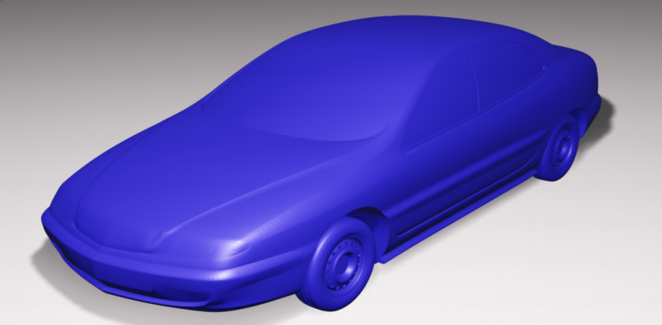
Test Case S2A
S2A
The S2A test case first reads the geometry of a car from a .obj file(like fig). From this obj file, the size of the domain is determined. The size of the domain is then adapted to fit the number of cells per block. This means it
is extended in all directions such that a natural number of blocks consisting of the given number of cells per block would fit the direction. In this way, the number of blocks for the block forest is calculated and distributed to the processes.
July 27 , 2023

Slide 9
FlagField
Basic Idea
Its not hard to imagine that, there is no need to compute the variety inside the the car. But due to the way the mesh is implemented, the block inside is still considered. So the basic idea of FlagField is to reduce the cost of computing kernels by not computing the domain inside the car
July 27 , 2023

Slide 10
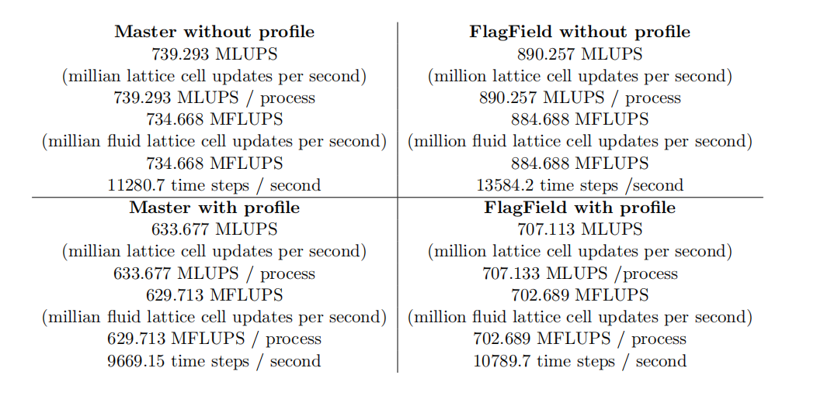
FlagField Test Result
July 27 , 2023

Slide 11
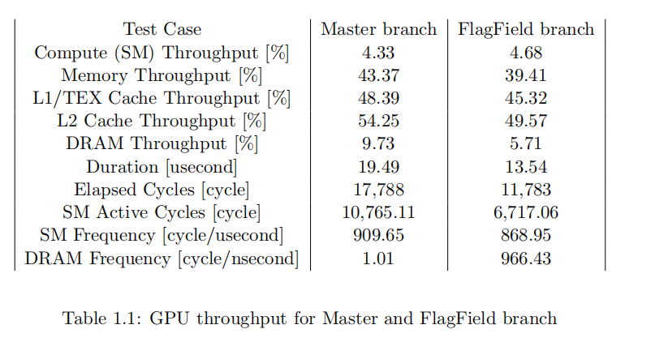
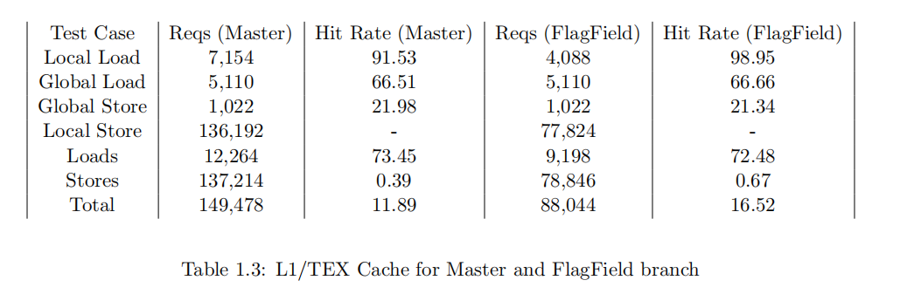
FlagField Test Analysis
July 27 , 2023

Slide 12
FlagField Conclusion
Conclusion
By ignoring the blocks inside the boundary, we achieved a 10% improvement in performance. Specifically,
the optimization is for the memory transfer part since in this case, the part of the message in these ignored
blocks has no need to be transferred around.
July 27 , 2023

Slide 13
SIMD instructions
Basic Idea
By developing the ‘FlagField’, we reduced the cost of computing kernels and the memory transfer by ignoring
the block inside the car. However, putting an ‘if’ condition in a GPU-based ‘for’ loop is not always a good
thing due to the parallel nature of GPU threads. The motivation for using SIMD instructions here is to
reduce the penalty of the ‘if’ condition, and also potentially increase the throughput.
*The SIMD instruction we used is ‘__device__​ unsigned int __vsetne4 ( unsigned int a, unsigned int b )’
This instruction do not reduce the comparation time, but reduced the data throughput by reusing.
July 27 , 2023

Slide 14
SIMD instructions
Thread 0
Thread 1
Thread 2
Thread 3
Thread 0
Thread 1
Thread 2
Thread 3
*The SIMD instruction we used is ‘__device__​ unsigned int __vsetne4 ( unsigned int a, unsigned int b )’
This instruction do not reduce the comparation time, but reduced the data throughput by reusing.
July 27 , 2023

Slide 15
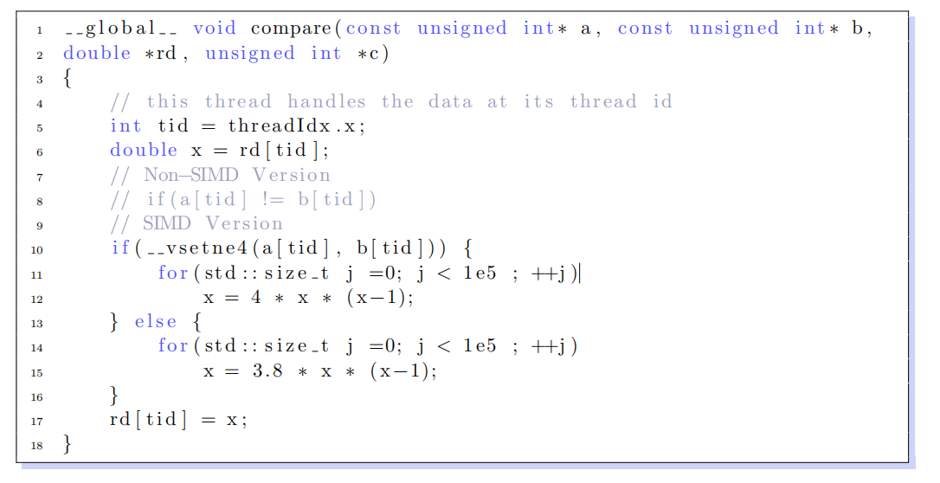
SIMD toy case
July 27 , 2023

Slide 16
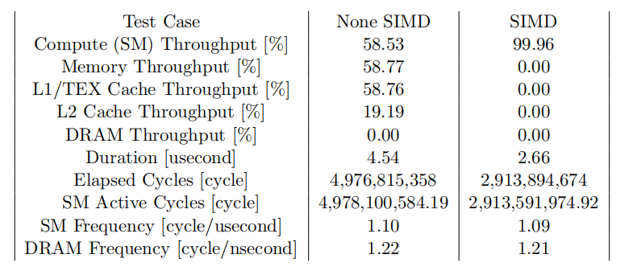
SIMD toy case result
Conclusion
It’s easy to find that the SIMD command gives advantages in reducing the memory bottleneck so as to make the GPU able to compute in full power.
July 27 , 2023

Slide 17
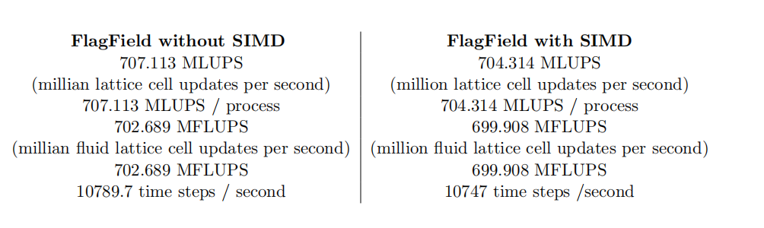
SIMD Result & Conclusion
Conclusion
Out of our toy case testing, the SIMD instruction helps enlarge the throughput by enabling the data reuse
and so reducing the memory transfer, and it will work in special cases (e.g called enough large time, and
the same core will reuse the same data). Unfortunately, our S2A case does not benefit from this instruction,
this is most probably because this case is also limited by other bottlenecks but not the memory.
July 27 , 2023

Slide 18
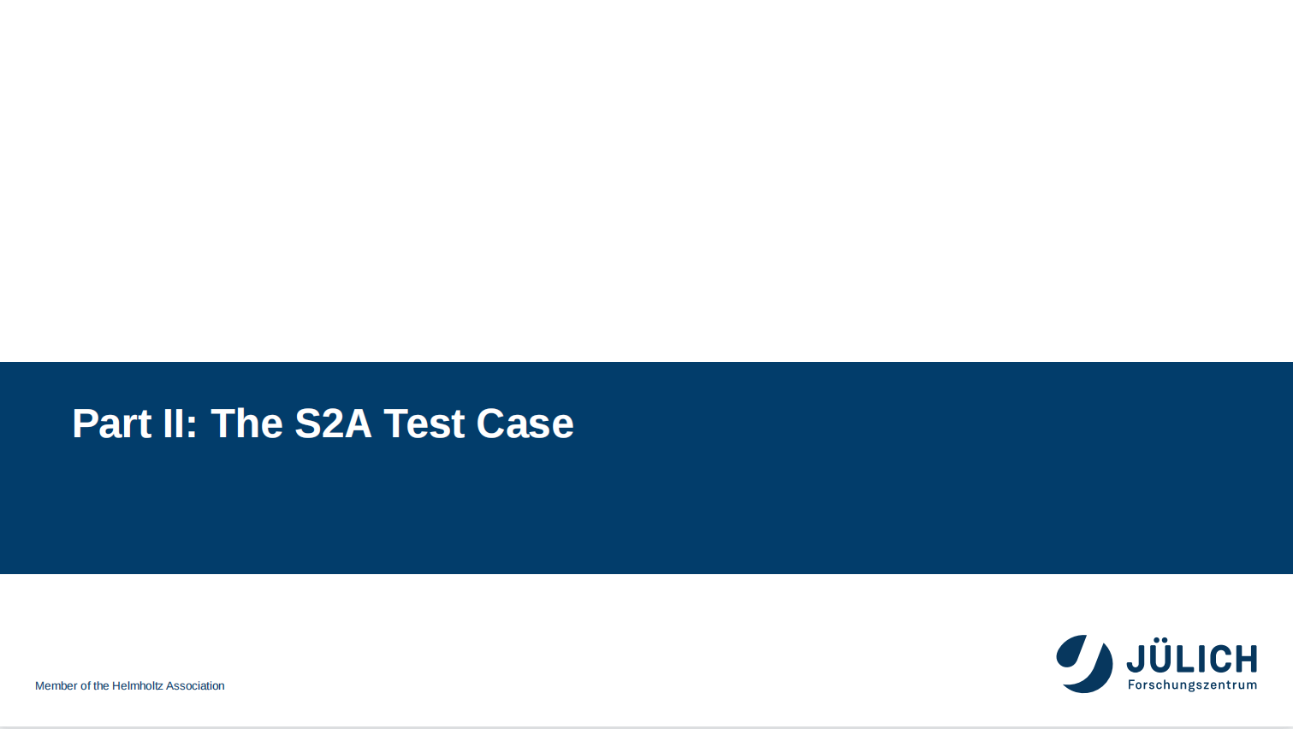
III: Communication-Bases Optimizations for Walberla

Slide 19
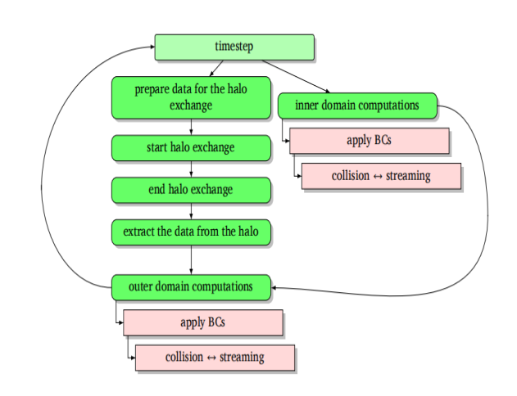
The MPI layer in waLBerla
July 27 , 2023

Slide 20
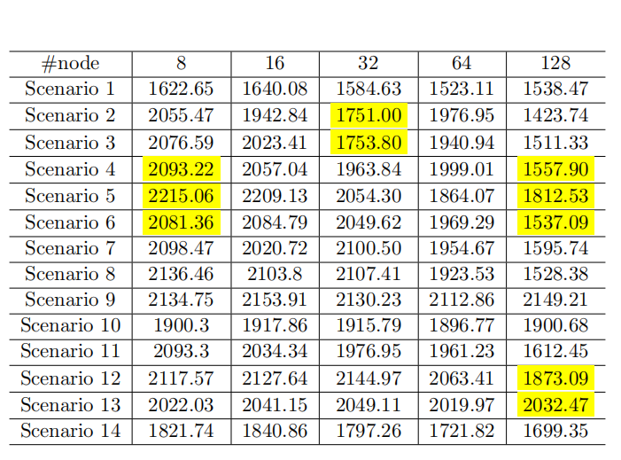
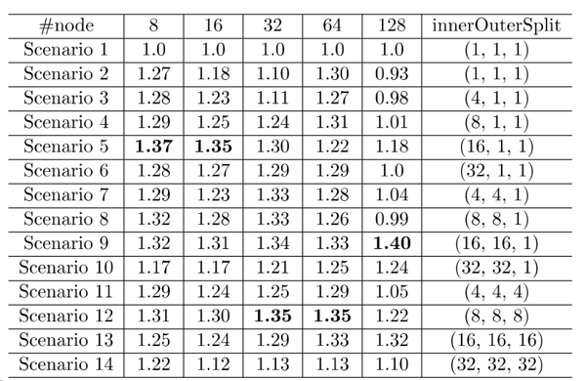
Speed up gain by Overlap
MLUPS
SpeedUp
July 27 , 2023

Slide 21
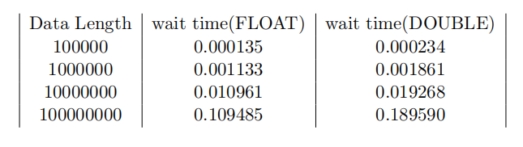
Data Compression
Basic Idea
Research has found that significant speedup is achieved by decoupling arithmetic precision and memory
precision. So the simple idea here is to transfer the data using float size while compute using double size.
July 27 , 2023

Slide 22
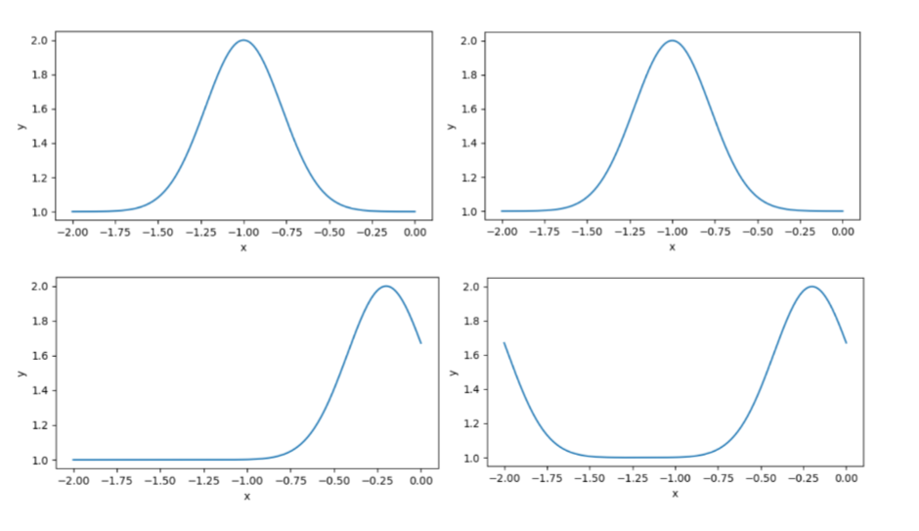
Mini Application
To further confirm whether this optimization will give benefits to our software, we also build a mini application that simulates the kernel function of Welberla which not only contains the communication but also the calculation for physics formulation.
July 27 , 2023

Slide 23
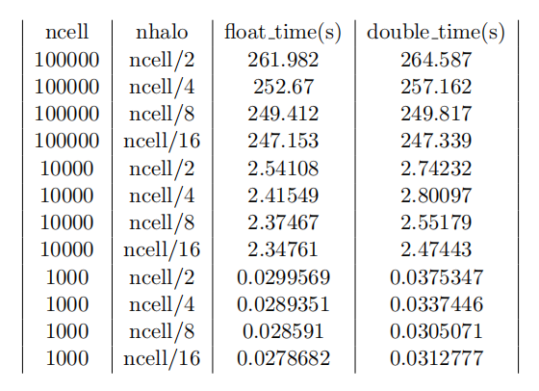
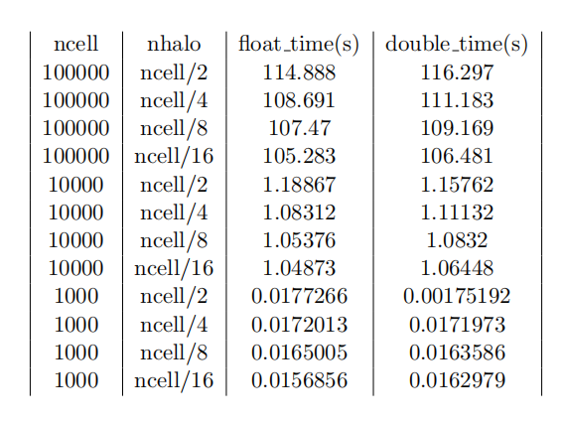
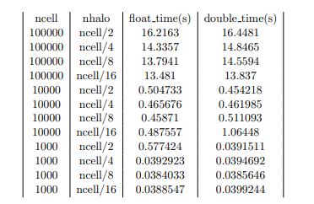
Mini Application Result
OMP_THREAD_NUM=1
OMP_THREAD_NUM=4
OMP_THREAD_NUM=64
Conclusion
From this mini-application, we can find that the compression will still benefit our kernel though have a limited effect, so we can now start to modify the source code.
July 27 , 2023

Slide 24
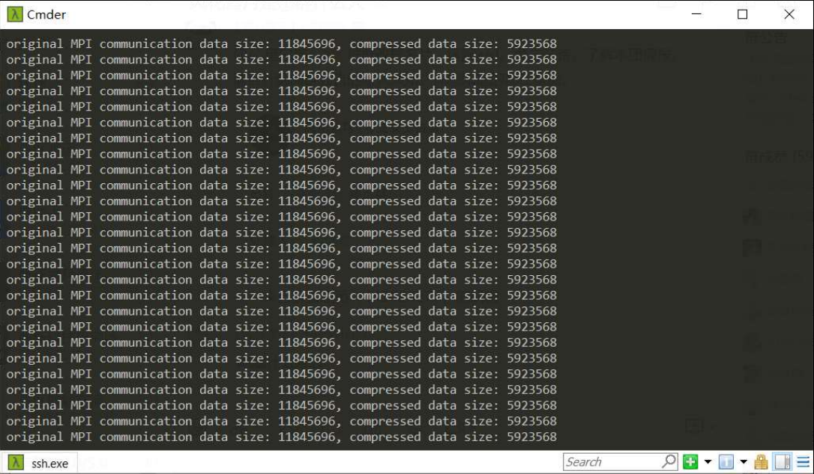
Data size(also see the profiler)
July 27 , 2023
July 27 , 2023

Slide 25
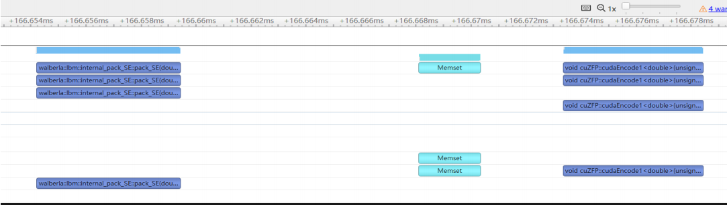
Data Compression Analyze & Current States
July 27 , 2023

Slide 26
Data Compression Conclusion
Conclusion
By checking the cost of the compress and the origin pack, we found the cost is comparable(shown
in Figure). In fact, the time consumed in the pack is about 5.21µs while the unpack runs 5.06µs. So
by this result, we can assume that by further modifying the bottom-level functions, we can get significant
speed up.
July 27 , 2023

Slide 27
IV: Conclusion

Slide 28
Conclusion
Conclusion
During this project, we test and verified in two directions to optimize the huge software Walberla. We gain some results in both the communication and vectorization parts. In the vectorization part, we improve the MLUPS by about 10% by decreasing the non-essential calculation data. Though the idea of `SIMD' do not gain obvious results, this idea surely decreased the memory load. For the communication part, overlap gives significant improvement. Then to further improve the communication idea, we also try to compress the data during communication. We build the mini-application for testing while getting the result shows the effect is limited. We still combined the compress with the origin code, finding the compression cost is not large compare the the origin data packing process. So we can conclude that though this idea was not effective now, when the communication demond comes huge, it will give benefits.
July 27 , 2023

Slide 29
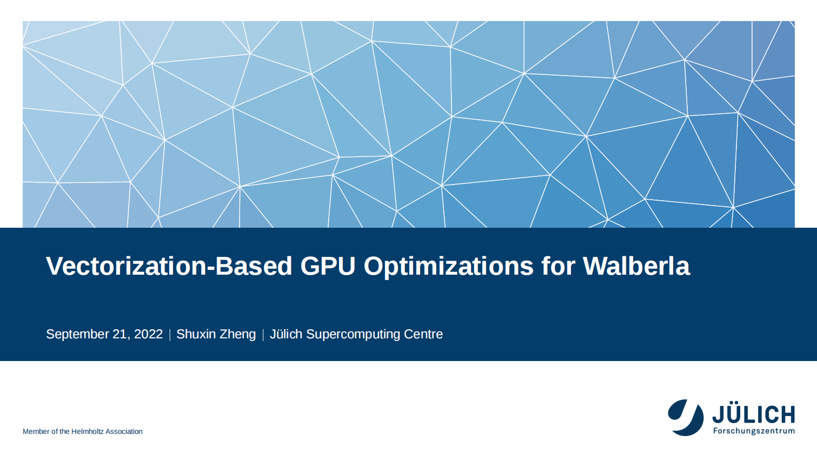
Communication Optimization by Data Compression in Walberla
Vectorization and Communication Based Optimizations
for Walberla
July 27, 2023

