Slide 1
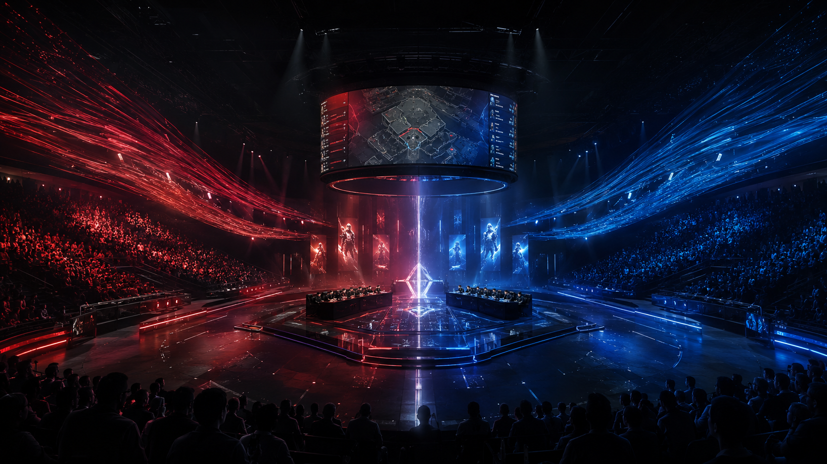
Predicting Valorant Match Outcomes
Using historical team performance and match context features
COMP 3608 Project
Binary Classification
VCT 2023–2025 Data

Slide 2
Project Focus
What we are trying to predict and why it matters
Problem
Goal: predict whether Team A wins or loses a Valorant match.
The problem is framed as a binary classification task.
The model uses pre-match information only, so predictions reflect a realistic pre-game setting.
The project focuses on comparing algorithms and explaining their tradeoffs, not only chasing one best score.
Target Variable
1 = Team A Wins
0 = Team A Loses
Models can also output win probabilities for interpretation, such as a 64% predicted chance of winning.
COMP 3608 Project • Valorant Match Outcome Prediction
2

Slide 3
Stakeholders and Value
Who can use the predictions?
Coaches
Prepare for high-risk matchups and target weaknesses
Analysts
Understand which indicators are most predictive
Team Managers
Support scouting, roster, and strategic decisions
Commentators
Create data-supported pre-match narratives
Organizers
Identify competitive matchups for scheduling and coverage
COMP 3608 Project • Valorant Match Outcome Prediction
3

Slide 4
Data Used
Three yearly Kaggle data subsets from Valorant Champions Tour
330
2023 matches
434
2024 matches
501
2025 matches
1265
total matches
Dataset Scope
The project uses the 2023, 2024, and 2025 yearly subsets from the VCT Kaggle data.
The data was downloaded, aggregated, cleaned, and transformed into a master modelling dataset.
Using recent seasons keeps the project focused on more current competitive trends and reduces unnecessary complexity.
COMP 3608 Project • Valorant Match Outcome Prediction
4

Slide 5
Project Pipeline
From raw data to model comparison
1
2
3
4
5
Download & organize
Selected yearly data
Aggregate & clean
Create master dataset
Engineer features
Historical, differential, context
Train models
Logistic Regression, Random Forest, XGBoost
Evaluate
Metrics, tradeoffs, sensitivity analysis
The notebook contains the full technical detail; the write up summarizes the project according to the rubric.
COMP 3608 Project • Valorant Match Outcome Prediction
5

Slide 6
Feature Engineering
Turning raw match data into predictive signals
Historical Form
Team win rate
Average rating
Map win percentage
Differential Strength
Win rate difference
Rating difference
Map win percentage difference
Match Context
Stage stakes
Elimination match
Grand final flag
Draft / ban first
Main idea: relative team strength is more useful than raw statistics alone.
COMP 3608 Project • Valorant Match Outcome Prediction
6

Slide 7
Experimental Design
A time-aware setup to avoid future data leakage
2023
2024
2025
Train: 2023 + 2024
Test: 2025
Why this matters
Older matches are used for training and newer matches are held out for testing.
Walk-forward validation checks whether models generalize from one season into the next.
COMP 3608 Project • Valorant Match Outcome Prediction
7

Slide 8
Algorithms Compared
Three approaches plus a simple baseline
Majority Baseline
Performance floor; predicts the most common class only
Logistic Regression
Interpretable model for probability and feature direction
Random Forest
Nonlinear ensemble model that captures feature interactions
XGBoost
Boosted tree model designed for stronger tabular performance
COMP 3608 Project • Valorant Match Outcome Prediction
8

Slide 9
Evaluation Metrics
How model performance was judged
Accuracy
Overall correctness
Precision
How reliable predicted wins are
Recall
How many actual wins are captured
F1 Score
Balance of precision and recall
ROC AUC
Ability to separate wins from losses
ROC AUC is especially useful because the majority baseline can have a high F1 score while still learning nothing useful.
COMP 3608 Project • Valorant Match Outcome Prediction
9

Slide 10
Final 2025 Test Results
Model performance on the held-out season
Main takeaways
Logistic Regression had the best ROC AUC, meaning it separated likely winners from losers best.
XGBoost had the best F1 score among learned models.
The baseline F1 is misleading because it predicts Team A wins every match.
COMP 3608 Project • Valorant Match Outcome Prediction
10

Slide 11
Interpretation and Tradeoffs
No model is perfect, so the best choice depends on the use case
Logistic Regression
Best for explanation
Strong ROC AUC and easy to interpret, but may miss nonlinear patterns
Random Forest
Middle ground
Handles nonlinear relationships, but performed weaker in this experiment
XGBoost
Best raw F1
Stronger classification performance, but less transparent and needs careful tuning
Best stakeholder-friendly option: Logistic Regression. Best predictive option by F1: XGBoost.
COMP 3608 Project • Valorant Match Outcome Prediction
11

Slide 12
Limitations and Future Improvements
What the model does not fully capture
Limitations
Season-to-season changes can affect performance: roster changes, meta shifts, coaching changes.
New or less active teams have limited history, creating a cold-start problem.
The model predicts match outcomes, not individual map outcomes or in-series adjustments.
Future Work
Add map-specific team performance and opponent strength ratings.
Include player-level form, agent composition, and roster change indicators.
Explore Elo-style regional ratings or more detailed round-by-round momentum features.
COMP 3608 Project • Valorant Match Outcome Prediction
12

Slide 13
Conclusion
What the project showed
Final message
The project successfully framed VCT match prediction as a binary classification problem.
Historical team strength and differential features provided useful predictive signal.
Logistic Regression was the strongest for ROC AUC and interpretation.
XGBoost produced the strongest F1 score among learned models.
The results show that pre-match historical data can help predict outcomes, but esports matches remain uncertain and high variance.
Thank you
COMP 3608 Project • Valorant Match Outcome Prediction
13

