Slide 1
AA AUTOMOBILE WORKSHOP
ALX SE PROGRAM
PROJECT PORTFOLIO
Member(s)
ABDULBASIT ABDULGANIYU
(FRONTEND)
COHORT 12

Slide 2
Project Description
This is a web application named AA Automobile Workshop that is intended to provide the folowing functions and features respectively:
Functions
A full web application to display the services, blog and get feedback from users.
Features
A map to depict the exact use’s location
A login form using third party app such as google 0Auth
Team
This is a sole web application project design and written by:
Abdulbasit Abdulganiyu

Slide 3
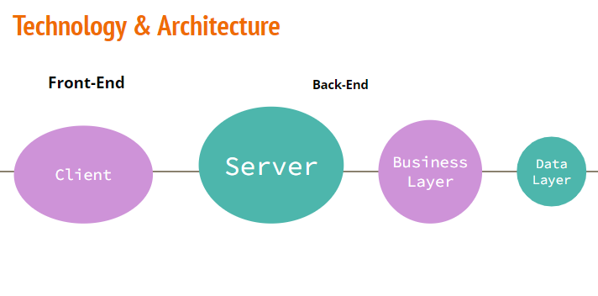
Technology Used

Slide 4
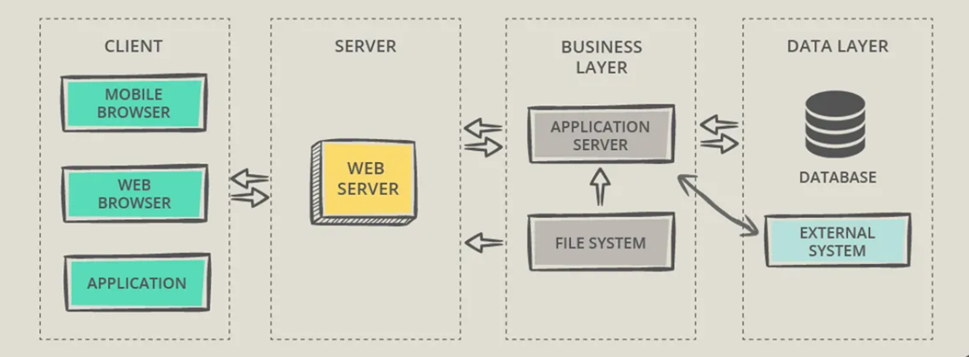
Block Diagram of Technology to be Adopted

Slide 5
Success
Although the backend part of the project was not actualized, but the project frontend and some of the features were realized. This includes;
Itemizing the services that to be rendered on the web application
A blog for updating and educating users on new trending in the automobile industry
A user login field for accepting user’s login details (username and password) such that the user will be able to have a full access to the web application features and functions
A feedback form which user can used to make comments, complains and reached out to the development team of the web application.

Slide 6
Challenges
The challenges identified include but not limited to the following:
A user needs to create a developer profile when using google map and login 0Auth to get and have valid accessible api.
A database need to be in place to keep record of user’s login details
Alot of backend routine for showing a nearby user whose maintenance and technical service is needed by peer to peer. Also the services outline were not work, just a preview of what the web application is capable of doing when fully build and optimised.

Slide 7
Areas of Improvement
The areas that needs improvement in the web application includes:
The services listed should be functional and optimized
The user login field should be able to accept 3rd party credentials such as gmail for full access to the web application features and functions
The blog should be update at some intervals automatically for easy notification to users
The feedback form should also be optimize and an automatic response mail should be send to user to confirm receive of feedback

Slide 8
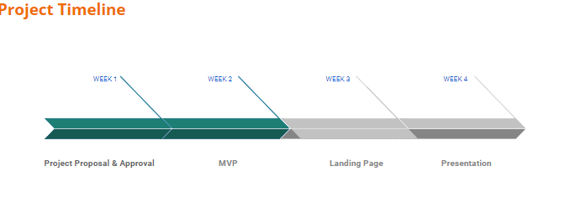
Schedule of Work

Slide 9
Conclusion:
This project is a web application that focus on the automobile industry to provide users with several services such as locating the nearest mechanic, buying spare part, scheduling maintenance etc.
The frontend part of the web application is actualized but not fully optimized, and it is in need of a stable backend application to make the aforementioned features feasible.

