Slide 1
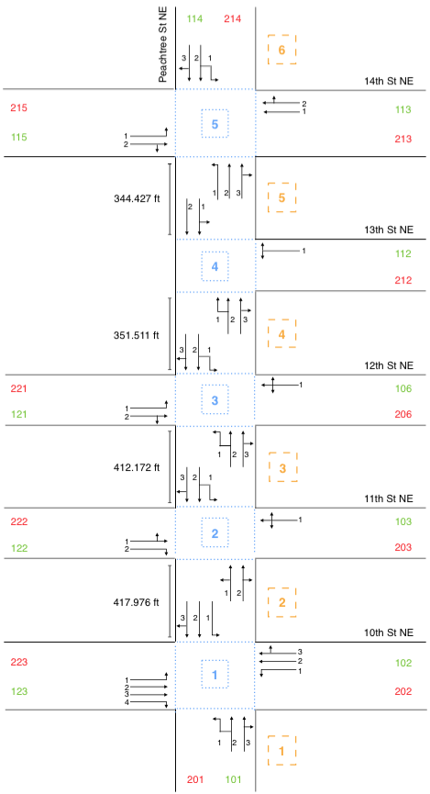
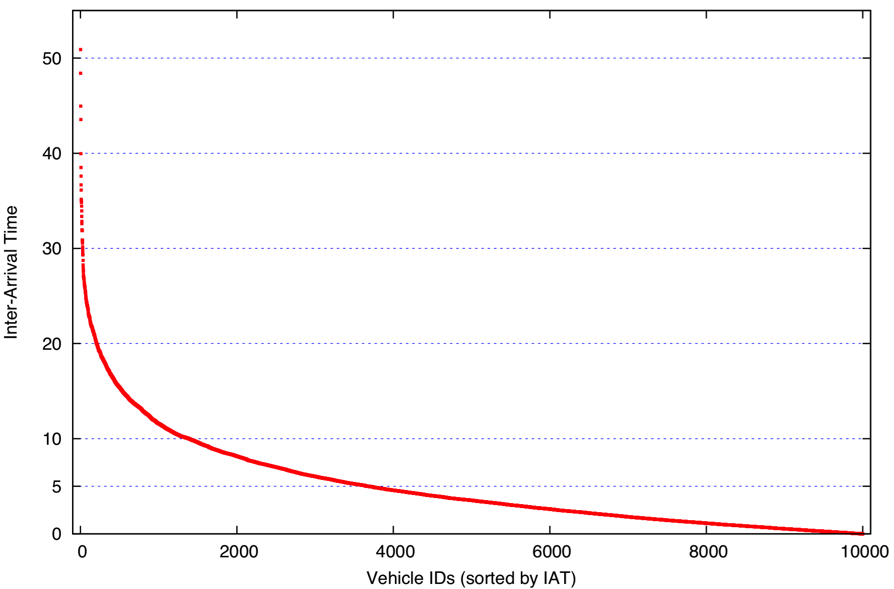
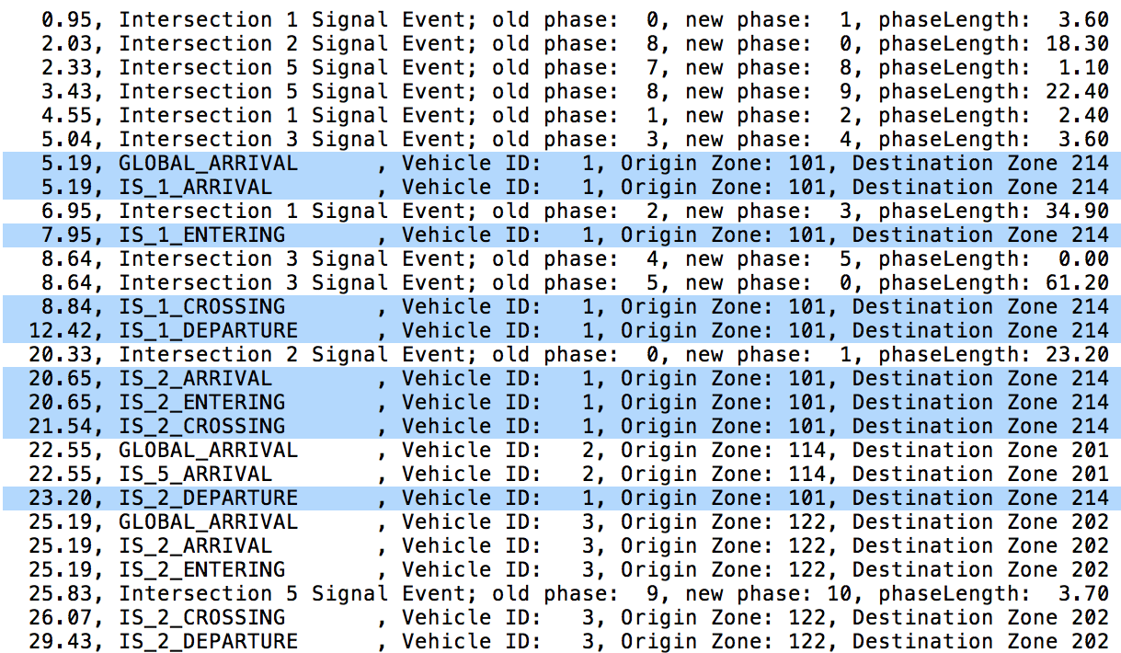
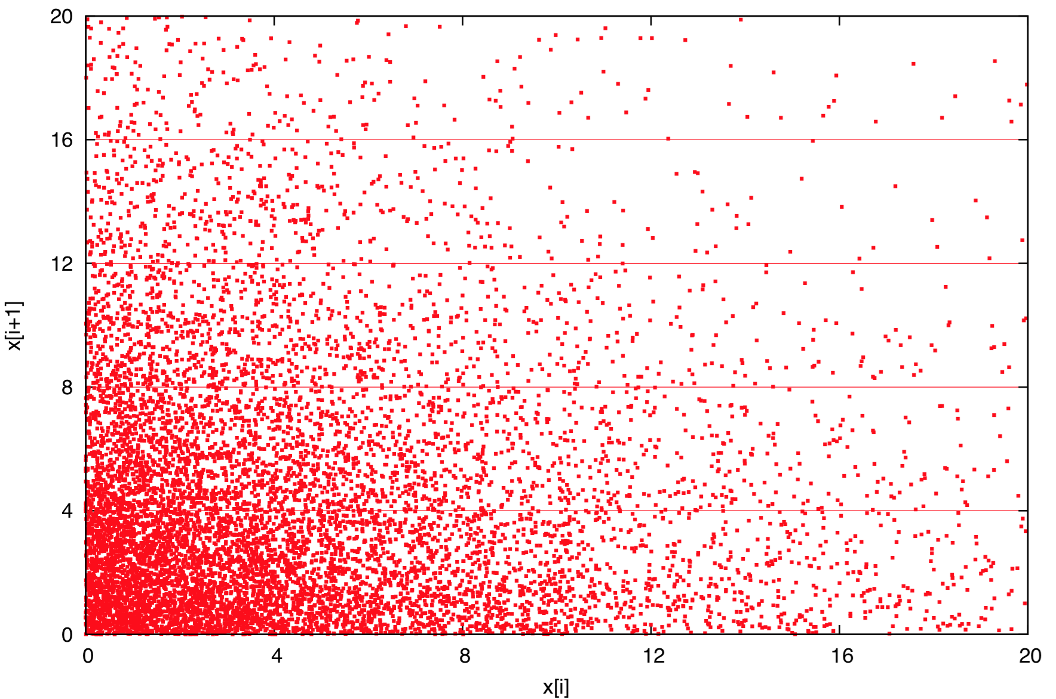
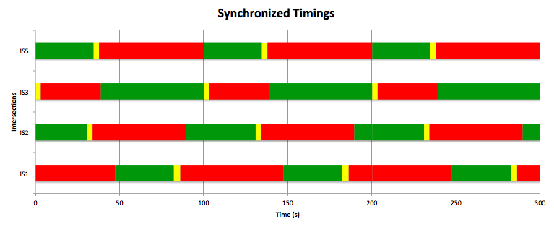
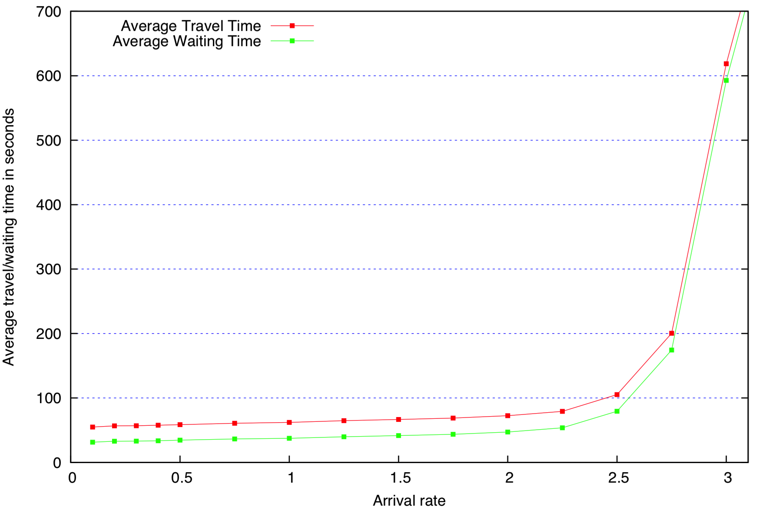
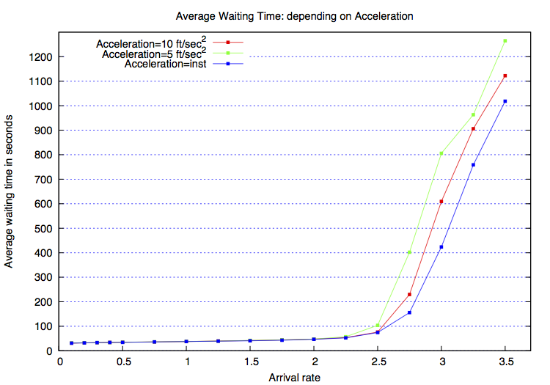
Peachtree Street Traffic Simulation
Stefan Henneking | Lanssie Ma | Eisha Nathan
Problem Description
Conceptual Model
Road Topology
When modeling traffic flows along a busy, congested street, minimizing average travel time to traverse portions of streets is key. The objective of this project is to compare the average travel time for vehicles traveling along a portion of Peachtree Street in Midtown Atlanta between a model using synchronized traffic lights versus unsynchronized traffic lights.
Objectives
Measure impact of synchronization on traffic signals and output parameters of traffic system.
Input Parameters
Signal Timings
Total Simulation time
Global Inter-arrival time
Vehicle length
Safety distance (driving/queuing)
Outputs
Avg travel time per vehicle
Avg wait time at a signall
Assumptions
No pedastrians/bikers
No construction
No weather
No accidents
Content
Entities(vehicle, intersections, street suctions, queues)
Activities(vehicle waiting in queue, traveling through streets)
Simplifications
No u-turns
Constant vehicle speed
Identical vehicles
Verification
Random Variables
Trace Analysis
The C standard library rand() function is assumed to return uniformly distributed random values in the (0, R) interval such that rand()/R is uniform in (0,1), where R is an integral constant defined in the library. All input parameters were mapped to a uniform distribution except the inter-arrival time between vehicles, which uses an exponential distribution.
The path and event timestamps for a single vehicle are checked against the topology and signal timing at intersections the vehicle must cross. The trace below (blue) shows a vehicle traveling from south to north, crossing all inter-sections.
Trace analysis was done for multiple sample configurations to verify the correct vehicle path, vehicle-intersection interaction, and vehicle-vehicle interaction.
This plot shows the inter-arrival time for a sample size of n= 10 000 and expected mean= 5, sorted in decreasing order.
The curve has a shape that is typical for an exponential distribution.
This plot shows the correlation of Inter-Arrival Times. The spread with no particular trend shows our random variables are Independent and Identically Distributed: ([xi;xi+1], uncorrelated)
Validation
Output Analysis
The following plot is the average travel and waiting time, dependent on arrival rate. It demonstrates the changes in behavior of wait and travel time when the capacity is at certain point of utilization that simulates the SUI functioning at full capacity.
Acceleration Results
Synchronization
We ran our study multiple times since it relies on random variables. Here, we plot the average total waiting time, dependent on acceleration.
Here, we ran our simulation 11 times, and plot the individual wait times for cars in our system. This plot shows the number of cars in each wait time interval.
Conclusions
Some shit here.

