Slide 1


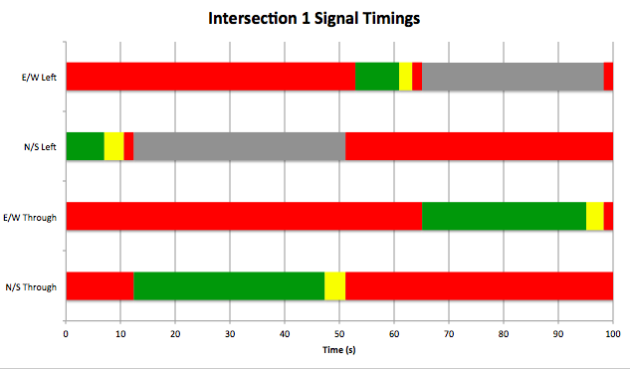
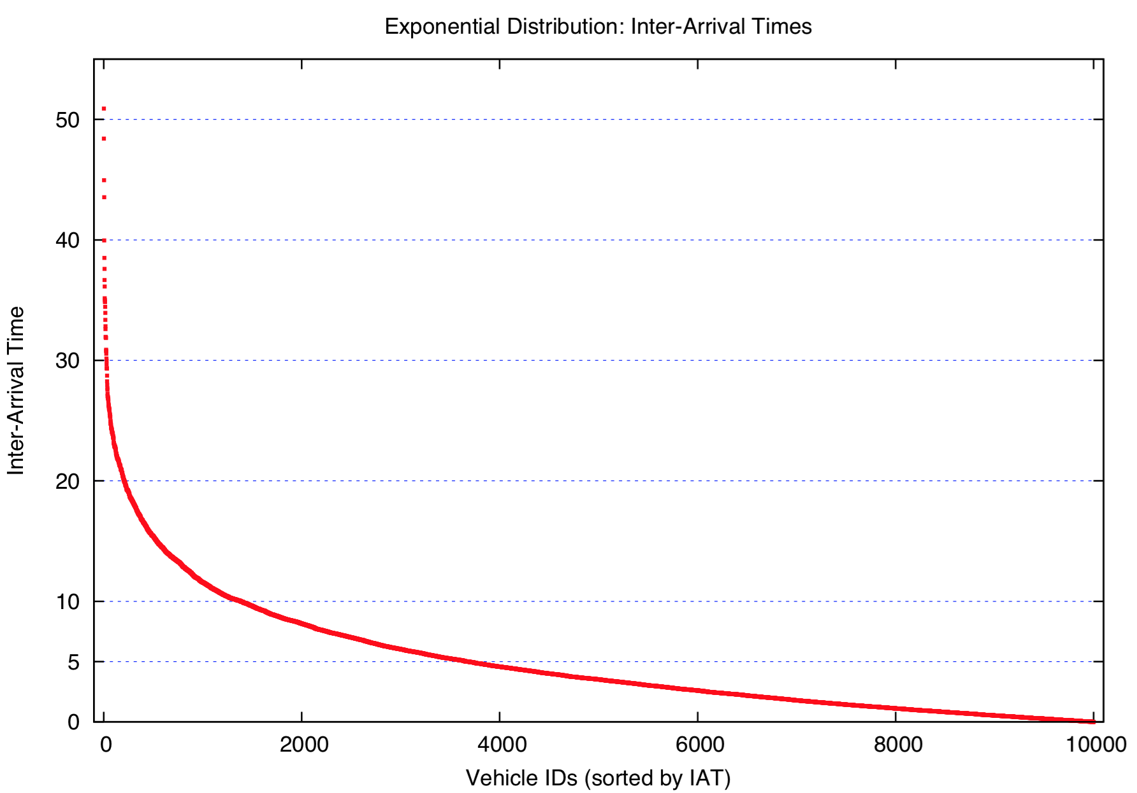
Road Traffic Simulation
Stefan Henneking^{1,3}, Eisha Nathan^{1,3}, Lanssie Ma^{2,3}
¹College of Computing, ²College of Engineering, ³Georgia Institute of Technology
CSE6730
SPRING 2015
Problem Description
When modeling traffic flows along a busy, congested street, minimizing average travel time to traverse portions of streets becomes key. The objective of this project is to compare the average travel time for vehicles traveling along a portion of Peachtree Street in midtown Atlanta between a model using synchronized traffic lights versus unsynchronized traffic lights.
Implementation
Signal Lights & Phases:
Vehicle Queues & Lanes:
Each lane is modeled as a queue and each queue is a linked list of events (where the object of the event is a vehicle); when the vehicle arrives at a particular intersection, it is placed in the appropriate lane queue. Each lane also has a flag associated with it, to be used for vehicles entering the portion of the lane entering the intersection. Finally, each lane has an associated lane counter indicating how many vehicles are entering and crossing the Intersection on this particular lane.
Intersection Event Handlers:
When the simulation enters the signal event handler, to simulate the switching of traffic lights, the current phase is incremented by 1. The next signal change will be scheduled using the current simulation time plus the time for the current phase as timestamp. When arriving at an intersection, the vehicle is put into the corresponding lane queue. If the vehicle is first in this queue and allowed to enter, the entering event is scheduled directly, and the vehicle velocity remains unchanged. In all other cases, the entering event will not yet be scheduled and the vehicle velocity is set to 0. The entering event sets the corresponding lane flag to 1, indicating no other vehicle may enter the intersection on this lane. The following crossing event is scheduled depending on on the vehicle acceleration, current and maximum velocity, length and safety distance parameters. When the vehicle starts crossing the Intersection, the corresponding lane flag is set to 0 so that the next vehicle may enter the Intersection and the Intersection departure is scheduled (again, dependent on the parameters mentioned above, as well as the Intersection crossing distance for this particular lane).
The Intersection departure schedules either a new arrival at the following Intersection or a global departure in case the vehicle is leaving the simulated roadway network.
Input/Output Analysis
hi
Each intersection structure contains a pre-calculated array containing the various stages of each light during each phase, and the current phase is kept track of as well as the total number of phases (see Fig. 1).
Fig. 1
Random Variables
The C standard library rand() function is assumed to return uniformly distributed random values in the (0, R) interval such that rand()/R is uniform in (0,1), where R is an integral constant defined in the library. All input parameters were mapped to a uniform distribution except the inter-arrival time between vehicles, where an exponential distribution was used.
Conceptual Model
Objectives
Measure impact of synchronization on traffic signals on output parameters of a simulation of traversing a portion of Peachtree Street in midtown Atlanta
Input Parameters
Signal timings for each intersection
Total simulation time
Global inter-arrival time
Vehicle length
Safety distance while driving and queuing up
Outputs
Average travel time between origin and destination per vehicle
Average waiting time at traffic signal
Assumptions
No pedestrians/bikers
No road construction
No weather
No vehicle accidents
Content
Entitles (vehicle, intersections and street section, queues)
Activities (vehicle waiting in queue, traveling through street, etc)
Simplifications
No u-turns
Constant vehicle speed
Identical vehicles
Plot of the inter-arrival time for a sample size of n=10,000 and expected mean μ= 5, sorted in decreasing order
Results
References
Notes:
*add Mozart pic?
*table, compare
Initializations (random & close to normals) then reconstruct
Then sparse noise inserted and reconstruct, sparse filtered out reconstruct
*right now—don’t have actual picture for reconstruction with and without l1 but will be in table.
*many methods of integrable field etc
*l1 starts with surface normal, only handling second half of problem
*image, surfacenormal extraction → because its not perfect method, trying to get rid of outliers
→ Complete method

