Slide 1
YAYASAN PENDIDIKAN LOKON · LAPORAN TEKNIS
YPL Smart Digital Library
Laporan menyeluruh: progress, fitur, kesesuaian briefing 21 BAB, UI/UX, UML, dan business process.
Basis data MySQL · 176/176 test hijau · 21 BAB briefing
13 Oktober 2026

Slide 2
01 · RINGKASAN EKSEKUTIF
Angka Kunci Saat Ini
• 176/176 automated test hijau (11 file test fitur + 1 unit) — garansi regresi tiap rilis.
• 32 tabel MySQL (utf8mb4) + index FULLTEXT, FTS5 SQLite untuk suite, trigger trigger-safe.
• 21 BAB briefing: 19 selesai penuh, 1 tersisa parsial (BAB 16 Odoo), kriteria 12/12 acceptance hijau.
• Stack: Laravel + Blade + Tailwind, PDF.js reader, MySQL production / SQLite test.
• Keamanan: 1 superadmin, password default dirotasi, dump ber-hash keluar repo, rute deploy dihapus.

Slide 3
02 · KONSEP INTI
DISCOVER → KNOW → UNDERSTAND → ACT
DISCOVER
Cari, koleksi,
rekomendasi
KNOW
Baca imersif
Reader Mode
UNDERSTAND
Graf relasi,
Ask + sitasi
ACT
Layanan,
kalender, unduhan
→
→
→
Setiap fitur memetakan ke satu tahap alur. Tidak ada fitur yatim: pencarian bermuara ke bacaan, bacaan ke pemahaman relasi, pemahaman ke tindakan layanan.

Slide 4
03 · KESESUAIAN BRIEFING 21 BAB (1/2)
BAB 1–11: Status Implementasi
BAB | Topik | Status
1 | Ringkasan Eksekutif | ✅ Acuan
2 | Design Principles (8) | ✅ Hidup di kode
3 | Information Architecture | ✅ 8 area + rute Inggris
4 | Dua Mode (Library/Reader) | ✅ Bookshelf + reader imersif
5 | Master Homepage | ✅ Hero, YPL Today, role-aware
6 | 10 Handbook B01–B10 | ✅ Living books + CRUD
7 | Knowledge Model (19 atribut) | ✅ + Event/FAQ first-class
8 | Reader Engine | ✅ Flip, TOC, thumbnail, notes, 3 tema
9 | Universal Search | ✅ 5 grup + panel AI
10 | Services (8 tipe) | ✅ Workflow hingga done
11 | Role-Aware + dashboard | ✅ Resolver + UNTUK ANDA

Slide 5
03 · KESESUAIAN BRIEFING 21 BAB (2/2)
BAB 12–21: Status Implementasi
BAB | Topik | Status
12 | Knowledge Graph | ✅ Graf 2-hop + peta di Library
13 | Governance Lifecycle | ✅ 6 status, approval, versi, notifikasi
14 | Ask YPL / AI Layer | ✅ Scope dokumen + explain terstruktur
15 | Visual & Interaction | ✅ Token, tipografi, serif baca
16 | Technical Architecture | ⚠️ Odoo belum (sistem tercatat)
17 | Sitemap | ✅ + Help Center
18 | Prioritas P1–P6 | ✅ P6 minus Odoo
19 | Prompt Plan | ✅ Prompt 9 via templat tunggal
20 | Acceptance 12/12 | ✅ Kriteria 12 opsi A live
21 | Penutup | ✅ Acuan

Slide 6
04 · ARSITEKTUR
Lapisan Sistem (BAB 16)
BROWSER
Blade + Tailwind
PDF.js
APP
Controllers
Policies
DOMAIN
Models + Services
DATA
MySQL + FTS
→
→
→
• File PDF di disk private — selalu lewat route berotorisasi, tanpa URL langsung.
• Odoo diparkir sebagai simpul systems; integrasi API tahap akhir (read-only dulu, queue, degradasi anggun).
• Test: SQLite :memory: (111+62 test); MySQL diverifikasi migrasi-nol + FULLTEXT + smoke 16/16.

Slide 7
05 · FITUR — LIBRARY & READER (BAB 4–8)
Perpustakaan Hidup + Ruang Baca
• Digital bookshelf B01–B10, 7 koleksi, filter, rekomendasi personal anti-bocor privat.
• Reader: two-page desktop / single mobile, flip 550ms + reduced-motion, TOC, thumbnail lazy, search-in-book, jump, bookmark, notes per halaman, tema Terang/Paper/Gelap.
• Ask YPL inline di Reader berkeskonteks dokumen; posisi baca autosave.

Slide 8
06 · FITUR — GOVERNANCE (BAB 13 + KRITERIA 12)
Siklus Hidup Dokumen Resmi
• Lifecycle DRAFT → REVIEW → APPROVAL → ACTIVE → REVIEW DUE → ARCHIVED + approval workflow + versioning snapshot + audit trail.
• Document Passport: owner, approver, PIC, tanggal berlaku/tinjau, riwayat versi, related knowledge.
• Kriteria 12 opsi A live: publik hanya versi berlaku; staff memantau draf; filter internal disembunyikan dari tamu; retensi arsip + notifikasi review-due.

Slide 9
07 · FITUR — SERVICES + HELP (BAB 10/17)
Pola 'Saya Ingin…' Tanpa Paham Struktur
• 8 tipe layanan (transportasi, cuti, maintenance, izin siswa, purchase, event, insiden, submission) + workflow pending → done + My Requests.
• Help Center /help: FAQ per kategori (accordion), pintu ke layanan dan Ask YPL; visibilitas internal/login.

Slide 10
08 · FITUR — COMMUNITY, CALENDAR, INSIGHT
Menu Nyata Berbasis Data
• Community: unit + hitung, peran, direktori orang (login saja, tanpa email), FAQ komunitas.
• Calendar: 5 kategori briefing + YPL Today (jatuh tempo tinjauan); panel kelola agenda untuk staff.
• Insight: etalase publik (statistik + dokumen terbaru + koleksi publik). URL Inggris konsisten.

Slide 11
09 · FITUR — ASK YPL + GRAPH + DASHBOARD
Kecerdasan Terhubung
• Ask YPL: ekstraktif + sitasi, permission-aware, scope per-dokumen (0 query), mode explain terstruktur (ringkasan/audience/berlaku/perubahan/terkait).
• Knowledge graph 2-hop (dokumen/sistem/agenda/FAQ/PIC) + peta di Library; relasi tepat-satu-target (422).
• Role dashboard: satu templat, urutan + kartu disaring scope peran, blok UNTUK ANDA; analytics staff (agregat berindeks, tanpa N+1).

Slide 12
10 · KEAMANAN & PRODUCTION READINESS
Yang Sudah Diamankan
• Otorisasi terpusat: isVisibleTo + scopeVisibleTo paritas (detail, stream, unduh, reader, ask, search, relasi, rekomendasi).
• 1 superadmin + password default dirotasi; dump ber-hash keluar repo; kunci LLM testing dicabut; rute /deploy dihapus.
• MySQL: user lokal saja, FULLTEXT terverifikasi, migrasi-dari-nol hijau; suite SQLite hijau; smoke 16/16.
• Sisa di server: APP_DEBUG=false, APP_KEY, kredensial, storage:link, backup terjadwal, user DB khusus.

Slide 13
11 · DESIGN SYSTEM UI/UX (BAB 15)
Bahasa Visual Tunggal
• Token: --ypl-navy #002F80, --ypl-red #C90018, --ypl-* menyeluruh; utilitas .grad-navy/.grad-red/.brand-line (test melarang duplikat inline).
• Tipografi kanonis: .page-title (24→30px), .page-eyebrow, .section-label; body baca serif Georgia, UI sans.
• Kartu rounded-2xl, signature line biru-merah, motion halus (card-hover, flip), kontras + fokus aksesibel.

Slide 14
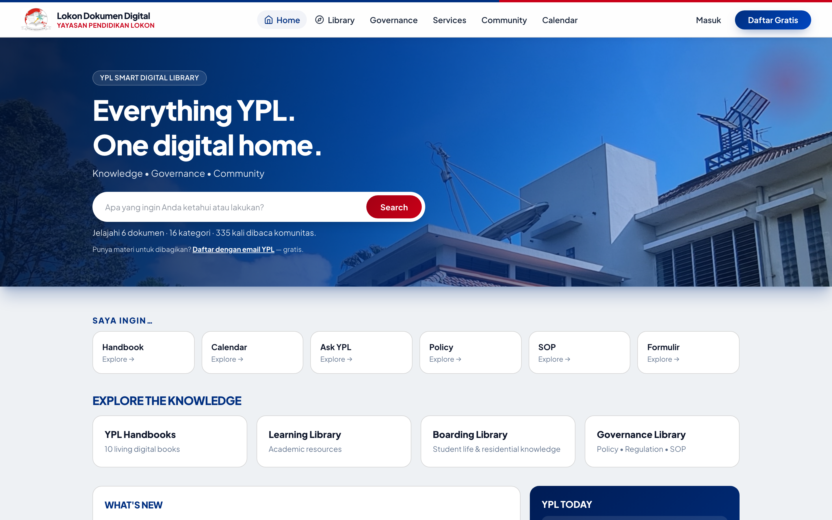
12 · ANTARMUKA (1/3)
BERANDA — hero foto + YPL Today

Slide 15
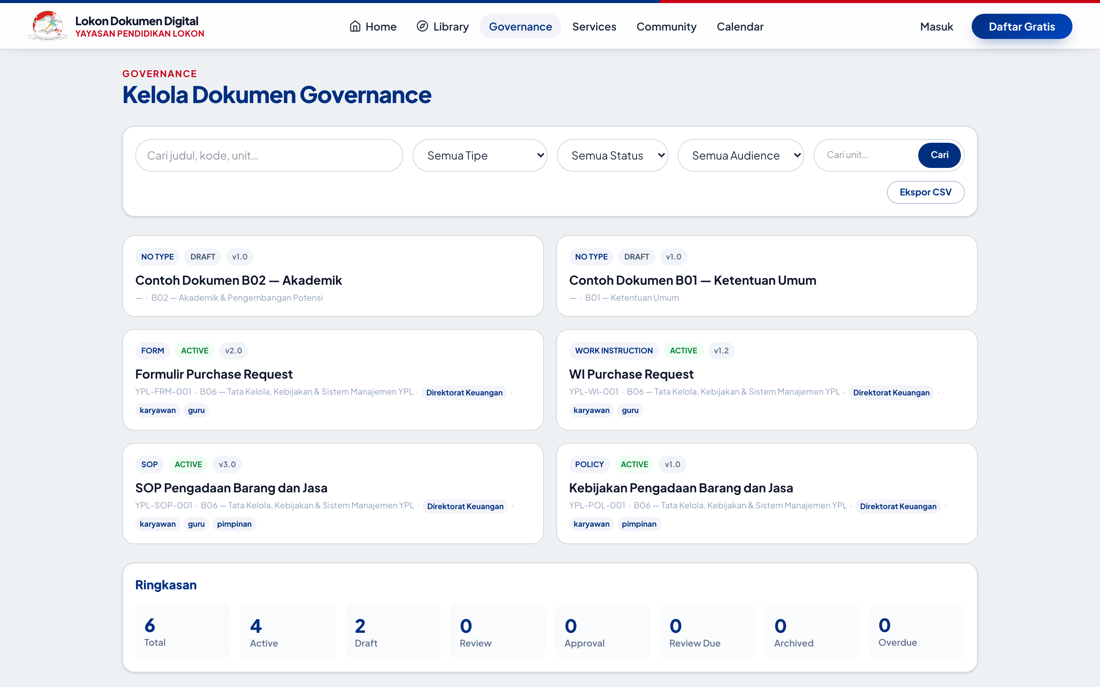
12 · ANTARMUKA (2/3)
GOVERNANCE — passport + lifecycle

Slide 16
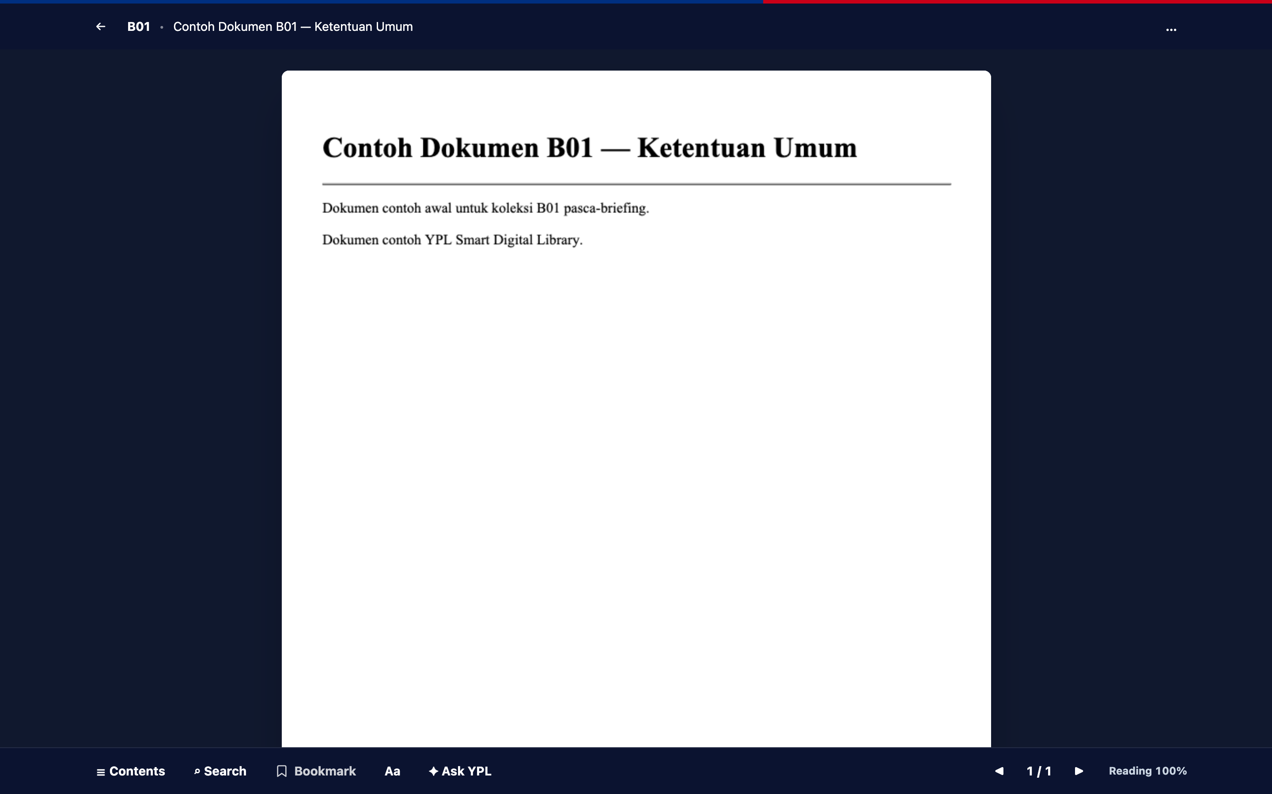
12 · ANTARMUKA (3/3)
READER — two-page + toolbar

Slide 17
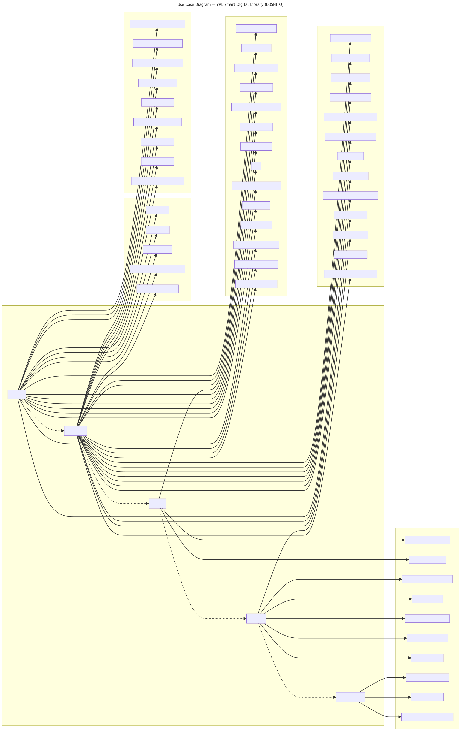
13 · UML — USE CASE
Aktor vs Fungsionalitas Inti

Slide 18
14 · UML — ERD (RINGKAS)
32 Tabel: Inti Domain
Tabel | Kolom Kunci | Relasi
documents | slug, doc_type, status, visibility, audience | owner, approver, PIC, kategori; pusat semua relasi
document_relations | related/event/faq/system_id (tepat satu) | dokumen↔dokumen/sistem/agenda/FAQ
document_versions | version, from/to_status, snapshot | riwayat per dokumen (cascade)
events / faqs | slug, visibility, kategori/urutan | simpul kalender & bantuan + relasi
users / roles | role↔slug (logis), scopes, homepage | hak + personalisasi (tanpa FK)
service_requests | type, status, handler | pemohon + staff pemroses
reading_* (pos/pref/notes) | user+document, halaman | milik user (cascade)
activity_logs | action, meta, index aksi+tanggal | sumber analytics (prune 180 hari)

Slide 19
15 · UML — DFD LEVEL 0
Aliran Data Konteks
TAMU / ANGGOTA
STAFF / ADMIN
YPL SMART DIGITAL LIBRARY
MySQL + FILE
ODOO (parkir)
→
→
• Masuk: dokumen/layanan/pertanyaan; keluar: bacaan, jawaban bersitasi, status pengajuan, analytics.
• Batas kepercayaan: tamu ↔ versi berlaku; staff ↔ draf internal; privat ↔ pemilik/admin.

Slide 20
16 · BUSINESS PROCESS — LIFECYCLE
DRAFT → REVIEW → APPROVAL → ACTIVE → REVIEW DUE → ARCHIVED
DRAFT
REVIEW
APPROVAL
ACTIVE
REVIEW DUE
ARCHIVED
→
→
→
→
→
• Tiap transisi berizin + tercatat (snapshot) + audit trail; review-due otomatis + notifikasi.
• Layanan: pengajuan → pending → approved/rejected → done; terpantau di My Requests + analytics.

Slide 21
17 · SISA PEKERJAAN
Roadmap Penutup
• Odoo (BAB 16): discovery → read-only sync systems via queue → tulis bila perlu; degradasi anggun.
• Server: values production, backup terjadwal, user DB khusus, rotasi Gemini, purge history (bila publik).
• Opsional: sub-tipe governance (Risk/Compliance), purge presentasi/ dari repo, suite MySQL (terbatas transaksi FTS).

Slide 22
PENUTUP
Siap Go-Live Bertahap
19/21 BAB selesai penuh · 12/12 acceptance · 176 test hijau · keamanan dikunci.
Rekomendasi: deploy staging → UAT peran → production; Odoo setelah stabil.

