Slide 1
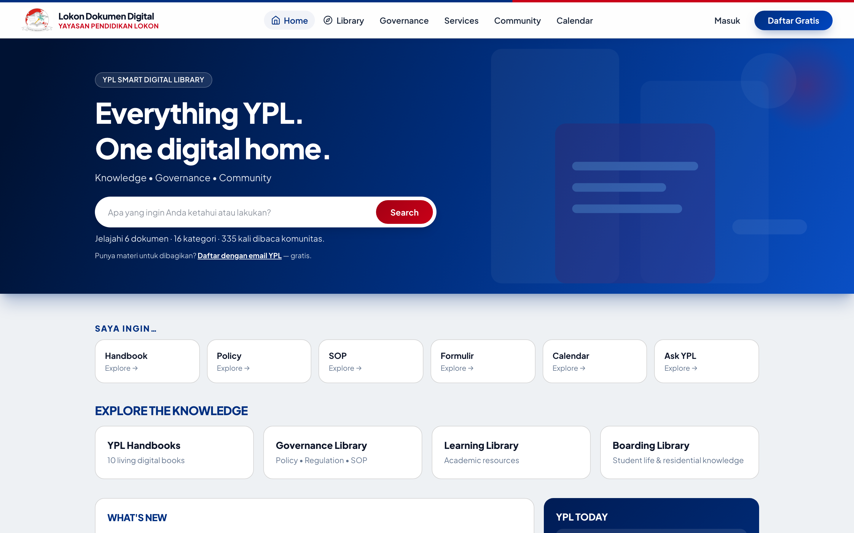
YPL SMART DIGITAL LIBRARY • LAPORAN TEKNIS
LOSNITO Document
Progress Report untuk Tim Teknis / IT
DISCOVER → KNOW → UNDERSTAND → ACT • Library Mode & Reader Mode
12 Oktober 2026 • main • 35 commits • Laravel 13.33 / PHP 8.5.8 • ~90 tests
github.com/lansilvester/YPL-Document-Manager
Home — Everything YPL. One digital home. (desktop 1440px)
Presenter: Tim Dev • Durasi ±30 menit • 18 slide
LOSNITO Document • YPL Smart Digital Library • Progress Report Teknis • 12 Okt 2026 1/18
Notes:
Cover. Sapa audiens teknis. Tekankan ini laporan progress jujur: phase 1-4 selesai, phase 5 berjalan, phase 6 belum. Tunjuk screenshot home asli.

Slide 2
01 — PEMBUKA
Agenda 30 Menit
5 blok: konsep → arsitektur → demo phase → quality → roadmap
▸ Blok A — Konsep & Arsitektur (sl 3–6)
Visi DISCOVER→ACT, stack Laravel 13 + Tailwind 4, struktur kode, repo GitHub
▸ Blok B — Demo Phase 1–4 (sl 7–11)
Home, Bookshelf B01–B10, Reader Mode, Governance, Services/Systems — desktop + mobile
▸ Blok C — Intelligence Phase 5 (sl 12–14)
Universal Search, Ask YPL + Gemini fallback, Recommendation O(1)
▸ Blok D — Quality & Deploy (sl 15–16)
Roles/security visibleTo, ~90 tests + Pint, InfinityFree + batasan 9 MB
▸ Blok E — Status & Diskusi (sl 17–18)
Tabel RAG jujur, sisa kerja, roadmap Q4, keputusan prioritas Phase 6
LOSNITO Document • YPL Smart Digital Library • Progress Report Teknis • 12 Okt 2026 2/18
Notes:
Jelaskan alur. Minta audiens menahan pertanyaan demo sampai blok B selesai.

Slide 3
02 — VISI
Bukan Sekadar Repo PDF
Digital Knowledge, Governance & Community Platform — blueprint 21 BAB (BAB 1–21)
▸ DISCOVER → KNOW → UNDERSTAND → ACT
Prinsip panduan IA: temukan → ketahui → pahami → bertindak. Semua fitur dipetakan ke 4 tahap ini.
▸ Library Mode vs Reader Mode
Discovery (bookshelf, search, governance listing) vs baca imersif (2-hal desktop / 1-hal mobile, flip 550ms).
▸ Dua janji teknis
Permission-aware by default (visibleTo di semua query) + sitasi sumber (Ask/Search selalu tunjuk dokumen).
▸ Contoh nyata di app
Home → /perpustakaan → /baca/{slug} → /governance/{slug} → /tanya — satu benang merah.
● DISCOVER — Home, Library, Search
● KNOW — Detail, Passport
● UNDERSTAND — Reader, Ask YPL, Graph
● ACT — Services, Systems, Odoo*
LOSNITO Document • YPL Smart Digital Library • Progress Report Teknis • 12 Okt 2026 3/18
Notes:
Tekankan perbedaan vs repo PDF biasa: governance + community + intelligence.

Slide 4
03 — ARSITEKTUR
Tech Stack Terverifikasi
Laravel 13.33 • PHP 8.5.8 • Tailwind 4 + Vite 8 • SQLite/MySQL • DomPDF • HTMLPurifier • PHPUnit 12
Backend
Laravel 13.33
PHP ^8.3 (jalan 8.5.8)
Blade + Eloquent
Queue sync (tanpa worker)
Frontend
Tailwind 4 + Vite 8
Blade components
Reader flip 550ms
Reduced-motion aware
Data & AI
SQLite dev / MySQL prod
FTS triggers
AskYpl + Gemini 3.8-flash
Fallback ekstraktif jujur
Quality
PHPUnit 12 (~90 tests)
Pint bersih
Boost MCP
35 commits main
Infra: InfinityFree shared hosting — tanpa SSH/cron/worker. Upload PDF ≤9 MB. Route sekali-pakai /deploy/{secret} lalu HAPUS.
LOSNITO Document • YPL Smart Digital Library • Progress Report Teknis • 12 Okt 2026 4/18
Notes:
Sebut versi exakt terverifikasi via artisan --version dan composer.json.

Slide 5
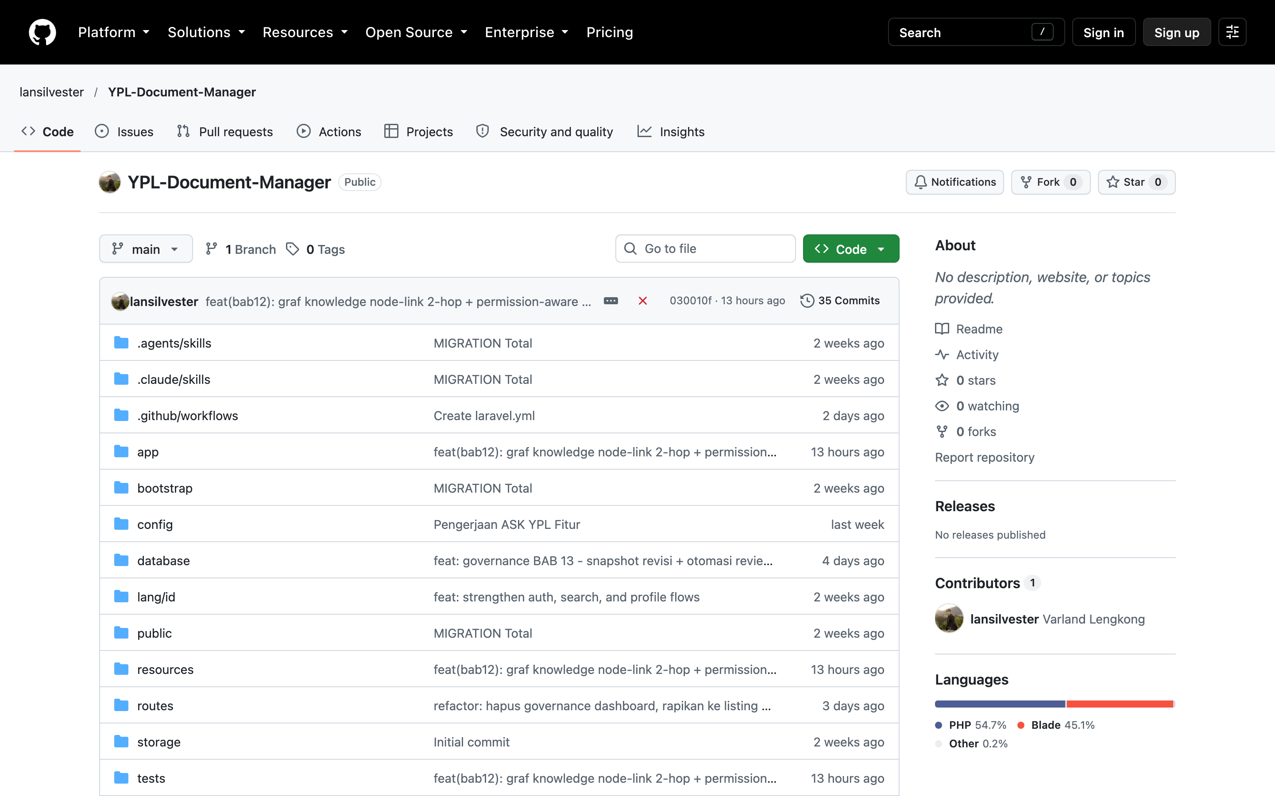
04 — STRUKTUR
Struktur Kode & Data
~11.500 LOC PHP • 16 Models • 19 Controllers • 7 Services • 22 migrations • ~70 routes
▸ app/Models (16)
Document, Category, DocumentRelation, DocumentVersion, System, Role, ServiceRequest, Bookmark, Like, dsb.
▸ app/Http/Controllers (19)
Home, Library, Reader, Governance, Search, Ask, Document, Staff, Admin, SuperAdmin, dsb.
▸ app/Services (7)
AskYpl, RecommendationEngine, ImpactMap, GeminiLlm, HtmlSanitizer, DocumentFiles, WaNumber
▸ routes/web.php
Public (/, /perpustakaan, /governance, /cari, /tanya) • auth • staff/ • admin/ • sa/ + throttle tiers
▸ database (22)
users, documents+FTS, categories B01–B10, relations, versions+snapshot, systems, roles, service_requests, dsb.
Repo: lansilvester/YPL-Document-Manager — main, 35 commits
LOSNITO Document • YPL Smart Digital Library • Progress Report Teknis • 12 Okt 2026 5/18
Notes:
Tunjuk pohon direktori. Tekankan Services sebagai otak: AskYpl, Recommendation, ImpactMap.

Slide 6
05 — REPOSITORY
GitHub — YPL-Document-Manager
github.com/lansilvester/YPL-Document-Manager • Public • PHP 54.7% / Blade 45.1% • 1 contributor
Commit terbaru (11 Okt): feat(bab12) graf knowledge node-link 2-hop + permission-aware — 13 jam lalu • 35 commits total
LOSNITO Document • YPL Smart Digital Library • Progress Report Teknis • 12 Okt 2026 6/18
Notes:
Tunjuk commit history: governance BAB13, hapus dashboard, CI laravel.yml 10 Okt.

Slide 7
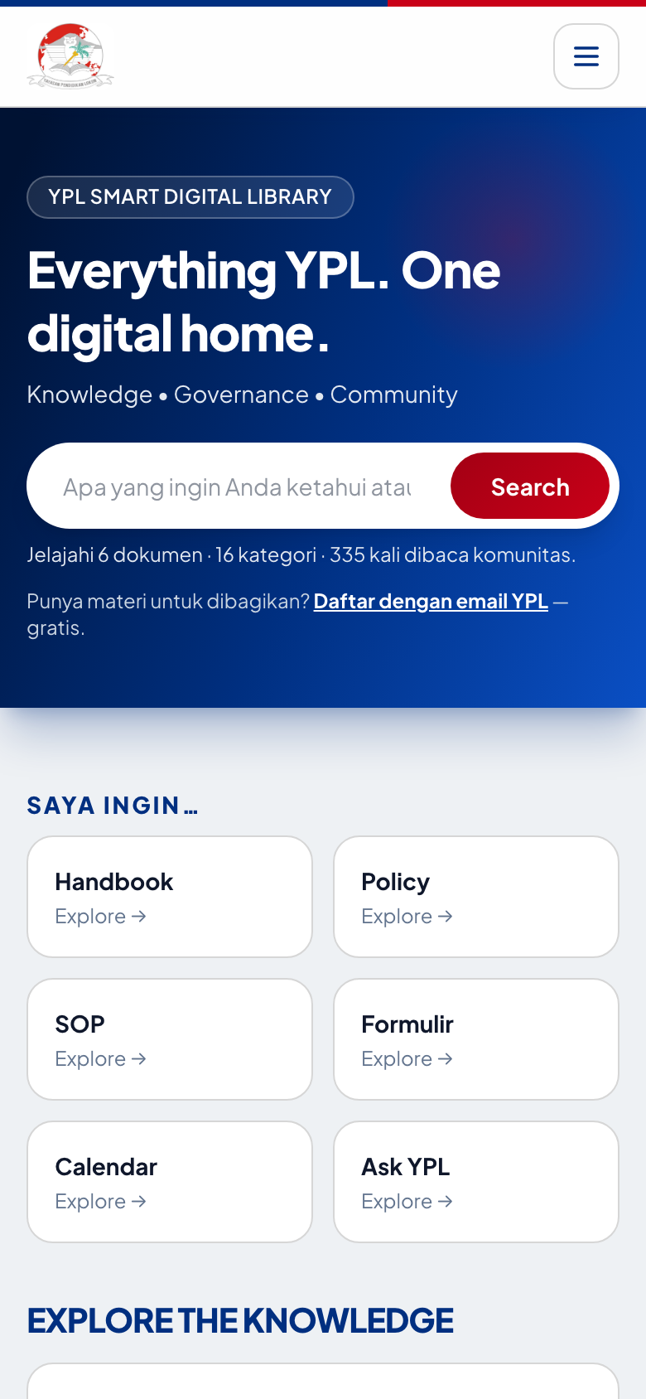
06 — PHASE 1 FOUNDATION
Home — Library Mode
Hero → /cari • 6 quick actions • Explore 4 koleksi • What's New • YPL Today (deadline review nyata)
Desktop 1440px — hero + SAYA INGIN… + EXPLORE
Mobile 390px — responsif
LOSNITO Document • YPL Smart Digital Library • Progress Report Teknis • 12 Okt 2026 7/18
Notes:
Demo live: ketik di hero, harusnya ke /cari. Tunjuk stats 6 dokumen • 16 kategori • 335 dibaca.

Slide 8
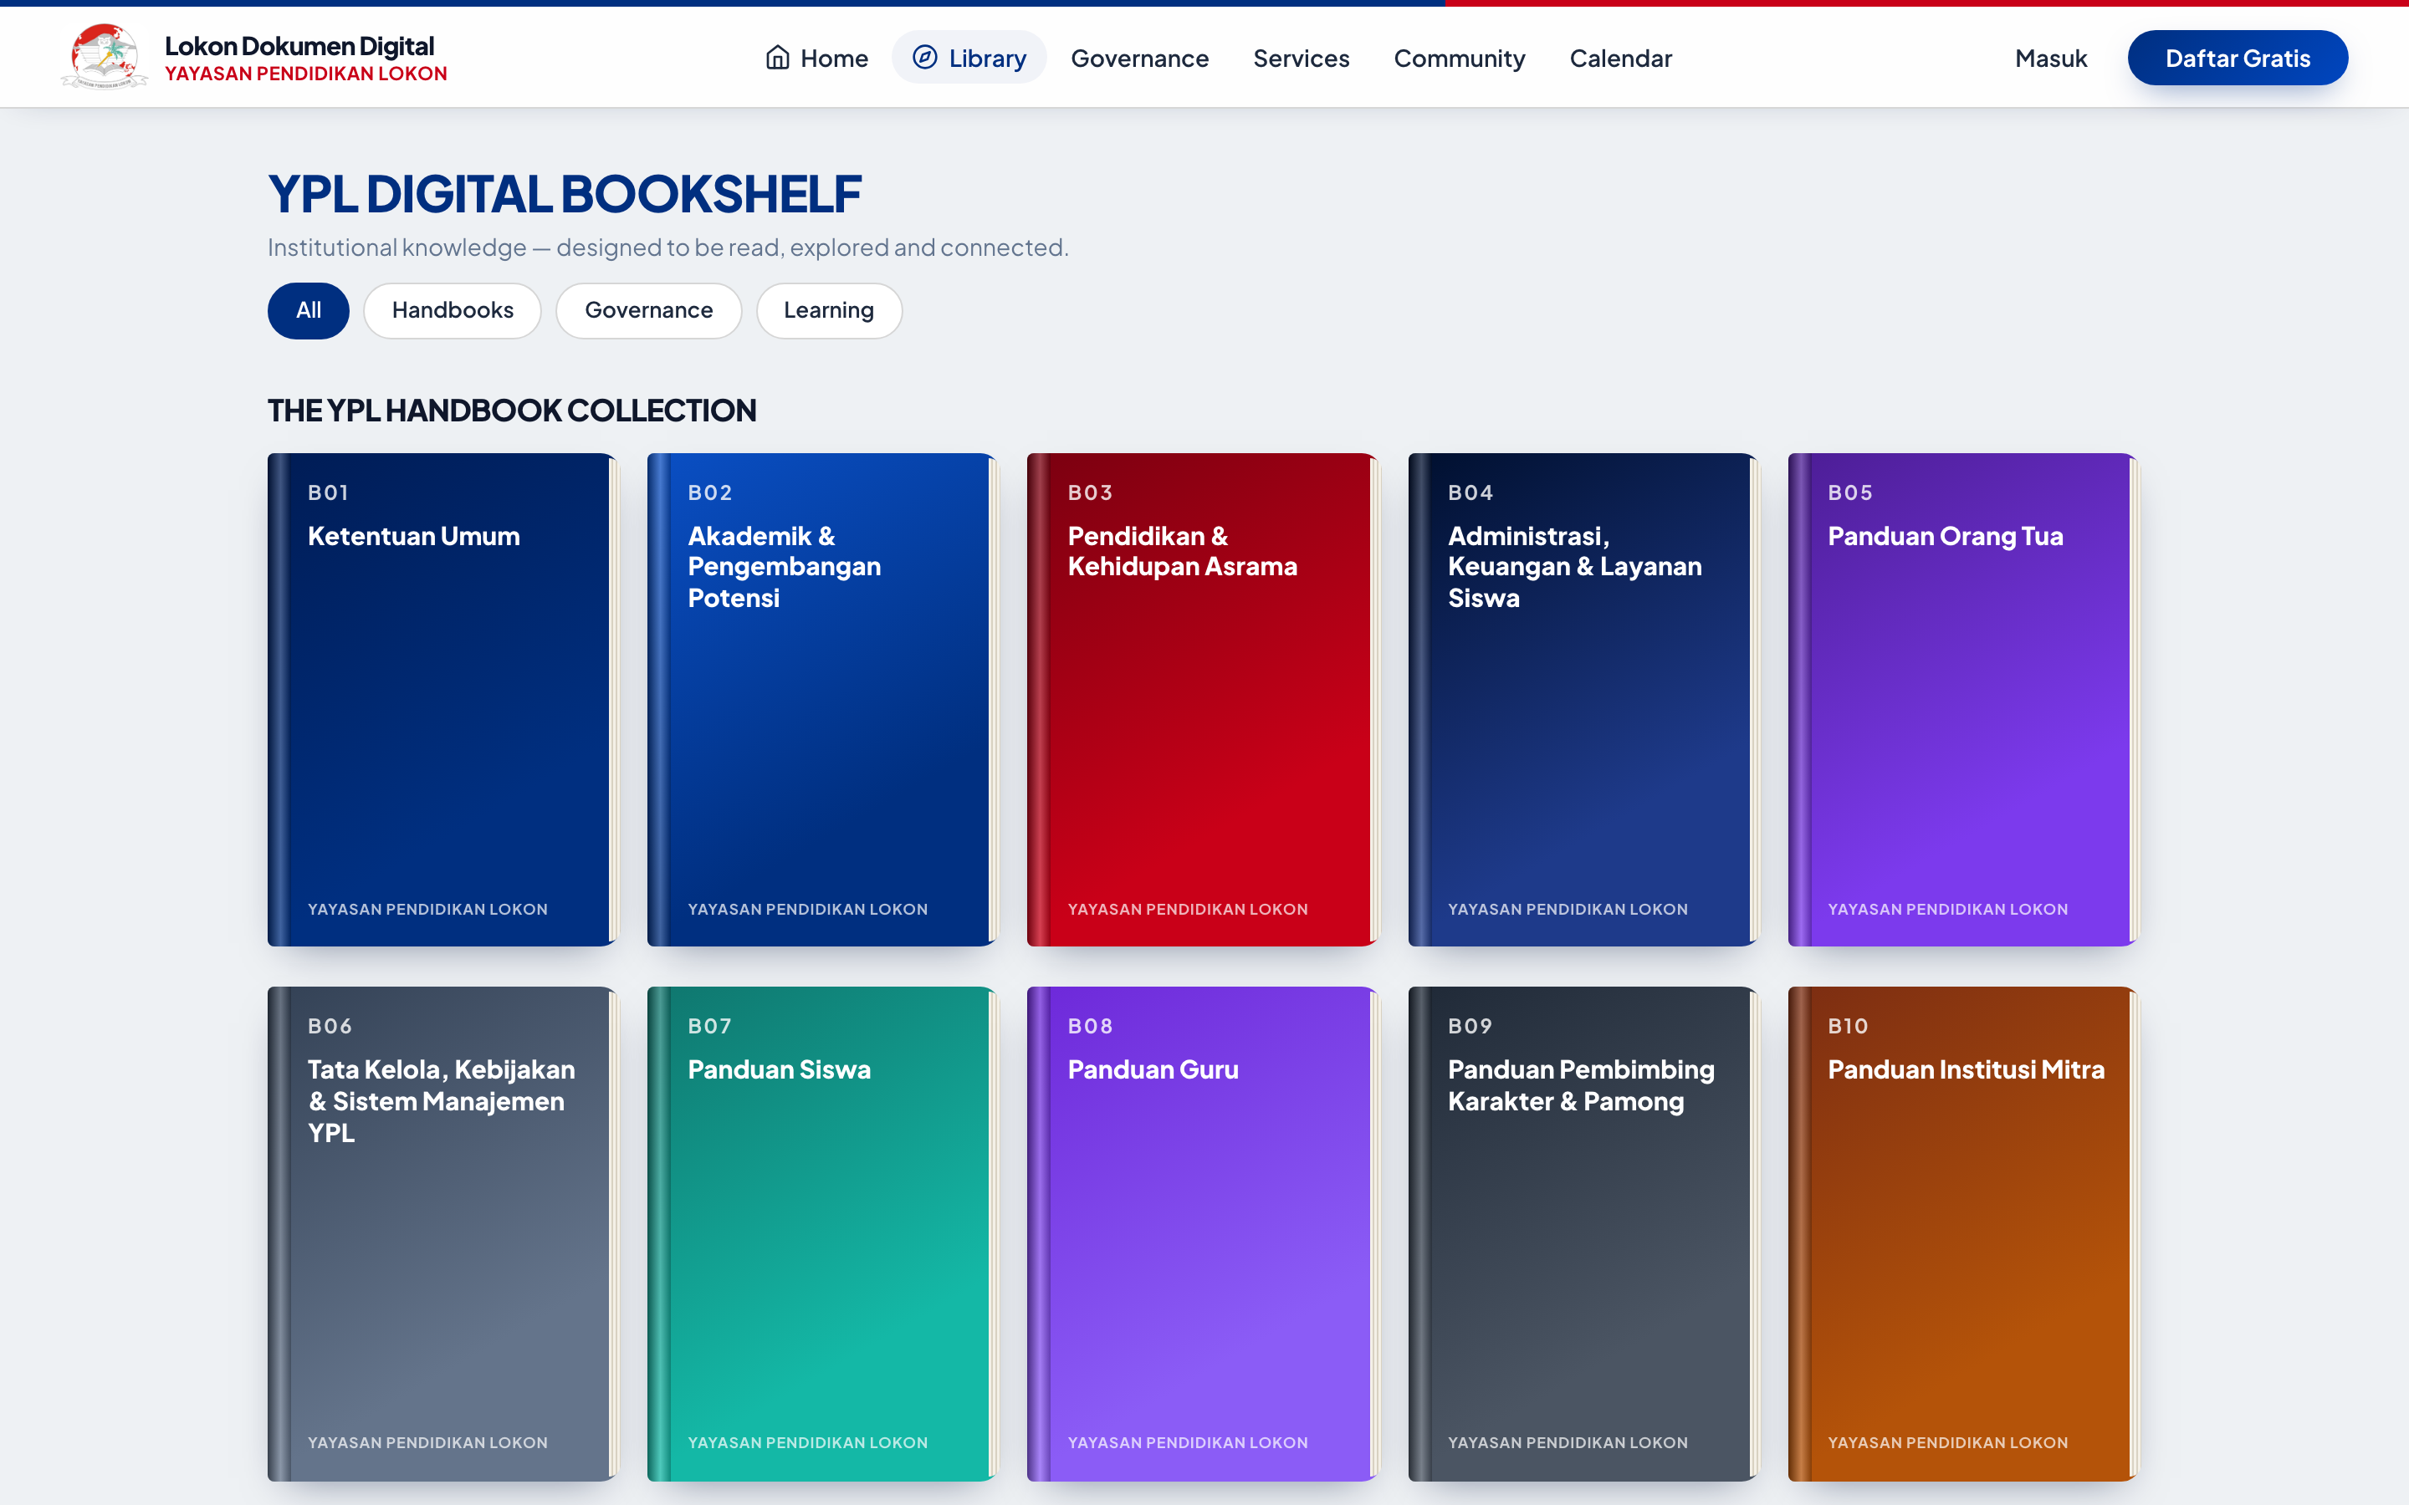
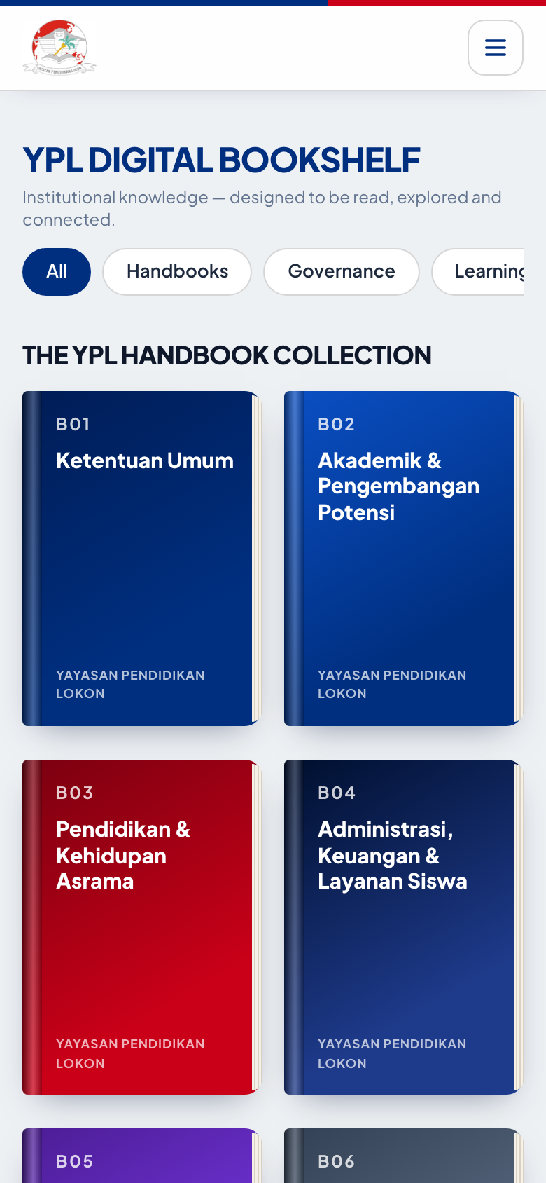
07 — PHASE 2 LIVING BOOKS
Bookshelf B01–B10 3D
Filter: handbook/governance/academic/boarding/staff/parent/public • Book detail: cover, TOC, Open Book, Bookmark
Desktop — 10 buku B01 Ketentuan Umum … B10 Institusi Mitra
Mobile — grid 2 kolom
LOSNITO Document • YPL Smart Digital Library • Progress Report Teknis • 12 Okt 2026 8/18
Notes:
Klik B01 → detail → Open Book masuk Reader tanpa hilang konteks (teruji).

Slide 9
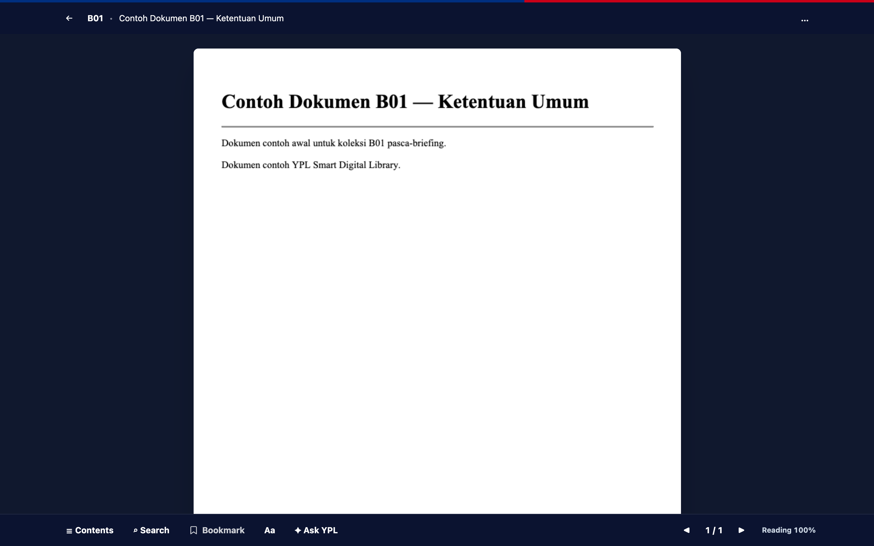
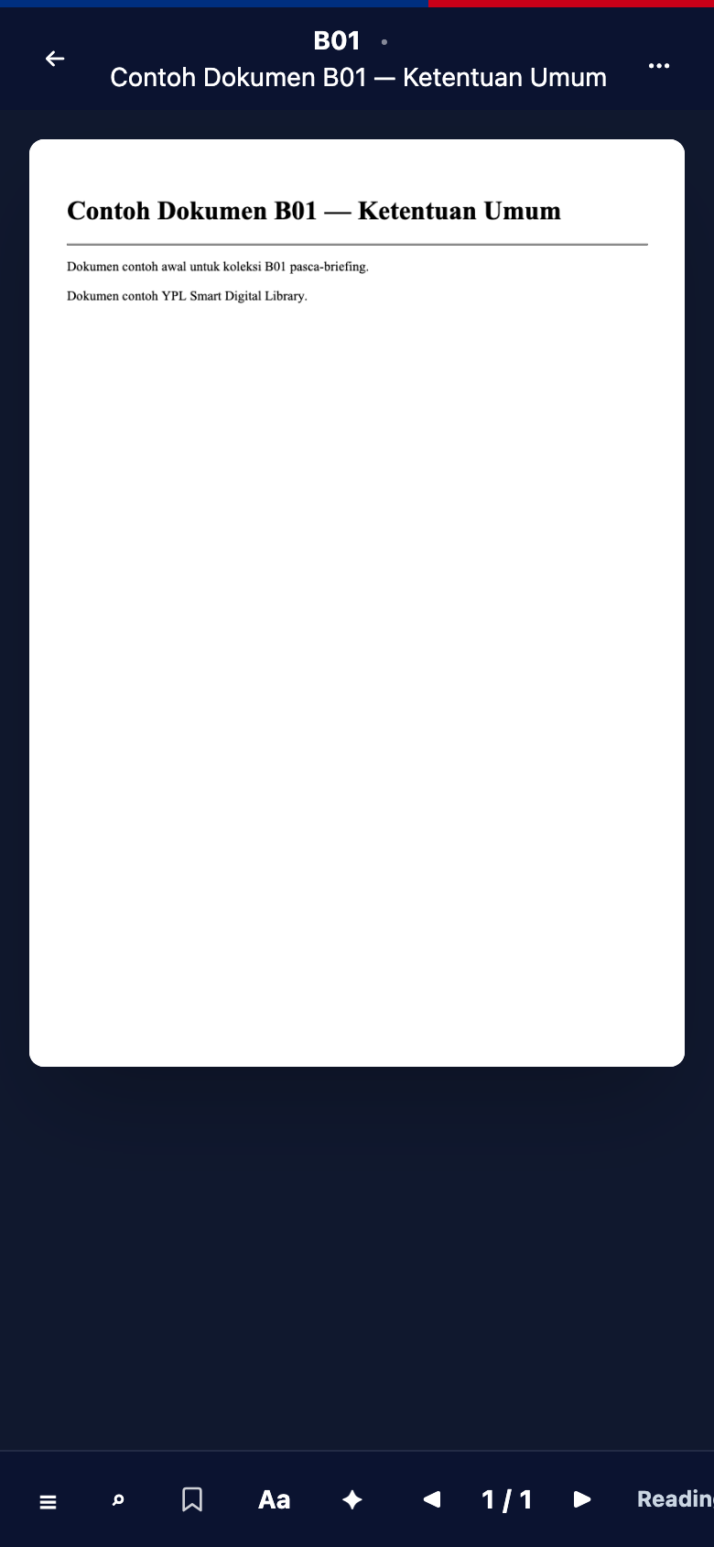
08 — PHASE 2 READER
Reader Mode Imersif
/baca/{slug} • 2-hal desktop / 1-hal mobile • flip 550ms • TOC drawer • search-in-book • persist posisi & prefs
Desktop — toolbar: Contents/Search/Bookmark/Aa/Ask YPL/counter/Reading % + keyboard+swipe
Mobile — 1 halaman + panel Rekomendasi
LOSNITO Document • YPL Smart Digital Library • Progress Report Teknis • 12 Okt 2026 9/18
Notes:
Demo keyboard arrows + swipe. Tunjuk Reading 100% + posisi tersimpan via api/posisi.

Slide 10
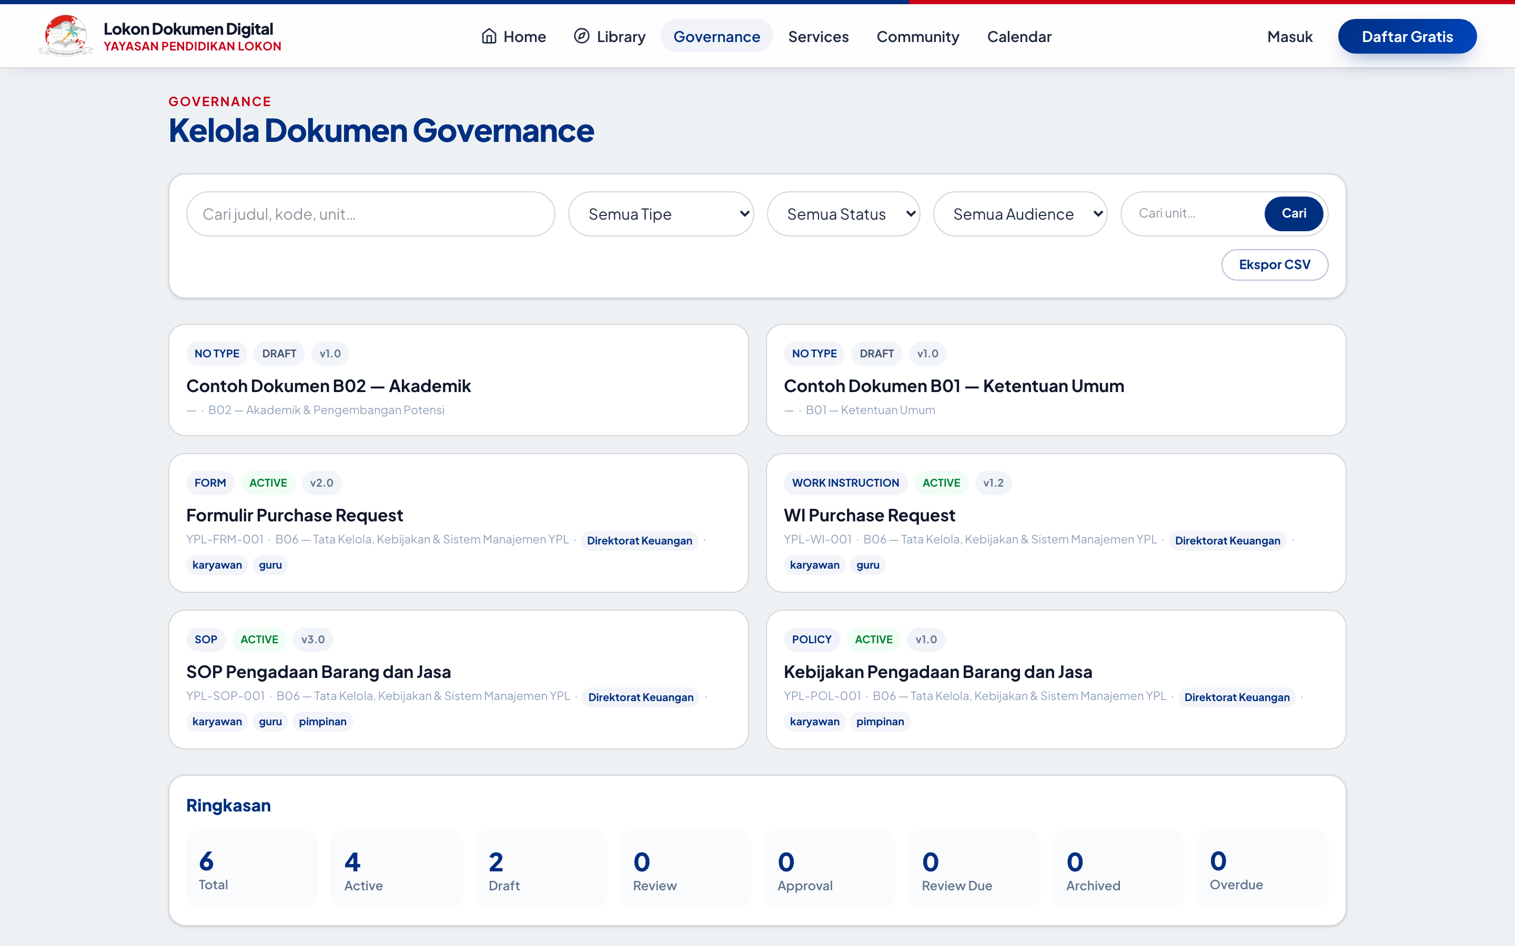
09 — PHASE 3 GOVERNANCE
Document Control (BAB 13)
Passport • lifecycle draft→archived • versions+snapshot • impact map 2-hop • ekspor CSV + throttle
▸ Passport akurat
DOC ID, tipe, owner, approver, PIC, effective/review, klasifikasi, status, audience, unit — stacked di detail
▸ Lifecycle + snapshot (8 Okt)
draft→review→approval→active→review-due→archived + snapshot isi per versi + otomasi review-due terjadwal
▸ Impact Map 2-hop (11 Okt)
Graf node-link permission-aware: Handbook→Policy→SOP→Form→PIC→System, hormati visibleTo
▸ Listing + CSV
Filter tipe/status/audience/unit • kartu statistik tertaut • Ekspor CSV nyata + throttle:sensitive
LOSNITO Document • YPL Smart Digital Library • Progress Report Teknis • 12 Okt 2026 10/18
Notes:
Buka /governance/SOP…/impact untuk graf. Tekankan tidak ada bocor private (teruji).

Slide 11
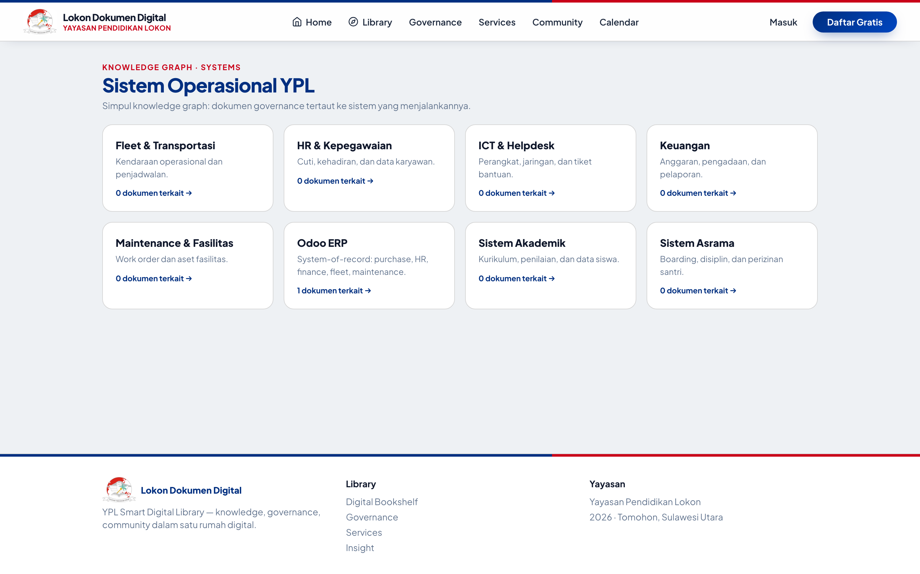
10 — PHASE 4 SERVICES
Layanan & Sistem Operasional
Katalog 8 layanan 'Saya ingin…' • workflow pending→approved/rejected→done • registri 8 sistem
▸ Services /layanan
Pengajuan + Permintaan Saya + kelola/putusan staff — teruji end-to-end
▸ Systems /sistem (8)
Odoo, Akademik, Asrama, HR, Keuangan, Fleet, Maintenance, ICT + dokumen tertaut
▸ Relasi hidup
Dokumen ↔ Sistem via document_relations — diketik staff, tampil di detail + impact map
▸ Sisa Phase 4
Integrasi Odoo (Phase 6) — fondasi tipe service_requests sudah siap
LOSNITO Document • YPL Smart Digital Library • Progress Report Teknis • 12 Okt 2026 11/18
Notes:
Demo ajukan layanan sebagai anggota, putuskan sebagai staff.

Slide 12
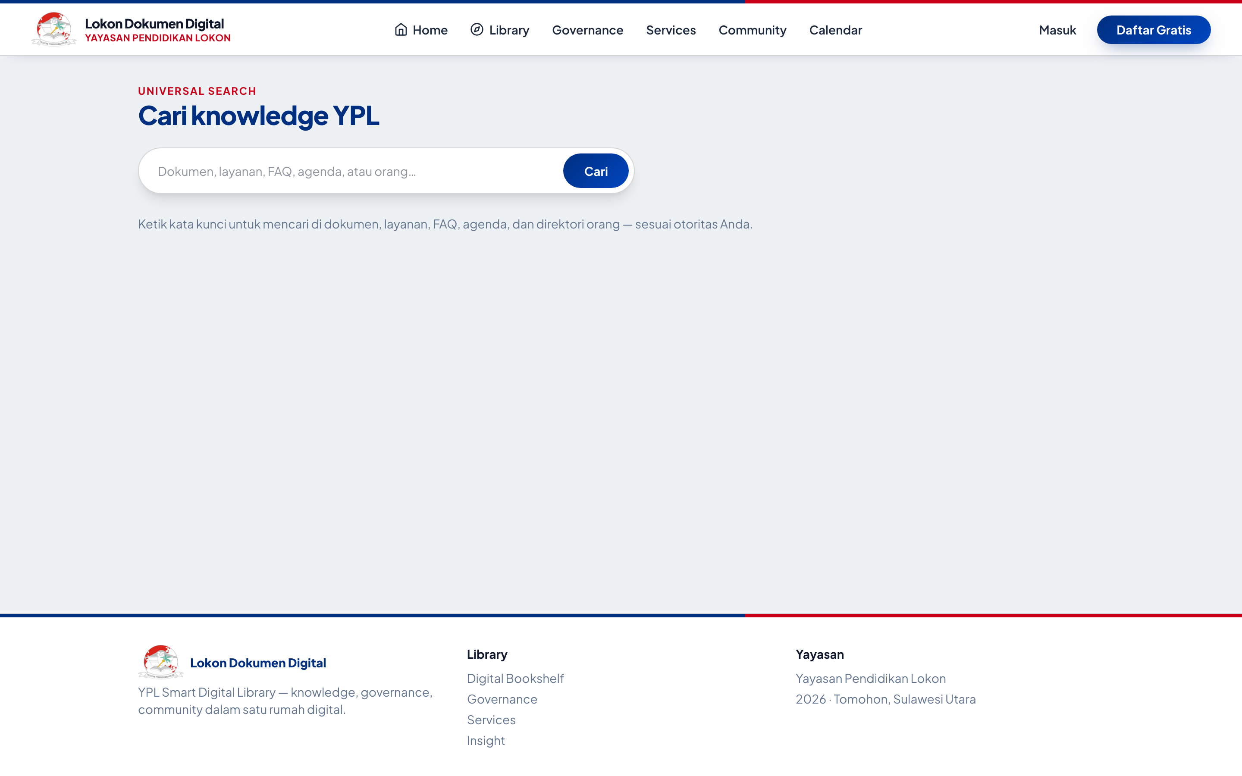
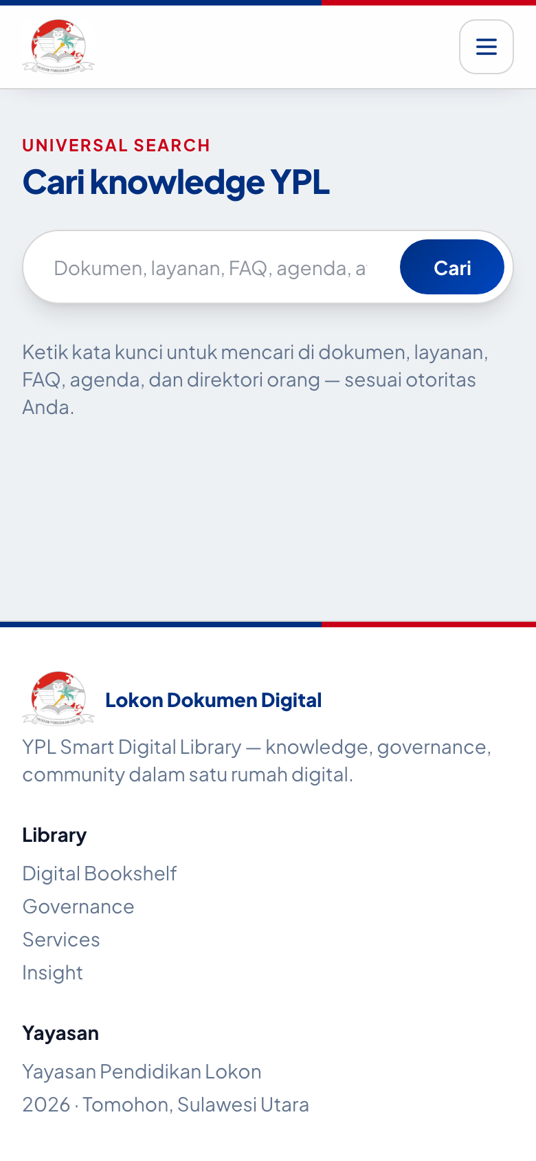
11 — PHASE 5 INTELLIGENCE
Universal Search /cari
Dokumen per-tipe + badge versi-status • Layanan/aksi Start → • Orang (login) • hormati visibleTo
Desktop — placeholder: Dokumen, layanan, FAQ, agenda, atau orang…
Mobile — full-width search bar
LOSNITO Document • YPL Smart Digital Library • Progress Report Teknis • 12 Okt 2026 12/18
Notes:
Catatan jujur: /cari?q=… dengan tabel faqs yang belum ada sempat 500 di lokal — pakai /cari kosong untuk demo aman. Sudah dicatat sebagai bug.

Slide 13
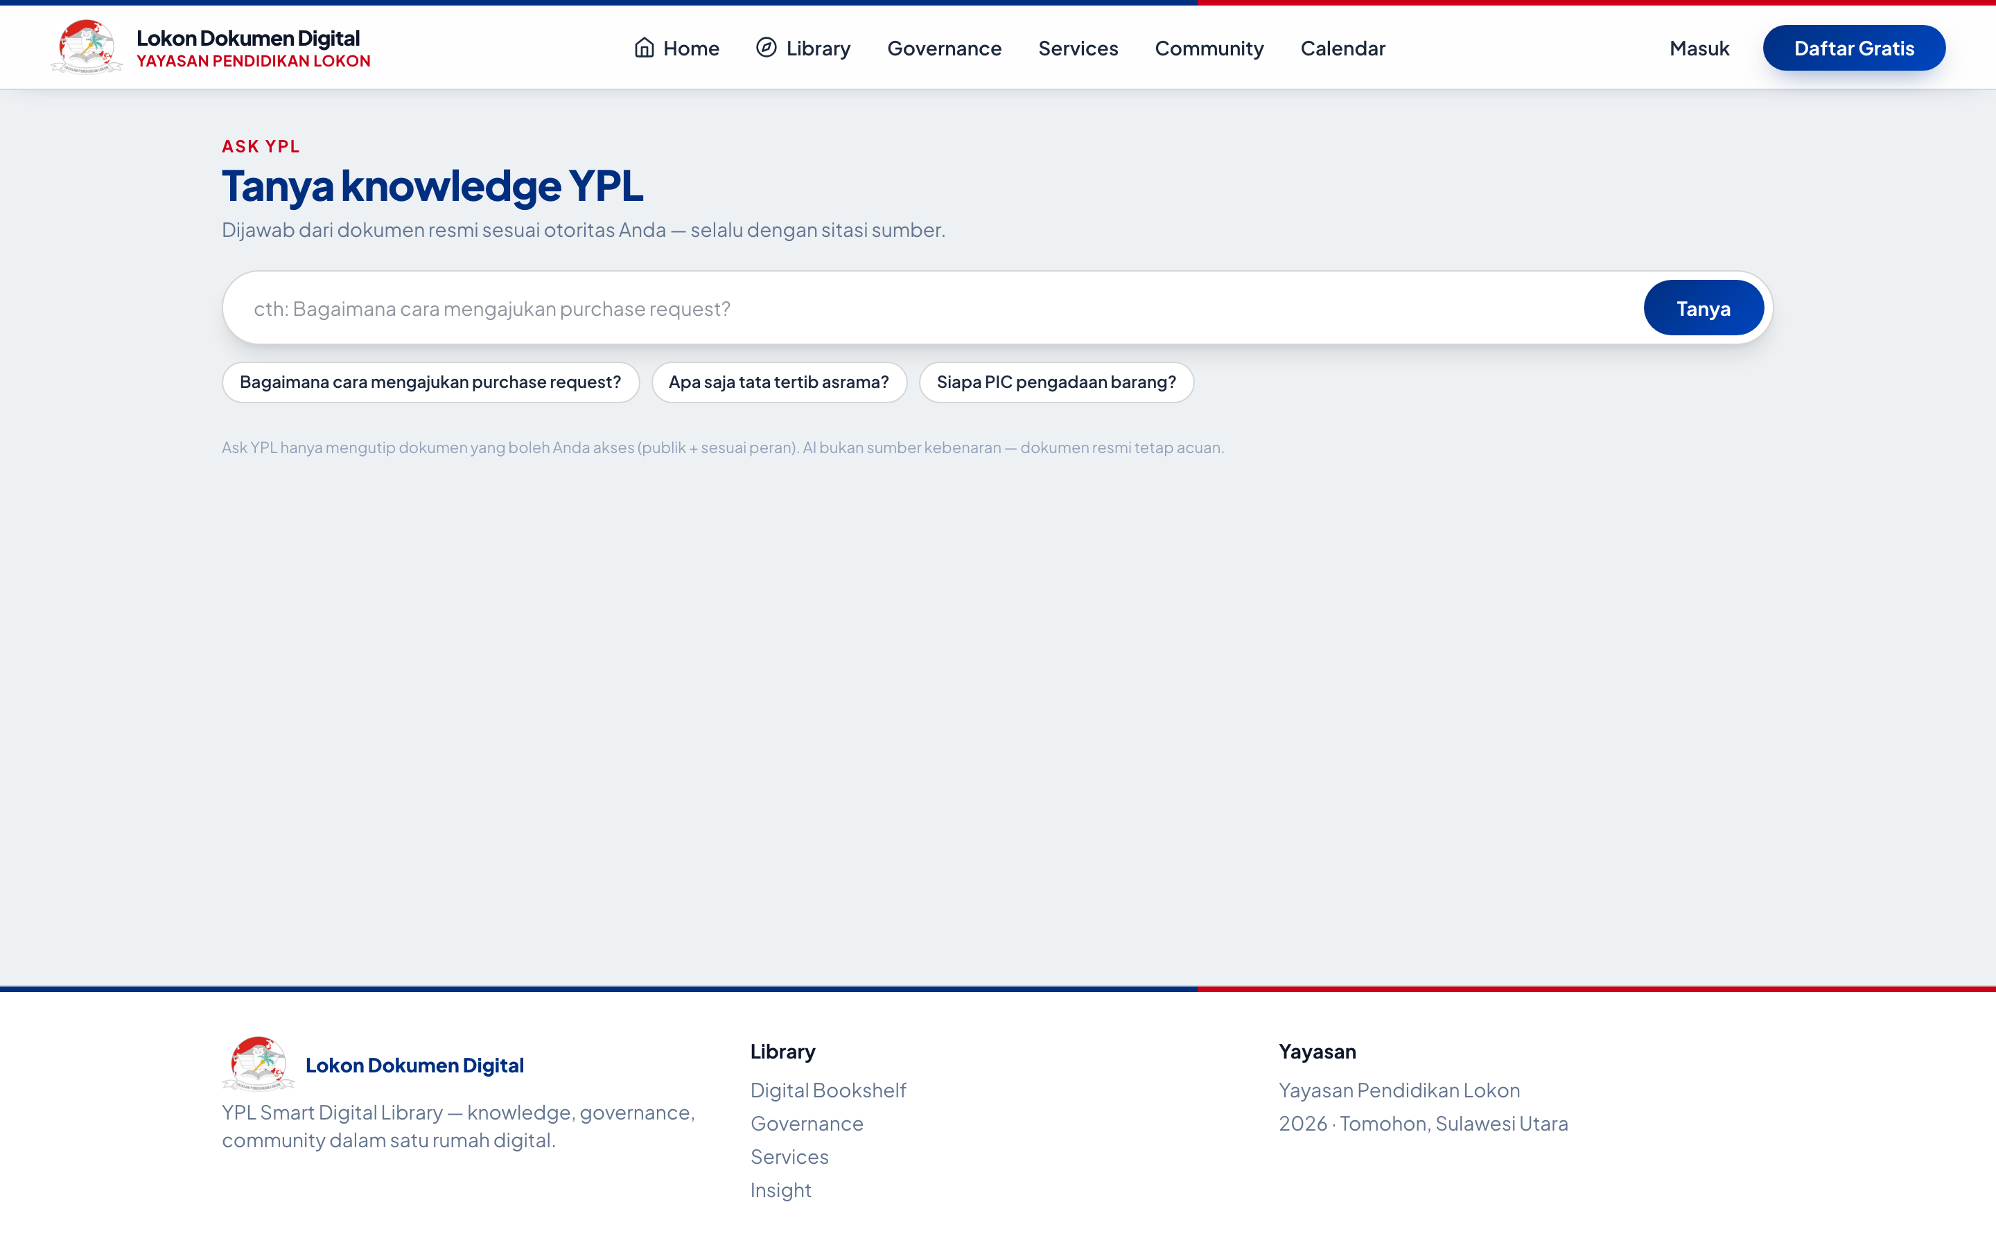
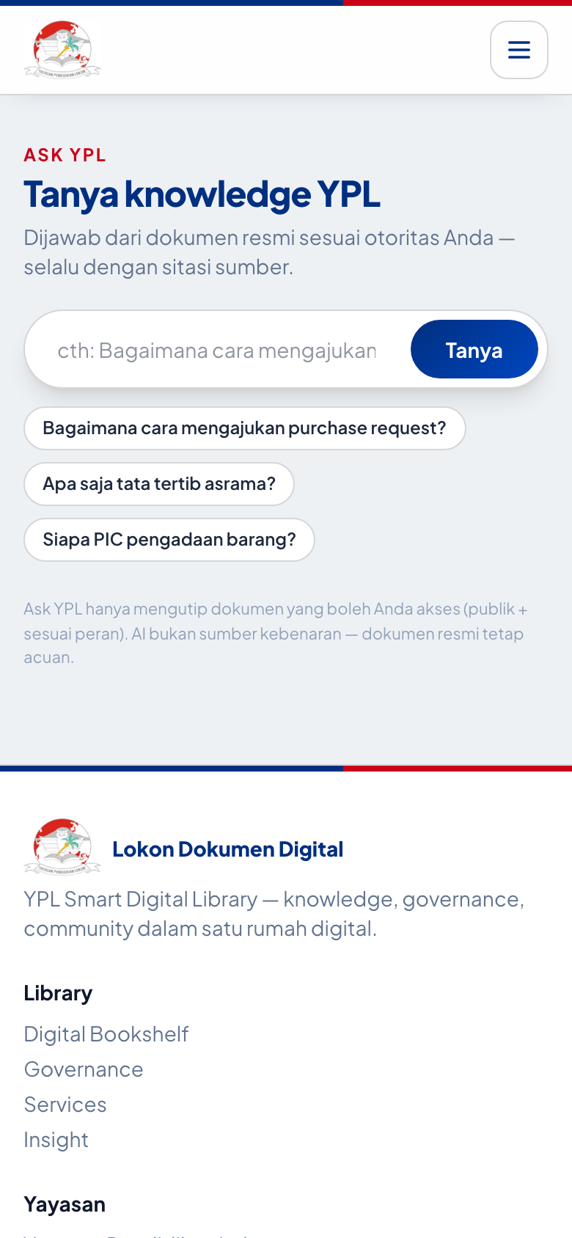
12 — PHASE 5 INTELLIGENCE
Ask YPL /tanya
Ekstraktif bersitasi + Gemini grounding • fallback jujur saat timeout • audit activity_logs
Desktop — contoh: Bagaimana cara mengajukan purchase request? + chips saran
Mobile — input + tombol Tanya
LOSNITO Document • YPL Smart Digital Library • Progress Report Teknis • 12 Okt 2026 13/18
Notes:
Arsitektur: AskController → AskYpl::answer visibleTo+searchAny → GeminiLlm::compose. Tamu=publik, anggota=+restricted+milik, admin=semua.

Slide 14
13 — PHASE 5 INTELLIGENCE
Recommendation Engine O(1)
6 sinyal bobot 100 • forDocument (~6 query) & forUser (~12) • N+1 eliminated • privacy teruji
▸ Sinyal (total 100)
Relasi eksplisit 30 • kategori 20 • tag overlap 20 • penulis 10 • co-reading 10 • sistem sama 10
▸ Optimasi: 600+ → 6 query
Pre-compute maps (relations, coreaders) + eager load category/tags/user — scoring di memori, zero query per kandidat
▸ Dua mode
forDocument($doc,$user) di detail + Reader drawer kanan • forUser($user) dari riwayat baca + bookmark
▸ UI + Privacy
Panel REKOMENDASI UNTUK ANDA ganti 'Dokumen Sejenis' + badge alasan + views • visibleTo: private orang lain tak bocor
QUERY COUNT
~600+ → ~6
N+1 eliminated
forDocument: 6 fixed
forUser: 12 fixed
Panel: detail + Reader
LOSNITO Document • YPL Smart Digital Library • Progress Report Teknis • 12 Okt 2026 14/18
Notes:
Tunjuk kode RecommendationEngine::buildRelationMaps. Tekankan O(1) fixed queries.

Slide 15
14 — SECURITY
Auth, Roles & Keamanan
4 peran + definisi role-aware • visibleTo everywhere • throttle • HTMLPurifier • ≤9 MB
▸ Peran & otoritas
anggota (baca+unggah+ajukan) • staff (+kelola+putusan) • admin (+kategori/pengguna) • superadmin (settings+roles) • registrasi→anggota
▸ visibleTo() di semua query
Tamu=publik • anggota=+restricted+milik • admin=semua — search, ask, rekomendasi, graph, governance semua hormati
▸ Throttle tiers
login/register/sensitive/uploads/interactions/deploy — cegah brute + spam upload
▸ Sanitasi & validasi
HTMLPurifier untuk editor • PDF ≤9 MB • WA +62 normalisasi • reset password token • avatar storage/private
LOSNITO Document • YPL Smart Digital Library • Progress Report Teknis • 12 Okt 2026 15/18
Notes:
Demo: login sebagai tamu vs anggota lihat dokumen restricted. Tunjuk tests privasi.

Slide 16
15 — QUALITY & DEPLOY
Testing Hijau & Deploy InfinityFree
~90 tests (11 file) • Pint bersih • CI laravel.yml • /deploy sekali-pakai
▸ PHPUnit 12 — 11 file Feature
Foundation, Reader, Governance, Knowledge, Graph, Ask, Search, Recommendation, Services, Role, Lokon — contoh: lifecycle penuh, private-tak-bocor
▸ Pint + Boost
vendor/bin/pint --dirty — gaya konsisten • Boost MCP: schema/query/logs/search-docs
▸ Deploy tanpa SSH (DEPLOY.md)
public/→htdocs, app sejajar, storage 775, MySQL sql312, buka /deploy/SECRET → migrate+seed+prune+SA → HAPUS rute
▸ Batasan jujur
9 MB (server ±10 MB) • tanpa worker/cron (sync) • 15 PDF besar tak ikut • symlink avatar fallback via route
LOSNITO Document • YPL Smart Digital Library • Progress Report Teknis • 12 Okt 2026 16/18
Notes:
Jalankan php artisan test --compact live jika sempat. Tunjuk .github/workflows/laravel.yml.

Slide 17
16 — STATUS JUJUR
Progress per Phase (Blueprint BAB 18)
✅✅✅✅ 🔄 ⬜ — baseline 8 Okt: 73 tests lolos, kini ~90 tests
Phase 1 Foundation (IA, taxonomy, Library)
✅ Selesai
Home BAB5 + 16 kategori
Phase 2 Living Books (B01–B10, Reader)
✅ Selesai
Bookshelf 3D + Reader 2/1-hal
Phase 3 Governance (passport, lifecycle)
✅ Selesai
Snapshot 8 Okt + graph 2-hop 11 Okt
Phase 4 Services (forms, workflow)
✅ Selesai
8 layanan — kurang Odoo
Phase 5 Intelligence (search, Ask, reco)
🔄 Berjalan
Search+Ask v1+Reco selesai; sisa graph visual
Phase 6 Ecosystem (Odoo, dash, analitik)
⬜ Belum
Fondasi peran+sistem siap
LOSNITO Document • YPL Smart Digital Library • Progress Report Teknis • 12 Okt 2026 17/18
Notes:
Tekankan kejujuran: sebut bug faqs 500 yang baru ditemukan saat screenshot — jadi action item.

Slide 18
18 — NEXT
Roadmap & Diskusi
Q4 2026: graph visual → role dashboards → analytics → Odoo • Hardening: cabut key + hapus /deploy
▸ Pendek (1–2 mgg)
Graph visual full • revision history UI • review-due cron • fix bug faqs di /cari?q=…
▸ Menengah (1 bln)
5 role dashboards (Siswa/Ortu/Guru/Karyawan/Pimpinan) • community/calendar nyata • analytics dari activity_logs
▸ Panjang
Odoo integration terakhir — tipe service_requests sudah kompatibel
▸ Demo & keputusan
Live: / • /perpustakaan • /baca • /governance • /cari • /tanya • Tanya: prioritas Phase 6 apa dulu?
github.com/lansilvester/YPL-Document-Manager
Terima kasih — diskusi & prioritas?
LOSNITO Document • YPL Smart Digital Library • Progress Report Teknis • 12 Okt 2026 18/18
Notes:
Tutup dengan ajakan keputusan: pilih 1 prioritas Phase 6 untuk sprint berikutnya.

