Slide 1

ENGLISH 1.1 ASSIGNMENT TOPIC: TECHNOLOGY
NAME: TRẦN ĐỨC LINH
STUDENT CODE: PH06402
CLASS: ENT1123.24
TEACHER: LÝ THỊ LOAN

Slide 2
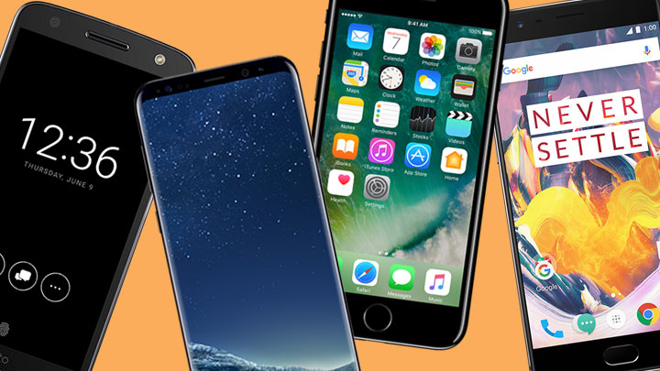
Outline
INTRODUCTION
BODY
History
Hardware
Software
Advantages and
Disadvantages
CONCLUSION

Slide 3


Introduction
Smartphones are the default source of communication for many people.
Useful tools for work or entertainment.

Slide 4
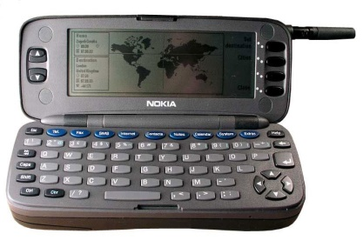
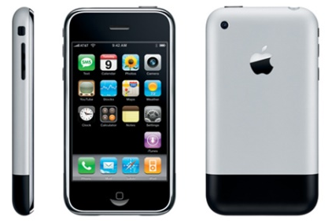
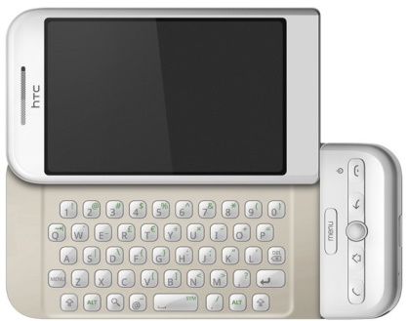
History
Body
In 1992, the first smartphone was invented.
In early 2007, Apple introduced the iPhone.
In October 2008, the first phone to use Android operating system called the HTC Dream was released.

Slide 5
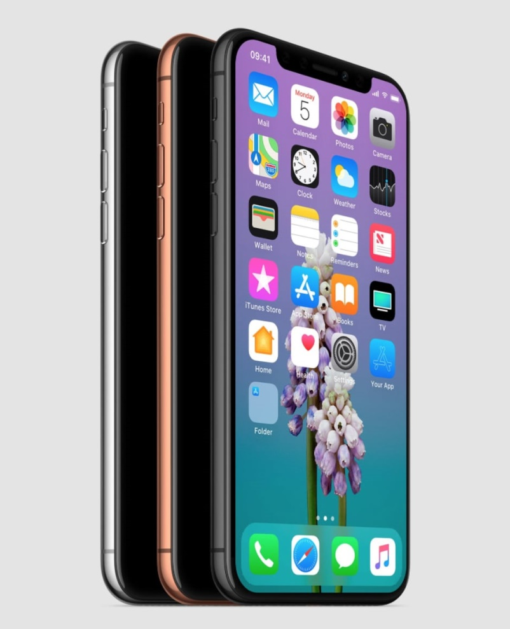
Hardware
Display
Fills most of the front surface of the device.
Screens larger than 5,2 inches are often called "phablets“.
Screen technologies for example: IPS, LED, OLED and AMOLED.

Slide 6
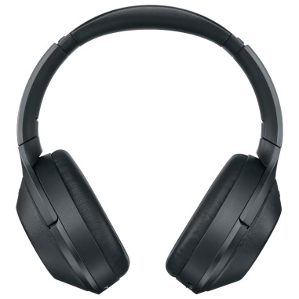

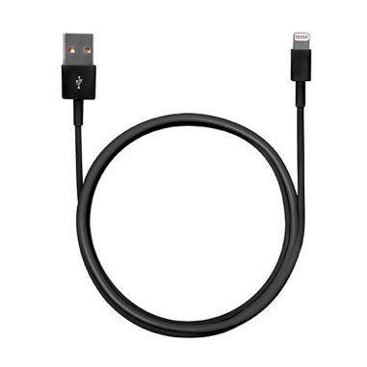
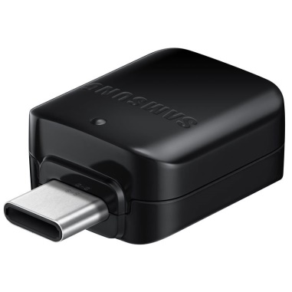
Hardware
Accessories
Screen protectors
Power charging cables
USB on-the-go
Headphones
Bluetooth speakers
…

Slide 7

Software
Android
Android is founded by Andy Rubin.
Android phones can run many applications at one time.
Phone manufacturers: samsung, LG, huawei, xiaomi, etc.

Slide 8
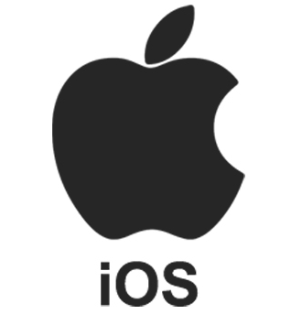
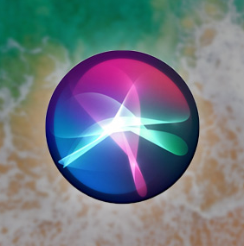
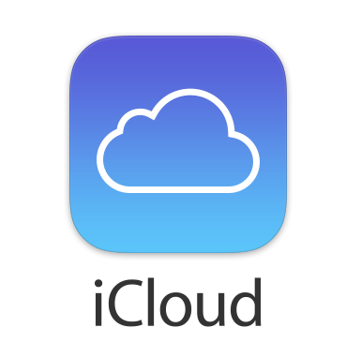
Software
iOS
iOS was developed by Apple.
iOS was first unveiled in January 2007.
iOS have Siri, iCloud, etc.

Slide 9
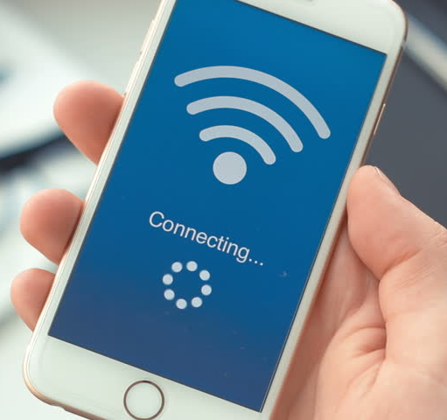
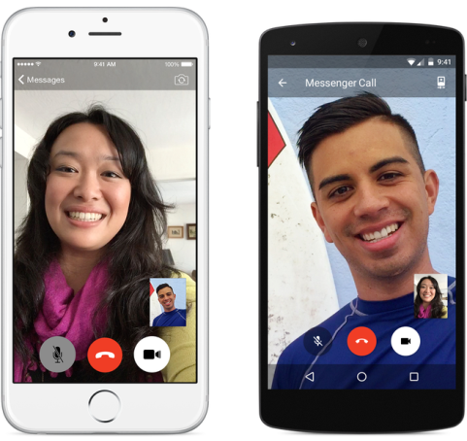
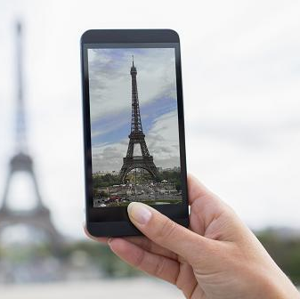
Advantages
- Access the internet
- Take photographs
Video chat with friends and loved ones
Entertain: play games, read news, shopping

Slide 10
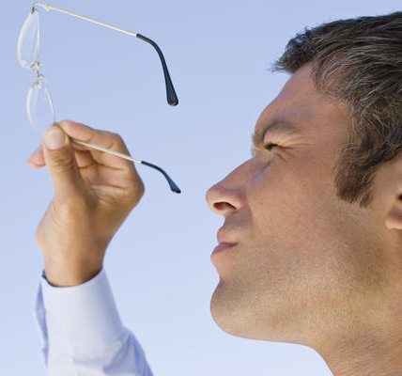


Disadvantages
Vision loss
Upset your biological clock: rhythm disturbances, lose sleep.
Traffic accidents.

Slide 11
Conclusion
Smartphones are a great invention. Everyone now owns at least one smartphones. However, Smartphones can only help us if we use them effectively.

Slide 12
The End
Thanks for watching!

