Slide 1


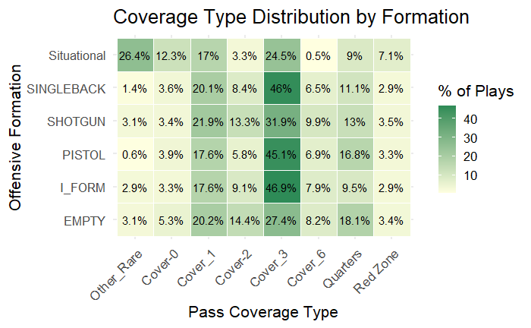
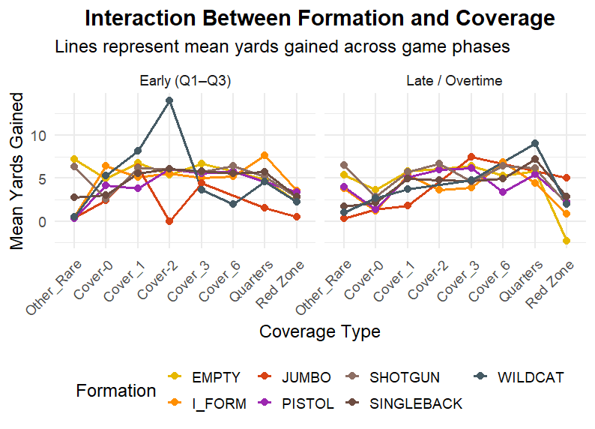

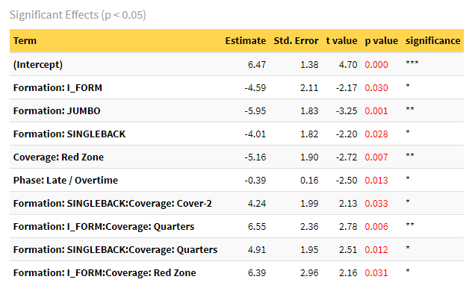
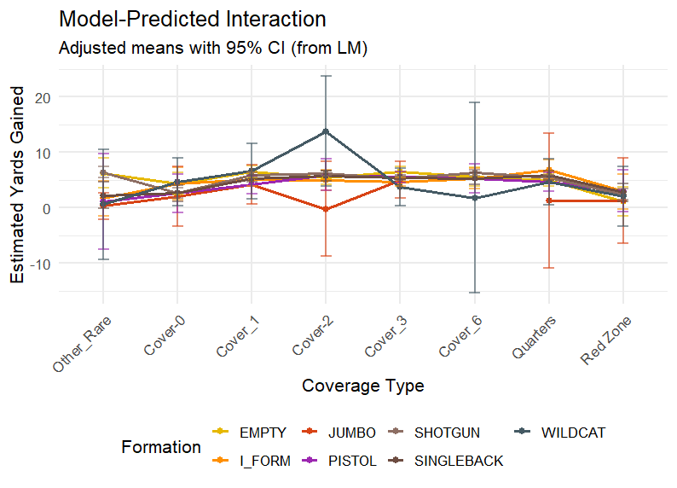
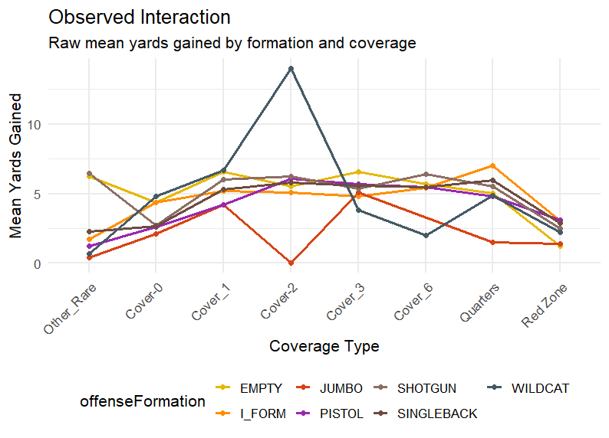
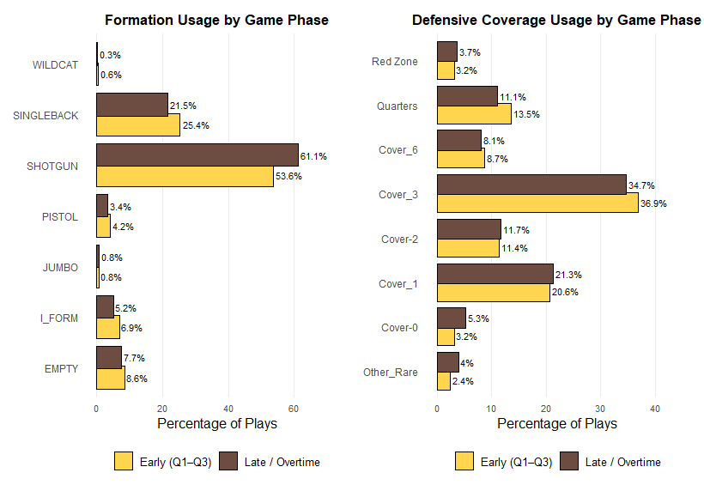
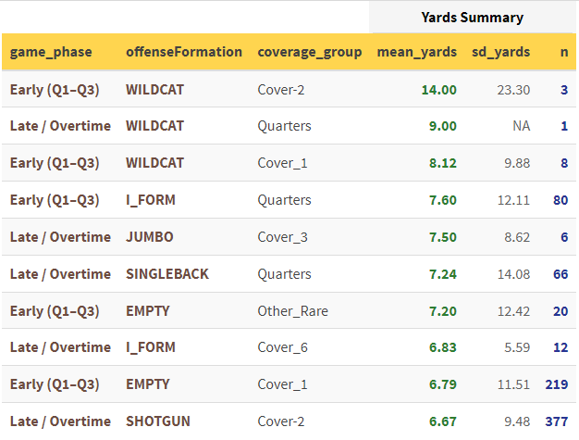
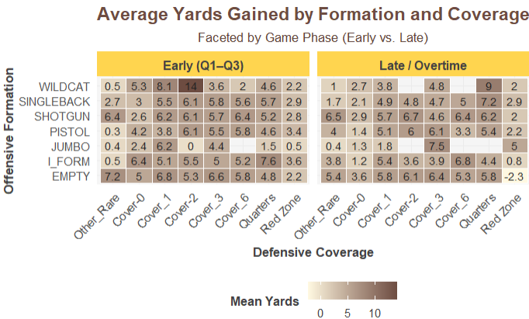
Exploratory Data Analysis NFL 2022
Analyzing the interaction between offensive formations, defensive coverages, and game phase on yards gained per play
Lan Vu– Dec 2026
Dr. Ray Herman
INTRODUCTION
Result
DISCUSSION
This study explores how offensive formations interact with defensive coverages to affect yards gained per play in the NFL 2022 season. Using exploratory data analysis.
I compare formations such as Shotgun, I-Form, Singleback, and Situational (Jumbo/Wildcat) against different pass coverages .
Game phase (early vs. late) is also examined to capture contextual shifts in performance.
Together, these analyses reveal how formation–coverage dynamics shape offensive success across different game scenarios.
Figure 2b
Regression model
Figure 2a
The multiple linear regression model explained roughly 1% of the variance.
This low explanatory power reflects the high variability and clustering inherent in football data, where outcomes are influenced by team tendencies, player ability, and situational context.
The model treats plays as independent, but observations are likely clustered by team or game, which violates independence assumptions and suggests that a mixed-effects or hierarchical model would better capture team-level patterns.
Method
To simplify defensive variety, pass coverages were grouped into broader categories (Cover-0/1/2, Cover-3/6, Quarters, and Red Zone). Offensive formations were also regrouped, combining Jumbo and Wildcat into a single Situational category to reflect their specialized usage near the goal line.
An ANOVA test was first conducted by quarter to evaluate differences in yards gained, which were later condensed into two game phases Early (Q1–Q3) and Late/Overtime for clearer comparison.
A multiple linear regression model,
R2=0.009 indicates high play-to-play variability, this is expected given the complexity and noise in football data.
Interaction effects were visualized using mean yardage plots, revealing how certain formations perform differently against specific coverages across game phases.
Regression assumptions such as normality and homoscedasticity were not tested in this exploratory phase, so statistical significance should be interpreted cautiously
Interaction Terms
Figure 2c
Figure 2d
In the interaction plots (Figures 2b–2d), Shotgun and Singleback formations show relatively stable yardage across most coverages.
While I-Form and Situational formations fluctuate more sharply, particularly under Cover-2 and Quarters defenses.
These results suggest that formation effectiveness depends on the defensive structure faced rather than the formation itself.
Although only a few interaction terms were statistically significant (p < 0.05), they highlight key tactical contrasts worth further modeling.
Figure 1a
Table 2a
Figure 2e
Conclusion
Overall, the analysis indicates that formation–coverage dynamics shape offensive outcomes more than game phase alone. Early- and late-game phases produced similar mean yardage trends, implying that situational context may be stronger predictors than time.
The exploratory findings emphasize descriptive insight over prediction. Future research should incorporate multilevel modeling and additional variables (down, distance, player alignment) to better explain performance variability.

