Slide 1
A Simulation Study of the Effect of the 2014 New National Allocation Policy for Deceased Donor Kidneys on Adult Recipients
Lanxin Jiang Yale School of Public Health
Department of Biostatistics

Slide 2
Old Policy
New Policy
Prioritizing allocation for patients with longer waiting time, high sensitization and zero HLA antigen mismatches
Longevity matching: patients with top 20th EPTS could have priorities to receive transplant from deceased donors with a KDPI smaller 20%
The start of waiting time: the earlier event of the time of dialysis initiation (even if prior to listing) or time of listing with an estimated GFR (eGFR) <= 20 mL/min/1.73 m2.
The initialization of waiting time: a candidate was listed and had a glomerular filtration rate (GFR) or creatinine clearance <= 20 mL/min/1.73 m2, or started dialysis

Slide 3
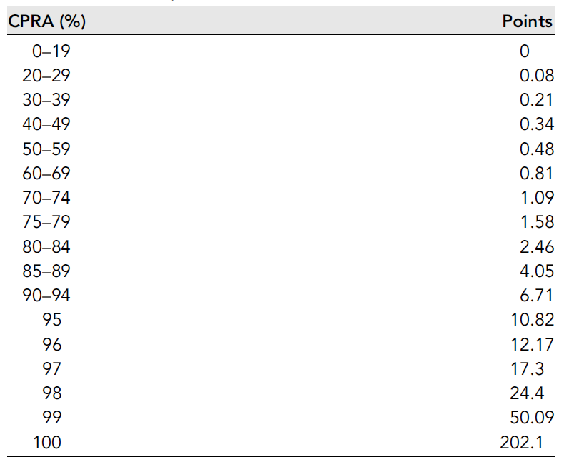
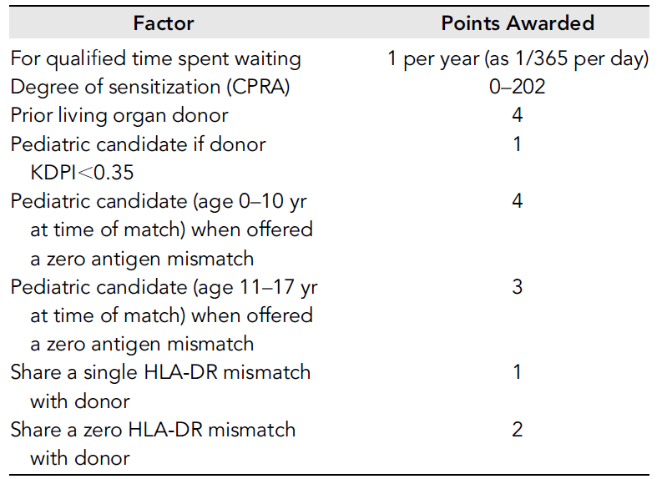
Priority point system for new Policy
Israni AK, Salkowski N, Gustafson S, Snyder JJ, Friedewald JJ, Formica RN, Wang X, Shteyn E, Cherikh W, Stewart D, Samana CJ. New national allocation policy for deceased donor kidneys in the United States and possible effect on patient outcomes. Journal of the American Society of Nephrology. 2014 Aug 1;25(8):1842-8.

Slide 4
Aim
To compare the two allocation systems and decide which system is better.
To simulate the new and old policies to see the effect of these allocation changes on the demographics of deceased donor transplant adult recipients.

Slide 5
Markov Model
52 times
week
92582 Candidates for kidneys transplant
New patients: 31532 /52
Pre-transplant death: 3722 /52
Living Donation: 5099 /52
Leave waitlist: 6483 /52
Deceased kidneys: 11277/52
95533 still on the list
Start of 2013
End of 2013

Slide 6
Model assumption
Each variable is independent of each other.
There is no geographic variation of the behavior of the graft allocation. I will treat the whole country as one transplant center.
The speed of new kidneys, new patients on the list, patients leaving the list is steady over the one-year course.
There is very little year difference in transplantation and donation cohort. So I can use 2012 data if I don’t have accurate 2013 measurements.
The number of kidneys provided is approximately the number of recipients.

Slide 7
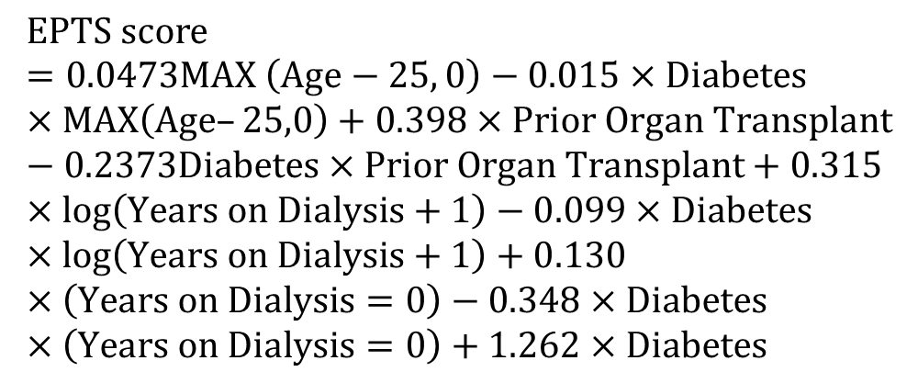
Parameters
 |  | Percent
Age | 18-34 | 9.3
 | 35-49 | 26.3
 | 50-64 | 43.5
 | 65+ | 20.8
Diabetes |  | 44.7
PRA/CPRA | <1% | 58.3
 | 1-<20% | 9.5
 | 20-<80% | 16
 | 80-<90% | 6.4
 | 98-100% | 9.8
Waiting time | <1 year | 28.6
 | 1-< 2 years | 21.5
 | 2-< 3 years | 16
 | 3-< 4 years | 11.9
 | 4-< 5 years | 7.9
 | 5+ years | 14.1
Time on dialysis | <1 year | 20.73
 | 1-<2 years | 11.69
 | 2-<3 years | 11.93
 | 3-<4 years | 11.03
 | 4-<6 years | 15.48
 | 6-<11 years | 16.04
 | 11+ | 13.09
Prior donor |  | 0.05
$$EPTS score=0.0473MAX \left(Age−25, 0\right)−0.015×Diabetes×MAX\left(Age–25,0\right)+0.398×Prior Organ Transplant−0.2373Diabetes×Prior Organ Transplant+0.315×log\left(Years on Dialysis+1\right)−0.099×Diabetes×log\left(Years on Dialysis+1\right)+0.130×\left(Years on Dialysis=0\right)−0.348×Diabetes×\left(Years on Dialysis=0\right)+1.262×Diabetes$$

Slide 8
Decision Tree
Living Donation
P=0.041
Pre-transplant Death
P=0.038
Weekly Allocation
Leave the waitlist
P=0.052
Decision Tree
EPTS>=80%
Kidney KDPI<=20%
Deceased Donation
EPTS<80%
Rank by Score
n=212
Deceased Donation
Rank by waiting time

Slide 9
Result 1- Comparison of recipients
 |  | New Policy | Old Policy | p-value
Age | 18-34 | 968(8.86%) | 1008(9.23%) | 0.076
 | 35-49 | 2956(27.07%) | 2841(26.02%)
 | 50-64 | 4790(43.86%) | 4739(43.40%)
 | 65+ | 2206(20.20%) | 2332(21.36%)
Diabetes | TRUE | 4798(43.94%) | 4930(45.15%) | 0.075
 | FALSE | 6122(56.06%) | 5990(54.85%)
Prior Organ Transplant | TRUE | 1580(14.47%) | 1624(14.92%) | 0.411
 | FALSE | 9340(85.53%) | 9262(85.08%)
CPRA |  | 82.65(35.02) | 24.68(36.40) | <0.001
Waiting Time(Week) |  | 160.79(108.70) | 387.20(27.68) | <0.001

Slide 10
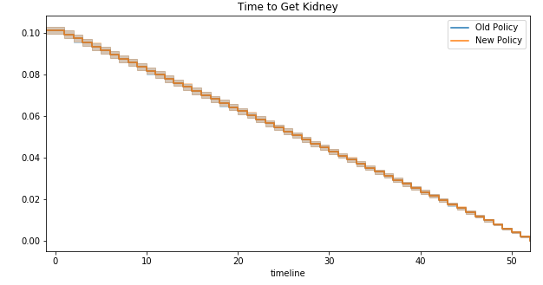
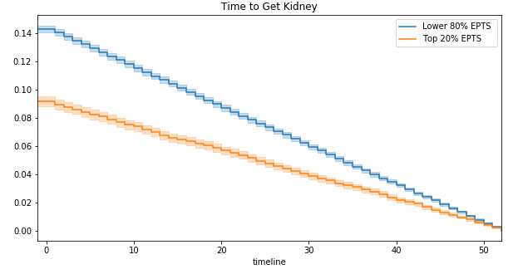
Result 2: Survival Curve
Comparison of Two policy
Comparison of EPTS in new Policy

Slide 11
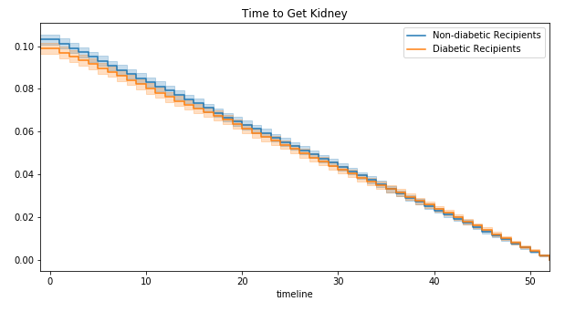
Result 3: Survival Experience
 | New Policy |  | Old Policy
 | Log-rank | Peto-Peto | Log-rank | Peto-Peto
Diabetes | 0.784 | 0.034 | 0.783 | 0.415
Age | 0.043 | 0.121 | 0.388 | 0.489
EPTS priority | <0.001 | <0.001 | 0.768 | 0.992

Slide 12
Conclusion
The new allocation system enables candidates with higher CPRA or diabetes to receive the kidneys earlier.
The results are credible because all the parameters were drawn from the national report.
The model is not comprehensive in that several candidates and donors’ properties and allocation procedure were simplified

Slide 13

Thanks!
Questions?

