Slide 1
RICM Architecture
& Code Structure
Kai ZHANG
2010.07.02
Notes:
2011-10-19

Slide 2
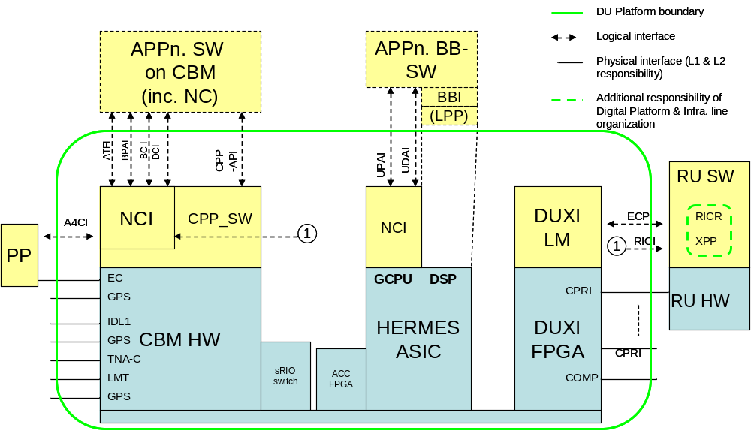
Structure and boundaries of the ‘DU platform’

Slide 3
RICM(Radio Interface Control Main part)
The RICM software is responsible for management of communication links between baseband modules and radio units.
It is capable of handling O&M, I/Q data, and synchronization between radio and baseband modules.
Detailed responsibility:
  management of CPRI links between main units (REC) and radio units (RE).
  manages startup and shutdown of ECP links, board control on DUW, DUL and DUS.
  delay management (Calculates and distributes delays (BB to RE))
  xIO management
  allocation of IQ slots.
  Fault supervision
RICM is client of the RICI interface and the RE is server.

Slide 4
Block Schematic for LTE of CPRI-link with control/traffic paths
Node Control
ANP
Baseband (REC)
Radio (RE)
Radio SW (XP)
CBC server
DUBC
RICM
Modem
Register
map
RICR
BB HW
Ra HW
CPRI
CPRI block
CPRI block
CPRI block
Interface
O&M control path
I&Q traffic path
HW/FPGA
SW

Slide 5
Detailed Architecture for DUS board
DUS
CPP
NC/MP
RICM DCI
RICM
Intra
NSS
CLIB BCI
DUBC
Functional signal interface HALI-2
DICM
Setup and Supervision Requests
for ports/blocks
Register setup calls
Register map interface (SVL) HALI-1
DUXI
Communication and Traffic Drivers
(CPP and BCP)
IDL2 CPRI
DUS
RRUx
Logical Traffic links
Logical Communication Links
Physical links (CPRI, IDL2 CPRI_partner mode?)
DUS
RRUx

Slide 6
Abbreviations
DICM DUXI Interface Control Main part
SVL SW Value Lookup table,
stores FPGA settings, initial port data, addresses etc.
DCI Device Control Interface (LTE)
BCI Board Control Interface (LTE)
DUBC DU Board Control SW
CBD Clock and Baseband Distribution (originally a WCDMA subsystem)
BLIB Base Station Component Library (sub system)
ELIB LTE Common Library
CLIB ???
GIC GULM Interface Circuit (FPGA on DUL)
GOBB Gates of Base Band (FPGA on DUW)
GULM Generic UMTS LTE Module

Slide 7
RICM(Radio Interface Control Main part)
NC
ELIB_BCI/DCI
RICM_DCI
RICM/
DUBC
ATFI & BPAI
BCP
EL1CI
RICI
RICR
BCP Board Control Part

Slide 8
Code Structure Overview
Source code is located in </vobs/rbs/hw/nci_comm/lte_bp/generic>
There are file folders and one soft link in generic/.
1. srio_sw and srio_verif is not related with RICM.
2. Besides,
build/ contains the build scripts and some configuration files.
If/ is a soft link. (if -> /vobs/rbs/hw/nci_comm/deliv/ifu/), includes the definition for two interfaces: ricm-cdci and ricr-ipci.
sw/ contains the souce code of RICM.
verif/: two filefolders, tests(source code of test cases, and logs) and tools(contains the MP, BCP and TU hardware simulation in NCI Sim, configuration files for verification)

Slide 9
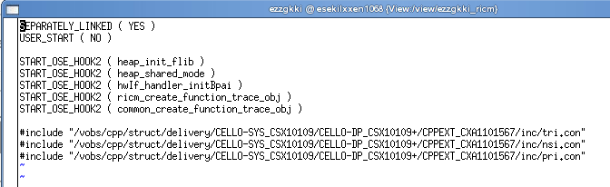
Code Structure(build/)
build/ contains the build scripts and some configuration files.
Highlights:
  cs: configure spec for current revision.
  heap.con: heap configuration.
  osemain.con: OSE *.con file
  ReadMe.txt: How to build; How to use perl scrips to make branch and check out/in.
  etc.

Slide 10
Code Structure(if/)
If/ is a soft link. (if -> /vobs/rbs/hw/nci_comm/deliv/ifu/), includes the definition for two interfaces: ricm-cdci and ricr-ipci.
Highlights in ricm-cdci:
  ricm.sig: CDCI signals definition, which are used in communication between RICM DC Server <-> RBS NC.
  ricm.h: Macros and typedefs used by ricm.sig.
  ricm_unioncontent.h: part of the union SIGNAL for OSE
IPCI: Inter Processing Unit Control Interface
CDCI: Common Device Control Interface

Slide 11
Code Structure(sw/)
sw/ contains the source code of RICM.
common config control hwDul21 hwDuxi hwGicGobb hwif interrupt lint supervision
Highlights:
  common: Definition of NCI_COMMON, FAULT Handling, Interfaces, and Trace Object.
  config: RICM config SWU, includes common, ricm parts and atfi, dui/CBCI(WCDMA) interfaces.
  control:
    1. Proxy of process Nci_control_proc (handles all NCI Generic specific CBCI/CDCI interface signals),
    2. RICM control SWU,
    3. ricm_control_ricm_handler, bpai_blib_handler & bpai_clib_handler (handling incoming RICM/BLIB/CLIB messages within RICM control SWU), ricm_control_dui_handler (WCDMA)
    4. ricm_control_commands(RICM test software, e.g., w/r FPGA)
    5. RICM trace object definitions

Slide 12
Code Structure(sw/)
sw/ contains the source code of RICM.
common config control hwDul21 hwDuxi hwGicGobb hwif interrupt lint supervision
Highlights:
  hwDul21 :
  hwDuxi:
    hwDuxi ccr buf duxi functions
    hwDuxi common functions
    hwDuxi cpri buf duxi functions
    hwDuxi ecp buf functions
    hwDuxi eth buf functions
    hwDuxi iq buf duxi functions
    hwDuxi iqc buf duxi functions
    hwDuxi pcie buf duxi functions
    hwDuxi sfp buf duxi functions
    hwDuxi trxCalCfg buf duxi functions
    hwDuxi xio buf duxi functions
    hwDuxi iq buf duxi functions (hwDuxiw_iq_buf??? DUXIW FPGA)
    ricm hwDuxi ccr functions
    ricm hwDuxi ecp functions
    ricm hwDuxi cpri functions
    ricm hwDuxi eth functions
    ricm hwDuxi iq functions
    ricm hwDuxi iqc functions
    ricm hwDuxi pcie functions
    ricm hwDuxi sfp functions
    ricm hwDuxi xio functions
    ricm hwDuxi trxCalCfg functions

Slide 13
Code Structure(sw/)
sw/ contains the source code of RICM.
common config control hwDul21 hwDuxi hwGicGobb hwif interrupt lint supervision
Highlights:
  hwGicGobb(Gic, DUL20/DUL21, Gobb, WCDMA) :
  hwif :
    ricm hwIf common functions
    ricm hwIf clk functions
    ricm hwIf cpri functions
    ricm hwIf ecp functions
    ricm hwIf eth functions
    ricm hwIf handler
    ricm hwIf hdlc functions
    ricm hwIf iq functions
    ricm hwIf iqc functions
    ricm hwIf sfp functions
    ricm hwIf xio functions

Slide 14
Code Structure(sw/)
sw/ contains the source code of RICM.
common config control hwDul21 hwDuxi hwGicGobb hwif interrupt lint supervision
Highlights:
  interrupt: on DUL20/DUL21/DUW/DUS(DUXI, DUXIW),
    Interrupts initialization (ETH, CPRI, ECP, GPA, IQ, IQC, XIO, SRIO)
    create_process for Interrupts handler processes, and kill_proc.
    ricm_interrupt_proc(handles interrupt handler setup), ricm_interrupt_sendEvent (Send interrupt event to Nci_supervision_proc, new routine added in 2012-03-05)

Slide 15

Code Structure(sw/)
sw/ contains the source code of RICM.
common config control hwDul21 hwDuxi hwGicGobb hwif interrupt lint supervision
Highlights:
  Lint: PC-lint/FlexeLint is a software package that finds errata in C and C++ programs consisting of one or more modules.
    Source code can be linted one by one or all in a sequence, by executing
      lint_cleanup
      lint_prepare
      lint_run
      If you instead would like to lint only one file, that is also possible: lint option_minor.lnt ../config/src/ricm_config_dui.c
      If you would like support from your editor to be able to easily jump to the code lines that the messages refer to, you will probably have to call lint like this: source /vobs/cello/cade_struct/setup/setup;
      lint option_minor.lnt ../config/src/ricm_config_dui.c

Slide 16
Code Structure(sw/)
sw/ contains the source code of RICM.
common config control hwDul21 hwDuxi hwGicGobb hwif interrupt lint supervision
Highlights:
  Supervision (NCI supervision SWU):
    ricm_supervision.c
    ricm_supervision_bvl.c
    ricm_supervision_carrier.c
    ricm_supervision_clk.c
    ricm_supervision_cmd.c
    ricm_supervision_cpri.c
    ricm_supervision_cpriDu.c
    ricm_supervision_cpriRu.c
    ricm_supervision_delay.c
    ricm_supervision_eth.c
    ricm_supervision_fault.c
    ricm_supervision_faultDui.c
    ricm_supervision_faultDul.c
    ricm_supervision_handler.c
    ricm_supervision_int.c
    ricm_supervision_om.c
    ricm_supervision_phantom.c
    ricm_supervision_rici.c
    ricm_supervision_sfp.c
    ricm_supervision_temp.c
    ricm_supervision_tmo.c
    ricm_supervision_xio.c
    ricm_supervision_xp.c

Slide 17


